Slide 1
Project: IEEE P802.15 Interest Group for Wireless Personal Area Networks (WPANs)
Submission Title: Introduction of new modulation scheme for High-rate Data Stream of Vehicular OWC/OCC System
Date Submitted: August 2018
Source: Nguyen Cong Hoan, Trang Nguyen and Yeong Min Jang [Kookmin University].
Contact: +82-2-910-5068 E-Mail: yjang@kookmin.ac.kr
Re:
Abstract : Introduce Region-of-Interest Signaling Vehicular System Using Optical Camera Communications
Purpose: To Introduce Region-of-Interest Signaling Vehicular System Using Optical Camera Communications.
Notice: This document has been prepared to assist the IEEE P802.15. It is offered as a basis for discussion and is not binding on the contributing individual(s) or organization(s). The material in this document is subject to change in form and content after further study. The contributor(s) reserve(s) the right to add, amend or withdraw material contained herein.
Release: The contributor acknowledges and accepts that this contribution becomes the property of IEEE and may be made publicly available by P802.15.

Slide 2
Region-of-Interest Signaling Vehicular System Using Optical Camera Communications

Slide 3
Introduction
The purpose of the communication system incorporated into car (using existing light-emitting diode (LED) lights and ordinary cameras) is to add region-of-interest signaling functionality for cars via either their headlights or taillights.
The helpful information alerts the car of surrounding drivers, potential dangers, and roadside hazards.
The identification data through the S2-PSK waveform is to support a car in detecting the RoI area.
Kookmin University

Slide 4
System Architecture
Bit 0
Bit 1
Phase relationship of two
LEDs waveform
Two waveforms at the same
Phase S2(t)=S1(t)
Two waveforms at inverse
Phases S2(t)=s1(t)(t)
Kookmin University

Slide 5
Spatial 2-PSK Encoding
In the S2-PSK scheme, the transmitter that consists of a pair of LEDs can blink a data bit during an interval of transmission.
The encoding maps a data bit into the relationship of phases between a pair of LED waveforms. In this study, bit 0 is transmitted through waveforms with the same phase, whereas bit 1 is transmitted through two inverse-phase waveforms.
Kookmin University

Slide 6
Spatial 2-PSK Decoding
To decode a S2- PSK signal, the bit value is decided using the Spatial -XOR model from an image of two LEDs. This method represents a typical class of S2-PSK decoding algorithms. The output bit is 0 if the captured states of two LED Waveforms are in the same phase,and the output bit is one for other captured states
Kookmin University

Slide 7
RLL Decoder
The decoding presented has assumed that the sampling times of two LEDs on an image are the same. This assumption may not be correct if the camera is rolling shutter type and under rotation.
The deviation in sampling times of two LEDs caused by the rotation of a rolling shutter camera Rx
Kookmin University

Slide 8
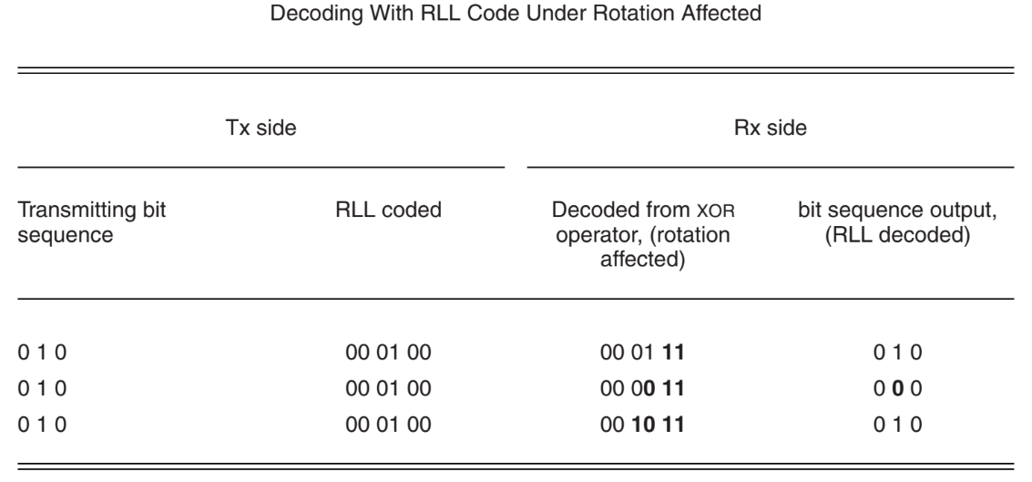
RLL Decoder
The XOR operation is incorrect because of the difference in sampling times on the same image.To correct this problem, line coding is proposed (see Table 3) and the code rate at 1/2 is used.

Slide 9
RLL Decoder
Table shows that the bit sequence is still correct even though grouping a pair of RLL digits is inappropriate. In the Tx side, every data binary is coded by inserting 0 in front. Therefore, in the sequence of coded binary for transmission, a data binary has two 0 along with it: 0 forward and 0 backward. In Rx, the RLL decoder compares a data binary with a 0 forward or 0 backward and correctly generates a data bit

Slide 10
References
[1] Minh Duc Thieu, Trang Nguyen, Yeong Min Jang, “New Waveforms for Selective-RoI-Signaling High-rate Optical Camera Communication System”, Ubiquitous and Future Networks (ICUFN), July 2018.
[2] T. Nguyen, and et.al., "Region-of-Interest Signaling Vehicular System Using Optical Camera Communications" IEEE Access, 2017.

