Slide 1
Project: IEEE P802.15 Working Group for Wireless Personal Area Networks (WPANs)
Submission Title: Sequential Ranging Control Information Element
Date Submitted: November 2018
Source: Seongah Jeong, Yi Yang, Hyunchul Kim, Sejong Yoon, Jong-Hoon Jang, Moon-Seok Kang, Jonghyo Lee, Aditya V. Padaki, Zheda Li, Boon Loong Ng (Samsung), Frank Leong, Brima Ibrahim, Rias Al-kadi (NXP)
Company: Samsung
E-Mail: sa.jeong@samsung.com,yi83.yang@samsung.com,hc77.kim@samsung.com,sejong.yoon@samsung.com,jh0.jang@samsung.com,moonseok.kang@samsung.com,jonghyo.lee@samsung.com,a.padaki@samsung.com,zheda.li@samsung.com,b.ng@samsung.com,frank.leong@nxp.com,brima.ibrahim@nxp.com,rias.al-kadi@nxp.com
Abstract: []
Purpose: []
Notice: This document has been prepared to assist the IEEE P802.15. It is offered as a basis for discussion and is not binding on the contributing individual(s) or organization(s). The material in this document is subject to change in form and content after further study. The contributor(s) reserve(s) the right to add, amend or withdraw material contained herein.
Release: The contributor acknowledges and accepts that this contribution becomes the property of IEEE and may be made publicly available by P802.15.

Slide 2
Overview
Need for Sequential Ranging-specific Payload Information Element (IE)
Proposed IE
Conclusions

Slide 3
Need for Sequential Ranging-Specific Payload IE
In the current two-way ranging mechanism, the responding ranging device/secure ranging device (RDEV/SRDEV) need to be on so that it can listen to the first ranging frame (RFRAME) from the initiating RDEV/SRDEV
This may result in the power consumption for the Sequential Ranging case where the multiple ranging procedures are sequentially considered
Also, for secure ranging, SRDEVs need to share the initial value for inter-packet STS update before the first RFRAME
Notes:
ㄴ

Slide 4
Proposal
We propose the addition of “Sequential Ranging Control (SRC) IE” to the existing list of MAC Payload IEs
We propose that before the first RFRAME in UWB ranging procedure, RDEVs/SRDEVs exchange the SRC IE
Notes:
ㄴ

Slide 5
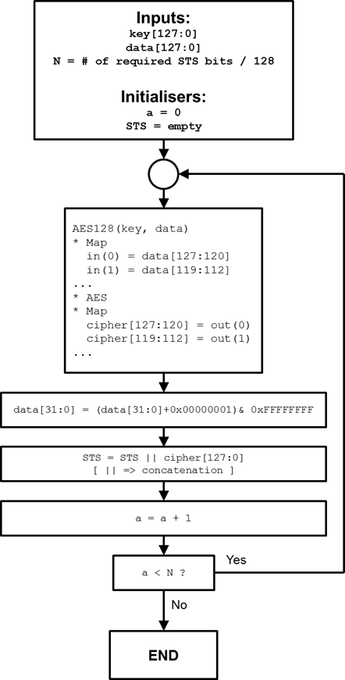
Proposal
The proposed SRC IE includes
1) Ranging interval until the next ranging procedure so that RDEVs/SRDEVs can be in sleep mode after completing the current ranging procedure to the time to start the next ranging procedure
2) Initial value “STS Data Init” for inter-packet STS update for secure ranging
  The initial value can be used for initiating data[127:32] in inter-packet STS update procedure in generic way, while data[31:0] update is already agreed
  e.g., data[95:32] = (data[95:32] + STS Data Init[63:0]) & 0xFFFFFFFFFFFFFFFF

Slide 6
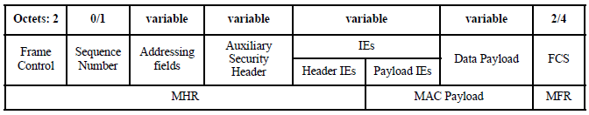
Sequential Ranging Control (SRC) IE
The content field of SRC IE is proposed as below
SRC IE (IE Class 1)
Octets: 1 | Octets: 0/3 | Octets: 0/4/8/12
Sequential Ranging Control Info | Interval | STS Data Init
Sequential Ranging Control Info Value | Meaning
0 (Normal Ranging Init) | This frame indicates that the next frame is initiating normal ranging procedure with the interval. After this interval, the next ranging procedure is started.
1 (Secure Ranging Init) | This frame indicates that the next frame is initiating secure ranging procedure with the STS Data Init and interval. After this interval, the next ranging procedure is started.
2-255 | Reserved

Slide 7
Example 1
Sequential Ranging Control Info value | Interval | STS Data Init
0x00 | 0x64 | X
Device A
Device B
SRC IE (0x00|0x64)
(RFRAME : Two-way ranging)
This flow can be applied to the case of Device A as initiator to send SRC IE
This case means the next frame after the frame with SRC IE initiates normal ranging procedure and next ranging procedure will start after ranging interval (100ms if unit is ms)
After the current ranging session is complete, the RDEVs can be in sleep mode until the next ranging procedure starts
(RFRAME: Two-way ranging)
Normal Ranging
100ms
Rx in sleep mode
Tx in sleep mode
SRC IE (0x00|0x64)
(RFRAME : Two-way ranging)
(RFRAME: Two-way ranging)
Normal Ranging
100ms
Rx in sleep mode
Tx in sleep mode

Slide 8
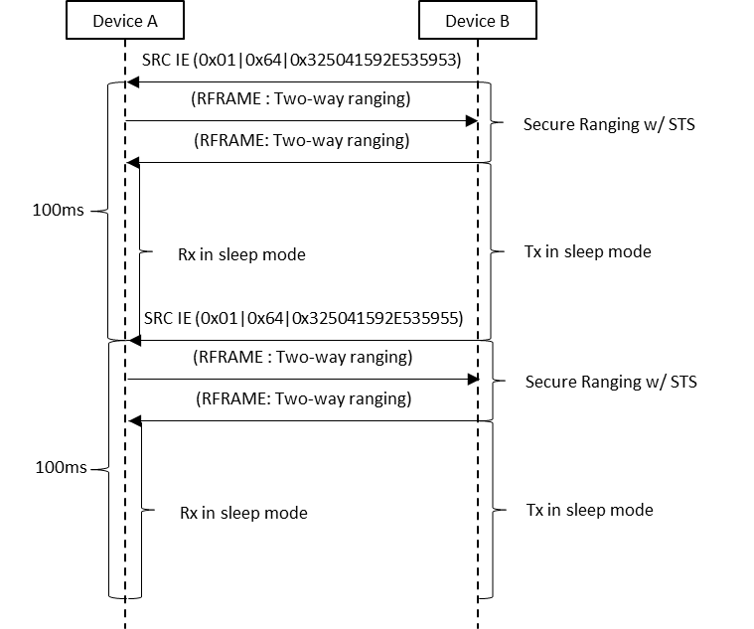
Example 2
Sequential Ranging Control Info value | Interval | STS Data Init
0x01 | 0x64 | 0x325041592E535953
This flow can be applied to the case of Device A as initiator to send SRC IE
This case means the next frame after the frame with SRC IE initiates secure ranging procedure with the STS Data Init and next ranging procedure will start after the ranging interval (100ms if unit is ms)
After the current ranging session is complete, SRDEVs can be in sleep mode until the next ranging procedure starts
Notes:
- 별다른 이슈 없어 보임

Slide 9
Conclusions
In the current TWR mechanism, the responding RDEV/SRDEV need to be on so that it can listen to the first RFRAME from the initiating RDEV/SRDEV resulting in power consumption
For the power efficiency in sequential ranging procedure, the inclusion of new frame with sequential ranging control payload IE is proposed

Slide 10
THE END

