Slide 1
Project: IEEE P802.15 Working Group for Wireless Personal Area Networks (WPANs)
Submission Title:[ Update of UWB Radio Regulation in Japan]
Date Submitted: [12 November 2018]
Source: [Ryuji Kohno1,2,3] [1;Yokohama National University, 2;Centre for Wireless Communications(CWC), University of Oulu, 3;University of Oulu Research Institute Japan CWC-Nippon]
Address [1; 79-5 Tokiwadai, Hodogaya-ku, Yokohama, Japan 240-8501
2; Linnanmaa, P.O. Box 4500, FIN-90570 Oulu, Finland FI-90014
3; Yokohama Mitsui Bldg. 15F, 1-1-2 Takashima, Nishi-ku,Yokohama, Japan 220-0011]
Voice:[1; +81-45-339-4115, 2:+358-8-553-2849], FAX: [+81-45-338-1157],
Email:[1: kohno@ynu.ac.jp, 2: Ryuji.Kohno@oulu.fi, 3: ryuji.kohno@cwc-nippon.co.jp] Re: []
Re: []
Abstract: [This document introduces latest change of radio regulation for Ultra Wide Band (UWB) radio use outdoor in Japan.]
Purpose: [information]
Notice: This document has been prepared to assist the IEEE P802.15. It is offered as a basis for discussion and is not binding on the contributing individual(s) or organization(s). The material in this document is subject to change in form and content after further study. The contributor(s) reserve(s) the right to add, amend or withdraw material contained herein.
Release: The contributor acknowledges and accepts that this contribution becomes the property of IEEE and may be made publicly available by P802.15.

Slide 2
Update of UWB Radio Regulation in Japan
Ryuji Kohno
Professor, Graduate School of Engineering Yokohama National University, Japan
Director, Center for Future Medical Infrastructure Based on Advanced ICT, Japan
Distinguished Professor, University of Oulu, Finland
CEO, University of Oulu Research Institute Japan – CWC-Nippon, Co. Ltd.

Slide 3
Introduction
Background:
Japanese radio regulation authority MIC (Ministry of Internal Affairs and Communications) has investigated technical requirement for ultra wide band (UWB) radio use according to UWB research, development, and business after it established regulatory requirement for communication uses for 3.4-4.8GHz, 7.25-10.25GHz in 2010, and collision avoidance radar uses for 22-29GHz in 2013. While UWB communication and sensing systems have been restricted indoor in Japan, the rest of world have been developing them to a lot of outdoor uses.
Lately in this IoT era, wide variety of UWB radio uses have been expected in Japan as well as in a world and demand for UWB radio outdoor use has been increasing while keeping transparency with other nations.
Major Change:
Bandwidth, Occupied, and Impermissible Emission Available Outdoor; Channel 9 of IEEE802.15.4aTM with central frequency 7987.2GHz and bandwidth 499.2MHz out of high band 7.25-10.25GHz has been considered to be available outdoor.
EIRP(Equivalent Isotropically Radiated Power); Japanese regulatory requirement for UWB radio has been regulated by antenna electricity, antenna gain as well as EIRP. For the sake of international compatibility, Japanese regulation for UWB radio uses could be regulated by EIRP.
Notes:
Smartness: Semantic approach, semantic interoperablity, heterogeneity management, IoT compliance Automatic node discovery (e.g. semantic discovery of nodes, composition (e.g. semantic discovery of nodes

Slide 4
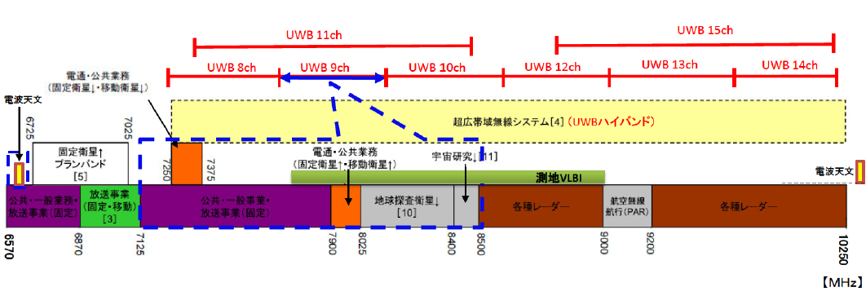
Radio Uses in the Frequency Band 6.57-10.25GHz
Red lines indicate channels defined by IEEE802.15.4a.
Available band is 7.587-8.4GHz. Blue dotted line systems should be protected for coexisitence such as fixed micro wave communication, satellite, radio astronomy and VLBI etc.
Public uses (Fixed & MobileSatelites
RAS
UWB High Band Systems
Planed Band for Fixed Sateliete
Public uses (Fixed & MobileSatelites
Space Research
Geolocation VLBI
RAS
Public/Civil Uses Fixed Broadcast
Fixed &
Mobile Broadcast
Public/Civil Uses Fixed Broadcast
EESS
Various Radars
AirPlane
(PAR)
Various Radars

Slide 5
回
Major Technical Requirement for Outdoor UWB Systems(1/ 2)
Technical Requirement of Outdoor UWB Systems
Permissible Variance of Band |  | 7.587GHz --- 8.4GHz
Antenna Electricity (by EIRP) |  | Average Power(EIRP) 7,587 -7,662 MHz: Lower than -51.3 dBm/MHz 7,662 -8,400 MHz : Lower than -41.3 dBm/MHz
 |  | Peak Power (EIRP) No Change
Antenna Absolute Gain |  | No Ragulation
Permissible Occupied Band width |  | 813MHz （Specified Band）
Permissible Spread Band width |  | No Change
Limits of Emission Power subsidiarily (by EIRP) | Not beyond 7.25 GHz | No Change
 | Higher than 7.25 GHz Not Beyond 10.25 GHz | 7.25 GHz -- 7.587 GHz | -59.3 dBm/MHz
 |  | 7.587 GHz -- 8.4GHz | -54.0dBm/MHz
 |  | 8.4 GHz -- 8.5 GHz | -59.3dBm/MHz
 |  | 8.5 GHz -- 10.25 GHz | -60.0dBm/MHz
 | Higher than 10.25 GHz | No Change
Technical Requirement of Intdoor High Band UWB Systems
Permissible Variance of Band |  | 7.25GHz --- 10.25GHz
Antenna Electricity (by EIRP) |  | Average Power(EIRP) Lower than -41.3 dBm/MHz
 |  | Peak Power (EIRP) 0 dBm / 50 MHz
Antenna Absolute Gain |  | 0 dBm
Permissible Occupied Band width |  | 3 GHz
Permissible Spread Band width |  | More than 450 MHz (10 dB Bandwidth)
Limits of Emission Power subsidiarily (by EIRP) | Not beyond 7.25 GHz | Less than 1,600MHz |  | -90.0dBm/MHz
 |  | 1,600-2,700 MHz |  | -85.0dBm/MHz
 |  | 2,700MHz -7.25 GHz |  | -70.0dBm/MHz
 | 7.25 GHz -- 10.25 GHz | 7.25 GHz – 10.25GHz -54.0dBm/MHz
 | Higher than 10.25 GHz | 10.25-10.6GHz | -70.0dBm/MHz
 |  | 10.6-10.7GHz | -85.0dBm/MHz
 |  | 10.7-11.7GHz | -70.0dBm/MHz
 |  | 11.7-12.56GHz | -85.0dBm/MHz
 |  | Beyond 12.75GHz | -64.0dBM/MHz

Slide 6
回
Major Technical Requirement for Outdoor UWB Systems(2/ 2)
Technical Requirement of Outdoor UWB Systems
Limits of Permitted Emission (by Average Power, EIRP) | Not beyond 7.25 GHz | No Change
 | 7.25 GHz – 10.25 GHz | 7.25 GHz -- 7.587 GHz | - 59.3 dBm/MHz
 |  | 7.587 GHz -- 8.4GHz | non
 |  | 8.4 GHz -- 8.5 GHz | -59.3dBm/MHz
 |  | 8.5 GHz -10.25GHz | -60.0dBm/MHz
 | over 10.25GHz | No Change
Limits of Permitted Emission (by Peak Power, EIRP) | Not beyond 7.25 GHz | No Change
 | 7.25 GHz -- 10.25 GHz | 7.25 GHz -- 7.587 GHz | -35.0 dBm/MHz
 |  | 7.587 GHz -- 8.4GHz | Non
 |  | 8.4 GHz -- 8.5 GHz | -35.0dBm/MHz
 |  | 8.5 GHz -- 10.25 GHz | -35.7dBm/MHz
 | Higher than 10.25 GHz | No Change
 | Package is not easily opened.
Technical Requirement of Indoor UWB Systems
Limits of Permitted Emission (by Average Power, EIRP) | Not beyond 7.25 GHz | Less than 1,600MHz | -90dBM/MHz
 |  | 1,600- 2,700MHz | -85.0dBM/Mhz
 |  | 2,700MHz-7.25GHz | -70dBM/MHz
 | 7.25 GHz – 10.25 GHz | Non
 | over 10.25GHz | 10.25-10.6GHz | -70.0dBM/MHz
 |  | 10.6G-10.7GHz | -85.0dBm/MHz
 |  | 10.7-11.7GHz | -70.0dBm/MHz
 |  | 11.7-12.75GHz | -85.0dBm/MHz
 |  | Beyod 12.75GHz | -70.0dBM/MHz
Limits of Permitted Emission (by Peak Power, EIRP) | Not beyond 7.25 GHz | Less than 1,600MHz | -84.0dBm/MHz
 |  | 1,600-2,700MHz | -79.0dBm/MHz
 |  | 2,700MHz-7.25GHz | -64.0dBm/MHz
 | 7.25 GHz -- 10.25 GHz | Non
 | Higher than 10.25 GHz | 10.25-10.6GHz | -64.0.0dBM/MHz
 |  | 10.6G-10.7GHz | -79.0dBm/MHz
 |  | 10.7-11.7GHz | -64.0dBm/MHz
 |  | 11.7-12.75GHz | -79.0dBm/MHz
 |  | Beyod 12.75GHz | -64.0dBM/MHz
 | Package is not easily opened.

Slide 7
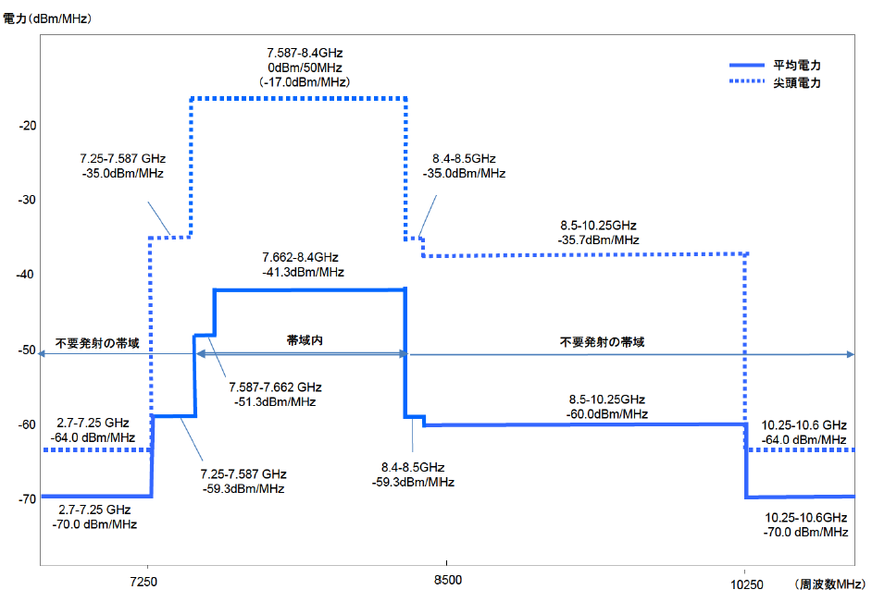
Updated UWB Spectral Mask for Outdoor Uses in Japan
Power(dBm/MHz)
Average Power
Peak Power
Out band
In band
Out band
Frequency (MHz)

Slide 8
Remark
These slides are translated from MICT documents by Ryuji Kohno, so it means these are not official MIC documents.

