Slide 1
Project: IEEE P802.15 Working Group for Wireless Personal Area Networks (WPANs)
Submission Title:[ ETSI SmartBAN for Digital Health]
Date Submitted: [12 November 2018]
Source: [John R. Farserotu] [CSEM]
Address [Jaquet-Droz 1 Case Postale CH-2002 Neuchatel, Switzerland]
Voice:[+41-7935-66816],
Email:[john.farserotu@csem.ch]
Re: []
Abstract: [In order to collaborate with IEEE802.15 IG-DEP, activities of ETSI SmartBAN will be introduced. This slides are copies of presentation in EAI international conference BodyNets2018 in Oulu, Finland on October 2, 2018.]
Purpose: [information]
Notice: This document has been prepared to assist the IEEE P802.15. It is offered as a basis for discussion and is not binding on the contributing individual(s) or organization(s). The material in this document is subject to change in form and content after further study. The contributor(s) reserve(s) the right to add, amend or withdraw material contained herein.
Release: The contributor acknowledges and accepts that this contribution becomes the property of IEEE and may be made publicly available by P802.15.

Slide 2
ETSI SmartBAN for Digital Health
John Farseroutu
Chair TC SmartBAN, ETSI
CESM, Switzerland
This slides are copies of presentation in EAI international conference BodyNets2018 in Oulu, Finland on October 2, 2018

Slide 3
Introduction
The use of wearables and body sensor devices is rapidly growing in the Internet of Things (IoT).
Wireless Body Area Networks (BAN) offer a means of connectivity, facilitating the sharing of data, interaction and interoperability within smart environments, such as smart homes and living environments, as well as, emerging automotive and aerospace applications.
SmartBAN started as academic research by European researchers. TC SmartBAN was approved in March 2013.
SmartBAN aims at a “smart” solution for BAN with improved and dedicated performance for medical, health improvement and sport and leisure applications, further to existing BAN standards. It covers:
  communication and the associated physical layer (PHY) and the Medium access control (MAC) layer
  network layer, security, Quality-of-Service (QoS) and provision of generic applications and services,
  a star network around a “smart” hub such as a handset or a watch, with the option for a multi-hop relay.
Notes:
Smartness: Semantic approach, semantic interoperablity, heterogeneity management, IoT compliance
Automatic node discovery (e.g. semantic discovery of nodes, composition (e.g. semantic discovery of nodes

Slide 4
The challenges
The challenges for BAN include interoperability in heterogeneous use cases, low power, low latency, security, robust operation and the ability to interact with embedded intelligence in smart environments. To meet these challenges, ETSI Technical Committee (TC) SmartBAN (SmartBAN) aims at the realization of a smart BAN with improved and dedicated performance for medical, health, sport and leisure applications.
To address these challenges, SmartBAN
  Targets a more efficient MAC and PHY, yielding very low latency emergency messaging, very low energy consumption and rapid initial set up time and channel reassignment.
  Provides additional semantic and data analytic enablers (e.g. semantic discovery, reasoning / rules) and automatic node discovery such as semantic discovery of nodes or composition.
  Provides added robustness via forward error correction
  Supports operation across heterogeneous networks with enhanced interoperability / connectivity options, including data, network and semantic interoperability.

Slide 5
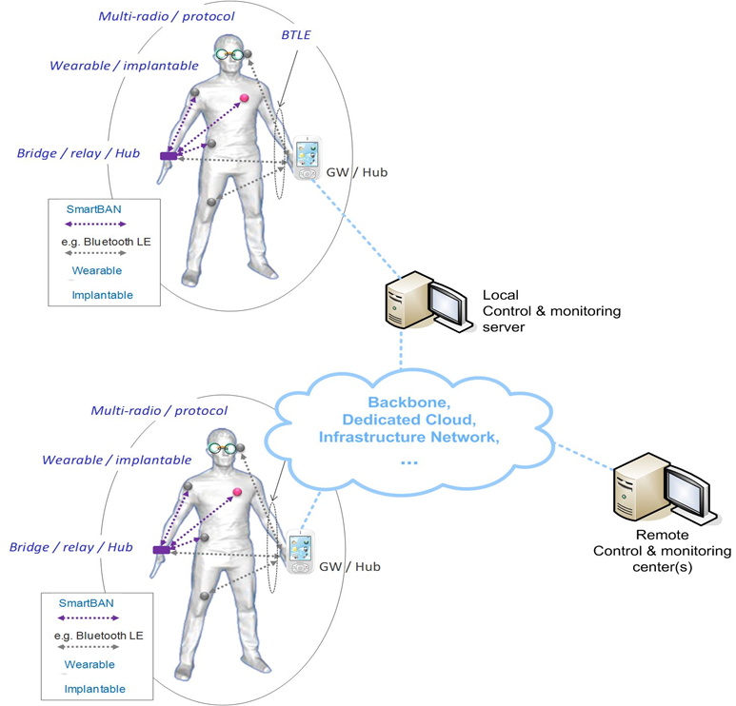
SmartBAN network and features
SmartBAN design features:
Star concept + multi hub relay
Efficient MAC and PHY, yielding very low latency emerging messaging, very low energy consumption, very fast initial set up time, channel reassignment
Real-time radio channel assignment (subject of further research)
Smart: semantic approach, semantic interoperablity, heterogeneity management, IoT compliance, automatic node discovery (e.g. semantic discovery of nodes)…
Slide 5

Slide 6
Comparison with other standards
Parameter |  | SmartBAN | BTLE | IEEE 802.15.6™
General system specs | System Architecture | Hub + smart relay coordination | One hub | One hub
 | Networking communication interoperability (SmartBAN and non-SmartBAN nodes) | Yes | No | No
 | Smart relay | Yes | No | No
PHY/MAC | FEC (forward error correction) | Yes | No | Yes
 | Initial set up time | Fast | Less fast | Less fast
 | Spread spectrum hopping | No | Yes | Yes (in limited cases)
 | Channel reassignment | Yes | No | Multiple channel
 | Very low latency emerging messaging | Very fast (timeslot) | No | Medium (superframe)
 | Reutilization of scheduled unused time slots (efficiency parameter) | Yes | No | No
 | Energy consumption/efficiency | Low (e.g. long sleep times) | Low | Medium
 | Network complexity | Star concept + multi hub relay (planned) | Star concept | Star concept + relay
Smarts | Semantic approach, semantic interoperability, heterogeneity management, IoT compliance | Yes | No | No
 | Additional semantic and data analytic enablers (e.g. semantic discovery, reasoning/rules) | Yes | No | No
 | Automatic node discovery (e.g. semantic discovery of nodes, composition) | Yes | Partially | No
 | Coexistence management by coordinator | High | Low | Low

Slide 7
Timeline, progress and milestones achieved
Status | Number | Title | Date
Published | TS 103 326 Ver. 1.1.1 | Smart Body Area Network (SmartBAN), Enhanced Ultra-Low Power Physical Layer | 2015-04-28
 | TS 103 325 Ver. 1.1.1 | Smart Body Area Network (SmartBAN), Low Complexity Medium Access Control (MAC) for SmartBAN | 2015-04-28
 | TS 103 378 Ver. 1.1.1 | Smart Body Area Networks (SmartBAN), Unified data representation formats, semantic and open data mode | 2015-12-11
 | TR103 395 Ver. 1.1.1 | Smart Body Area Network (SmartBAN); Measurements and modelling of SmartBAN Radio Frequency (RF) environment | 2016-12-20
 | TR103 394 Ver.1.1.1 | Smart Body Area Networks (SmartBAN); System Description | 2018-1-15
In preparation | DTR/SmartBAN-001 | Comparative analysis between SmartBAN and other short-range standards | Q4 2018 (draft), Q3 2019 (approval)
 | DTS/SmartBAN-004 - TS 103 327 | Smart Body Area Networks (SmartBAN); Service and application standardized enablers and interfaces, APIs and infrastructure for interoperability management | Q3 2018 (publication)
 | RTS/SmartBAN-005r1 – TS 103 325 | Low complexity MAC and routing for SmartBAN, Draft started (TS 103 325) | Q2 2018 (draft), Q1 2019 (approval)
 | RTS/SmartBAN-009r1 - TS 103 378 | SmartBAN unified data representation formats, semantic open data model and corresponding ontology | Q1 2019 (publication)
The group has released the following specifications and reports:

Slide 8
PHY-MAC
Technical Requirements for PHY-MAC
1. Ultra Low Power Design
  HUB/Node Role Sharing
    HUB takes care of MAC operation functionality as much as possible. Node operation is designed to be minimum.
    Low complexity/low energy is maintained by exploiting the two-channel approach
2. Timely Accessible Mechanism
  Emergency Signal Transmission
3. Co-existence Robustness
  Co-existence between HUBs
  Automatic interference avoidance between BANs using the same data channel
4. QoS Optimization Mechanism
  Transmission (re-transmission) at the required level of BER, latency, etc.
2-ch Concept and Access Schemes

Slide 9
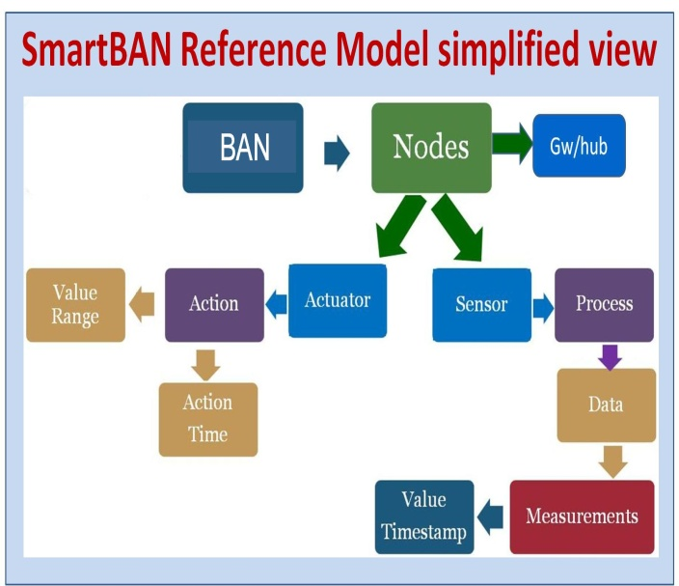
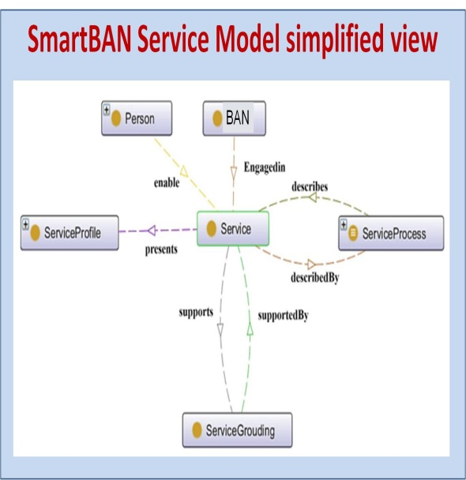
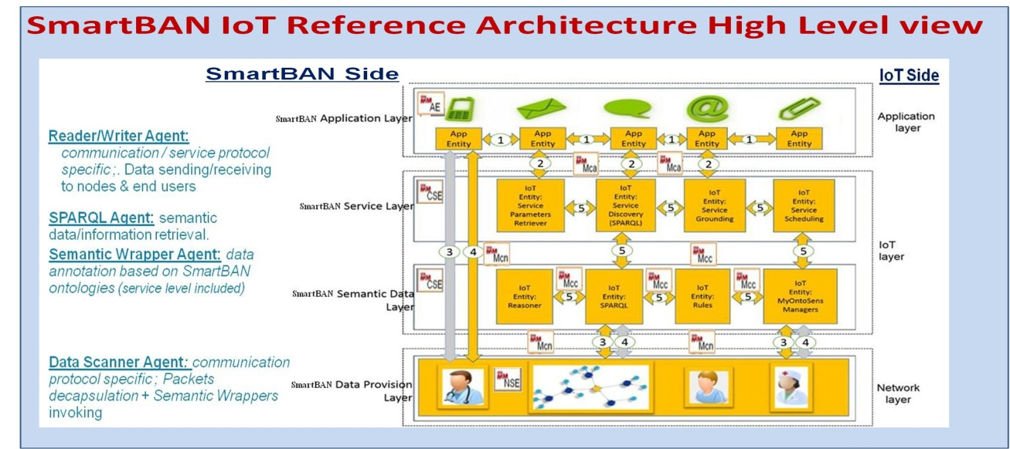
Data representation and interoperability management
A BAN (SmartBAN) – data, device, service/application – unified semantic and open reference model, with corresponding modular ontology:
  key element for BANs data/device interoperability,
  coupled with a XaaS/WoT strategy for semantic interoperability handling, device discovery and composition facilities, data sharing at application level and cross domain use cases handling,
  eases implementation of automated monitoring/control strategies.
A BAN (SmartBAN) global and more integrated IoT reference architecture for secure interaction and access to BAN data & entities:
  specified on top of the SmartBAN reference model,
  oneM2M and Multi-Agent based,
  addresses network/syntactic/semantic interoperability,
  provides in particular generic service enablers for semantic data sharing/management, embedded semantic analytics (device/edge/fog levels), and distributed monitoring/control operations.

Slide 10
Cooperation with other bodies and demonstration of the technology
Cooperation
  SmartBAN has collaborated with oneM2M and namely contributed to the ITEA3 CareWare project demonstrator (elderly at home support)
  Clinical tests in partnership with OHS –Office d'Hygiène Sociale – Nancy are ongoing.
  TC SmartBAN’s work continues to be promoted via contributions to various bodies both within ETSI and internationally e.g.:
    oneM2M/SmartM2M (M. Girod-Genet), ERM TG 30 (D. Ansai), AIOTI (M. Girod-Genet), IEC (H. Tanaka, official liaison to IEC systems committee, active assisted living, BT SIG (H. Tanaka), H2020 ACTIVAGE (J. Farserotu)…
Demonstration of SmartBAN technology will be held at ETSI IoT Week including:
  Semantic interoperability and SmartBAN reference IoT/oneM2M platform for remote monitoring and control applications (M. Girod-Genet)
  SmartBAN 2.4GHz PHY (H. Tanaka)

Slide 11
Moving forward – near term
New Work Item (NWI) on implant communication was initiated in 2018, in cooperation with ETSI ERM TG 30.
NWI on security, privacy and trust for SmartBAN is currently being drafted
Joint group between ETSI TC SmartBAN and ETSI TC SmartM2M is envisioned for merging and/or aligning the SmartBAN ontology with SAREF* and oneM2M ontologies.
SmartBAN Workshop, Connected Things for Wellbeing and Health, at ETSI IoT Week, 22-26 October, at ETSI headquarters, Sophia Antipolis, France.
*SAREF: Smart Appliances REFerence ontology

Slide 12

ETSI IoT Week 2018, SmartBAN Workshop, Thursday 25 October
09:00 | Session 1: Welcome & Introduction to SmartBAN Session Chair: John Farserotu, CSEM - Chair ETSI SmartBAN
09:00 | Keynote: Mesh network technologies for industrial applications Ichiro Seto, Deputy Director, Telecommunications Research Lab., Toshiba Research Europe, Ltd.
09:20 | SmartBAN in the Internet of Health and the Digital Transformation John FARSEROTU, CSEM - Chair ETSI SmartBAN
09:40 | Vital data gathering in wireless wearable sensors for sports and healthcare applications (title TBC) Burkhard Duemler, Adidas AG
10:00 | Introduction of scenario case using wearable data and other field data Yukari Urata - Aki Umetani, TIS Corporation
10:20 | Coffee Break & Showcases visit
11:00 | Session 2: SmartBAN Demonstrations Session Chair: John Farserotu, CSEM - Chair ETSI SmartBAN
11:00 | SmartBAN Demonstrations
11:50 | Panel & Wrap-up: SmartBAN moving forward in the IoT / M2M
12:20 | Lunch Break & Showcases visit
12:20 | End of the Smart Body Area Networks Workshop

Slide 13
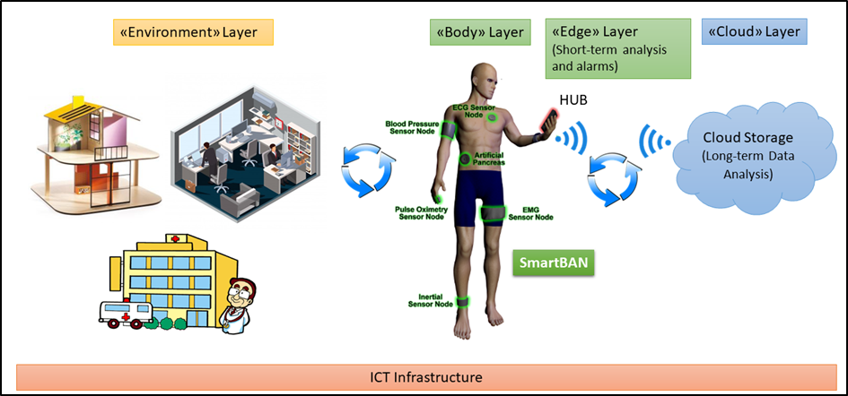
SmartBAN in the IoT – a view to the future

Slide 14
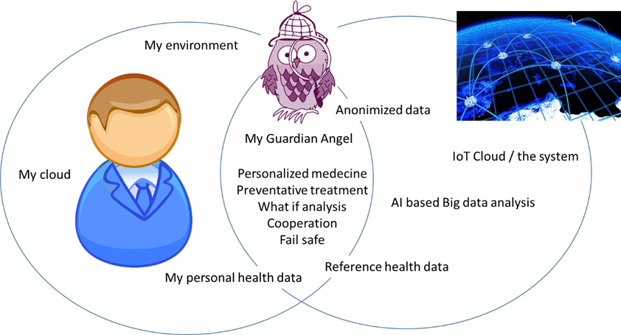
SmartBAN and Digital Health - a vision for the digital future
SmartBAN our personal interface to the digital healthcare system of the future!
Sources:
Future Health: https://ec.europa.eu/futurium/en/system/files/ged/futurehealth_white_paper.pdf
Health EU, https://www.health-eu.eu/
Digi Twins: http://www.engineersjournal.ie/2018/06/12/revolutionary-healthcare-proposal-digitwins-seeking-eu-flagship-success/
Notes:
Building the Human Avatars. We envision Human Avatars as our personal interface to the healthcare system of the future. Our avatar is effectively an Artificial Intelligence (AI) that serves as an agent, coach and Guardian Angel. An overview is provided by Figure 1, from which it can be seen that our wise and trusted Guardian Angel gathers data from our personal sensor devices as well as from our environment. It processes this data locally and provides feedback to us. The feedback is based on knowledge of our personal case and the collective wisdom established via AI based analysis of big data gathered over years from all of the persons in the system. It can perform predictive simulations and projections in reply to what if questions that we may pose, or which it poses on our behalf, and it supports personalized medicine (e.g. monitoring of dosage and drug combinations). It receives reference data from the system and returns anonymized data to the system, enabling it to continuously refine and update the global database. It is capable of interacting with sensors in the environment and cooperating with other Guardian Angels. It also serves as a “fail safe” storing recent personal history and confirming that incoming data and requests are consistent with expectations, which is potentially important in the event of system corruption (e.g. spoofing, falsification of reference data).
The realization of our Guardian Angel requires an unprecedented combination of intelligence embedded in a miniaturized, energy efficient processing platform with trusted and dependable connectivity to the cloud 24/7. Machine learning and Artificial Intelligence (ML / AI) will be pervasive throughout the system; from ML processing in sensor edge devices to minimize the staggering amounts of data to be transmitted (Zetabytes by 2020 and growing!), to AI algorithms performing analysis on big data health trends in the cloud. In WP2, we envision focussing on the development of the AI algorithms necessary to implement our Guardian Angels and the provision of requirements and specifications to other WPs (e.g. processing requirements, transmission rates, power and latency). While our Guardian Angel may reside in many locations (e.g. handset), and may even be distributed (e.g. in the cloud), in a the preferred implementation, key functionaliteis may reside in a personal device over which we can, with the help of our Guardian Angel, maintain a degree of control (what data we allow out, what requests we accept and under what conditions), such as a watch.

Slide 15
Concluding remarks
In order to realize the vision of SmartBAN as our personal interface to the digital healthcare system of the future, new solutions are needed:
  Security, privacy and trust
  Low power, yet high performance, edge devices (wearable and sensor nodes)
  Robustness and coexistence
  Ensuring interoperability

Slide 16
Thank you for your attention!
SmartBAN is supported by the Hermes Partnership (www.hermes-europe.net/‎) a network of leading European organizations in wireless and mobile communication and the European H2020 ACTIVAGE project (http://www.activageproject.eu/)
Notes:
Acknowledgement
SmartBAN is supported by the Hermes Partnership (www.hermes-europe.net/‎) a network of leading European organizations in wireless and mobile communication and the European H2020 ACTIVAGE project (http://www.activageproject.eu/.

