Slide 1
Project: IEEE P802.15 Working Group for Wireless Personal Area Networks (WPANs)
Submission Title: [SG SECN Amendment text]
Date Submitted: [12 November, 2018]
Source: [Don Sturek] Company [Itron]
Address [230 W. Tasman Drive, San Jose, CA 95134]
Voice:[+1 669 770 4790], FAX: [+1 866 776 0015], E-Mail:[don.sturek@itron.com]
Re: [IEEE 802.15 4y SECN]
Abstract: [4y SECN Amendment draft text]
Purpose: [4y SECN Amendment draft text]
Notice: This document has been prepared to assist the IEEE P802.15. It is offered as a basis for discussion and is not binding on the contributing individual(s) or organization(s). The material in this document is subject to change in form and content after further study. The contributor(s) reserve(s) the right to add, amend or withdraw material contained herein.
Release: The contributor acknowledges and accepts that this contribution becomes the property of IEEE and may be made publicly available by P802.15.

Slide 2
802.15 4y SECN Amendment draft text
Don Sturek Itron

Slide 3
From San Diego 4y Sessions
Document edits for 15.4y to IEEE 802.15.4-2015. All section and table references below are for 15.4-2015
15.4-2015 Section 9
Rename CCM * to AEAD
Security state machine in reference B14 – Tero to update the document
Note on 9.3.4 (CCM *) – Item f in Section 9.2.1 – Edit to add in obtaining the algorithm
Section 9.2.3 – Check into whether minimum security level can be leveraged to provide the same function
Section 9.2.3 (i) to avoid CCM *
Section 9.2.3 (l) augment with algorithm ID from RFC 5116
Section 9.2.7 (c) (2) – Correct to reflect the algorithm ID rather than just security level
Section 9.2.9 – Correct to reflect the algorithm ID
Section 9.2.3 (n) – Add in algorithm ID
Section 9.2.4 (e) (f) – Add in algorithm ID
Section 9.2.9 (b) – Update to add in algorithm ID
Section 9.5, Table 9-15 – Update to add in algorithm ID
Section 9.2.3 – Change to refer to AEAD, references to annex B should be evaluated to determine whether they reference CCM or not.
Section 9.3.1 – Integer and octet representation used by the algorithm should be noted

Slide 4
From San Diego 4y Sessions
Document edits for 15.4y to IEEE 802.15.4-2015. All section and table references below are for 15.4-2015
Keep annex B and C for CCM * in the amendment, create a new document to cover the new algorithms
Section 9.3.2.1 – Check into whether all algorithm IDs use nonce lengths of 13. Rename this as the AEAD default nonce generator. Change CCM * to AEAD
Section 9.3.3 – Genericize to AEAD
Section 9.3.4, 9.3.5 – Remove CCM *, rest of text does not change
Figure 9-6 fix “reserved” bit numbering
Section 9.4.2 – Remove CCM * in favor of AEAD
Section 9.5 Table 9-10 – Add in algorithm ID
Identify an ANA process to identify algorithm ID’s supported in 15.4y. Ask 802.15 to create a process to add new algorithm IDs includes providing Annex B/C information on the new algorithm. AES-256 CCM as a first example
Check into algorithm ID definition of nonces
In 802.15.9 WNG – need to deal with algorithm matching as part of key establishment
Keep Annex B and C. Create a new document and process to add new algorithms – SECN to do the AES-256 CCM as an example
Annex C updates
Only 2006 frames right now
Beacon frame (not enhanced beacon)
MAC Command frame (not encrypted in frame type v1 but encrypted in frame type v2)
Need examples with frame type v2 with header IE’s and payload IE’s. Need example with enhanced beacons, MAC commands, data frames, multipurpose frames
Table C.8 – won’t repeat for other algorithms
C.2.3.3.2 (a) – AuthData differs by missing 2 bytes from earlier AuthData, 2B is missing after 1D and before DC

Slide 5
From San Diego 4y Sessions
AES-256 CCM example for Annex B/C –
Annex B would map 15.4 terminology to FIPS document ideally (not with the cut/paste sections of the CCM standard as was done previously)
Annex C should compute interim values (reviewed MACSEC document in IEEE 802.1 as an example)
Different block sizes for other light weight algorithms should be considered (128 bits vs. Keccak with 512 bits). Determine whether this matters within the key descriptor

Slide 6
15.4md comments on security
Technical comments

Slide 7
15.4md comments on security
Editorial comments (note these are rogue comments so we should weigh in on whether 15.4md processes these)

Slide 8
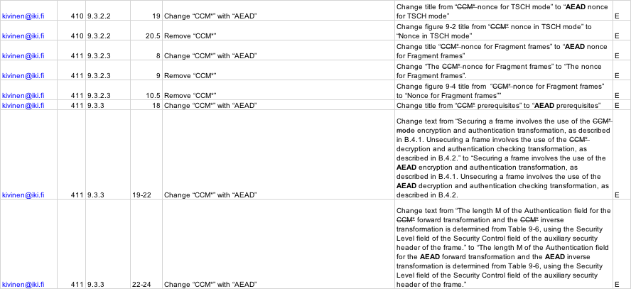
15.4md comments on security
Editorial comments (note these are rogue comments so we should weigh in on whether 15.4md processes these)

Slide 9
15.4md comments on security
Editorial comments (note these are rogue comments so we should weigh in on whether 15.4md processes these)

Slide 10
15.4md comments on security
Editorial comments (note these are rogue comments so we should weigh in on whether 15.4md processes these)

