Slide 1
Doc.: IEEE 15-18-0485-00-004g
Project: Discussion on Hybrid Multiple Access for Wireless Personal Area Networks (WPANs)
Submission Title: September 2018 IEEE 802.15
Date Submitted: 08 September, 2018
Source: Ningbo Zhang, Beijing University of Posts and Telecommunications
Address： Xitucheng Road No. 10, Haidian, Beijing, China
E-Mail: nbzhang@bupt.edu.cn
Re: Proposal for the multiple assess for P802.15
Abstract: Analysis on Hybrid Multiple Access for WPANs
Purpose: To address the coexistence capability of IEEE 802.15 to satisfy requirements of large number of accesses, NOMA is introduced.
Notice: This document has been prepared to assist IEEE P802.15 Multiple Access
Release: The contributor acknowledges and accepts that this contribution becomes the property of IEEE and may be made publicly available by P802.15.

Slide 2
Motivation
September, 2018
Doc.: IEEE 15-18-0485-00-004g
In NOMA random access, SIC receiver is required to cancel inter-user interferences at STA[1]
SIC receiver requires diverse arrived power to distinguish multiplexing users.
To obtain the diverse arrived power, a power back-off scheme is proposed for uplink NOMA transmission.
BUPT

Slide 3
Hybrid Random Access
September, 2018
Doc.: IEEE 15-18-0485-00-004g
Access mode selection
Received SNR at STA
where is the variance of noise and is the received power at SAT.
Fig.1 Hybrid RA scheme
BUPT

Slide 4
NOMA RA
September, 2018
Doc.: IEEE 15-18-0485-00-004g
Step 1: Peer discovery: This step is to discover neighbor paired STAs.
Step 2: NOMA group establishment: Select a group center and allocate the power back-off index.
Step 3: Channel detection: The group center sends preamble to detect the channel on behalf of NOMA group.
Step 4: Detection response: AP sends back the detection response to NOMA group STAs.
Step 5: Power back-off: NOMA group STA power back-off to guarantee diverse received power at AP.
Step6: SIC reception and ACK: AP performs SIC receiver to cancel multi-STA interferences and sends back ACK/NACK.
BUPT

Slide 5
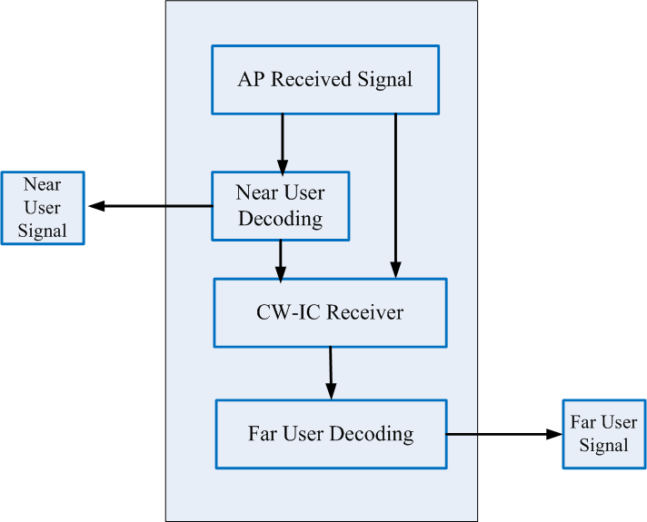
Multiple User Decoding at STA
September, 2018
Doc.: IEEE 15-18-0485-00-004g
Two Users are multiplexed
Near User: baseline arrived power
Far User: dB lower than near user
AP decoding
For near user, AP direct decodes the
message since the interference from
far user is neglected.
For far user, AP first cancels the near
user’s message and then decodes the
far user’s message.
Fig.2 SIC receiver at STA
BUPT

Slide 6
Power Control for Uplink NOMA
September, 2018
Doc.: IEEE 15-18-0485-00-004g
The transmit power of the i-th User in a NOMA set is:
Where is the maximum transmit power, is the target arrived power and is the path loss including distance-dependent path loss and lognormal shadowing. is the assigned resource unit.
Near user
Far User
BUPT

Slide 7
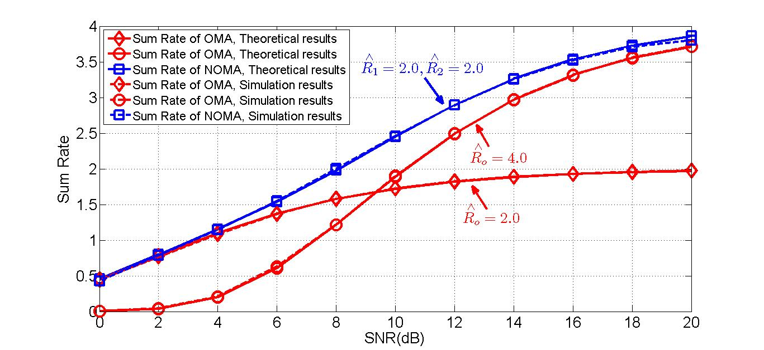
Simulation Results
September, 2018
Doc.: 15-18-0485-00-004g
Assumptions:
-
Parameter | Value
Carrier | 2.4GHz
 | 23dBm
Distance between near user and AP | 10 meters
Distance between far user and AP | 30 meters
Distance between OMA user and AP | 10 meters
Tb size | 100bits
Modulation order | QPSK
 | 5dB
Target data rate for near user and far user
Target data rate for OMA user
Fig.3 Sum rate simulation between OMA and NOMA
NOMA achieves signiﬁcant gain at lower SNR region when the target data rate of OMA equals the sum of NOMA’s target data rate.
NOMA achieves almost double sum data rate more than OMA at higher SNR region when the target data rate of OMA is the same as NOMA UE.
BUPT

Slide 8
Conclusions
September, 2018
Doc.: 15-18-0485-00-004g
Power control is required in uplink NOMA access:
In hybrid random access, STA adaptively selects the OMA RA procedure or the NOMA RA according to a predefined SNR threshold.
SIC receiver is required to cancel inter-user interferences in NOMA random access
Power back-off scheme is required for far user
NOMA transmission outperforms OMA transmission in all cases.
BUPT

Slide 9
References
September, 2018
Doc.: IEEE 15-18-0485-00-004g
[1] IEEE 15-16-0426-00-004t, “TG4t Multiple Access Document,” May, 2016.
BUPT

Slide 10
Doc.: IEEE 15-16-0851-00-004t
Thanks!
BUPT

