Slide 1
Project: IEEE P802.15 Working Group for Wireless Personal Area Networks (WPANs)
Submission Title: LiFi/CamCom Technology for Semi-Automated Door Control ADAS Solution
Date Submitted: September 2018
Source: Jaesang Cha, Minwoo Lee (SNUST), Jeong Gon Kim(Korea Polytechnic Univ.), Younkwan Kim (The Catholic University of Korea), Hyeongho Lee (Netvision Telecom Inc., Korea), Sooyoung Chang (SYCA) , Vinayagam Mariappan (SNUST)
Address: Contact Information: +82-2-970-6431, FAX: +82-2-970-6123, E-Mail: chajs@seoultech.ac.kr
Re:
Abstract: This documents introduce the V2V LiFi/CamCom Link design consideration for VAT. This proposed LiFi/CamCom solution for semi-automated vehicle door control ADAS function. This VAT to operate on the application services like ITS, ADAS, IoT/IoL, etc. on road condition. Also this can be used for LEDIT, Digital Signage with connected information services etc.
Purpose: To provided concept models of Light Communication based LiFi/CamCom solution for Vehicular Assistant Technology (VAT) Interest Group
Notice: This document has been prepared to assist the IEEE P802.15. It is offered as a basis for discussion and is not binding on the contributing individual(s) or organization(s). The material in this document is subject to change in form and content after further study. The contributor(s) reserve(s) the right to add, amend or withdraw material contained herein.
Release: The contributor acknowledges and accepts that this contribution becomes the property of IEEE and may be made publicly available by P802.15.
Slide 1

Slide 2
Contents
Need for Semi-Automated Door Control ADAS Solutions
Semi-Automated Door Control LiFi/CamCom Link
Conclusion
Slide 2

Slide 3
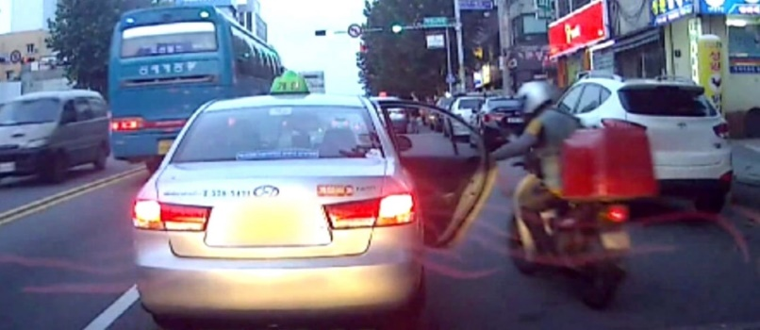
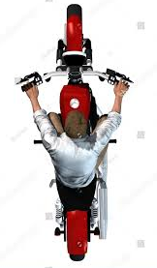
Need for Semi-Automated Door Control ADAS Solutions
Needs
Many accidents were happened with cars and motorcycles during opening the door of cars because of people's carelessness or because of their rush.
Needs to provide road condition confirmation before opening door in onroad condition.
Basic Concept
Propose the LiFi/CamCom technology solutions to prevent collision of cars and motorcycle on the road when somebody coming out from car opening the door
Uses the two wheelers head light and car mirror camera
To avoid any accidents and make it more safer for passengers when they open the door of car.
GOOGLE
< Roadway Collision of Car and Motorcycle >
< Roadway Car Door Opening Illustration >
Slide 3

Slide 4
Semi-Automated Door Control LiFi/CamCom Link
V2V LiFi/CamCom Link
Tx : Head Lights
Rx : PD / Camera
Day-Night Communication Mode
Modulations :
OOK, VPPM, Offset-VPWM, Multilevel PPM, Inverted PPM, Subcarrier PPM, DSSS SIK etc.
Data Rate : 1K ~ 1Mb/s
Supported LoS (Line of Sight)
Available Distance : 2m ~ 200m
VLC
Camera
Head Light
< Motorcycle to Car V2V LiFi/CamCom Link >
Uses the Motorcycle head lighting system and Side Mirror Cameras in the car to enable Semi-Automated Door Control ADAS Solutions using LiFi/CamCom technology.
Slide 4

Slide 5
Conclusion
Proposed the Semi-Automated Door Control ADAS Solutions using LiFi/CamCom technology
Uses the Motorcycle head lighting system and Side Mirror Cameras to enable LiFi/CamCom connectivity between Cars using Motorcycle
Reduce the accidental condition of peoples careless drive and traffic rush time drive
Slide 5

