Slide 1
Project: IEEE P802.15 Working Group for Wireless Personal Area Networks (WPANs)
Submission Title: LiFi/CamCom Link for Vehicle Access Control Solution in High Security Facility Area
Date Submitted: September 2018
Source: Jaesang Cha, Minwoo Lee (SNUST), Jeong Gon Kim(Korea Polytechnic Univ.), Il-kyoo Lee(Kongju Nat’ Univ.) , Sooyoung Chang (SYCA) , Vinayagam Mariappan (SNUST)
Address: Contact Information: +82-2-970-6431, FAX: +82-2-970-6123, E-Mail: chajs@seoultech.ac.kr
Re:
Abstract: This documents introduce the V2I LiFi/CamCom Link design consideration for VAT. This proposed LiFi/CamCom solution used for secured Vehicle access control solution in high security facility area. This VAT to operate on the application services like ITS, ADAS, IoT/IoL, etc. on road condition. Also this can be used for LEDIT, Digital Signage with connected information services etc.
Purpose: To provided concept models of Light Communication based LiFi/CamCom solution for Vehicular Assistant Technology (VAT) Interest Group
Notice: This document has been prepared to assist the IEEE P802.15. It is offered as a basis for discussion and is not binding on the contributing individual(s) or organization(s). The material in this document is subject to change in form and content after further study. The contributor(s) reserve(s) the right to add, amend or withdraw material contained herein.
Release: The contributor acknowledges and accepts that this contribution becomes the property of IEEE and may be made publicly available by P802.15.
Slide 1

Slide 2
Contents
Needs for Secured Access Control Solution in High Security Areas
Secured Vehicle Access Control LiFi/CamCom Link
Conclusion
Slide 2

Slide 3
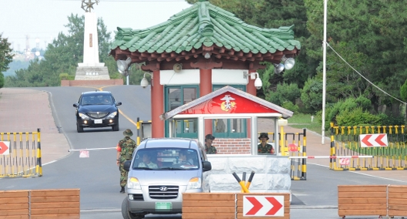
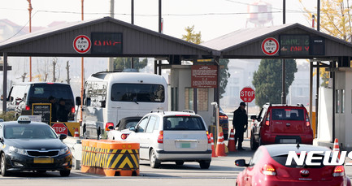
Needs for Secured Access Control Solution in High Security Areas
Needs
In a military base or a high security facility, access control systems for external vehicles proceed through complex procedures
When entering security facilities, time is delayed due to briefing and writing of the correct purpose.
Needs secured real-time verification for Vehicle permission to passes through the high security areas
A solution is needed to improve ineffective security facility access control systems
Basic Concept
Uses the Vehicle headlights and security verification area installed CCTV camera to establish the LiFi/CamCom Link for Security Facility Access Control
The principle of this technology is to receive related information data through communication based on LiFi/CamCom link using head light attached to vehicle and camera attached to guard shack.
The system controls the access by transferring the pre-uploaded information of the vehicle occupant to the guard shack.
< Security Facility Access Control >
GOOGLE
Slide 3

Slide 4
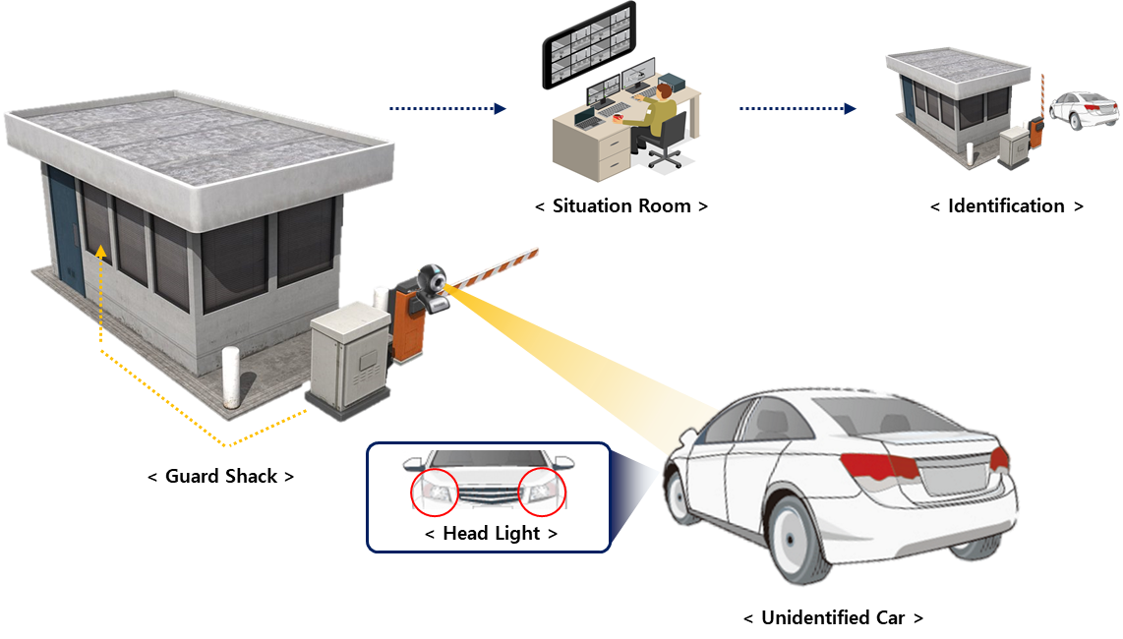
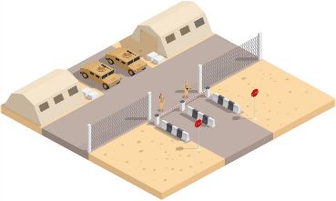
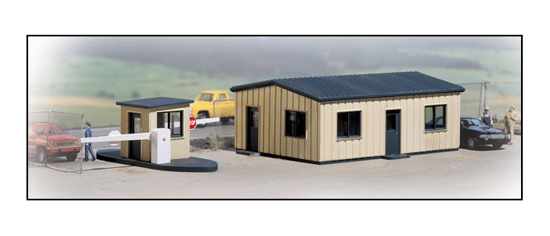
Secured Vehicle Access Control LiFi/CamCom Link
Vehicle Light and Guard Shack Camera based LiFi/CamCom Link for Security Facility Access Control Solution
Tx : Vehicle Head Light
Rx : Guard Shack PD/Camera
Modulations :
OOK, VPPM, Offset-VPWM, Multilevel PPM, Inverted PPM, Subcarrier PPM, DSSS SIK etc.
Day-Night Communication Mode
Data Rate : 10K ~ 2Mb/s
Supported LoS(Line of Sight)
Available Distance : 5m ~ 20m
※ This technology is a system that controls the access of the vehicles by transmitting the passenger's information to the guard shack through the LiFi/CamCom link.
< Military Base >
< Security Facility >
< Security Facility Access Control LiFi/CamCom Solution >
Slide 4

Slide 5
Conclusion
Proposed the Access Control Solution applicable to Military base or high security facilities area.
This technology is a system that controls the access of the vehicles by transmitting the passenger's information to the guard shack through the LiFi/CamCom link based on head light attached to vehicle and camera attached to guard shack.
This technology can be applied not only to access control of military bases and security facilities, but also to the protected areas inside buildings and various other protection facilities.
Slide 5

