Slide 1
Project: IEEE P802.15 Interest Group for Wireless Personal Area Networks (WPANs)
Submission Title: Technical considerations for two-way VLC system for machine control feedback data
Date Submitted: August 2018
Source: Doohee Han [Kyung Hee University] , Kyujin Lee [Semyung University] and Yeong Min Jang [Kookmin University].
Contact: +82-2-910-5068 E-Mail: yjang@kookmin.ac.kr
Re:
Abstract: Present a problem of conventional unidirectional VLC system and limited two-way VLC system, and propose a suitable uplink feedback communication structure.
Purpose: General considerations and suggestions for VLC systems for two-way communication.
Notice: This document has been prepared to assist the IEEE P802.15. It is offered as a basis for discussion and is not binding on the contributing individual(s) or organization(s). The material in this document is subject to change in form and content after further study. The contributor(s) reserve(s) the right to add, amend or withdraw material contained herein.
Release: The contributor acknowledges and accepts that this contribution becomes the property of IEEE and may be made publicly available by P802.15.

Slide 2
Technical considerations for two-way VLC system for machine control feedback data

Slide 3
Introduction
In the visible light communication environment using only the conventional LED, bidirectional communication for feedback of user data information between the transmitter and receiver is limited.
When all the receiving devices transmit the feedback information through the LED light source, it is inconvenient for the users due to the unnecessary light source generation in the indoor lighting environment due to the characteristics of the visible light communication system performing both the communication and the illumination. In addition, interference due to a plurality of light sources occurs, and the performance of the system is deteriorated.

Slide 4
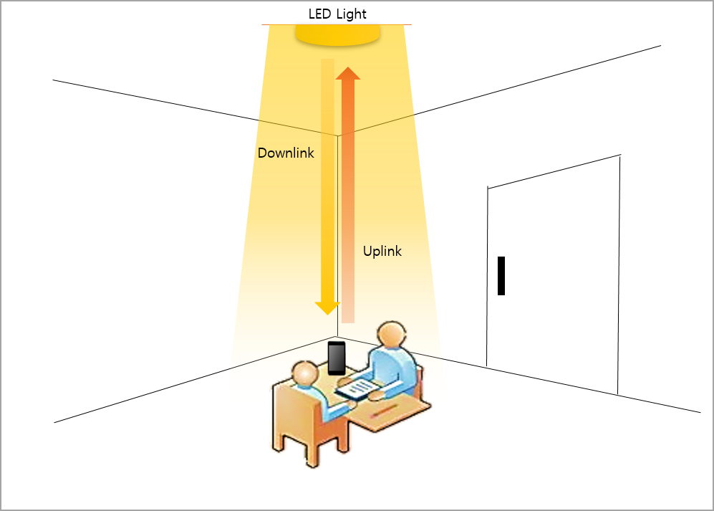
The need for uplink technology for two-way VLC systems
In the visible light communication environment using only the conventional LED, two-way communication for feedback of user data information between the transmitting and receiving sections is limited. As a fusion technology, a bidirectional communication system is indispensable for application to various fields of networking infrastructure.
Two-way visible light communication system model

Slide 5
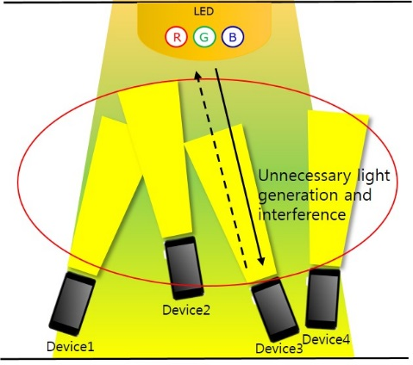
Problems of the two-way VLC system implemented up to now is that it is not easy to transmit upward from the terminal to the illumination direction. In the case of RF or Bluetooth, it is not suitable for use in a visible light communication environment having an advantage of free from radio interference since an environment in which radio waves are used must be added. Upward transmission is a necessary function for networking requiring bidirectional transmission, and a transmission method capable of ensuring sufficient transmission distance, interference elimination of LED illumination, and power efficiency should be used.
Indoor two-way visible light communication system environment

Slide 6
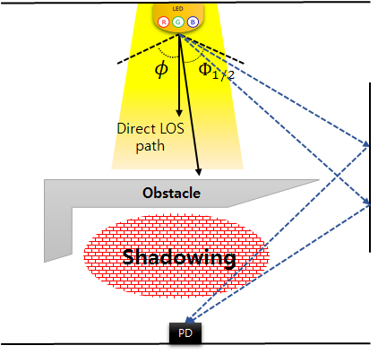
When an obstacle is generated between the transmitter and the receiver, a shadow area is generated in the direct light path and a temporary communication disconnection occurs. However, since it is difficult to transmit the channel feedback in the uplink in the environment of the unidirectional visible light communication, it is difficult to variably cope with the degradation of the data reception rate due to the shadow area.
Since it is difficult to configure a networking environment that requires feedback of user data, there are many restrictions to be used in constructing a network infrastructure in various fields. Therefore, research on uplink for bidirectional communication is needed.
Creation of shaded areas due to obstacles

Slide 7
Technical considerations for Two-way VLC system
Two-way communication refers to communication capable of simultaneously implementing downlink transmission and uplink transmission.. In the case of a terminal used for uplink transmission, mobility is considered, so that a relatively small amount of data is fed back to the uplink, and the asymmetric link configuration is considered do.
Upward transmission attempts have been made using several methods, but satisfactory solutions have not been proposed yet. Upstream transmission is also excluded in the visible light communication standard created in IEEE 802.15.7.

Slide 8
References
[1] Y. Tanaka, S. Haruyama and M. Nakagawa, “Wireless optical transmission with the white colored LED for the wireless home links,” Proc. 11th int. Symp. On Personal, Indoor and Mobile Radio Communications (PIMRC 2000), London, UK, pp.1325-1329, 2000.
[2] Uddin, M.S., Aktar, N., Jae Sang Cha and Yeong Min Jang, Path mapping and control of mobile cleaning robot using LED-ID network, 2011 Third International Conference on Ubiquitous and Future Networks (ICUFN), pp.123-126, 2011.

