Slide 1
Project: IEEE P802.15 Working Group for Wireless Personal Area Networks (WPANs)
Submission Title: Automatic Railway Shunter Docking Solution Using LiFi/CAMCOM Technology
Date Submitted: September 2018
Source: Jaesang Cha, Minwoo Lee (SNUST), Jeong Gon Kim (Korea Polytechnic Univ.), Il-kyoo Lee (Kongju Nat’ Univ.) , Sooyoung Chang (SYCA) , Vinayagam Mariappan (SNUST)
Address: Contact Information: +82-2-970-6431, FAX: +82-2-970-6123, E-Mail: chajs@seoultech.ac.kr
Re:
Abstract: This documents introduce the V2V LiFi/CamCom Link design consideration for VAT. This proposed LiFi/CamCom solution for automatic railway shunter docking . This VAT to operate on the application services like ITS, ADAS, IoT/IoL, etc. on road condition. Also this can be used for LEDIT, Digital Signage with connected information services etc.
Purpose: To provided concept models of Light Communication based LiFi/CamCom solution for Vehicular Assistant Technology (VAT) Interest Group
Notice: This document has been prepared to assist the IEEE P802.15. It is offered as a basis for discussion and is not binding on the contributing individual(s) or organization(s). The material in this document is subject to change in form and content after further study. The contributor(s) reserve(s) the right to add, amend or withdraw material contained herein.
Release: The contributor acknowledges and accepts that this contribution becomes the property of IEEE and may be made publicly available by P802.15.
Slide 1

Slide 2
Contents
Need for Automatic Railway Shunter Docking Solutions
Railway Shunter Docking LiFi/CamCom Link
Conclusion
Slide 2

Slide 3
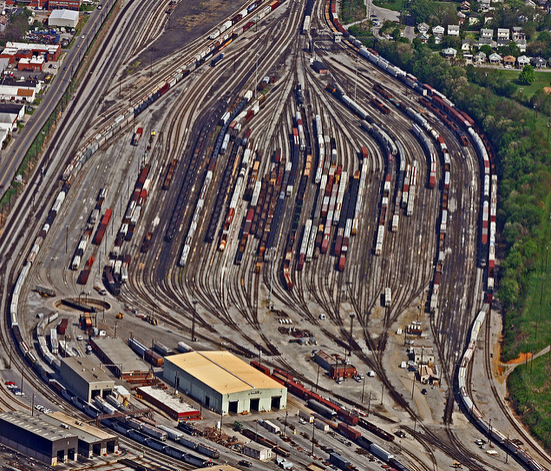
Need for Automatic Railway Shunter Docking Solutions
Needs
In the railway rail yard there are so many railways and on the each railway there is bunch of trains
For the driver of locomotive to connect the locomotive to correct train tail is not easy and it takes time
After connecting the train it requires checking is it correct or not
Using the light source installed on the train tail and Camera installed on the back of locomotive provides immediate identifying system to verify
Provides confirmation for drivers of locomotive and save time in connection.
Basic Concept
Use the light communication to right locomotive to connect with train tail and docking position alignment for docking
Every locomotive and train tail to have the light communication transceiver and operate on both LiFi/CamCom technology to communicate each other when it needs the docking
Make effective docking with less time
< Railway Rail Yard >
GOOGLE
< Railway Shunter Dock >
Slide 3

Slide 4
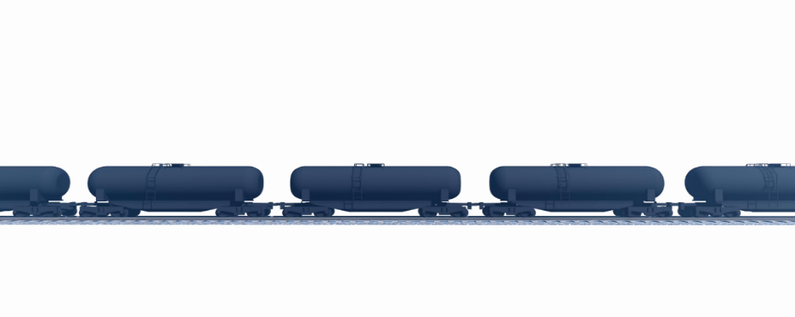
Railway Shunter Docking LiFi/CamCom Link
Camera
< Railway Shunter Docking LiFi/CamCom Link >
Light Communication Based Railway Shunter LiFi/CamCom Link
Tx : Rail Locomotive and Tail LED Lights
Rx : PD / Camera
Day-Night Communication Mode
Modulations :
OOK, VPPM, Offset-VPWM, Multilevel PPM, Inverted PPM, Subcarrier PPM, DSSS SIK etc.
Data Rate : 1K ~ 1Mb/s
Supported LoS (Line of Sight)
Available Distance : 2m ~ 50m
Slide 4

Slide 5
Conclusion
Proposed the solution for connecting locomotive to train tail method using LiFi/CamCom Technology
Using LiFi/CamCom provides identifying system to locomotive is that train right or not and gives confirmations to connect the trains.
Provides signals of identifying to driver of locomotive whether is right train tail or not.
Reduce the time of connecting and checking.
Slide 5

