Slide 1
Project: IEEE P802.15 Working Group for Wireless Personal Area Networks (WPANs)
Submission Title: Location Localization OCC Link for Outbound Logistics Service
Date Submitted: September 2018
Source: Jaesang Cha, Minwoo Lee, Deokgun Woo (SNUST), Kaewon Choi(SKKU), Sooyoung Chang (SYCA) , Vinayagam Mariappan (SNUST)
Address: Contact Information: +82-2-970-6431, FAX: +82-2-970-6123, E-Mail: chajs@seoultech.ac.kr
Re:
Abstract: This documents introduce the OCC V2X communication link design consideration for VAT. The proposed OCC data link to introduce the possibility of using light communication for outbound management on logistics centers. This proposed solution can be utilized as a part of a complex of monitoring, logistics and scheduling.
Purpose: To provided concept models of OCC Link for Vehicular Assistant Technology (VAT) Interest Group
Notice: This document has been prepared to assist the IEEE P802.15. It is offered as a basis for discussion and is not binding on the contributing individual(s) or organization(s). The material in this document is subject to change in form and content after further study. The contributor(s) reserve(s) the right to add, amend or withdraw material contained herein.
Release: The contributor acknowledges and accepts that this contribution becomes the property of IEEE and may be made publicly available by P802.15.
Slide 1

Slide 2
Contents
Need for Outbound Logistic Service
OCC Link for Outbound Location Localization
Conclusion
Slide 2

Slide 3
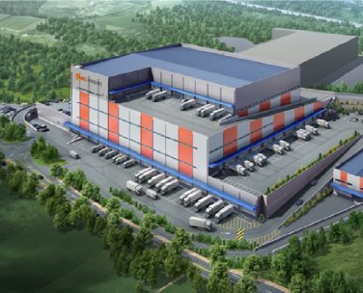
Need for Outbound Logistic Service
< Outbound area of Current Logistics Center >
Needs for Outbound Logistic Service
The logistics center is widely used for the shipping industry such as courier service.
Carrying status is collected manually by driver.
Basic Concept
CSK-based optical camera communication allows real-time access to the delivery vehicle
Both consumers and companies can see faster shipping information
Slide 3

Slide 4
OCC Link for Outbound Location Localization
Rx : Image Sensor
Tx : CSK Modulation
< CSK based OCC Link for Logistics Outbound Recognition System >
CSK based Data Link
Tx : CSK based LED Patch / Display
Rx : Camera Image Sensor In Outside of Center
Modulations :
CSK, VTASC, SS2DC, OOK, VPPM, Offset-VPWM, Multilevel PPM, Inverted PPM, Subcarrier PPM, DSSS SIK etc.
Data Rate : 256 ~ 512b/s
Supported LoS (Line of Sight)
Available Distance : more than 30m in general CCTV
Slide 4

Slide 5
Conclusion
Proposed the Location Localization OCC Link for Outbound Logistics Service
CSK based encoded transmitter is uses display, LED patch, etc. can be attached to the upper part of the trailer of the delivery truck, and the entrance and exit can be recognized through the camera installed on the outer wall of the logistics center
Proposed CSK based outbound recognition technology can be efficiently used for smart logistics system
Slide 5

