Slide 1
Project: IEEE P802.15 Working Group for Wireless Personal Area Networks (WPANs)
Submission Title: International Railway Light Signals Management Solution for ITS Service using IoT/IoL Technology
Date Submitted: September 2018
Source: Jaesang Cha, Minwoo Lee, Jonghyeok Lee (SNUST), Soonho Jung (Sunil Elecomm Co., LTD.), Jinyong Choi(Shinhan Bank), Sooyoung Chang (SYCA), Vinayagam Mariappan (SNUST)
Address: Contact Information: +82-2-970-6431, FAX: +82-2-970-6123, E-Mail: chajs@seoultech.ac.kr
Re:
Abstract: This documents introduce the V2I IoT/IoL Link design consideration for VAT. This proposed IoT/IoL solution for ITS Service used in international railway light Signals management subsystem. This VAT to operate on the application services like ITS, ADAS, etc. on road condition. Also this can be used for LED IT, Digital Signage with connected information services etc.
Purpose: To provided concept models of light communication based IoT/IoL solution for Vehicular Assistant Technology (VAT) Interest Group
Notice: This document has been prepared to assist the IEEE P802.15. It is offered as a basis for discussion and is not binding on the contributing individual(s) or organization(s). The material in this document is subject to change in form and content after further study. The contributor(s) reserve(s) the right to add, amend or withdraw material contained herein.
Release: The contributor acknowledges and accepts that this contribution becomes the property of IEEE and may be made publicly available by P802.15.
Slide 1

Slide 2
Contents
Needs for International Railway Light Signals Management Solution
IoT/IoL Link for Railway Light Signals Solution
Conclusion
Slide 2

Slide 3
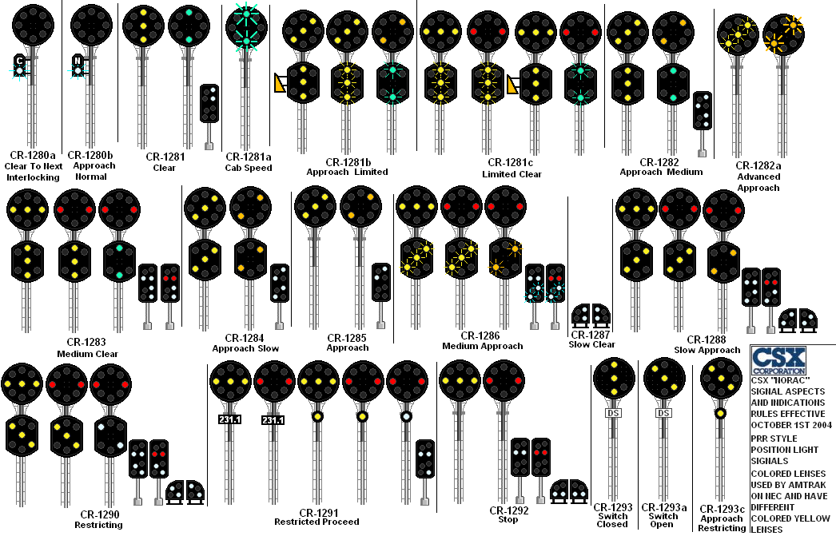
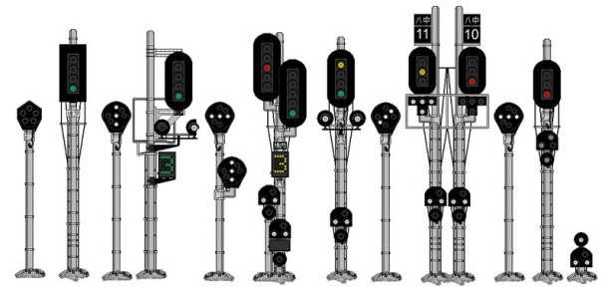
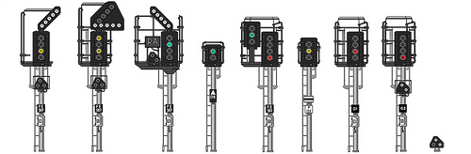
Needs for International Railway Light Signals Management Solution
Needs
  Each country has their own railroad light signaling systems
  Railroad light signaling systems are not fully standardized and not unified for international railway traffic
  Unification of the railroad light signaling system is difficult activity
  No country want to change existing traffic light system and the change of existing standard has a big influence to education system of this sphere, which requires retraining of specialists.
Basic Concept
  Present railroad signaling approach allows to modify the signaling system from the international differences and create new standard of railroad signalization based on existing light infrastructure.
  Propose the IoT/IoL technology solution to adapt the international railway light signaling method
  Uses the Existing Lighting System and Railroad vehicles built in with Camera / PD based receiver
  IoT/IoL technology solution create an opportunity to come to international standard with almost zero expenses.
GOOGLE
  < CSX “NORAC” private railway company signals , USA >
GOOGLE
  < Japan basic railway signals>
GOOGLE
  < United Kingdom basic railway signals>
Slide 3

Slide 4
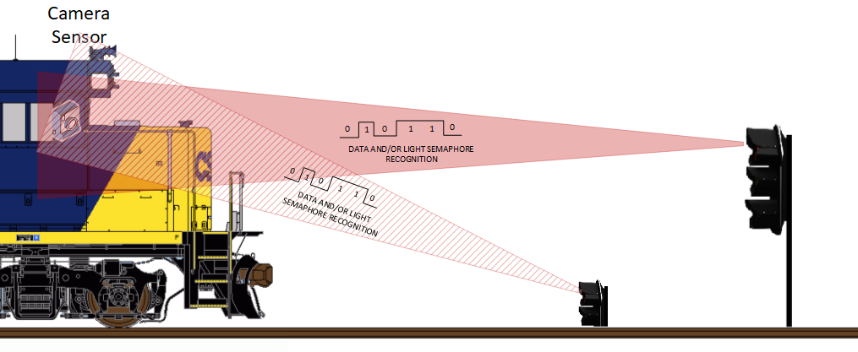
IoT/IoL Link for Railway Light Signals Solution
V2I IoT/IoL Link for Railway Light Signal System
  Tx : Railroad Traffic Lights
  Rx : PD / Camera Installed on Railroad Vehicles
  Day-Night Communication Mode
  Modulations :
    OOK, VPPM, Offset-VPWM, Multilevel PPM, Inverted PPM, Subcarrier PPM, DSSS SIK etc.
  Data Rate : 1K ~ 1Mb/s
  Supported LoS (Line of Sight)
  Available Distance : 2m ~ 200m
  < V2I IoT/IoL Link for Railroad Signal System >
Signalization is based on IoT/IoL connectivity link which allows to instantly identify semaphore shape and/or receive accurate system Data which is matching existing system
Train driver can get more status information and other additional information services
Helps to simplify and unify existing differences in international Railroad signalization
Slide 4

Slide 5
Conclusion
Proposed the International Railway Light Signals Management Solution for ITS Service using IoT/IoL Technology.
Uses the Existing Lighting System and Railroad vehicles built in with Camera / PD based receiver.
IoL/IoL solution allows to instantly identify semaphore shape receive additional system data.
Train driver can get more status information and other additional information services from ITS Server.
Helps to simplify and unify existing differences in international Railroad signals management.
Slide 5

