Slide 1
Project: IEEE P802.15 Working Group for Wireless Personal Area Networks (WPANs)
Submission Title: [Pulse energy considerations]
Date Submitted: [12th September 2018]
Source: [Prof Tony Fagan, Michael McLaughlin] Company [Decawave Ltd.]
Address [Peter Street, Dublin 8, Ireland]
Voice:[+353.87.233.7323], E-Mail:[billy.verso (at) decawave.com]
Re: [data modes for the HRP UWB PHY]
Abstract: [contribute to the enhanced impulse radio group w.r.t. the HRP UWB PHY ]
Purpose: []
Notice: This document has been prepared to assist the IEEE P802.15. It is offered as a basis for discussion and is not binding on the contributing individual(s) or organization(s). The material in this document is subject to change in form and content after further study. The contributor(s) reserve(s) the right to add, amend or withdraw material contained herein.
Release: The contributor acknowledges and accepts that this contribution becomes the property of IEEE and may be made publicly available by P802.15.

Slide 2
Each frame is mean power limited
Mean power must be < -41.3 dBm per MHz in any 1ms
  500 MHz BW ⇒ < 37.1 nJ of total energy in any frame shorter than 1ms
A minimum length secure ranging frame must contain a minimum number of pulses
  At least 4096 for the cipher/STS (32μs at 128MHz PRF)
  At least 2000 pulses for the SHR. (SYNC+SFD).
    20μs of DW proposal or 16 μs of ABCN proposal
  ⇒ At least 6096 pulses
Maximum energy per pulse = 37.1nJ / 6096 = 6.1 pJ

Slide 3
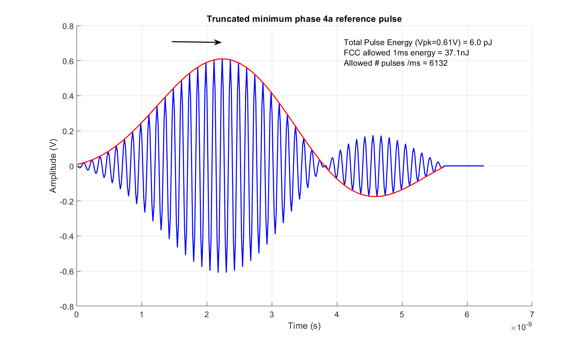

Energy of a single pulse
(Truncated 15.4a Reference pulse)
$For 499.2MHz BW$:
$$Energy / pulse ={16.26V}_{pk}^{2}pJ$$
At 0.61V peak energy is 6.06 pJ
37100/6.06 = 6122 pulses
This just allows the smallest frame with No Data
Smallest usable data frame has 12 bytes
= 1536 pulses at 125 MHz PRF at 7.8Mbps (ABCN scheme)
⇒ 4.86 pJ/pulse ⇒ 0.55 V_{pk}

Slide 4
Proposal
All comparisons of preamble schemes use a maximum peak power of:
All comparisons of data modulation schemes use a maximum peak power calculated from number of pulses in smallest frame:
Preamble V_{pk} ≤ 0.61 Volts referenced to 50 Ω
e.g. for ABCN 7.8 Mbps proposal
Data Mode V_{pk} ≤ 0.55 Volts referenced to 50 Ω

Slide 5
Practical peak power design considerations
Standard CMOS in a 40 nm process can only generate the peak power equivalent of about 0.7V peak into 50 Ω at the antenna when there are the following constraints:
  wide band
  operates up to 8.25 GHz
  variable output power
  power efficient
  meeting a predefined spectral transmission mask
  over all PVT corners up to 105 ⁰C
  No external RF passives
    External passives can provide much higher Quality Factor than on-chip

Slide 6
Peak power considerations
There are losses of 6 dB or more after the signal is generated before it reaches the antenna
  8 GHz is a high frequency for standard 40 nm RF CMOS
    particularly production CMOS rather than research.
  Considerable loss in an integrated balun
    exaggerated by non RF process i.e. standard substrate
  Losses in the Tx/Rx switches
    exaggerated by bulk process i.e. limited device performance
  Losses in the tracks and package
    exaggerated by non RF process i.e. standard BEOL (metallisation and associated finishing)
  Losses in the antenna feed and the antenna itself
    exaggerated by low cost FR4 PCB substrates
  Losses higher at higher temperatures (must work to 105 ⁰C)
    exaggerated by low cost packages with higher thermal resistance

Slide 7
Peak pulse power summary
Difficult to get > 0.7 V with UWB design constraints
No point in designing pulse generator that can go beyond 0.61V
All schemes are mean limited if data is more than ~10 bytes
Even with no data whatsoever, only preamble and cipher, only a 0.3 dB difference between peak limited frame and mean limited frame for both 4a 6.8 Mbps and DW proposed scheme
2 ns pulse spacing is just as good as 4 ns spacing. Extra peak amplitude possible for 4 ns pulses would break mean power limit

Slide 8
12 byte frame comparison
DW 13.6 Mbps mode gets same range as ABCN at 6.8 Mbps
  Halves the duration of the data portion
DW 6.8 Mbps gets considerably greater range
2 ns pulse spacing allows 50% guard time

Slide 9
40 byte frame comparison
DW 13.6 Mbps mode gets same range as ABCN at 6.8 Mbps
  Halves the duration of the data portion
DW 6.8 Mbps gets considerably greater range
2 ns pulse spacing allows 50% guard time

Slide 10
Data Rates proposal
We propose that 4z has 3 data modes as shown
  2 ns pulse spacing
  250 MHz mean PRF
  50% guard time
  Concatenated 55/63 RS code with standard rate 1/8 K=3 convolutional code
6.8 Mbps for maximum range
27 Mbps for minimum power consumption
13.6 Mbps for range/power compromise

