Slide 1
Project: IEEE P802.15 Working Group for Wireless Personal Area Networks (WPANs)
Submission Title: [EIRP Considerations]
Date Submitted: [12 September, 2018]
Source: [Frank Leong] Company [NXP Semiconductors]
Address [High Tech Campus 60, 5656 AG, The Netherlands]
Voice:[+31 6 133 60727], E-Mail:[Frank.Leong (at) nxp.com]
Re: [Input to the Task Group]
Abstract: [Presentation, enhancements to 802.15.4 for secure ranging, ranging integrity]
Purpose: []
Notice: This document has been prepared to assist the IEEE P802.15. It is offered as a basis for discussion and is not binding on the contributing individual(s) or organization(s). The material in this document is subject to change in form and content after further study. The contributor(s) reserve(s) the right to add, amend or withdraw material contained herein.
Release: The contributor acknowledges and accepts that this contribution becomes the property of IEEE and may be made publicly available by P802.15.

Slide 2
EIRP Considerations Note: Notation/nomenclature based on 15-18-0286-01-004z-hrp-uwb-srdev-ppdu-text-contribution.docx and 15-18-0335-00-004z-srdev-ppdu-for-enhanced-impulse-radio.pptx

Slide 3
Rationale
Secure RF ranging on the PHY layer requires many short pulses per measurement
UWB as specified in IEEE 802.15.4 PHYs may be suitable as starting point
QoS depends on link budget → Aim to minimize impact of EIRP constraints → Design enhancements accordingly

Slide 4
IR-UWB Protocols with Short Frames (I)
Short Frame UWB modes offer several interesting features:
Reduced on-time can significantly improve (key fob) battery life
High data rate can reduce system latency
Short symbol duration improves resilience against EDLC attacks
Reduced on-time reduces collision probability in multi-user scenarios
Reduced on-time improves compatibility with duty-cycle regulation
All of these features are enhanced by reducing the frame length relative to the average power integration window length

Slide 5
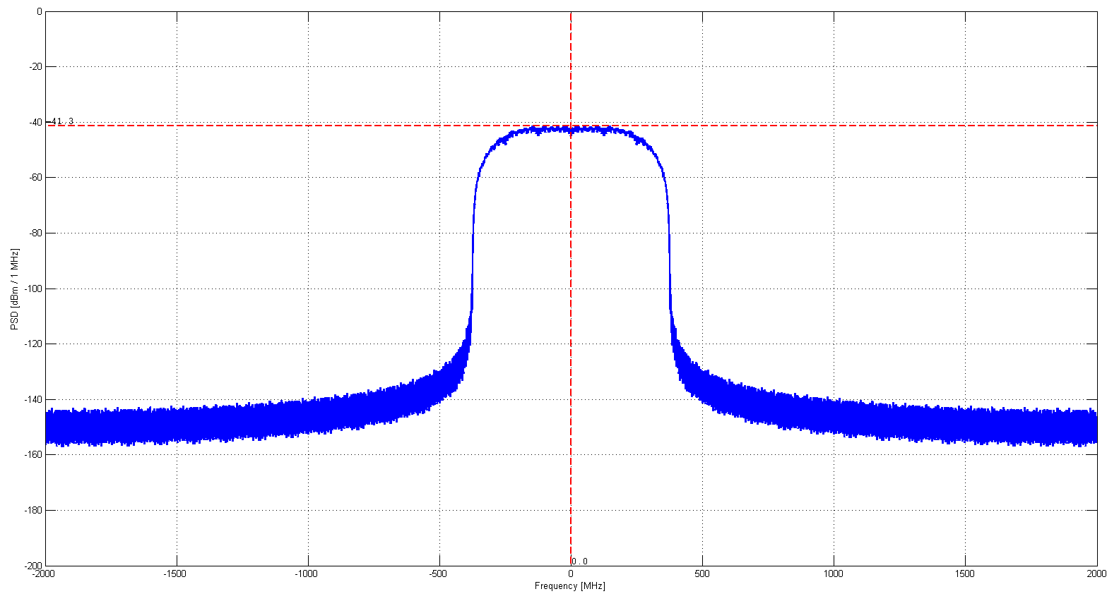
IR-UWB Protocols with Short Frames (II)
For an intuitive understanding, we make an assumption: The modulated spectrum is approximately equal to the spectrum of a single pulse, multiplied by the number of pulses inside the integration window (i.e., the energy in two pulses is twice the energy of a single pulse)
This assumption is supported by the following plot of a typical Mean EIRP for a ~65 µs long PRF128 STS: [Note how similar the spectrum is to the spectrum of the individual Root-Raised Cosine pulse]
Pulse shape: RRC (Tp = 2 ns, alpha = 0.5)

Slide 6
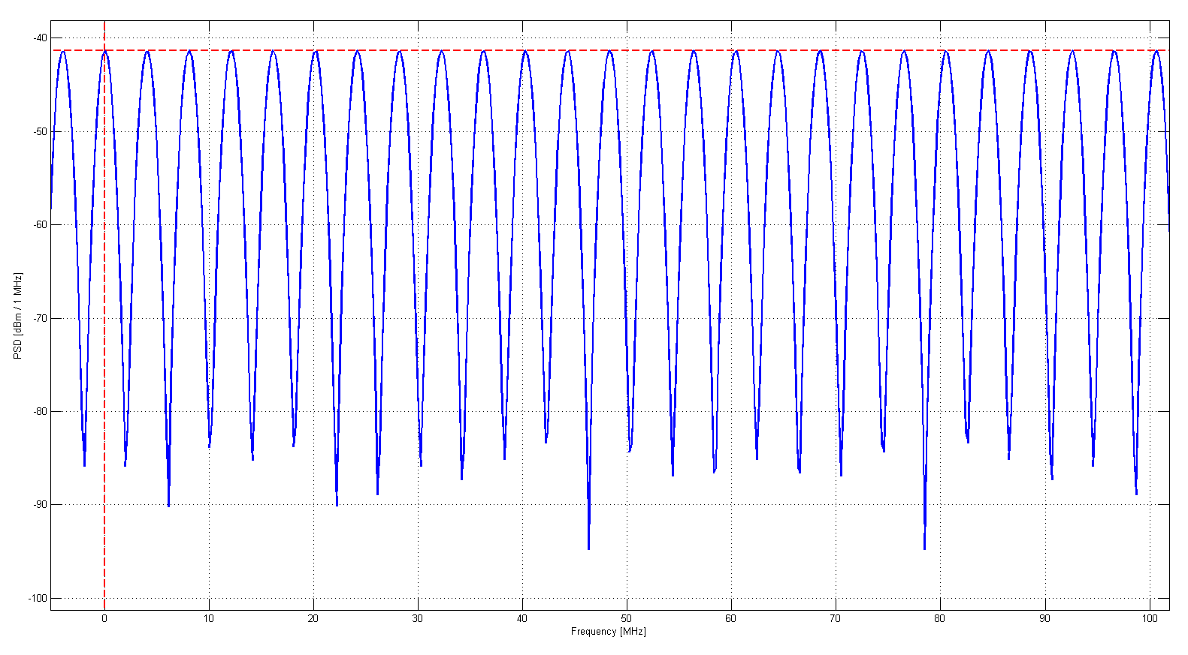
IR-UWB Protocols with Short Frames (IIa)
Assumption: Mean EIRP spectrum of a frame is similar to the individual pulse spectrum
Note: This is only true in the absence of >1 MHz modulation periodicity
(see also: Y.-P. Nakache and A. Molisch, "Spectral Shape of UWB Signals – Influence of Modulation Format, Multiple Access Scheme and Pulse Shape,“ IEEE Vehicular Technology Conference, pp. 2510-2514, April 2003)
Example: Plot shows Mean EIRP of a CiL31 SYNC code* with spreading factor 4 (i.e., ~4 MHz period), repeated 64 times (i.e., ~16 µs), resulting in ~4.5 dB band power loss
*: --0-+++++-+++-0++-0--+-+-0+00++

Slide 7
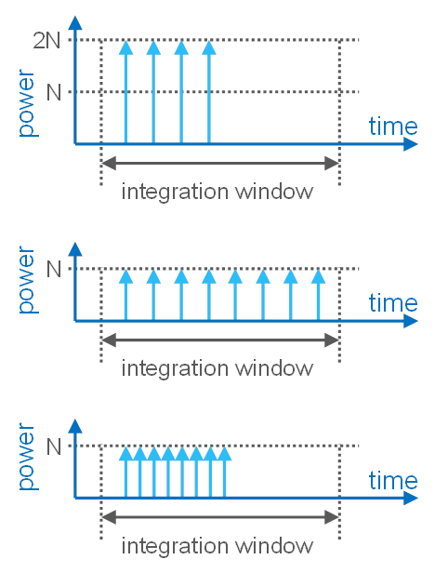
IR-UWB Protocols with Short Frames (III)
Simplified conceptual representation:
Considering (BPM-)BPSK modulation (not shown), the avg. power (Mean EIRP) spectra corresponding to the three plots are basically identical. We can have 8 pulses with power N, distributed equally or unequally, or 4 pulses with power 2N. In all cases, the average power during the integration window is roughly equal.

Slide 8
IR-UWB Protocols with Short Frames (IV)
Conclusion: Max. PSD for short frames ≈ -41.3 + 10·log₁₀(1 ms / L_{frame}) dBm/MHz.
Example (assuming frame without >1 MHz periodicity, such as POM): For a 500 MHz wide brick-wall filtered IR-UWB signal and a frame length of 150 µs, the allowed average power during the frame is -41.3 + 10·log₁₀(500 MHz / 1 MHz) + 10·log₁₀(1 ms / 0.15 ms) dBm = -6.07 dBm. This represents an 8.24 dB amplitude increase for the short frame, when compared to a long frame. → Increased data rate does not always lead to link budget penalty.

Slide 9
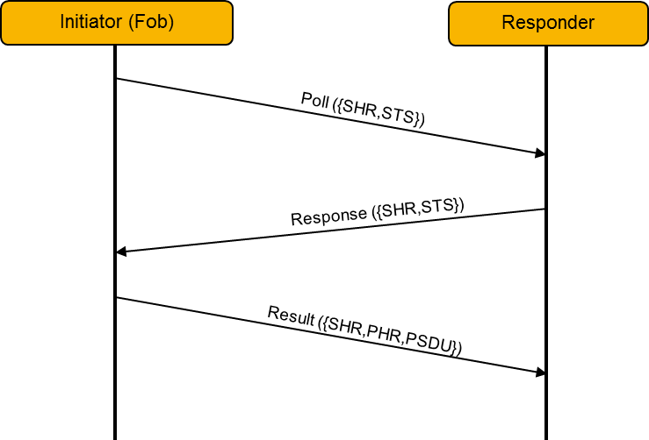
Short Frame Gain – Example (I)

Slide 10
Short Frame Gain – Example (II)
STS Frame (Poll, Response) acc. POM frame structure (PRF128 STS)
Sync of 32 symbols of ~1 µs length each = 32.56 µs
SFD of 4 symbols of ~1 µs length each = 4.07 µs
Gap of ~1 µs length = 1.03 µs (not counted)
STS where “$l=0$” = 32.82 µs
Overall length incl. gap = 70.48 µs
Overall length minus gap = 69.45 µs → Short Frame Gain = 11.6 dB
Data Frame (Result) acc. POM frame structure (7.8 Mbit/s PSDU)
Sync of 32 symbols of ~1 µs length each = 32.56 µs
SFD of 4 symbols of ~1 µs length each = 4.07 µs
PHR+PSDU of 24 bytes of ~1 µs length each = 24.61 µs
Overall length = 61.25 µs → Short Frame Gain = 12.1 dB

Slide 11
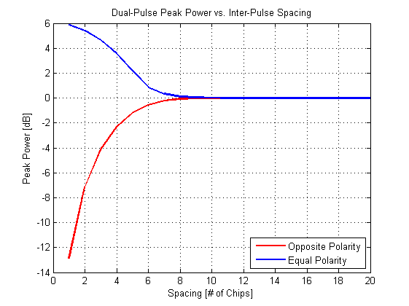
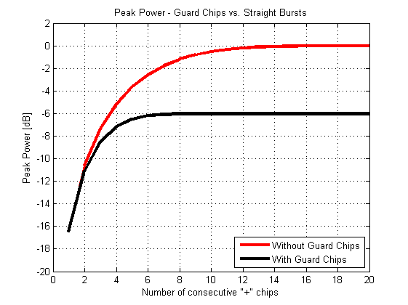
Peak EIRP – Considerations
Note: Peak Power (Peak EIRP) defined acc. FCC/ETSI

Slide 12
Peak EIRP – Remarks
BPSK polarity matters
Longer bursts (up to ~20 ns) lead to larger Peak EIRP in 50 MHz RBW
Guard chips reduce Peak EIRP for equal number of pulses (>2) per burst
Peak EIRP scales with 20 dB/dec, while Mean EIRP scales with 10 dB/dec → When splitting one pulse into two adjacent pulses, equal Mean EIRP corresponds to a ~3 dB increase in Peak EIRP

