Slide 1
Project: IEEE P802.15 Working Group for Wireless Personal Area Networks (WPANs)
Submission Title: Discussion on MAC functionalities
Date Submitted: March 6, 2018
Source: John Li
Company: Huawei
Address: No.156 Beiqing road, Beijing
Voice: +86 158 0153 9749
e-mail: john.liqiang@hisilicon.com
Re:
Abstract: This document summarize the MAC functionalities in current draft and assist discussion on future MAC development
Purpose: Assist discussion on MAC functionalities
Notice: This document has been prepared to assist the IEEE P802.15. It is offered as a basis for discussion and is not binding on the contributing individual(s) or organization(s). The material in this document is subject to change in form and content after further study. The contributor(s) reserve(s) the right to add, amend or withdraw material contained herein.
Release: The contributor acknowledges and accepts that this contribution becomes the property of IEEE and may be made publicly available by P802.15.

Slide 2
Current MAC functionalities
 | Superframe structure | Slotted or not | CSMA
Beacon enabled OWPAN | With superframe structure BP + CAP + CFP | Slotted | Slotted CSMA/CA; Polling
Non-Beacon enabled OWPAN | No superframe structure | No slot | unslotted CSMA/CA
For discussion:
Option 1: only beacon enabled OWPAN is kept
Option 2: only non-beacon enabled OWPAN is kept
Option 3: both beacon enabled and non beacon enabled OWPAN are kept

Slide 3
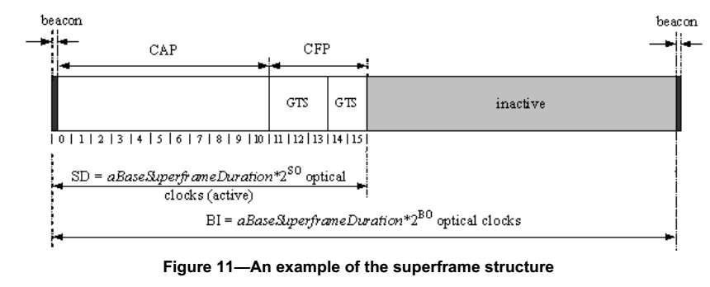
Superframe structure
For discussion
Is inactive part necessary?

Slide 4
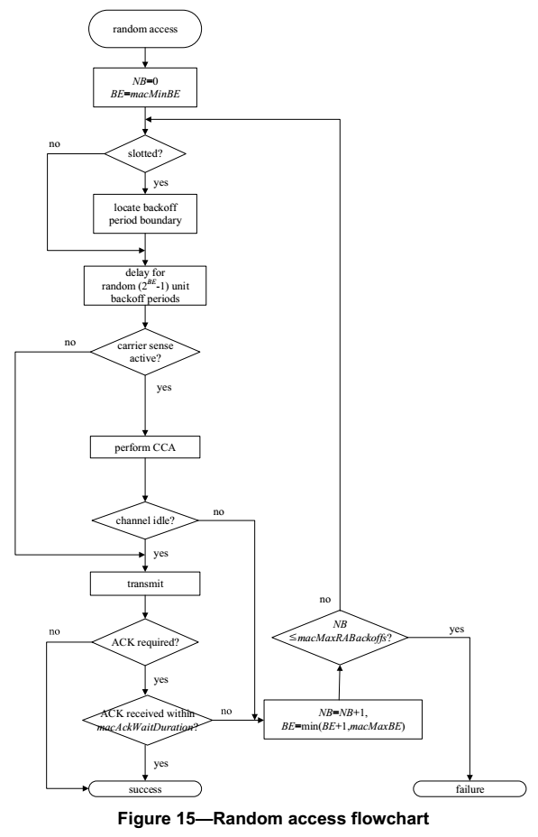
Current MAC functionalities
CAP (Contention Access Period)
Slotted CSMA/CA;
RTS / CTS
Polling
For discussion
Option 1: CSMA/CA only
Option 2: Polling only
Option 3: Polling is integrated into CSMA/CA (if coordinator gained access, it will occupy the channel and use polling for the remaining time)

Slide 5
Current MAC functionalities
CFP (optional)
GTS
Polling?
For discussion
Should CFP be made mandatory?
Is polling part of CFP?

