Slide 1
Project: IEEE P802.15 Working Group for Wireless Personal Area Networks (WPANs)
Submission Title: [802.15.4w Fraunhofer IIS proposal discussion slides]
Date Submitted: [10 September, 2018]
Source: [Johannes Wechsler] Company [Fraunhofer Institute for Integrated Circuits IIS]
Address [Nordostpark 84, Nuremberg, 90411, Bavaria]
Voice:[ +49 911 58061-3334], FAX: [+49 911 58061-3299], E-Mail:[johannes.Wechsler@iis.fraunhofer.de]
Re: [IEEE P802.15.4w Low Power Wide Area Call for Proposals, IEEE 802.15-18-0147-01-004w]
Abstract: [Discussion on the 802.15.4w proposal from Fraunhofer IIS which shows the compliance with the PAR, the technical guidance document as well as the requirements defined during the meeting San Diego 2018.]
Purpose: [Discuss the proposal of Fraunhofer IIS for 802.15.4w and its compliance with the call for proposal requirements.]
Notice: This document has been prepared to assist the IEEE P802.15. It is offered as a basis for discussion and is not binding on the contributing individual(s) or organization(s). The material in this document is subject to change in form and content after further study. The contributor(s) reserve(s) the right to add, amend or withdraw material contained herein.
Release: The contributor acknowledges and accepts that this contribution becomes the property of IEEE and may be made publicly available by P802.15.

Slide 2
802.15.4w Fraunhofer IIS proposal
Discussion
Johannes Wechsler
Fraunhofer IIS

Slide 3
Motivation
Trend: everything is smart and connected: houses, cities, meters, headphones …
→ more and more wirelessly connected devices
Most networks operate within a very limited range and don’t require very high sensitivity
→ Only very close networks interfere one another

Slide 4
Motivation
Low Power Wide Area (LPWA) networks for smart metering, predictive maintenance etc., use very high sensitivity to achieve low-power and wide-area (10km+)
Many networks are potential interferers for the LPWA network

Slide 5
Motivation
Radio systems originally designed for reliable long range communication have to deal with increased interference, especially in narrow, unlicensed bands [4]
22
interferer linear frequency sweep
frequency channel →
20
18
wide-band interferer
16
14
12
wide band spread-spectrum interferer
10
8
narrow-band interferer
6
4
2
0
0
0.5
1
1.5
2
2.5
3
3.5
time [sec] →

Slide 6
802.15.4 LPWA extension
Extend 802.15.4 portfolio with option for LPWA at high interference [2]
802.15.4 for Low energy critical infrastructure monitoring (LECIM) FSK perfect candidate for extension to LPWA applications [4][1]
  Already uses fragmentation
  Designed for low data rates
  Already includes FEC and interleaving

Slide 7
Fragmented codeword transmission
  Improve interference resilience with codeword fragmentation
    spread fragments (sub-packets) over time AND
    spread sub-packets over frequency (similar to FHSS)
    → capitalize on time and on frequency diversity
Many sub-packets (green) are not affected by interference
FEC can compensate losses
→ Low packet error rate (PER) despite interference
22
20
frequency channel →
18
16
14
12
10
8
6
4
2
0
0
0.5
1
1.5
2
2.5
3
3.5
time [sec] →

Slide 8
802.15.4w
Extend 802.15.4 LECIM FSK [3][4]
  Improve interference resilience with codeword fragmentation
  Extend to lower data rates to be even better suited for LPWA applications
Detailed requirements agreed upon
  PAR + CSD
  Technical Guidance Document
  Additions in San Diego 2018 Meeting in San Dieg

Slide 9
Modulation
LECIM offers multiple choices for FSK [1]
  already includes a modulation index of 0.5 → MSK
  Use 2 FSK bit to symbol mapping
    Before the bit-to-symbol mapping the data bits are precoded differentially
      Reverses the differential nature of the 2FSK
      Allows to use a coherent decoder
Add Gaussian filtering with a BT of 1.0
  Further narrow down spectral mask
  Increase spectral efficiency to reduce impact on existing systems
Most common transceivers already support GFSK modulation

Slide 10
Fragmentation symbol rates and channel spacing
SDR receivers are capable to receive multiple transmissions simultaneously
Detection very computationally expensive when a plethora of options for modulation, data rate and channelization need to be considered
Efficient FFT based implementation possible, when:
  Channel spacing is an integer multiple of the symbol rate
    (G)MSK modulation ideal candidate width of 1bit/s/Hz
    allows channel widths of symbol rate in hz

Slide 11
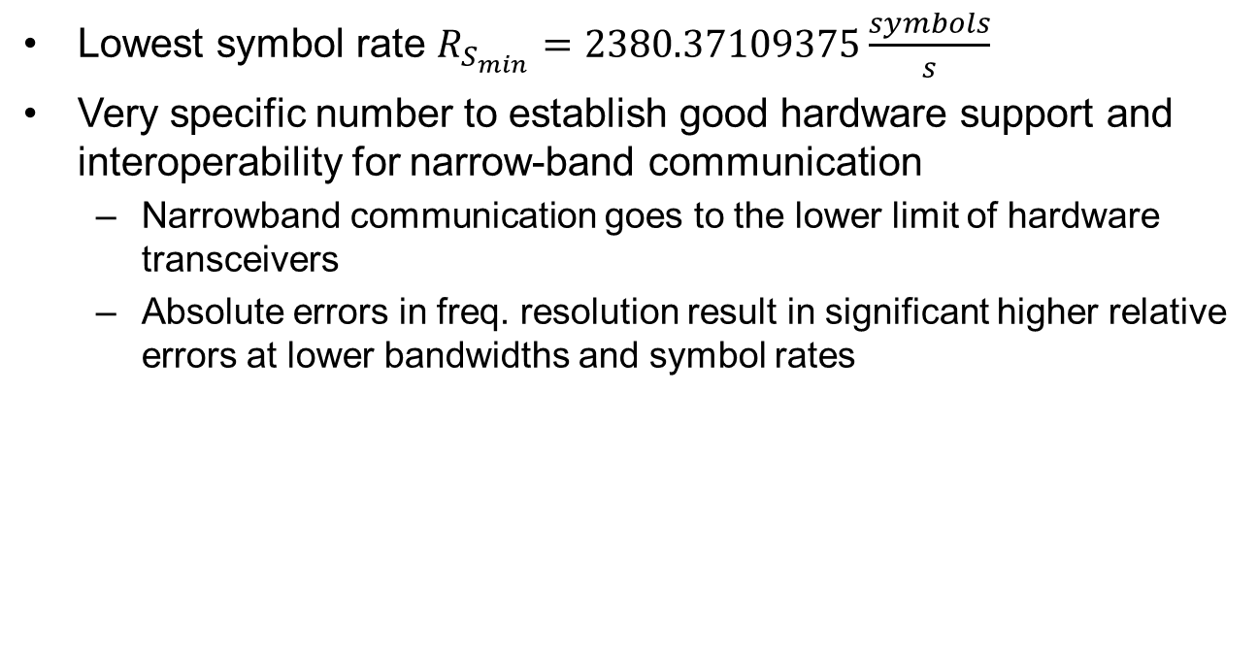
Symbol rate
Lowest symbol rate $R_{S_{min}}=2380.37109375\frac{symbols}{s}$
Very specific number to establish good hardware support and interoperability for narrow-band communication
  Narrowband communication goes to the lower limit of hardware transceivers
  Absolute errors in freq. resolution result in significant higher relative errors at lower bandwidths and symbol rates

Slide 12
Symbol rate
Common freq. resolution for transceivers ~100 Hz @900 MHz band
  Worst case channel error = 50 Hz
  Relative error at mismatch @ 2kHz channels: 2.5% error by design if step sizes mismatch
Deviation resolution and channel resolution commonly identical or separated by an integer multiple
  MSK through FSK modulator by deviation 1/4th of symbol rate
    → If deviation can’t be matched, modulation error by design

Slide 13
Symbol rate
Goal: Good support for current off-the shelf crystals and oscillators
  Most transceivers use a power-2 decimator in the fractional PLL
  Freq. resolution = (Crystal Frequency) / 2^x
  with x commonly between 16 and 20 for channelization and between 16 and 22 for deviation
Transceivers often utilize crystals that are widely available
  26 MHz (GSM)
  32 MHz (Used in many transceivers)
  38.4 MHz (USB)

Slide 14

Symbol rate
Symbol rate ideally is a multiple that can be obtained using one of these crystal frequencies divided by a power-of-2 and multiplied by an integer
For $R_{S_{min}}=2380.37109375\frac{symbols}{s}$
Crystal frequency | min. Power-of-2
 | for channelization | For deviation
26 MHz | 16 | 18
32 MHz | 19 | 21
38.4 MHz | 20 | 22
39 MHz | 14 | 16

Slide 15
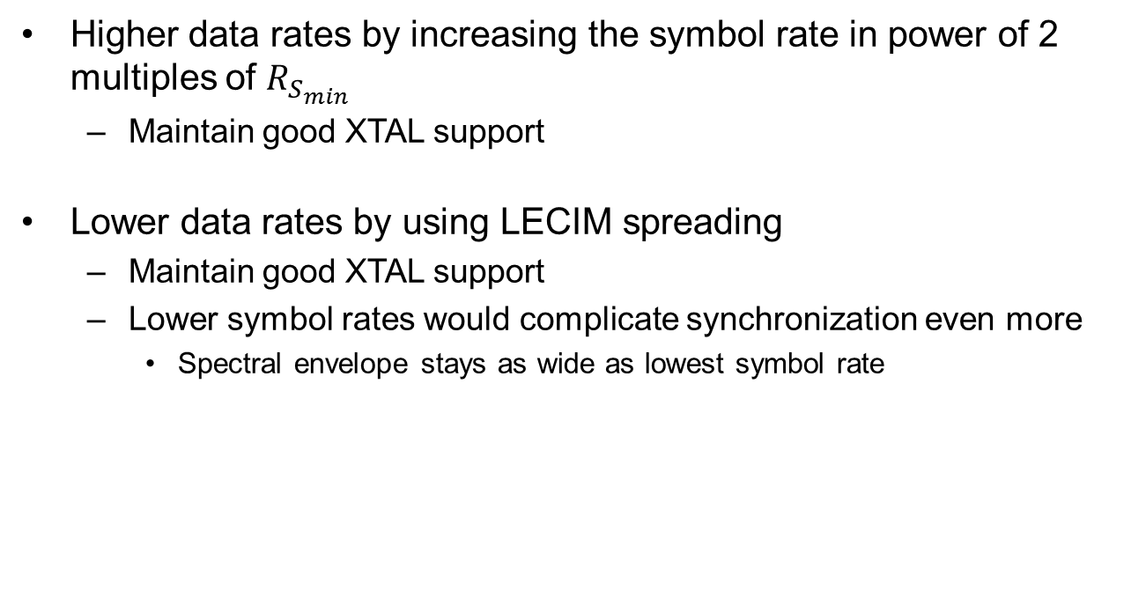
Data rate
Higher data rates by increasing the symbol rate in power of 2 multiples of $R_{S_{min}}$
  Maintain good XTAL support
Lower data rates by using LECIM spreading
  Maintain good XTAL support
  Lower symbol rates would complicate synchronization even more
    Spectral envelope stays as wide as lowest symbol rate

Slide 16
Channelization
Transmission can be significantly narrower than minimal channel bandwidth allowed by regulations (3kHz ←→ 25 kHz)
Introduce sub-channelization to make best use of frequency resources

Slide 17
Detectability / Synchronization
Decodeability in interference channels given through FEC
Detectability in interference channels through inclusion of synchronization header (SHR) in every sub-packet
  Distributed SHR allow detection and synchronization even if multiple sub-packets are interfered

Slide 18
Synchronization header (SHR)
SHR design considerations for TSMA
  Non-TSMA overhead only one SHR ←→ TSMA multiple SHR
    Reduce size for single SHR to reduce overhead
  Allow reception with current off-the-shelf transceiver ICs
→ SHR as short prefix with start-of-frame delimiter SFD and short preamble
  4 bit of the tail of a preamble and 12 synchronization bits form16 bit SHR
    16 bit widely supported by current transceivers
  Additional preamble octets ‘01010101’ configurable
 | preamble-tail | synchronization bits
Bit map | 0101 | 1011 1010 1010

Slide 19
Sub-packet splitting
Fragmentation of coded words and distribution over time
A single transmission comprises a fixed number of sub-packets
Number of sub-packets per transmissions dependent on utilized FEC
Sub-packet length depends on payload length

Slide 20
PHY service data unit (PSDU)
Fragmented transmission ideally for small payloads up to 64 bytes PSDU
  Memory requirements for reception increase with the length of the PSDU
  LPWAN applications predominantly use small payloads
    Optimized for these small payload
  PSDUs exceeding 64 byte can be fragmented in higher layers

Slide 21
PHY Header (PHR)
No changes necessary to existing header [1]
Considerations for possible enhancements
  Frame Length length ideally not larger than 64 byte
    Introduction of a limit might free some bits for other use
Bits: 0–1 | 2 | 3 | 4 | 5–15
Reserved | Parity | FCS Type | Data Whitening | Frame Length

Slide 22
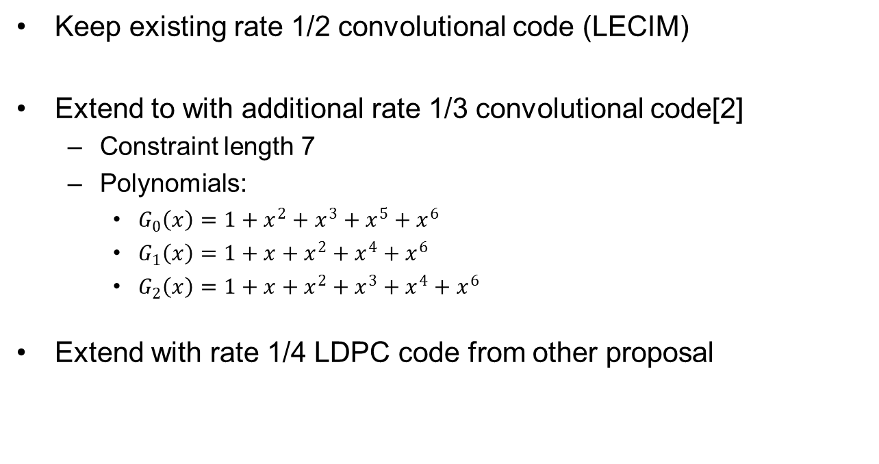
Forward Error Correction (FEC)
Keep existing rate 1/2 convolutional code (LECIM)
Extend to with additional rate 1/3 convolutional code[2]
  Constraint length 7
  Polynomials:
    $G_{0}\left(x\right)=1+x^{2}+x^{3}+x^{5}+x^{6}$
    $G_{1}\left(x\right)=1+x+x^{2}+x^{4}+x^{6}$
    $G_{2}\left(x\right)=1+x+x^{2}+x^{3}+x^{4}+x^{6}$
Extend with rate 1/4 LDPC code from other proposal

Slide 23
Forward Error Correction (FEC)
Consider additional packing format for both convolutional codes
  PHR and PSDU are simply concatenated and zero terminated before encoding
  Current, explicit PHR termination not useful for fragmented transmission and only introduces overhead
PHR | PSDU | TERMINATION

Slide 24
Interleaving
Block erasure or block interference are most common scenario in radio channels
  LECIM interleaver already deals with block errors
  TSMA adds time-frequency distribution → extend interleaver to sub-packets
Needs to handle loss or
distortion of:
  single sub-packet
  (most common)
  multiple successive
  sub-packets
  (seldom)
22
frequency channel →
20
18
16
14
12
10
8
6
4
2
0
0
0.5
1
1.5
2
2.5
3
3.5
time [sec] →

Slide 25
Interleaving by example (1)
No Interleaving
Loss of 1st
Loss of 1st and 2nd

Slide 26
Interleaving by example (2)
Spread consecutive symbols of codeword in different sub-packets
Loss of 1st
Loss of 1st and 2nd

Slide 27
Interleaving Method
Order the first input symbols linear to the S sub-packets
  First symbol → first sub-packet, first symbol
  Second symbol → second sub-packet, first symbol
  S-th symbol → S-th sub-packet, first symbol
  S+1 th symbol → first sub-packet, second symbol
  …
Repeat until all symbols are mapped to sub-packets

Slide 28
Time/Frequency Pattern
Design goals
  Optimize to cope well with expected interference [4]
    Minimal time gap needs to be longer than longest interferer
    Minimal frequency step should exceed bandwidth of widest interferer
  Comply with regulatory requirements to be considered a FHSS system in EU (EN 300 220) and NA (FCC 15.247)
    At least 57 channels (EU)
    At least 25 kHz wide (NA)
    Use all channels with same duty cycle (NA)

Slide 29
Time/Frequency Pattern
Random Access
Random Access Channel (ALOHA)
  Predefined time-frequency pattern table as defined in ETSI LTN
  Added possibility to transmit only parts of the pattern
    Requires only one table for all number of sub-packets
    Sections are chosen pseudo randomly based on CRC over PHR and PSDU
    Will not comply with FCC requirements to utilize every channel evenly
      Adding a table for each number of sub-packets can ensure correct utilization
  Other patterns are explicitly allowed and can be tailored to implementation and regulatory requirements
  Sub channelization not required due to crystal tolerances

Slide 30
Time/Frequency Pattern
Time Slotted PAN
Coordinated Time-Slotted PAN
  Coordinators open their radio listening window at predefined times spread over time-slots and channels

Slide 31
Time/Frequency Pattern
Time Slotted PAN
Large tables would be required to allow decoupling of many overlapping PANs
Alternative: Numerical generation of pattern “on-the-fly”
  Based on information within beacon or synchronization sub-packets
  Defines selected channel and sub-channels
    Sub-channels required as network is fully synchronized
    SDR receivers might be able to receive multiple sub-channels simultaneously → introduce sub-channel stacks for this purpose
  Defines whether a time slot is considered active or not
  Pseudo randomness allows determination of future slots without requirement to stay in sync all the time

Slide 32
Time/Frequency Pattern
Time Slotted PAN
PAN ID and Counter form a 32bit number
Number is randomized using a CRC32
Slices of this 32bit pseudo random number are used to derive variables for channel hopping

Slide 33
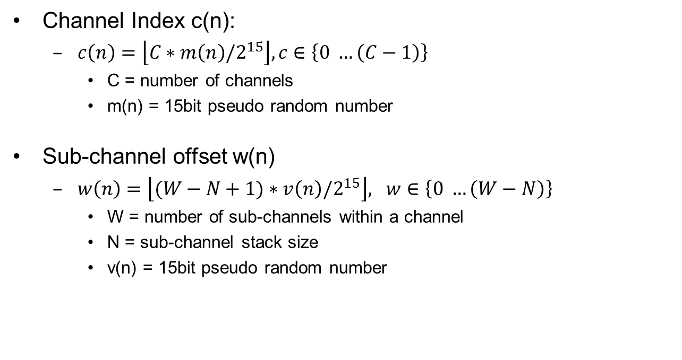
Time/Frequency Pattern
Time Slotted PAN
Channel Index c(n):
  $c\left(n\right)=\left\lfloor C∗m\left(n\right)/2^{15}\right\rfloor , c∈\left\{0 …\left(C−1\right)\right\}$
    C = number of channels
    m(n) = 15bit pseudo random number
Sub-channel offset w(n)
  $w\left(n\right)=\left\lfloor (W−N+1)∗v\left(n\right)/2^{15}\right\rfloor , w∈\left\{0 …\left(W−N\right)\right\}$
    W = number of sub-channels within a channel
    N = sub-channel stack size
    v(n) = 15bit pseudo random number

Slide 34
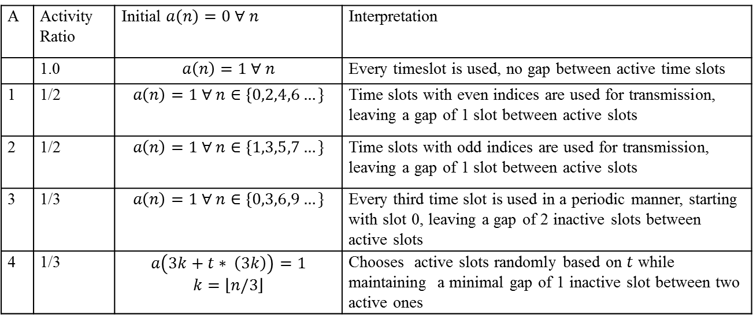
Time/Frequency Pattern
Time Slotted PAN
Activation indicator a(n)
  Determine if a slot is active, or not
    a(n) == 1 → slot is active; a(n) == 0 → slot is inactive
A | Activity Ratio | Initial $a\left(n\right)=0 ∀ n$ | Interpretation
 | 1.0 | $$a\left(n\right)=1 ∀ n$$ | Every timeslot is used, no gap between active time slots
1 | 1/2 | $$a\left(n\right)=1 ∀ n∈\{0,2,4,6…\}$$ | Time slots with even indices are used for transmission, leaving a gap of 1 slot between active slots
2 | 1/2 | $$a\left(n\right)=1 ∀ n∈\{1,3,5,7…\}$$ | Time slots with odd indices are used for transmission, leaving a gap of 1 slot between active slots
3 | 1/3 | $$a\left(n\right)=1 ∀ n∈\{0,3,6,9…\}$$ | Every third time slot is used in a periodic manner, starting with slot 0, leaving a gap of 2 inactive slots between active slots
4 | 1/3 | $$a\left(3k+t∗ \left(3k\right)\right)=1$$ $$k=\left\lfloor n/3\right\rfloor$$ | Chooses active slots randomly based on $t$ while maintaining a minimal gap of 1 inactive slot between two active ones

Slide 35
Time/Frequency Pattern
Time Slotted PAN example
n | 0 | 1 | 2 | 3 | 4 | 5 | 6
c(n) | 0 | 3 | 5 | 2 | 1 | 4 | 6
w(n) | 1 | 2 | 1 | 0 | 1 | 2 | 2
a(n) | 1 | 0 | 0 | 1 | 0 | 0 | 1

Slide 36
Initial Synchronisation
ALOHA transmission to request asynchronously to join a network
  Only works with base stations capable of scanning the whole band continuously
PAN with beacon
  Beacon should have different pattern on every transmission
    Decoupling of overlapping PANs
    Maximize the interference and fading robustness
    Search for the beacon for non-synchronized devices nearly impossible
    Introduce a few hard defined synchronization sub-packets that are transmitted a defined time before the beacon
    Information in synchronization sub-packets only needs to allow to determine beacon hopping pattern

Slide 37
Initial Synchronisation

Slide 38
Proposed
LECIM FSK Reference Modulator

Slide 39
Simulation Parameters
Additional settings
  10.000 packets per point to achieve smooth graphs
  PSDU size of 37 Bytes [6]
  Time gap between fragments: 64 symbols to cope with longest interferers of given model
  2.0 MHz bandwidth
  Receiver decodes with realistic channel estimation
  FEC = 1/3 rate convolutional code
    Effective data rates include FEC, PHR and SHR
Symbol rate (kS/s) | 2.38 + 2*Spread | 2.38 | 4.76 | 19.04
Eff. data rate (kbit/s) | 0.29 | 0.58 | 1.17 | 4.66

Slide 40
Simulation models and settings
Setup environment from [3] and [6]
  Noise figure = 3 dB
  Channel models
    Static: no frequency selectivity, no fading
    TU 6-TAP, 0km/h [4]
    TU 6-TAP, 30km/h [6]

Slide 41
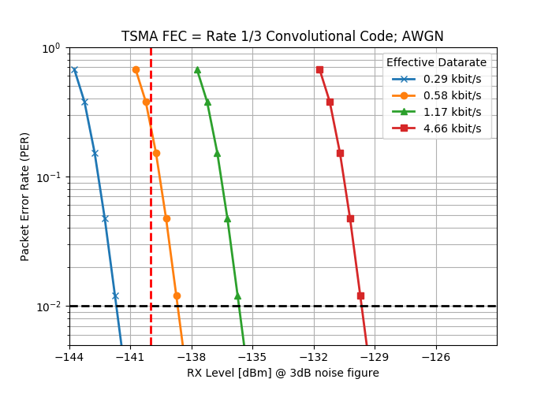
Minimum Required Sensitivity
Effective data rate of 0.29 kBit/s achieves required -140 dBm easily at 1% PER
Requires symbol spreading with factor of 2 and usage of R = 1/3 FEC

Slide 42
Impact of fragmentation with FEC (1)
Comparison based on same on-air time to have same energy requirement for transmission
FEC 1/3 Convolutional Code + Codeword fragmentation
  Effective data rate ~4.66 kbit/s
  Total on-air time 66ms
Uncoded single transmission
  38.25 Byte = 306 bits @ 4.76 kbit/s
  Total on-air time 64ms

Slide 43
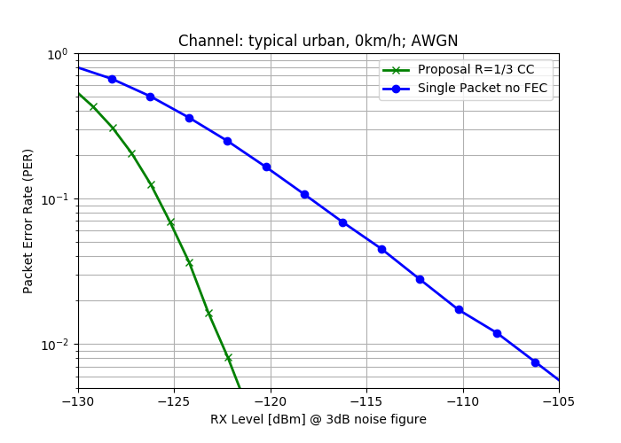
Impact of fragmentation with FEC (2)
no interference
transmission at same transmission energy
15 dB gain of proposal compared to uncoded at 1% PER
15 dB

Slide 44
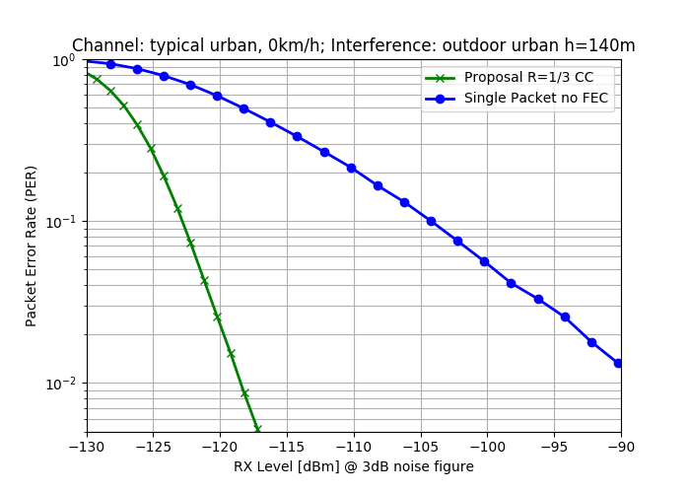
Impact of fragmentation with FEC (3)
interference outdoor urban,
h = 140m [4]
transmission at same transmission energy
28 dB+ gain of proposal compared to uncoded at 1% PER
28.5 dB

Slide 45
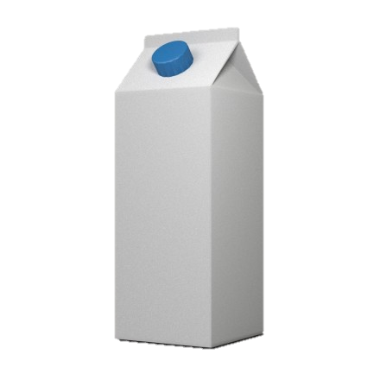

Impact of fragmentation with FEC (4)
Same on-air time for both transmissions for approximately similar power consumption
FEC coded can achieve same performance at ~ 1/500th of the required transmit energy
28 dB difference in required energy correspond to roughly to the comparison of a coin cell battery to a milk carton with same energy density
vs

Slide 46
Interference Robustness
Interference models to test against [3]
  Required: Outdoor urban, h_{BS}=140m [4]
  Additional: Outdoor urban, h_{BS}=32m
Channel model
  AWGN, static
Simulated
  Proposal: Rate 1/3 Convolutional Code, fragmented
  Single Packet: Rate 1/3 Convolutional Code, no fragmentation
  Proposal AWGN: Reference Rate 1/3 Convolutional Code, fragmented, no interference

Slide 47
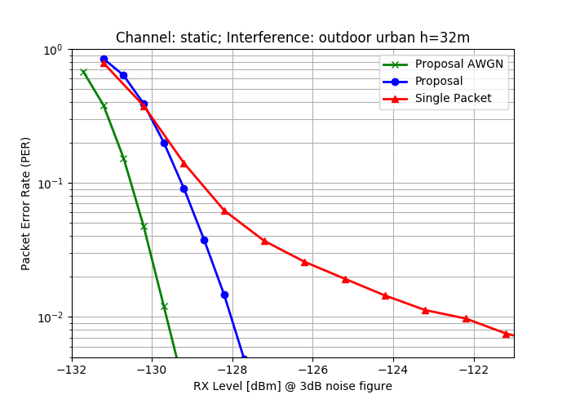
Interference Robustness
Scenario less exposed receiver rural, h = 32m
>5 dB gain over
non-fragmented transmission at 1% PER
only 1.5 dB loss compared to non-interfered transmission at 1% PER
> 5 dB

Slide 48
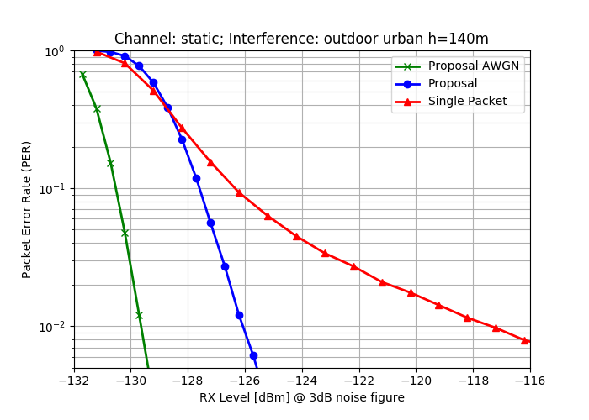
Interference Robustness
Required Scenario urban, h = 140m [4]
8.5 dB gain over non-fragmented transmission at 1% PER
only 3.5 dB loss compared to non-interfered transmission at 1% PER
8.5 dB

Slide 49
Interference Robustness
Two different interference models considered
  32m less exposed antenna, less interference
  140m higher exposure to interferers
The higher the interference, the more gain can be obtained by fragmentation

Slide 50
Multipath Performance
Check impact of multi path fading as required by [3]
Use higher symbol rate of 8 x 2.380 kBit/s to see any impact
Channel models
  Single path channel → no inter-symbol-interference (ISI)
  2-Tap Multipath channel
    Taps equally strong
    Time between taps = 1/8th of the symbol rate → 6.6µs

Slide 51
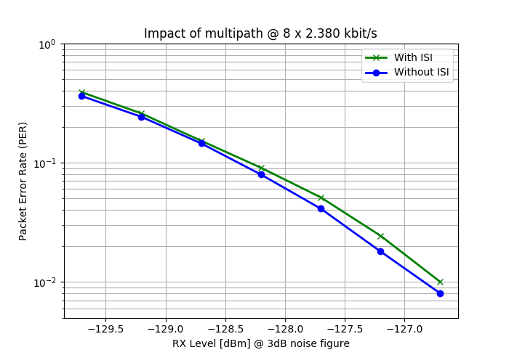
Multipath Performance
Almost no impact on the performance for a multipath channel

Slide 52
Mobility Performance
Demonstrate performance in a mobile channel as discussed [6]
Channel Models used for comparison
  TU 6-TAP, 0km/h [4]
  TU 6-TAP, 30km/h [6]

Slide 53
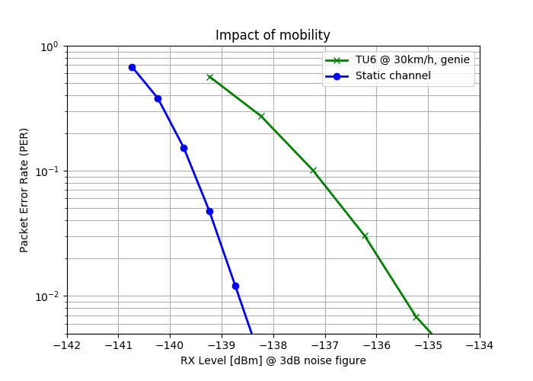
Mobility Performance
Performance at 30 km/h decreases roughly by 4 dB
LPWA applications
are mostly stationary
Slow moving
nodes are still
receivable, however
a small impact on
range is to be
expected

Slide 54
Coexistence
LBT and fragmentation allows for flexible adjustment to channel conditions
  Pause between fragments allows good channel analysis for LBT
  Finer LBT granularity possible than existing LECIM for packet lengths
High success rate even in heavily used channels → little to no retransmissions required
Preambles differs from legacy systems
High frequency dynamic allows to avoid narrow systems

Slide 55
Thank you!
Any questions or suggestions?

Slide 56
References
[1] | LAN/MAN Standards Committee, IEEE Standard for Low-Rate, IEEE Std 802.15.4-2015, 2015.
[2] | R. Heile, P802.15.4w PAR, IEEE P802.15-18-0050-03-0000.
[3] | J. Robert, 802.15.4w Technical Guidance Document, IEEE P802.15-18-0161-00-004w.
[4] | J. Robert, Draft IG LPWA Report, IEEE P802.15-17-0528-01-lpwa.
[5] | J. Robert, IEEE P802.15.4w Low Power Wide Area Call for Proposals, IEEE P802-15-18-0147-01-004w.
[6] | J. Robert, TG 802.15.4w LPWA Agenda July 2018 Plenary, IEEE P802. 15-18-0319-04-004w

