Slide 1
Project: IEEE P802.15 Working Group for Wireless Personal Area Networks (WPANs)
Submission Title: [Figure of Merit for HRP UWB data modulations]
Date Submitted: [10th September 2018]
Source: [Prof Tony Fagan, Michael McLaughlin] Company [Decawave Ltd.]
Address [Peter Street, Dublin 8, Ireland]
Voice:[+353.87.233.7323], E-Mail:[tony.fagan (at) decawave.com]
Re: [Figure of merit for 4z]
Abstract: [contribute to the enhanced impulse radio group w.r.t. the HRP UWB PHY ]
Purpose: []
Notice: This document has been prepared to assist the IEEE P802.15. It is offered as a basis for discussion and is not binding on the contributing individual(s) or organization(s). The material in this document is subject to change in form and content after further study. The contributor(s) reserve(s) the right to add, amend or withdraw material contained herein.
Release: The contributor acknowledges and accepts that this contribution becomes the property of IEEE and may be made publicly available by P802.15.

Slide 2
What do we care about for data portion of frame?
What we care about most is Range and Packet Duration under certain restrictions
Regulatory restrictions
  Must not violate -41.3dBm mean power in any 1MHz RBW bin averaged over 1ms
  Must not violate 0dBm at any time in any 50MHz bin
Standard CMOS 2.5V supply also restricts us
  Very difficult to generate >0.7V peak (1.4V pk-pk) at the antenna in a power efficient standard CMOS transmitter
    See companion submission for details

Slide 3
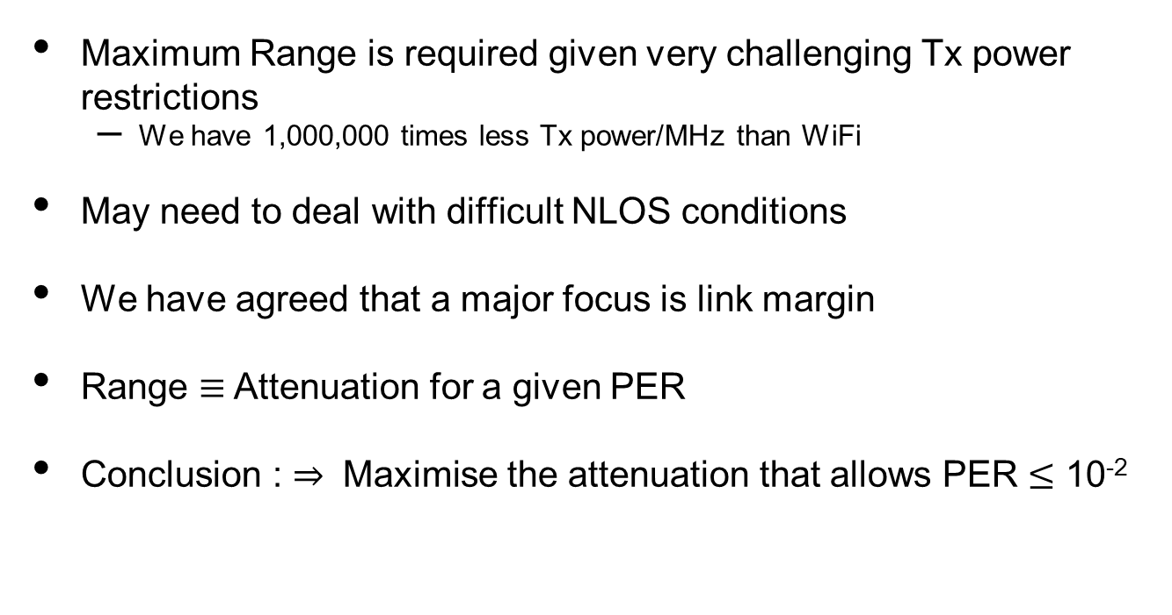
Why is Range important?
Maximum Range is required given very challenging Tx power restrictions
  We have 1,000,000 times less Tx power/MHz than WiFi
May need to deal with difficult NLOS conditions
We have agreed that a major focus is link margin
Range $≡$Attenuation for a given PER
Conclusion : $⇒$ Maximise the attenuation that allows PER $≤$ 10⁻²

Slide 4
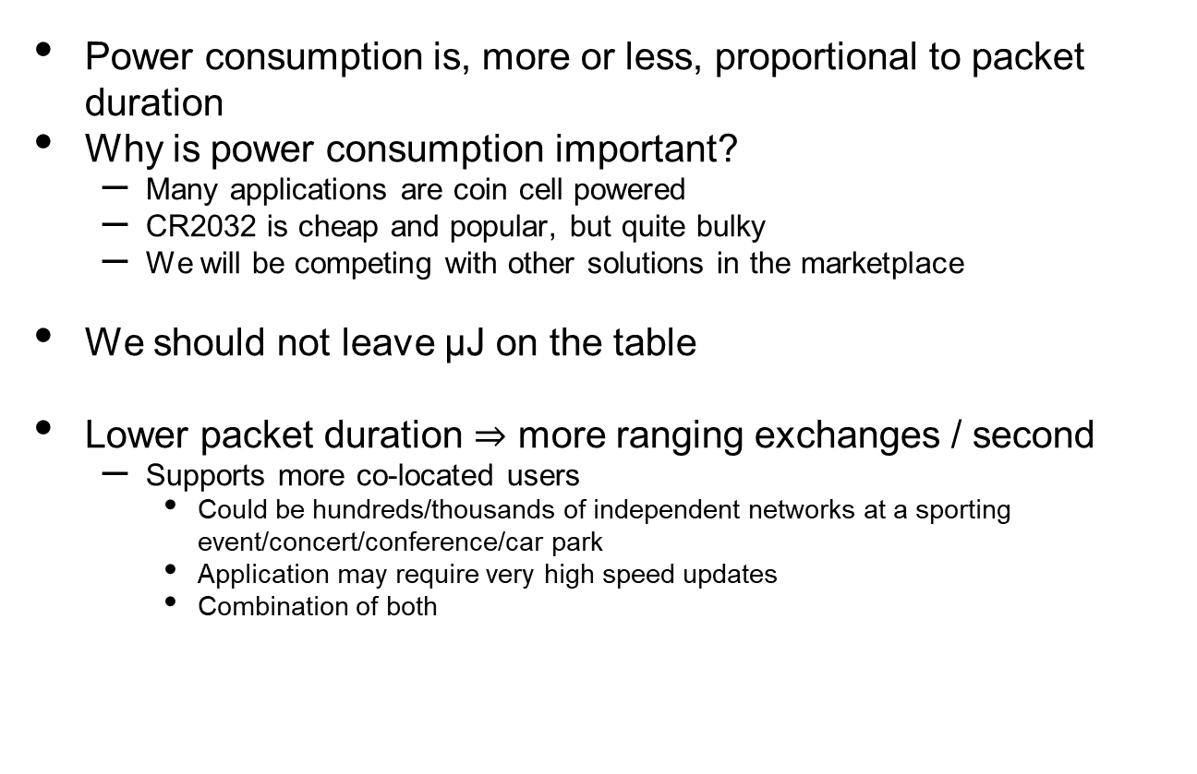
Why is Packet Duration important?
Power consumption is, more or less, proportional to packet duration
Why is power consumption important?
  Many applications are coin cell powered
  CR2032 is cheap and popular, but quite bulky
  We will be competing with other solutions in the marketplace
We should not leave μJ on the table
Lower packet duration $⇒$ more ranging exchanges / second
  Supports more co-located users
    Could be hundreds/thousands of independent networks at a sporting event/concert/conference/car park
    Application may require very high speed updates
    Combination of both

Slide 5
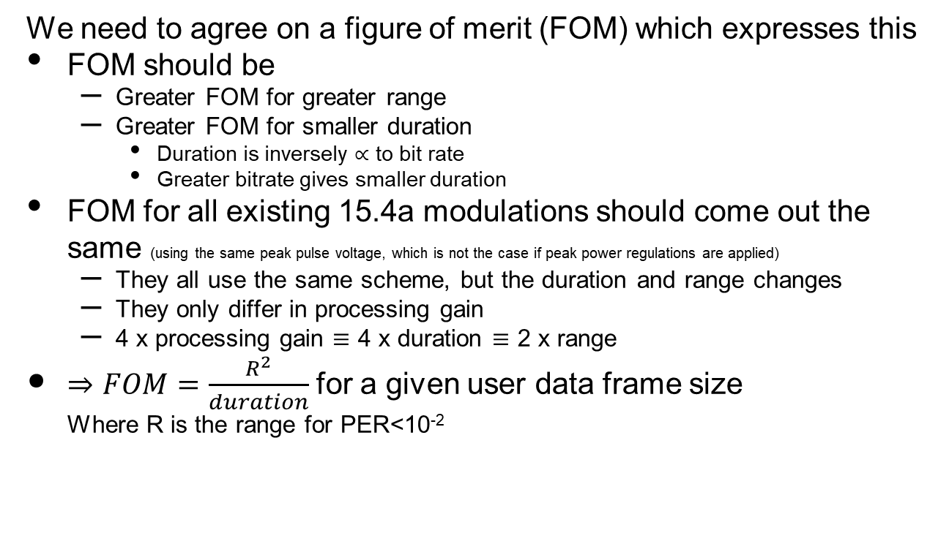
How can we measure this?
We need to agree on a figure of merit (FOM) which expresses this
FOM should be
  Greater FOM for greater range
  Greater FOM for smaller duration
    Duration is inversely $∝$ to bit rate
    Greater bitrate gives smaller duration
FOM for all existing 15.4a modulations should come out the same (using the same peak pulse voltage, which is not the case if peak power regulations are applied)
  They all use the same scheme, but the duration and range changes
  They only differ in processing gain
  4 x processing gain $≡$ 4 x duration $≡$ 2 x range
$⇒FOM=\frac{R^{2}}{duration}$ for a given user data frame size
  Where R is the range for PER<10⁻²

Slide 6
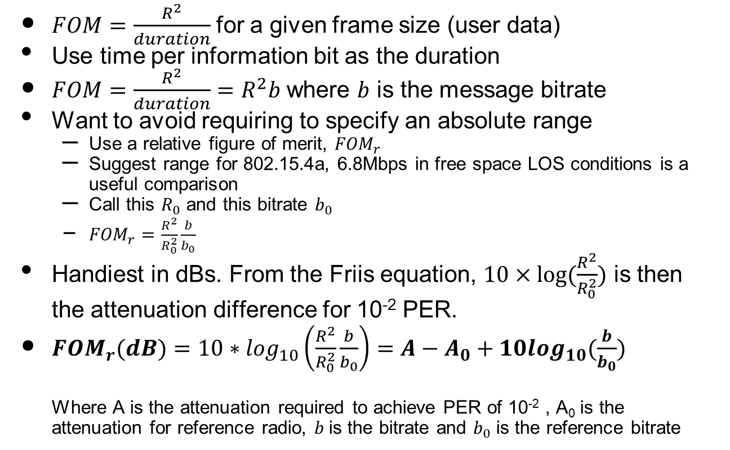
Other ways to express it?
$FOM=\frac{R^{2}}{duration}$ for a given frame size (user data)
Use time per information bit as the duration
$FOM=\frac{R^{2}}{duration}=R^{2}b$ where $b$ is the message bitrate
Want to avoid requiring to specify an absolute range
  Use a relative figure of merit, ${FOM}_{r}$
  Suggest range for 802.15.4a, 6.8Mbps in free space LOS conditions is a useful comparison
  Call this $R_{0}$ and this bitrate $b_{0}$
  ${FOM}_{r}=\frac{R^{2}}{R_{0}^{2}}\frac{b}{b_{0}}$
Handiest in dBs. From the Friis equation, $10×log⁡(\frac{R^{2}}{R_{0}^{2}})$ is then the attenuation difference for 10⁻² PER.
${FOM}_{r}(dB)=10∗\log_{10}\left(\frac{R^{2}}{R_{0}^{2}}\frac{b}{b_{0}}\right)=A−A_{0}+10\log_{10}(\frac{b}{b_{0}})$
  Where A is the attenuation required to achieve PER of 10⁻² , A₀ is the attenuation for reference radio, $b$is the bitrate and $b_{0}$ is the reference bitrate

Slide 7
Some FOMs for various schemes
ABCN 6.8Mbps figure of 2.6dB below is made up of
  Assumes coding gain is the same (Actually 4a concatenated code is ~0.5dB better than K=7 code)
  +3dB because each bit has 16 pulses vs 8 pulses for 4a.
  +0.6dB because rate is 7.8Mbps vs 6.8Mbps
  -1dB because peak pulse voltage of 0.45V vs 0.50V to comply with mean power limit (More pulses / bit)

Slide 8
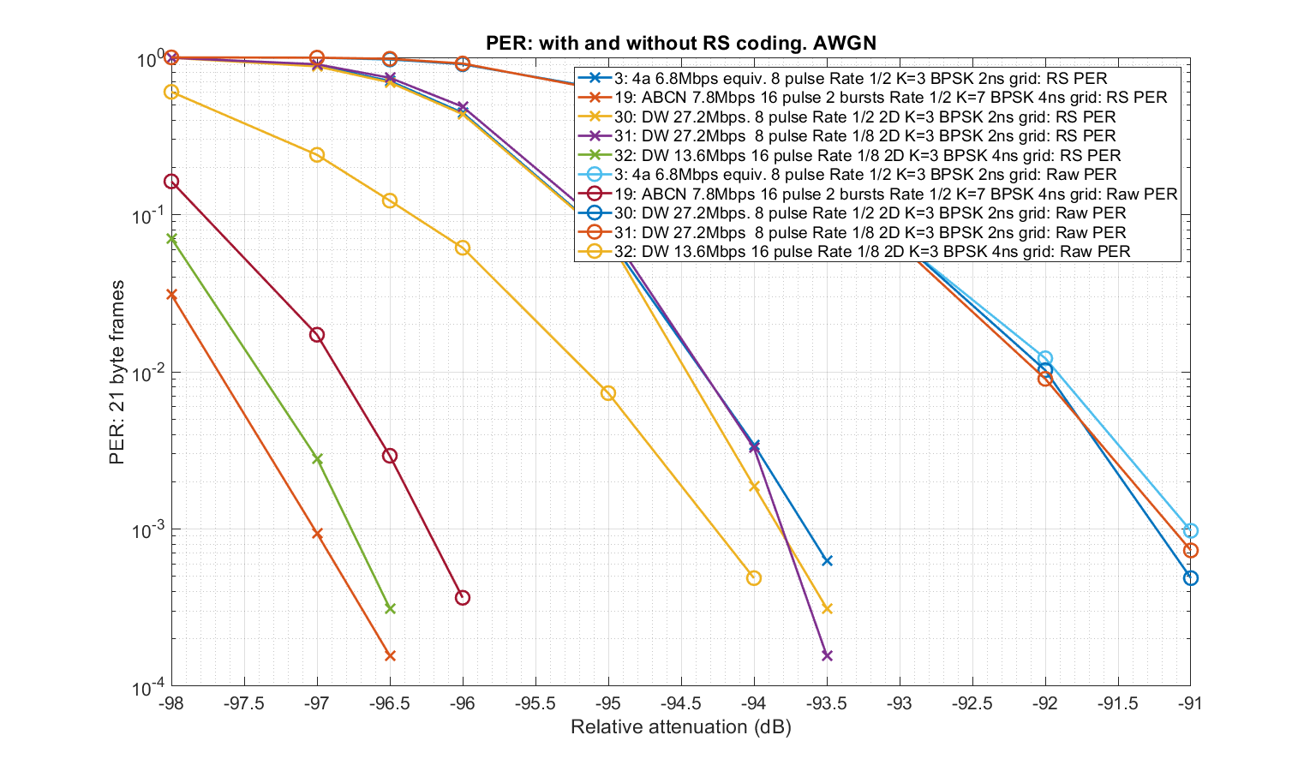
AWGN Packet Error Rates for various schemes

Slide 9
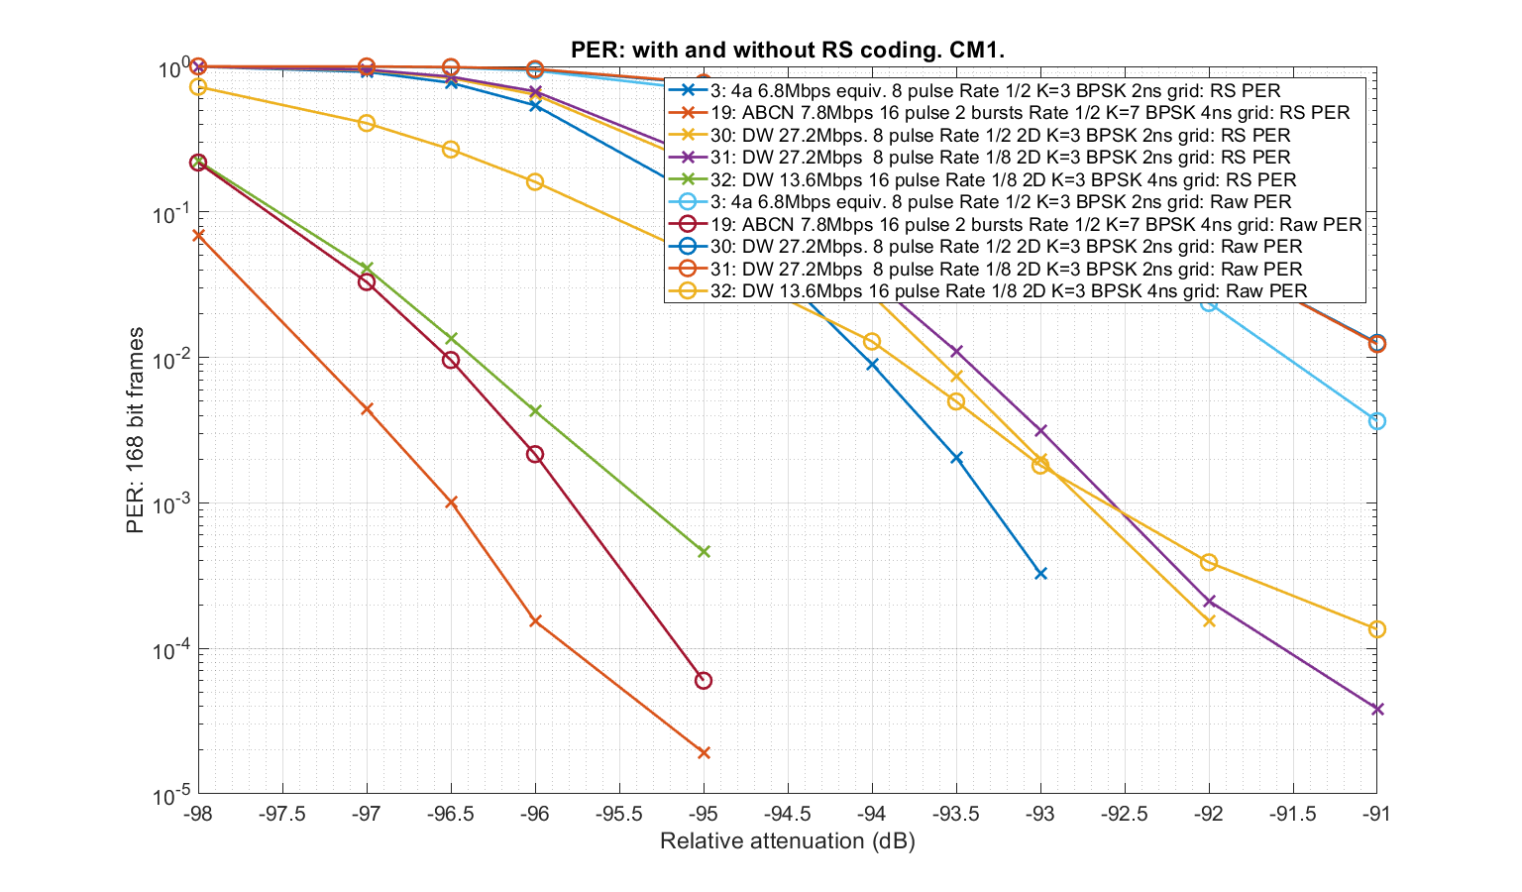
Multipath Packet Error Rates for various schemes

Slide 10
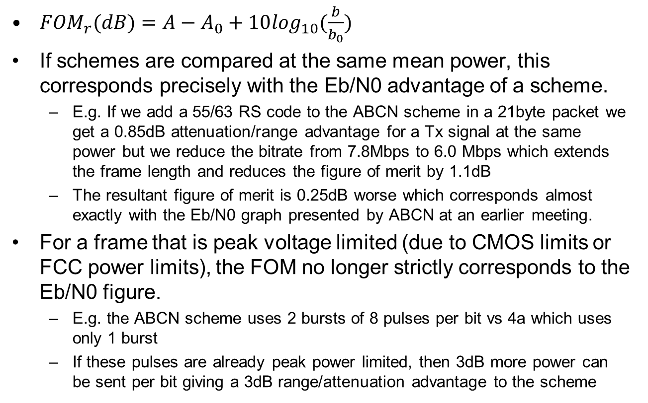
How does the FOM_{r} relate to Eb/N0
${FOM}_{r}(dB)=A−A_{0}+10\log_{10}(\frac{b}{b_{0}})$
If schemes are compared at the same mean power, this corresponds precisely with the Eb/N0 advantage of a scheme.
  E.g. If we add a 55/63 RS code to the ABCN scheme in a 21byte packet we get a 0.85dB attenuation/range advantage for a Tx signal at the same power but we reduce the bitrate from 7.8Mbps to 6.0 Mbps which extends the frame length and reduces the figure of merit by 1.1dB
  The resultant figure of merit is 0.25dB worse which corresponds almost exactly with the Eb/N0 graph presented by ABCN at an earlier meeting.
For a frame that is peak voltage limited (due to CMOS limits or FCC power limits), the FOM no longer strictly corresponds to the Eb/N0 figure.
  E.g. the ABCN scheme uses 2 bursts of 8 pulses per bit vs 4a which uses only 1 burst
  If these pulses are already peak power limited, then 3dB more power can be sent per bit giving a 3dB range/attenuation advantage to the scheme

