Slide 1
Project: IEEE P802.15 Working Group for Wireless Personal Area Networks (WPANs)
Submission Title: [Suggested changes to include channel #3 for enhancing LRP UWB]
Date Submitted: [September, 2018]
Source: [Huan-Bang Li, Kenichi Takizawa, and Fumihide Kojima] Company [NICT, Japan]
[Hisashi Nishikawa] Company[Global Interface Technologies Japan Inc.]
Address [3-4 Hikarino-oka, Yokosuka, Kanagawa, Japan]
[590 Nojiri, Rittoh-shi, Siga, Japan]
Voice:[-], E-Mail:[lee (at) nict.go.jp]
Re: [Proposed changes to IEEE802.15.4-2015 for enhancing LRP UWB PHY]
Abstract: [Contribute a proposal to group 15.4z]
Purpose: [To enhance LRP UWB PHY]
Notice: This document has been prepared to assist the IEEE P802.15. It is offered as a basis for discussion and is not binding on the contributing individual(s) or organization(s). The material in this document is subject to change in form and content after further study. The contributor(s) reserve(s) the right to add, amend or withdraw material contained herein.
Release: The contributor acknowledges and accepts that this contribution becomes the property of IEEE and may be made publicly available by P802.15.

Slide 2
Suggested Changes to Include CH #3 for Enhancing LRP UWB

Slide 3
ToC
Background
Objectives
Suggested changes in detail

Slide 4
Background
In the specifications of LRP UWB in 802.15.4-2015, a 2 GHz-bandwidth channel, CH #2, is defined which can be used in USA, EU, etc.
A large bandwidth provides high precision of time resolution which is of great interest for high precision ranging and locolization.
For global harmonization, it is necessary to include a 2 GHz-bandwidth chanel for countries including Japan that have different UWB regulations from USA and EU.

Slide 5
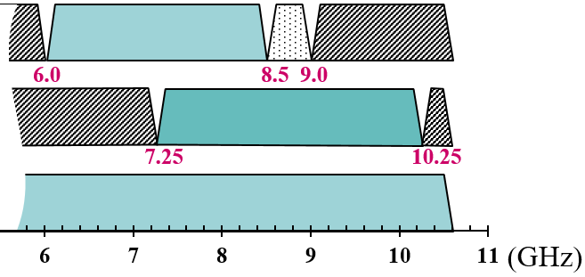
UWB Highband At a Glance
Europe
Japan
USA
-41.3dBm/MHz
-70.0dBm/MHz
-41.3dBm/MHz with DAA

Slide 6
Objectives
In July 2018 meeting, baseline agreement was reached. The group agreed to add a CH #3 for LRP UWB.
The purpose of adding CH #3 is to enable a 2 GHz-bandwidth for operations in Japan, Korea, etc., which is not provided by IEEE802.15.4-2015.
This document suggests necessary changes to be made to include CH #3.

Slide 7
Suggested Changes in Detail
Changes are suggested based on present IEEE802.15.4-2015.
Contents need to be modified are shown in red.
Suggested changes or additions are shown in blue.

Slide 8
Suggested Changes to 10.1.2.7
10.1.2.7 Channel numbering for LRP UWB PHY
The LRP UWB PHY uses channel page 8 with the channel numbers defined in Table10-9. A total of three frequency channels, numbered 0 to 2, are available in the 6289.6 MHz to 9185.6 MHz frequency bands. Different subsets of these frequency channels are available in different regions of the world. In North America and Europe, a shared channel may be used.
10.1.2.7 Channel numbering for LRP UWB PHY
The LRP UWB PHY uses channel page 8 with the channel numbers defined in Table10-9. A total of four frequency channels, numbered 0 to 3, are available in the 6289.6 MHz to 10184.0 MHz frequency bands. Different subsets of these frequency channels are available in different regions of the world. Channel 1 and Channel 2 can be shared in North America and Europe, while Channel 3 can be shared in North America, Japan and Korea.

Slide 9
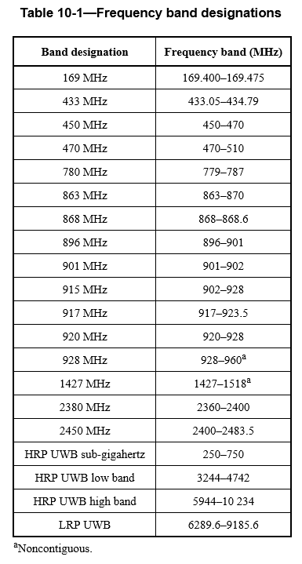
Suggested Changes to Table 10-1
10184.0

Slide 10
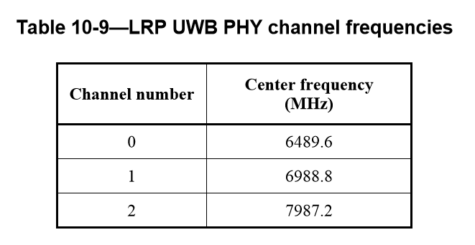
Suggested Changes For Table 10-9
3 | 8486.4
Notes:
19.7.3 LPR UWB PHY PSD mask
IEEE802.15.4-2015

Slide 11
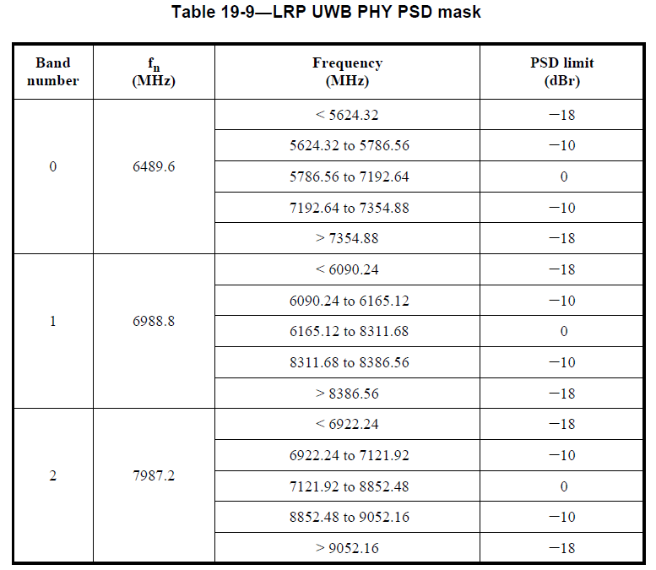
Suggested Changes to Table 19-9
3 | 8486.4 | <7587.84 | -18
 |  | 7587.84 to 7662.72 | -10
 |  | 7662.72 to 9809.28 | 0
 |  | 9809.28 to 9884.16 | -10
 |  | > 9884.16 | -18
Notes:
19.7.3 LPR UWB PHY PSD mask
IEEE802.15.4-2015

Slide 12
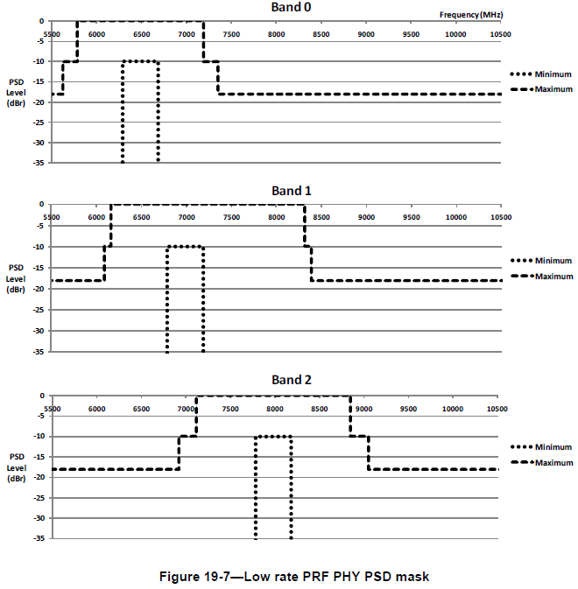


Suggested Changes to Fig. 19-7
Add Band 3

Slide 13
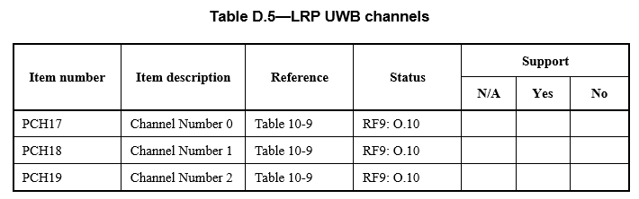
Suggested Changes to Table D.5
PCH20 | Channel Number 3 | Table 10-9 | RF9: O.10

Slide 14
Reference Slides

Slide 15
Harmonization With HRP Band Plan
LRP Band number | HRP Band plan
0 | Ch.7
1 | Ch. 5, 6, 8, 9
2 | Ch.11
3 | Ch. 9, 10, 12, 13

Slide 16
Definition of PSD Mask
19.7.3 Transmit PSD mask
The transmitter shall operate with a power spectral density contained by one of three PSD masks defined in Table19-9 and shown in Figure19-7. The permitted spectral density is defined in dBr relative to the maximum spectral density of the signal, and shall be made using a 1MHz resolution bandwidth and a 1 MHz video bandwidth. Additionally, the upper -10 dBr point of the transmitter PSD shall be at least 200 MHz above a nominal frequency, fn, and the lower -10 dBr point shall be at most 200MHz below the same nominal frequency.

Slide 17
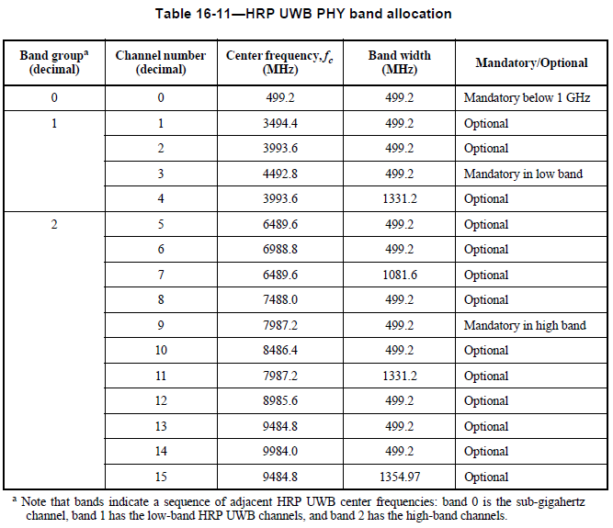
HRP Band Plan

Slide 18
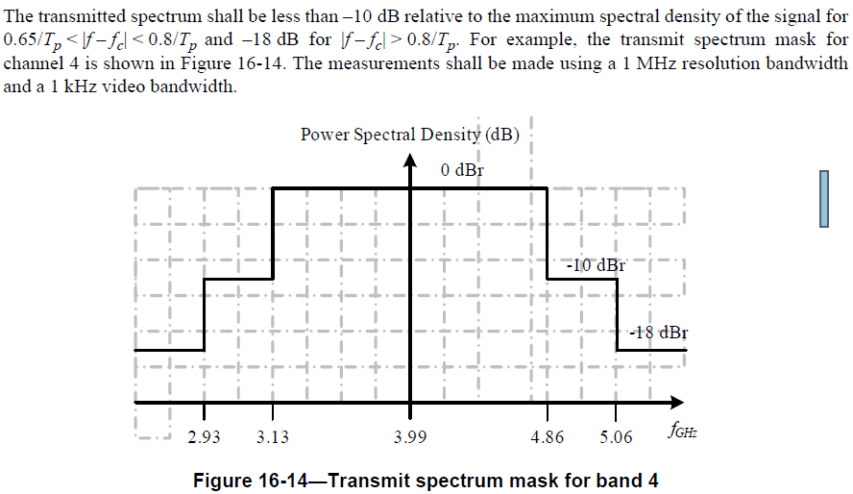
Calculation of PSD Mask
16.4.6 Transmit PSD mask

