Slide 1
Project: IEEE P802.15 Interest Group for Wireless Personal Area Networks (WPANs)
Submission Title: Introduction of new modulation scheme for High-rate Data Stream of Vehicular OWC/OCC System
Date Submitted: August 2018
Source: Minh Duc Thieu, Trang Nguyen and Yeong Min Jang [Kookmin University].
Contact: +82-2-910-5068 E-Mail: yjang@kookmin.ac.kr
Re:
Abstract: Introduce a new modulation scheme for high-rate data stream of OWC/OCC system in V2V/V2I communication
Purpose: To introduce a new modulation scheme for high-rate waveform of OWC/OCC system for V2V/V2I communication.
Notice: This document has been prepared to assist the IEEE P802.15. It is offered as a basis for discussion and is not binding on the contributing individual(s) or organization(s). The material in this document is subject to change in form and content after further study. The contributor(s) reserve(s) the right to add, amend or withdraw material contained herein.
Release: The contributor acknowledges and accepts that this contribution becomes the property of IEEE and may be made publicly available by P802.15.

Slide 2
Introduction of new modulation scheme for High-rate Data Stream of Vehicular OWC/OCC System

Slide 3
Introduction
The next generation of high-rate OCC with an adaptive-RoI ability has its novel feature to be incorporated.
In OCC field, applying hybrid waveform for high-rate OCC system for vehicles can bring the benefits of cost-effectiveness because it allows to achieved high speed data stream while reducing the cost of computation for the systems.
A notable schemes are introduced by IEEE TG7m such as DS8-PSK can be applied for high-rate data stream.

Slide 4
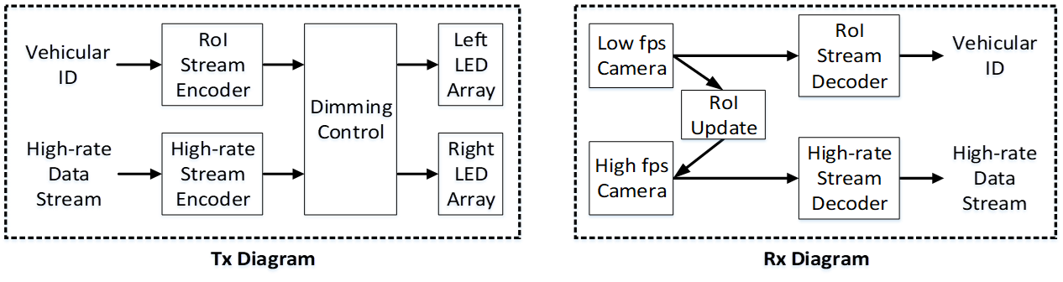
Hybrid waveform for vehicular OWC/OCC system
Two data streams are used in this system
  RoI-signaling waveform: to detect region of interest (RoI) and set up communication link
  High-rate waveform: to transmit high-speed data through this LOS link between two near-by vehicles.
Reference architecture vehicular OWC/OCC system using hybrid waveform [1]

Slide 5
Technical considerations for high-rate data stream
The dimmable waveform is required for high-rate data stream modulation.
  The clock of dimming control for this high-rate communication is synchronized to the clock of the low-rate RoI signaling stream.
  Such a selection of a modulation scheme for high-rate stream must provide acceptable performance under dimming.
The required sampling rate also plays an important role in the proposed system. Particularly, sampling rate determined by high frame-rate camera must follow the Nyquist theorem. The frame rate requirement is not about technical concern but about the economic (cost effective) expense.

Slide 6
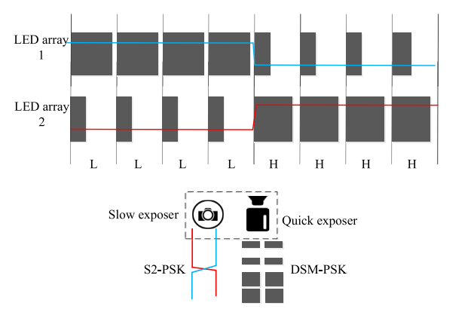
Hybrid-Spatial-Phase-Shift-Keying (HS-PSK)
HS-PSK is the combination of S2-PSK and DS8-PSK
An illustration of HS-PSK waveform [2]

Slide 7
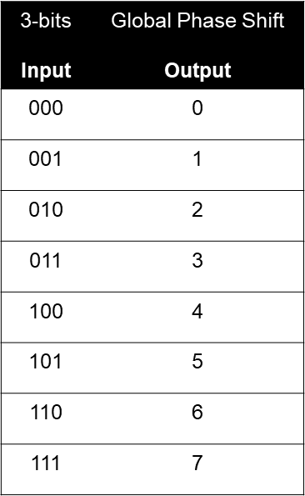
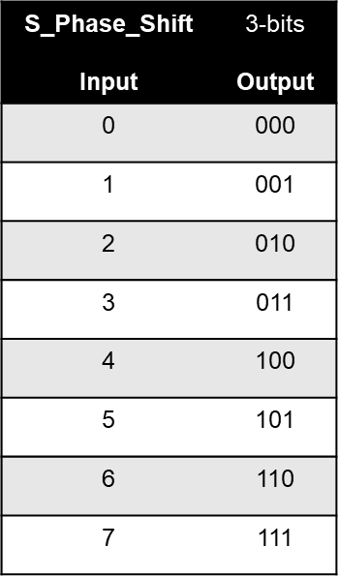
Dimmable-Spatial-8-Phase-Shift-Keying
(DS8-PSK)
8 LEDs per group defined a spatial phase with dimming support
Decoding Tables
(Phase-to-Bits Table)
Encoding Table
Decoding equation:
S_Phase_Shift = S_Phase(data) - S_Phase(reference)

Slide 8
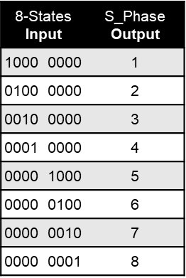
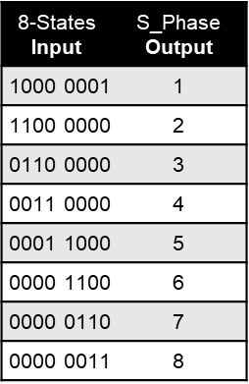
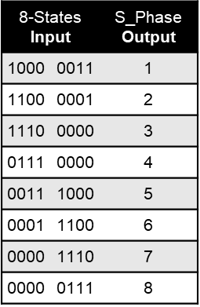
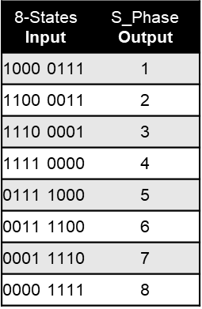
Dimmable-Spatial-8-Phase-Shift-Keying
(DS8-PSK)
S_Phase decoding tables for each dimming levels
1/8 Dimming
2/8 Dimming
3/8 Dimming
4/8 Dimming

Slide 9
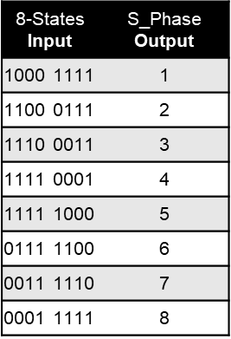
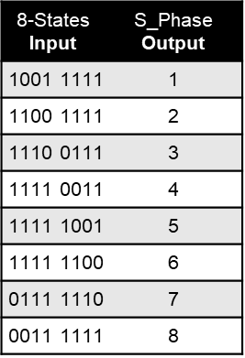
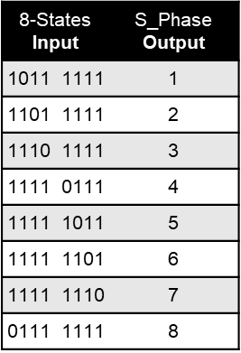
Dimmable-Spatial-8-Phase-Shift-Keying
(DS8-PSK)
S_Phase decoding tables for each dimming levels
5/8 Dimming
6/8 Dimming
7/8 Dimming

Slide 10
Hybrid-Spatial-Phase-Shift-Keying (HS-PSK)
DS8-PSK decoder
An example of decoding DS8-PSK waveform

Slide 11
References
[1] Minh Duc Thieu, Trang Nguyen, Yeong Min Jang, “New Waveforms for Selective-RoI-Signaling High-rate Optical Camera Communication System”, Ubiquitous and Future Networks (ICUFN), July 2018.
[2] T. Nguyen, and et.al., "Current Status and Performance Analysis of Optical Camera Communication Technologies for 5G Networks," IEEE Access, 2017.

