Slide 1
Project: IEEE P802.15 Interest Group for Wireless Personal Area Networks (WPANs)
Submission Title: Technical Considerations of OWC/OCC system for V2V/V2I communication
Date Submitted: September 2018
Source: Minh Duc Thieu, Trang Nguyen and Yeong Min Jang [Kookmin University].
Contact: +82-2-910-5068 E-Mail: yjang@kookmin.ac.kr
Re:
Abstract: General technical considerations of OWC/OCC system for V2V/V2I communication
Purpose: To summary general technical consideration of OWC/OCC system for V2V/V2I communication.
Notice: This document has been prepared to assist the IEEE P802.15. It is offered as a basis for discussion and is not binding on the contributing individual(s) or organization(s). The material in this document is subject to change in form and content after further study. The contributor(s) reserve(s) the right to add, amend or withdraw material contained herein.
Release: The contributor acknowledges and accepts that this contribution becomes the property of IEEE and may be made publicly available by P802.15.

Slide 2
Technical Consideration of Vehicular OWC/OCC System

Slide 3
Introduction
In the context of a safety assistance communication-based solution, OWC is a strong candidate for delivering the V2V communication power to cars. It is realized that the LED lighting is equipped to car mandatorily.
The existence of supportive infrastructure enables the great potential for accepting OWC technology into the vehicle industry. For examples, LED system can support both lighting purpose and communication purpose simultaneously. Therefore, vehicular OCC system has an advantage over current RF system.

Slide 4
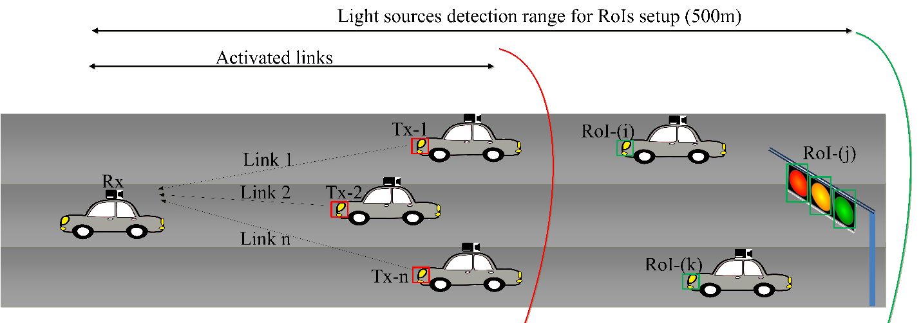
Hybrid waveform for vehicular OWC/OCC system
The next generation of high-rate OCC with an adaptive-RoI ability has its novel feature to be incorporated.
Scenario of V2X communication using OCC with RoI activation

Slide 5
Technical considerations for vehicular OWC/OCC system (1)
Despite the potential of a massive industrial market for vehicular OWC/OCC, this new technology is still challenged by the environmental requirements.
The selection and initialization of interesting links among thousands of possible artificial lights those are objected to eliminate. Rx should be able to detect the active light sources and initialize the communication with an acceptable-short delay.
The ability of camera to support light source detection. Because of the imaging lens, even the best quality camera cannot perfectly focus on all the light sources simultaneously at different distances away from its position.

Slide 6
Technical considerations for vehicular OWC/OCC system (2)
The asynchronous communication mode must be supported for a wider range of applicable usages with the least unidirectional communication.
(For examples, while a car is communicating with its paired car in a private communication mode, the other cars should also be able to identify the two cars and asynchronously receive a minimum data set in a public communication mode for safety assistance)
The communication distance requirement for different traffic conditions is discussed. A required inter-vehicular distance for communication is up to 200 m for highway or rural areas [1].

Slide 7
Technical considerations for vehicular OWC/OCC system (3)
Illumination is still a primary purpose of any light source. So that the quality of modulated light intensity must adhere the industrial light regulars, including the flicker-free requirement. Optical clock rate should be at least 200 Hz for no flicker-free [2].
High-resolution dimming is necessary in particular scenarios. Certainly, the support for dimming is one of the technical consideration in any VLC/LiFi specification, and OCC is not an exception.

Slide 8
References
[1] A.-M. Cailean, and M. Dimian, "Current Challenges for Visible Light Communications Usage in Vehicular Applications: A Survey," IEEE Communications Surveys & Tutorials, 2017.
[2] Sridhar Rajagopal-Samsung Electronics, Richard D. Roberts-Intel and Sang Kyu Lim-ETRI, “IEEE 802.15.7 Visible Light Communication: Modulation and Dimming Support,” IEEE Communication Magazine, March 2012.

