Slide 1
Project: IEEE 802.15 Working Group for Low Power Wide Area Network (LPWAN)
Submission Title: Proposal of New Spectrum for LECIM FSK extension
Date Submitted: September, 2018
Source: Thang Nguyen, Yeong Min Jang, Sangsung Choi*
Company: Kookmin University, Woosong University*
Address
Voice: +82-2-910-5068
FAX: +82-2-910-4449
E-Mail: yjang@kookmin.ac.kr
Re:[]
Abstract: Propose to add a lower data-rate and a narrow band FSK PHY for new spectrum in Korea
Purpose: Extend the IEEE 802.15.4k standard
Notice: This document has been prepared to assist the IEEE 802.15. It is offered as a basis for discussion and is not binding on the contributing individual(s) or organization(s). The material in this document is subject to change in form and content after further study. The contributor(s) reserve(s) the right to add, amend or withdraw material contained herein.
Release: The contributor acknowledges and accepts that this contribution becomes the property of IEEE and may be made publicly available by 802.15.

Slide 2
Background
  802.15 TG4w Scope
  This amendment defines a Low Power Wide Area Network (LPWAN) extension to the IEEE Std 802.15.4 Low Energy, Critical Infrastructure Monitoring (LECIM) PHY layer to cover network cell radii of typically 10-15 km in rural areas. It uses the LECIM PHY Frequency Shift Keying (FSK) modulation schemes with extensions to lower bit-rates (e.g. payload bit-rate typically <30 kb/s). Additionally, it extends the frequency bands to additional sub-GHz unlicensed and licensed frequency bands to cover the market demand. For improved data integrity in channels with high levels of interference, it defines mechanisms for the fragmented transmission of Forward Error Correction (FEC) code-words, as well as time and frequency patterns for the transmission of the fragments. Modifications to the Medium Access Control (MAC) layer, needed to support this PHY extension, are defined.

Slide 3
Overview of Proposal(1)
  Propose to add a lower data-rate(<12.5Kbps) in current FSK LECIM PHY Standard
  Add 6.25Kbps with modulation index 2.0
  It is convenient to change data-rates without changing modulation schemes

Slide 4
Overview of Proposal(2)
  Propose a narrowband FSK LECIM PHY for new spectrum(262 ~ 264MHz) in Korea
  Flexible channel bandwidth (<200KHz) of new spectrum in Korea allows to adapt the narrow band FSK transceivers
  Add 2 low data-rates(2.4, 4.8Kbps) in 262 ~ 264MHz band, which use 12.5KHz channel spacing

Slide 5
Overview of Proposal(3)
  Propose the SFD Sequence spreading/dispreading scheme for reliable packet detection at low SNR
  Current SFD sequence has poor PMR performance at low SNR
  The overall PER performance is limited by PMR performance due to SFD detection failure at low-SNR
  A simple SFD sequence spreading scheme to improve SFD detection performance

Slide 6
Motivations(1)
  The lower data-rates (<12.5Kbps) are very important in the world because they provide many options for extension of communication ranges in IoT services
  Many FSK transceivers are already deployed in the world today
  It is convenient to change data-rates without changing modulation schemes

Slide 7
Motivations(2)
  Recently Korean government allocated 2 unlicensed frequency bands for IoT services, and the IoT market in Korea requires a new narrow band radio transceiver in those frequency bands.
  262~264MHz and 940.1~946.3 MHz bands were allocated in Korea recently.
  Spectrum efficiency of current LECIM is not good in Korea because it must keep the fixed center frequency every 200KHz in 917~923.5MHz
  New spectrum(262~264MHz) is suitable to adapt the narrow band FSK LECIM because it allows flexible channel bandwidth (<200 KHz)

Slide 8
Motivations(3)
  Current SFD detection in FSK LECIM PHY is required to improve the performance because of poor PMR in low SNR
  The overall PER performance is limited by PMR performance due to SFD detection failure at low-SNR.
  Note that LECIM standard includes the reliability enhancing schemes (FEC, spreading) only for PHR+PSDU part.
  It is necessary to improve the reliability of the SFD sequence, which can shift the PMR curve to the left for the successful packet recovery at low-SNR

Slide 9
Extension proposal #1
  Current Data-rates in FSK LECIM(1)
  2 data-rate modes are provides for 169MHz band
  25Kbps with modulation index 0.5
  12.5Kbps with modulation index 0.5
Frequency Band | Parameter | Operating Mode #1 | Operating Mode #2
169MHz | Data-rate | 25kbps | 12.5kbps
 | Modulation | 2-FSK P-FSK | 2-FSK P-FSK
 | Modulation Index | 0.5 | 1.0
 | Channel Spacing

Slide 10
Extension proposal #1
  Current Data-rates in FSK LECIM(2)
  3 data-rate modes are provided for all other bands
  37.5Kbps with modulation index 0.5
  25Kbps with modulation index 1.0
  12.5Kbps with modulation index 2.
  Either 100kHz or 200kHz channel spacing may be used as permitted by local regulations.
Frequency Band | Parameter | Operating Mode #1 | Operating Mode #2 | Operating Mode #3
For all other bands | Data-rate | 37.5kbps | 25kbps | 12.5kbps
 | Modulation | 2-FSK P-FSK | 2-FSK P-FSK | 2-FSK P-FSK
 | Modulation Index | 0.5 | 1.0 | 2.0
 | Channel Spacing | 100/200KHz | 100/200KHz | 100/200KHz

Slide 11
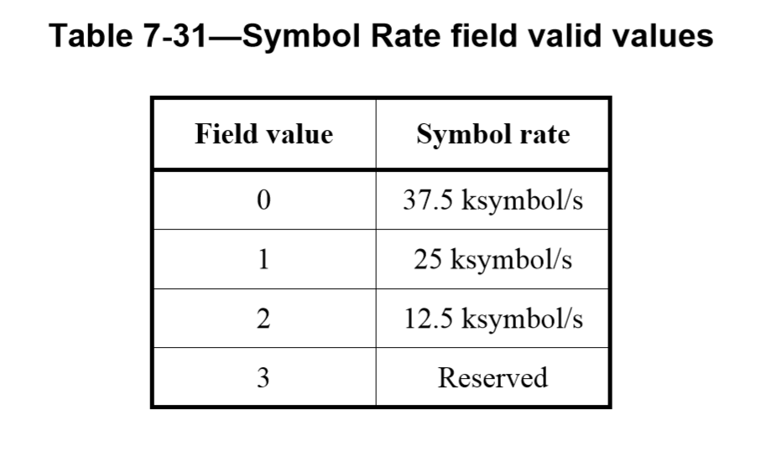
Extension proposal #1
  LECIM FSK Operating Mode IE
  As defined in table 7.31, there is only 1 filed value reserved, add optional PHY as defined in table below

Slide 12
Extension proposal #1
  Additional lower data-rate modes in FSK LECIM PHY
  Add 6.25Kbps with modulation index 2.0
  Expect to improve 3dB of sensitivity compare to 12.5Kbps without changing modulation scheme
Frequency Band | Parameter | Operating Mode #1 | Operating Mode #2 | Operating Mode #3 | Operating Mode #4
For all other bands | Data-rate | 37.5 (kbps) | 25.0 (kbps) | 12.5 (kbps) | 6.25 (kbps)
 | Modulation | 2-FSK P-FSK | 2-FSK P-FSK | 2-FSK P-FSK | 2-FSK P-FSK
 | Modulation Index | 0.5 | 1.0 | 2.0 | 2.0
 | Channel Spacing | 100/200 (KHz) | 100/200 (KHz) | 100/200 (KHz) | 100/200 (KHz)
The nominal frequency deviation, fdev, shall be (symbol rate × modulation index)/2.

Slide 13
Extension proposal #2
  Current spectrum in Korea
  917~923.5MHz Band
  32 channels with channel band width 200KHz (fixed center frequency)
  Different radiated power limits depend on service
    CH.1, 3, 4, 6, 7, 9, 10, 12, 13, 15, 16, 18 ≤ 3mW
    CH. 2, 5, 8, 11, 14, 17, 19, 20~25 ≤ 10mW
    CH. 26 ~ 32 ≤ 25mW
  Must use Duty Cycle or LBT or Frequency Hopping

Slide 14
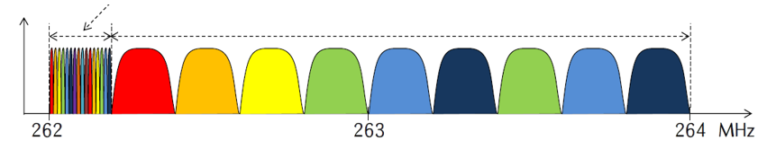
Extension proposal #2
  New spectrum in Korea
  262~264MHz band
  General bandwidth: channel spacing 200 kHz
  Narrow bandwidth: can use channel spacing 12.5 kHz for IoT services
  Must use duty cycle
12.5 KHz/channel * 16 channel
200 KHz/channel * 9 channels

Slide 15
Extension proposal #2
  Propose a narrowband FSK LECIM PHY in 262~ 264MHz
  2 lower data-rates: 2.4kbps and 4.8Kbps
  - 2.4Kbps with modulation index 2.0
  - 4.8Kbps with modulation index 1.0
  12.5KHz channel spacing
Frequency Band | Parameter | Operating Mode #1 | Operating Mode #2
262~264 (MHz) | Data-rate | 2.4kbps | 4.8kbps
 | Modulation | GFSK | GFSK
 | Modulation Index | 2 | 1.0
 | Channel Spacing | 12.5KHz | 12.5KHz

Slide 16
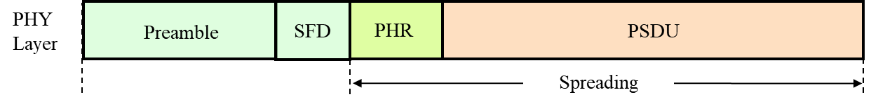
Extension proposal #3
  Packet format in LECIM
  Each packet has a header called a synchronization header (SHR) that performs synchronization, followed by the body of the packet (PHR and PSDU) that contains the data.
  SHR: Preamble & SFD
  Once the SFD contained in SHR is detected, the subsequent recovery process of PHR and PSDU bits can be performed

Slide 17
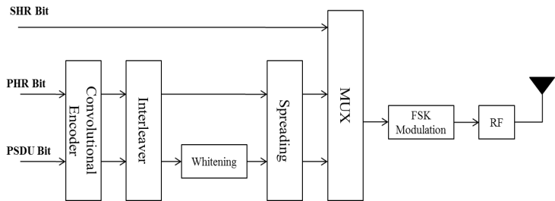
Extension proposal #3
  Synchronization performance at low SNR
  Reliability enhancement techniques apply only PHR and PSDU
  FEC with K=4 and K=7
  Spreading with SF=2,4,8, and 16
  SFD sequence in LECIM fails to ensure reliability at low-SNR
  SFD sequence has a length of 2 or 3 octets designed to reduce the FAR of the packet

Slide 18
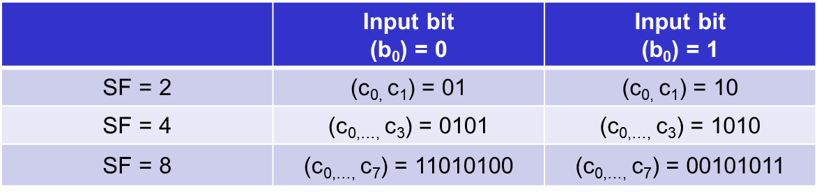
Extension proposal #3
  Propose SFD Spreading/Dispreading scheme
  Apply spreading scheme to the SFD sequence to maintain SHR at a level of similar to the reliability of PHR and PSDU
  This method improves Packet Missing Rate(PMR) performance while maintaining FAR performance
  A single SFD sequence input bit (b₀) is mapped into the SFD sequence spreading bits (c_{0,…,} c_{SF-1})
  - Suggest SF = 2, 4, 8

Slide 19
Extension proposal #3
  Simulation of PER performance(1)
  PER performance consists of PMR and PHR + PSDU error rate
  PMR performance indicates SFD detection failure
  Overall PER includes the PMR as well as the error rate occurring in PHR and PSDU
  PMR performance, is relatively poor and is only 1 dB performance gap compared with error rate of PHR and PSDU
  No FEC and spreading schemes are applied to PHR and PSDU
  Applying optional FEC or spreading schemes to PHR and PSDU
  PHR + PSDU error rate curve shifts the left (e.g. more than 3 dB)
  PMR curve remains the same.
  The overall PER performance is limited by PMR due to SFD detection failure at low-SNR
  SFD detection is required to improve the performance

Slide 20
Extension proposal #3
  Simulation of PER performance(2)

Slide 21
Extension proposal #3
  Simulation results of proposed SFD sequence spreading(1)
  Spreading is applied to the SFD sequence
  Simulation results show that synchronization performance is improved
  SF 4: improve PMR 2.5dB
  SF 8: improve PMR 3.5dB
  The proposed SFD sequence spreading scheme with reliability enhancement schemes (e.g., FEC and spreading) to the PHR and PSDU enables the operating SNR of 10 dB at PER 10⁻²
  It results in an 80 % increase in communication range

Slide 22
Extension proposal #3
  Simulation results of proposed SFD sequence spreading(2)

Slide 23
Conclusions
  Propose to add lower data rates (<12.5 kbps) in LECIM FSK PHY for ISM bands
  Add 6.25Kbps with modulation index 2
  It is convenient to change data-rates without changing modulation schemes
  Propose a narrowband system for new spectrum(262~264MHz) in Korea
  2.4 and 4.8Kbps in 12.5KHz channel spacing
  Satisfy customer’s request in Korean IoT market
  Propose SFD spreading/dispreading scheme
  Spreading is applied to the SFD sequence
  Improve SFD detection performance in low SNR

Slide 24
Abbreviations
LECIM Low Energy Critical Infrastructure Monitoring
GFSK Gaussian Frequency Shift Keying
PHR PHY header
PPDU PHY protocol data unit
PSDU PHY service data unit
SFD Synchronization Frame Delimiter
SHR Synchronization header
ISM Industrial Scientific Medical

Slide 25
References
[1] IEEE Standard for Low-Rate Wireless Personal Area Networks (WPANs)
[2] 802.15.4w Technical Guidance Document; 12 March, 2018; 15-18-0161-00-004w
[3] P802.15.4w PAR
[4] P802.15.4w CSD

