Slide 1
Project: IEEE 802.15 Working Group for Low Power Wide Area Network (LPWAN)
Submission Title: Proposal of New Spectrum for LECIM FSK extension
Date Submitted: September, 2018
Source: Thang Nguyen, Yeong Min Jang, Sangsung Choi*
Company: Kookmin University, Woosong University*
Address
Voice: +82-2-910-5068
FAX: +82-2-910-4449
E-Mail: yjang@kookmin.ac.kr
Re:[]
Abstract: Propose to add a lower data-rate and a narrow band FSK PHY for new spectrum in Korea
Purpose: Extend the IEEE 802.15.4k standard
Notice: This document has been prepared to assist the IEEE 802.15. It is offered as a basis for discussion and is not binding on the contributing individual(s) or organization(s). The material in this document is subject to change in form and content after further study. The contributor(s) reserve(s) the right to add, amend or withdraw material contained herein.
Release: The contributor acknowledges and accepts that this contribution becomes the property of IEEE and may be made publicly available by 802.15.
Notes:
This document was contributed by Kookmin University, Woosong University
My name is Thang Nguyen, I am represented for the presentation today

Slide 2
Background
  802.15 TG4w Scope
  This amendment defines a Low Power Wide Area Network (LPWAN) extension to the IEEE Std 802.15.4 Low Energy, Critical Infrastructure Monitoring (LECIM) PHY layer to cover network cell radii of typically 10-15 km in rural areas. It uses the LECIM PHY Frequency Shift Keying (FSK) modulation schemes with extensions to lower bit-rates (e.g. payload bit-rate typically <30 kb/s). Additionally, it extends the frequency bands to additional sub-GHz unlicensed and licensed frequency bands to cover the market demand. For improved data integrity in channels with high levels of interference, it defines mechanisms for the fragmented transmission of Forward Error Correction (FEC) code-words, as well as time and frequency patterns for the transmission of the fragments. Modifications to the Medium Access Control (MAC) layer, needed to support this PHY extension, are defined.
Notes:
First of all is an overview of IEEE 802.15.4w.
This amendment defines an extension to the IEEE 802.15.4 -Low Energy, Critical Infrastructure Monitoring (LECIM) PHY layer
To cover network of typically 10-15 km in rural areas. It uses the LECIM PHY FSK modulation schemes with payload bit-rate typically <30 kb/s

Slide 3
Overview of Proposal(1)
  Propose to add a lower data-rate(<12.5Kbps) in current FSK LECIM PHY Standard
  Add 6.25Kbps with modulation index 2.0
  It is convenient to change data-rates without changing modulation schemes
Notes:
- Narrowband systems are defined as having less than 25 kHz bandwidth and provide an excellent link budget due to low in-band receive noise (narrow receive filters remove most of the noise), 12.5-kHz channel
spacing is commonly used
Narrowband technique for long range and reasonably low date rate is widely accepted by the industry since it gives the optimum tradeoff between range and the transmission time and Optimize spectrum efficiency.
- The bandwidth used is big and the data rate low (i.e. time on-air is long), there is a high probability of collision with many narrowband interferers

Slide 4
Overview of Proposal(2)
  Propose a narrowband FSK LECIM PHY for new spectrum(262 ~ 264MHz) in Korea
  Flexible channel bandwidth (<200KHz) of new spectrum in Korea allows to adapt the narrow band FSK transceivers
  Add 2 low data-rates(2.4, 4.8Kbps) in 262 ~ 264MHz band, which use 12.5KHz channel spacing
Notes:
- Narrowband systems are defined as having less than 25 kHz bandwidth and provide an excellent link budget due to low in-band receive noise (narrow receive filters remove most of the noise), 12.5-kHz channel
spacing is commonly used
Narrowband technique for long range and reasonably low date rate is widely accepted by the industry since it gives the optimum tradeoff between range and the transmission time and Optimize spectrum efficiency.
The bandwidth used is big and the data rate low (i.e. time on-air is long), there is a high probability of collision with many narrowband interferers
low-complexity and low-power consumption

Slide 5
Overview of Proposal(3)
  Propose the SFD Sequence spreading/dispreading scheme for reliable packet detection at low SNR
  Current SFD sequence has poor PMR performance at low SNR
  The overall PER performance is limited by PMR performance due to SFD detection failure at low-SNR
  A simple SFD sequence spreading scheme to improve SFD detection performance
Notes:
- Narrowband systems are defined as having less than 25 kHz bandwidth and provide an excellent link budget due to low in-band receive noise (narrow receive filters remove most of the noise), 12.5-kHz channel
spacing is commonly used
Narrowband technique for long range and reasonably low date rate is widely accepted by the industry since it gives the optimum tradeoff between range and the transmission time and Optimize spectrum efficiency.
- The bandwidth used is big and the data rate low (i.e. time on-air is long), there is a high probability of collision with many narrowband interferers

Slide 6
Motivations(1)
  The lower data-rates (<12.5Kbps) are very important in the world because they provide many options for extension of communication ranges in IoT services
  - Many FSK transceivers are already deployed in the world today
  - It is convenient to change data-rates without changing modulation schemes
Notes:
The drawback of a narrowband system has traditionally been the higher requirements on the RF crystal. A frequency error on the RF crystal leads to an offset on the programmed RF frequency. If the offset gets too big, the signal will fall outside the channel, and be filtered out by the strong receive filters
- Legacy narrowband systems typically use temperature-controlled oscillators (TCXOs). These have been more expensive than standard crystals, but the difference has been drastically reduced

Slide 7
Motivations(2)
  Recently Korean government allocated 2 unlicensed frequency bands for IoT services, and the IoT market in Korea requires a new narrow band radio transceiver in those frequency bands.
  262~264MHz and 940.1~946.3 MHz bands were allocated in Korea recently.
  Spectrum efficiency of current LECIM is not good in Korea because it must keep the fixed center frequency every 200KHz in 917~923.5MHz
  New spectrum(262~264MHz) is suitable to adapt the narrow band FSK LECIM because it allows flexible channel bandwidth (<200 KHz)
Notes:
The drawback of a narrowband system has traditionally been the higher requirements on the RF crystal. A frequency error on the RF crystal leads to an offset on the programmed RF frequency. If the offset gets too big, the signal will fall outside the channel, and be filtered out by the strong receive filters
- Legacy narrowband systems typically use temperature-controlled oscillators (TCXOs). These have been more expensive than standard crystals, but the difference has been drastically reduced

Slide 8
Motivations(3)
  Current SFD detection in FSK LECIM PHY is required to improve the performance because of poor PMR in low SNR
  The overall PER performance is limited by PMR performance due to SFD detection failure at low-SNR.
  Note that LECIM standard includes the reliability enhancing schemes (FEC, spreading) only for PHR+PSDU part.
  It is necessary to improve the reliability of the SFD sequence, which can shift the PMR curve to the left for the successful packet recovery at low-SNR
Notes:
The drawback of a narrowband system has traditionally been the higher requirements on the RF crystal. A frequency error on the RF crystal leads to an offset on the programmed RF frequency. If the offset gets too big, the signal will fall outside the channel, and be filtered out by the strong receive filters
- Legacy narrowband systems typically use temperature-controlled oscillators (TCXOs). These have been more expensive than standard crystals, but the difference has been drastically reduced

Slide 9
Current Data-rates in FSK LECIM
  2 data-rate modes are provides for 169MHz band
  25Kbps with modulation index 0.5
  12.5Kbps with modulation index 0.5
Frequency Band | Parameter | Operating Mode #1 | Operating Mode #2
169MHz | Data-rate | 25kbps | 12.5kbps
 | Modulation | 2-FSK P-FSK | 2-FSK P-FSK
 | Modulation Index | 0.5 | 1.0
 | Channel Spacing
Notes:
- 169-MHz wireless M-bus (wM-Bus) standard for metering applications in Europe. For wM-Bus, 169-MHz narrowband was chosen to get maximum range for water and gas meters to enable fixed network deployments with very few concentrators.

Slide 10
Current Data-rates in FSK LECIM
  3 data-rate modes are provided for all other bands
  37.5Kbps with modulation index 0.5
  25Kbps with modulation index 1.0
  12.5Kbps with modulation index 2.0
Frequency Band | Parameter | Operating Mode #1 | Operating Mode #2 | Operating Mode #3
For all other bands | Data-rate | 37.5kbps | 25kbps | 12.5kbps
 | Modulation | 2-FSK P-FSK | 2-FSK P-FSK | 2-FSK P-FSK
 | Modulation Index | 0.5 | 1.0 | 2.0
 | Channel Spacing | 100/200KHz | 100/200KHz | 100/200KHz
  Either 100kHz or 200kHz channel spacing may be used as permitted by local regulations.
Notes:
- 169-MHz wireless M-bus (wM-Bus) standard for metering applications in Europe. For wM-Bus, 169-MHz narrowband was chosen to get maximum range for water and gas meters to enable fixed network deployments with very few concentrators.

Slide 11
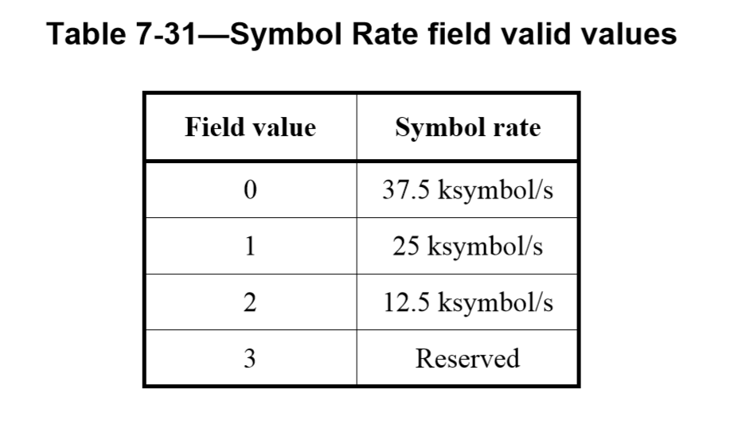
LECIM FSK Operating Mode IE
  As defined in table 7.31, there is only 1 filed value reserved, add optional PHY as defined in table below
Notes:
- add optional PHYs as defined in table below
As defined in table 7-31 Symbol Rate field valid values for LECIM FSK, there is only 1 field value reserved

Slide 12
Extension proposal #1
  Additional lower data-rate modes in FSK LECIM PHY
  Add 6.25Kbps with modulation index 2.0
  Expect to improve 3dB of sensitivity compare to 12.5Kbps without changing modulation scheme
Frequency Band | Parameter | Operating Mode #1 | Operating Mode #2 | Operating Mode #3 | Operating Mode #4
For all other bands | Data-rate | 37.5 (kbps) | 25.0 (kbps) | 12.5 (kbps) | 6.25 (kbps)
 | Modulation | 2-FSK P-FSK | 2-FSK P-FSK | 2-FSK P-FSK | 2-FSK P-FSK
 | Modulation Index | 0.5 | 1.0 | 2.0 | 2.0
 | Channel Spacing | 100/200 (KHz) | 100/200 (KHz) | 100/200 (KHz) | 100/200 (KHz)
The nominal frequency deviation, fdev, shall be (symbol rate × modulation index)/2.
Notes:
- add optional PHYs as defined in table below
As defined in table 7-31 Symbol Rate field valid values for LECIM FSK, there is only 1 field value reserved

Slide 13
Extension proposal #2
  Current spectrum in Korea
  917~923.5MHz Band
  32 channels with channel band width 200KHz (fixed center frequency)
  Different radiated power limits depend on service
    CH.1, 3, 4, 6, 7, 9, 10, 12, 13, 15, 16, 18 ≤ 3mW
    CH. 2, 5, 8, 11, 14, 17, 19, 20~25 ≤ 10mW
    CH. 26 ~ 32 ≤ 25mW
  Must use Duty Cycle or LBT or Frequency Hopping
Notes:
Narrowband system in 262~264MHz

Slide 14
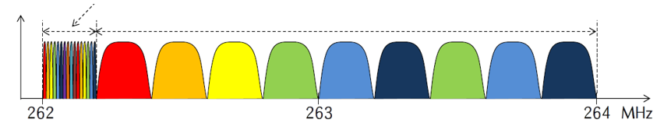
Extension proposal #2
  New spectrum in Korea
  262~264MHz band
  General bandwidth: channel spacing 200 kHz
  Narrow bandwidth: can use channel spacing 12.5 kHz for IoT services
  Must use duty cycle
12.5 KHz/channel * 16 channel
200 KHz/channel * 9 channels
Notes:
- The functional block diagram is provided as a reference for specifying the GFSK PHY modulation and spreading functions

Slide 15
Extension proposal #2
  Propose a narrowband FSK LECIM PHY in 262~ 264MHz
  2 lower data-rates: 2.4kbps and 4.8Kbps
  - 2.4Kbps with modulation index 2.0
  - 4.8Kbps with modulation index 1.0
  12.5KHz channel spacing
Frequency Band | Parameter | Operating Mode #1 | Operating Mode #2
262~264 (MHz) | Data-rate | 2.4kbps | 4.8kbps
 | Modulation | GFSK | GFSK
 | Modulation Index | 2 | 1.0
 | Channel Spacing | 12.5KHz | 12.5KHz
Notes:
Parameter Narrowband Coded wideband
Spectrum efficiency High Very Low
Protection against other channels 65 dB (market leading) 10–20 dB (very poor)
Preamble / leader sequence length Short, down to 4 bit Very long, typically 10s to 100s of Bytes
Battery efficiency Good, TX and RX dominated by payload data Low, TX and RX dominated by leader sequence
Availability Multi-vendor, proven technology Single source, proprietary, locked IP

Slide 16
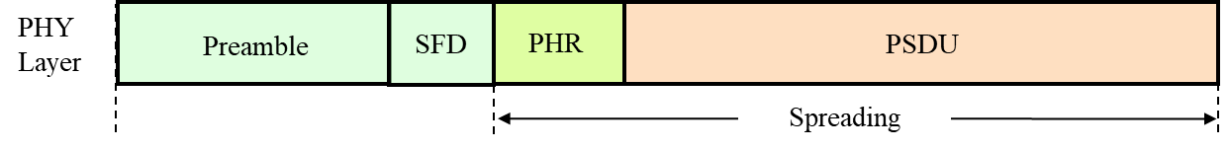
Extension proposal #3
  Packet format in LECIM
  Each packet has a header called a synchronization header (SHR) that performs synchronization, followed by the body of the packet (PHR and PSDU) that contains the data.
  - SHR: Preamble & SFD
  - Once the SFD is detected, the subsequent recovery process of PHR and PSDU bits can be performed
Notes:
Selectively used for enhanced reliability
Apply to (PHR+PSDU)
Spreading gain: dependent on spreading factor

Slide 17
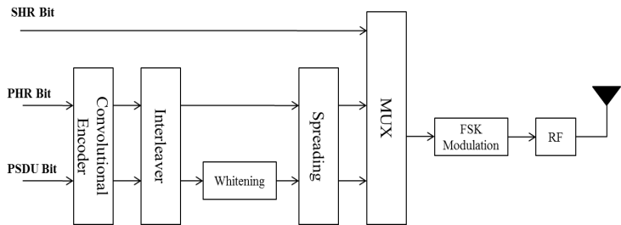
Extension proposal #3
  Synchronization performance at low SNR
  The SFD sequence in LECIM standards fails to ensure reliability at low-SNR
  PHR and PSDU are protected by FEC and spreading schemes
  - Reliability enhancement techniques apply only PHR and PSDU
  .
Notes:
- Incorporating service requirements for IoT service (the transmission rate ranges from a few Kbps to several hundred Kbps, the data size in one packet is more than 100 bytes, the distance ranging from several hundred meters to a few kilometer), we propose a narrowband FSK physical layer integrating 15.4g SUN and 15.4k LECIM standards as shown in figure

Slide 18
Extension proposal #3
  PER performance consists of PMR and PHR + PSDU error rate
  No FEC and spreading schemes are applied to PHR and PSDU.
  SFD sequence have poor PMR performance in low SNR
  SFD detection is required to improve the performance
Notes:
First of all, we conduct simulation to check the PER performance when the transmitter in Fig. 1 is used
The bit rate is 1/T = 50 KHz frequency deviation f_{d} = 25 KHz modulation index h = 1 The length of PSDU is 100 byte for various IoT applications SFD sequence of 0x904E as in SUN standard
Figure 2 shows PER performance that consists of PMR and PHR + PSDU error rate, where no FEC and spreading schemes are applied to PHR and PSDU
It is observed that SFD detection performance i.e., PMR performance, is relatively poor and is only 1 dB performance gap compared with error rate of PHR and PSDU

Slide 19
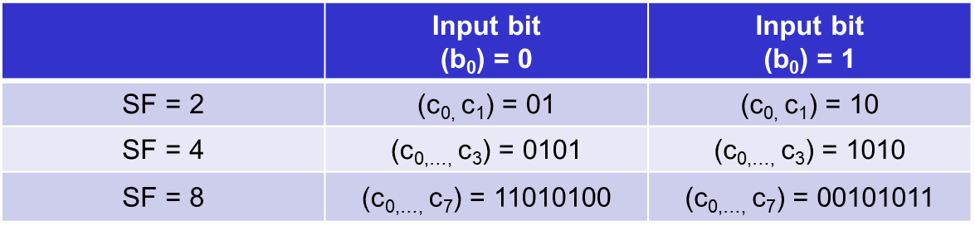
Extension proposal #3
  Propose to change SFD Spreading/Dispreading scheme
  Apply spreading scheme to the SFD sequence to maintain SHR at a level of similar to the reliability of PHR and PSDU
  - It leads to lowered packet missing rate at low-SNR
  - A single SFD sequence input bit (b₀) is mapped into the SFD sequence spreading bits (c_{0,…,} c_{SF-1})
  - Suggest SF = 2, 4, 8
Notes:
Accordingly, we propose a simple SFD sequence spreading scheme to improve SFD detection performance. Table II represents an input SFD sequence bit to SFD spreading bits mapping
A single SFD sequence input bit (c₀) is mapped into the SFD sequence spreading bits (c₀,…,c_{SF-1}). Theoretically, spreading with a larger spreading factor (SF) gives better performance gain when detecting the SFD sequence
We suggest only three spreading factors of 2, 4, and 8 as in Table to reduce transmission overhead due to extended synchronization header with SFD sequence spreading

Slide 20
Extension proposal #3
  Simulation results of proposed SFD sequence spreading
  SF 4: improve PMR 2.5dB
  SF 8: improve PMR 3.5dB
  SF 16: No performance improvement compared to SF 8
Notes:
Figure depicts the PMR performance at various SFs, where the SF 4 achieves 2.5 dB gain and SF 8 3.5 dB gain compared with no spreading case of SF 1
It means that the proposed SFD sequence spreading scheme with reliability enhancement schemes to the PHR and PSDU enables the operating SNR of 10 dB at PER 10⁻², which results increase in communication range
the case of SF 2 is omitted from the simulation since no gain occurs due to hard decision based de-spreading scheme

Slide 21
Conclusions
  Propose to add lower data rates (<12.5 kbps) in LECIM FSK PHY for ISM bands
  Add 6.25Kbps without changing modulation scheme
  Propose a narrowband system for new spectrum(262~264MHz) in Korean
  Satisfy customer’s request in Korean IoT market
  2.4 and 4.8Kbps in 12.5KHz channel spacing
  Propose to change SFD spreading/dispreading scheme
  FEC & Spread: Propose PHR + PSDU
  Improve SFD detection performance
Notes:
A narrowband FSK physical layer and its synchronization header for enhanced synchronization are proposed for IoT applications requiring LPWA connectivity
Simulation results show that synchronization performance is improved, which makes our design widely applicable for IoT services requiring LPWA connectivity.

Slide 22
Abbreviations
LECIM Low Energy Critical Infrastructure Monitoring
GFSK Gaussian Frequency Shift Keying
PHR PHY header
PPDU PHY protocol data unit
PSDU PHY service data unit
SFD Synchronization Frame Delimiter
SHR Synchronization header
ISM Industrial Scientific Medical

Slide 23
References
[1] IEEE Standard for Low-Rate Wireless Personal Area Networks (WPANs)
[2] 802.15.4w Technical Guidance Document; 12 March, 2018; 15-18-0161-00-004w
[3] P802.15.4w PAR
[4] P802.15.4w CSD

