Slide 1
Project: IEEE P802.15 Working Group for Wireless Personal Area Networks (WPANs)
Submission Title: IEEE P802.15.13 MAC layer support for MIMO and adaptive bitloading-------------------
Date Submitted: 10 Sep. 2018
Source: Kai Lennert Bober, Volker Jungnickel [Fraunhofer HHI]
Address: Einsteinufer 37, 10587 Berlin, Germany
Voice:[+49-30-31002 302], E-Mail:[kai.lennert.bober@hhi.fraunhofer.de]
Voice:[+49-30-31002 768], E-Mail:[volker.jungnickel@hhi.fraunhofer.de]
Re:
Abstract:
Purpose: Contribution to IEEE 802.15.13
Notice: This document has been prepared to assist the IEEE P802.15. It is offered as a basis for discussion and is not binding on the contributing individual(s) or organization(s). The material in this document is subject to change in form and content after further study. The contributor(s) reserve(s) the right to add, amend or withdraw material contained herein.
Release: The contributor acknowledges and accepts that this contribution becomes the property of IEEE and may be made publicly available by P802.15.

Slide 2
IEEE P802.15.13 MAC layer support for MIMO and Adaptive Bitloading
Date: 2018-09-10 Place: Waikoloa, Hawaii
Authors:

Slide 3
Content
This doc. contains proposals for MAC layer support of
i) MU-MIMO with distributed optical frontends and
ii) adaptive bit-loading
in 802.15.13 D4.

Slide 4
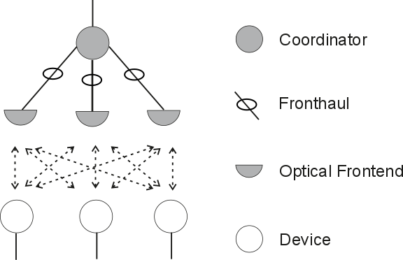
MU MIMO with distributed optical FEs
Use of multiple distributed optical frontends (OFEs) with a single coordinator as MU-MIMO system.
Delay difference compensation for multiple OFEs
Control signaling for MU MIMO

Slide 5
1a) Delay differences: Example
Assume digital fronthaul e.g. over Ethernet using PTP
Light networks are small, e.g. 10-100 m*5 ns/m=50-500 ns fronthaul delay
PTP = Precision time protocol IEEE 1588v2
PTP packets get high priority, accuracy is <<1 µs in stationary scenarios ^{1,2}
Fronthaul+prop. delay+PTP accuracy < long CP or synch seq. length
LB PHY @ 32 MHz: CP = 160 samples*31,25 ns = 4.8 µs
HB PHY: CP = 1.28 µs
PM PHY @ 200 MHz: synch sequence length = 384 samples*5 ns = 1.92 µs
Obviously, all delays together less than long CP/synch sequence length
Precise fronthaul alignment can be achieved over the air
1 L. Cosart, "Precision Packet Delay Measurements Using IEEE 1588v2," 2007 IEEE Int. Symp. on Precision Clock Synchronization for Measurement, Control and Communication, Vienna, 2007, pp. 85-91.
² R. L. Scheiterer, C. Na, D. Obradovic, G. Steindl, F.-J. Goetz, „Synchronization Performance of the Precision Time Protocol in the Face of Slave Clock Frequency Drift,” 4th IEEE Conference on Automation Science and Engineering, Key Bridge Marriott, Washington DC, USA, August 23-26, 2008

Slide 6
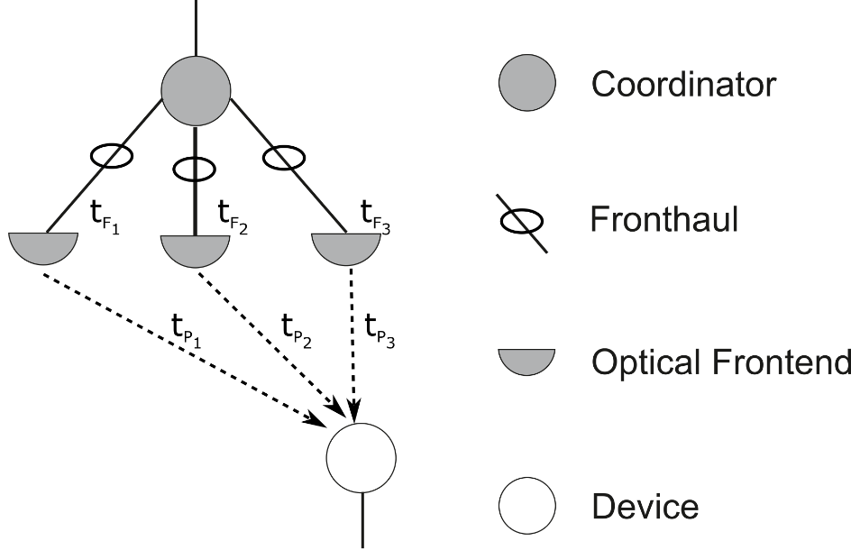
1a) Delay difference compensation: Problem
Optical frontends (OFE) have to be time-aligned
Fronthaul protocol, if any, is transparent for OWC
Fronthaul is analog or digital but implies a certain delay
Coordinator compensates the remaining delay differences at each OFE
Situation:
System is switched on
E.g. PTP is applied
There is individual time error t_{F1}, t_{F2}, t_{F3} at each OFE
There is individual propagation delay t_{P1}, t_{P2}, t_{P3} from each OFE
Overall delay spread is < 1µs

Slide 7
1a) Time alignment: Proposed solution
Proposed solution:
Measure individual delay differences over the air
Inform the coordinator about the delay differences
Correct them with variable FIFO delay buffer in each OFE
Proposal:
Beacon uses long-enough (>1 µs) CP for channel estimation, header, optional fields and payload
Beacon contains orthogonal sequences for MIMO in optional fields
Device performs multi-cell channel estimation for all OFEs
Device sends CIRs for all visible OFEs in association request or CFP (CSI feedback)
Coordinator corrects the delay difference in each OFE accordingly

Slide 8
1b) Downlink MIMO Operation (clause 5.1.12.3)
Beacon is jointly transmitted via all OFEs
Delay difference measurement is supported using MIMO reference signals
OFEs are identified by different MIMO reference signals
Device performs multi-cell channel estimation for each OFE
Device provides feedback of channel state information (CSI) per visible OFE to coordinator, CSI can be significantly compressed (see next slide)
Coordinator applies delay difference compensation at each OFE
Coordinator
Beacon + multi-cell channel estimation symbols
CSI feedback
Device

Slide 9
1b) Adaptive CSI feedback compression
L. Schulz, K. Manolakis and V. Jungnickel, "Adaptive Feedback Compression for Joint Transmission Coordinated Multi-Point," 2013 IEEE 77th Vehicular Technology Conference (VTC Spring), Dresden, 2013
Select visible OFEs
Transform channel from frequency to time domain → reconstruct the CIR
Select non-zero taps based on noise- and interference dependent threshold
Quantize the amplitude on each non-zero tap
Use fixed or variable quantization, variable depends on the SINR

Slide 10
1b) MIMO CSI feedback format
Time-domain feedback for all visible OFEs
For each tap amplitude, adaptive quantization is used (may be fixed)
Impulse response feedback format ³ :
OFE index denotes source OFE
Step size and quant. bits describe adaptive quantization
Delay vector is bitmap, is 1 at position l if l^{th} tap is non-zero, else 0
L=sum(Delay vector) is number of no-zero taps in the CIR
Taps contains amplitude of L taps, quantized with B bits depth
3 L. Schulz et al., "Adaptive Feedback Compression for Joint Transmission Coordinated Multi-Point," 2013 IEEE 77th VTS, Dresden, 2013.
4 In case of PM PHY, just amplitude is used. For HB OFDM PHY, taps are complex numbers with in-phase and quadrature components
Bits: 8 | 12 | 3 | Max. taps | B*L(*2) ⁴
OFE index | step size | quant. Bits (B) | delay vector | taps

Slide 11
2) Adaptive Bit-Loading (5.1.12.2)
Adaptive bit-loading is used together with HB OFDM PHY.
A runtime bit allocation table (BAT) is negotiated by the MAC.
The device measures subcarrier-specific SNR values and calculates a desired BAT that contains the number of bits per subcarrier or subcarrier group.
The desired BAT is fed back to the coordinator via the desired BAT control message. i.e. if channel has changed
The coordinator decides if the desired or another BAT is used.
The coordinator informs the device using the granted BAT control message.
For fast switching between predefined and runtime BATs, the PHY header contains the BAT ID required for demodulation.

Slide 12
2) Adaptive Bit-Loading: Procedure (5.1.12.2)
Fundamental BAT maintenance procedure:
Devices regularly update the BAT they can support
Procedure can be started by device or coordinator
Coordinator transmits channel estimation symbols in each preamble frame or after request by the device
Negotiation as described on previous slide
Coordinator
Frame + Pilot symbols
Desired BAT
Granted BAT
Transmission using new BAT
Device
Channel estimation

Slide 13
Desired BAT format
Included information:
BAT ID to be updated
Grouping of subcarriers in groups of 1, 2, 4, 8, 16.
Valid BAT IDs
FEC block size
FEC code rate
Lowest loaded subcarrier(-group)
Highest loaded subcarrier(-group)
Bits loaded per subcarrier(-group)
Frame format follows

