Slide 1
Project: IEEE P802.15 Working Group for Wireless Personal Area Networks (WPANs)
Submission Title: [802.15.4w 802.15.4w Fraunhofer IIS proposal simulations update]
Date Submitted: [8 August, 2018]
Source: [Johannes Wechsler] Company [Fraunhofer Institute for Integrated Circuits IIS]
Address [Nordostpark 84, Nuremberg, 90411, Bavaria]
Voice:[ +49 911 58061-3334], FAX: [+49 911 58061-3299], E-Mail:[johannes.Wechsler@iis.fraunhofer.de]
Re: [802.15.4w proposal preview Fraunhofer IIS, IEEE 802.15-18-0310-02-004w]
Abstract: [Fraunhofer IIS for 802.15.4w proposal simulations updated according to agreement of last meeting.]
Purpose: [Updated Simulation results for the proposed PHY layer for a more interference robust transmission based on the existing LECIM PHY.]
Notice: This document has been prepared to assist the IEEE P802.15. It is offered as a basis for discussion and is not binding on the contributing individual(s) or organization(s). The material in this document is subject to change in form and content after further study. The contributor(s) reserve(s) the right to add, amend or withdraw material contained herein.
Release: The contributor acknowledges and accepts that this contribution becomes the property of IEEE and may be made publicly available by P802.15.

Slide 2
802.15.4w Fraunhofer IIS proposal simulations update
Johannes Wechsler
Fraunhofer IIS

Slide 3
Blocks PHY service data unit (PSDU)
A block can transmit up to 64 bytes PSDU
PSDU size limited to 64byte for TSMA mode
Memory requirements increase with the lengths of the PSDUs
LPWAN applications predominantly use small payloads
Optimized for these small payloads
PSDUs exceeding 64 byte are fragmented in higher layers
Possibly work in existing LECIM Fragmentation (?)

Slide 4
Simulation models and settings
Setup environment from [3]
Noise figure = 3 dB
Channel models
TU0: Typical Urban 0Hz Doppler [4]
TU3: Typical Urban 3Hz Doppler [4]
Interference models to test against [3]
Outdoor urban, h_{BS}=140m [4]

Slide 5
Simulation Parameters
Additional settings
10.000 packets per point to achieve smooth graphs
Updated PSDU size of 37 Bytes
69 Symbols per sub-packet
69 Symbols gap between sub-packets
TSMA Time gap 64 symbols to cope with longest interferers of given model
2.0 MHz bandwidth
Receiver decodes with realistic channel estimation
FEC = 1/3 rate convolutional code
Effective data rates include FEC, PHR and SHR
Symbol rate (kS/s) | 2.38 + 2*Spread | 2.38 | 4.76 | 19.04
Eff. data rate (kbit/s) | 0.29 | 0.58 | 1.17 | 4.66

Slide 6
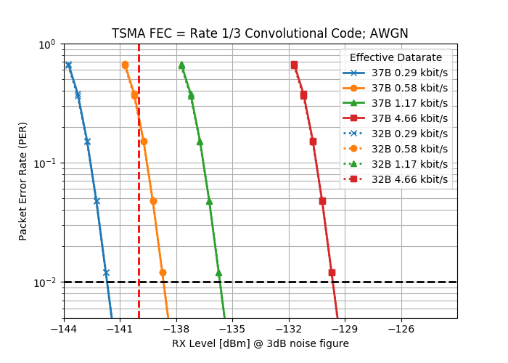
Minimum Required Sensitivity
Effective data rate of 0.29 kBit/s achieves required -140 dBm easily at 1% PER
AWGN performance not affected by packet length

Slide 7
Impact of TSMA with FEC (2)
no interference
transmission at same transmission energy
16 dB gain of proposal compared to uncoded at 1% PER
Minimal impact of larger size of 37B on proposal, ~1dB on non-TSMA
16 dB

Slide 8
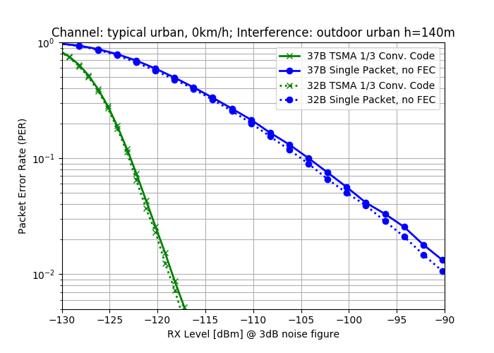
Impact of TSMA with FEC (3)
interference outdoor urban, h = 140m [4]
29 dB+ gain of proposal compared to uncoded at 1% PER
Minimal impact of larger size of 37B on proposal, ~1dB on non-TSMA
29+ dB

Slide 9
Interference Robustness (1)
Scenario less exposed receiver rural, h = 32m
5.5 dB gain over FEC coded transmission without TSMA at 1% PER
Minimal impact of larger size of 37B on proposal, more on non-TSMA
5.5 dB

Slide 10
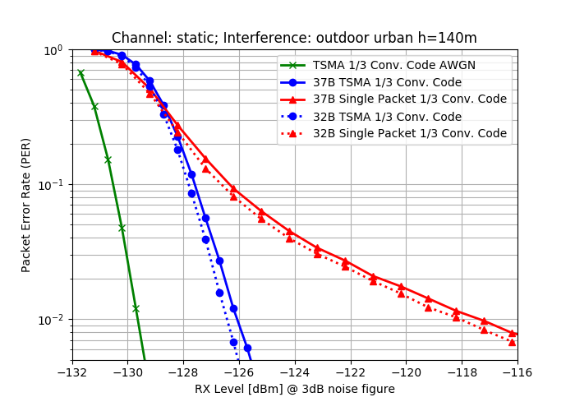
Interference Robustness (2)
Required Scenario urban, h = 140m [4]
9 dB gain over FEC coded transmission without TSMA at 1% PER
Minimal impact of larger size of 37B on proposal, more on non-TSMA
9 dB

Slide 11
References
[1] IEEE Std 802.15.4™-2015
[2] P802.15.4w PAR
[3] 802.15.4w Technical Guidance Document; 12 March, 2018; 15-18-0161-00-004w
[4] Draft IG LPWA Report; 3 November, 2017; 15-17-0528-01

