Slide 1
Project: IEEE P802.15 Working Group for Wireless Personal Area Networks (WPANs)
Submission Title: [SRDEV HRP PHY Step 1 Consensus – Baseline Mode]
Date Submitted: [12 July, 2018]
Source: [Frank Leong (NXP Semiconductors), Jochen Hammerschmidt (Apple), Billy Verso (Decawave Ltd.), Jaroslaw Niewczas (Decawave Ltd.),
Wolfgang Küchler (NXP Semiconductors), Thomas Baier (NXP Semiconductors),
Brima Ibrahim (NXP Semiconductors), Ayman Naguib (Apple),
Thomas Reisinger (Continental), Daniel Knobloch (BMW)]
Re: [Input to the Task Group]
Abstract: [Presentation, SRDEV, PHY, Enhanced Impulse Radio]
Purpose: []
Notice: This document has been prepared to assist the IEEE P802.15. It is offered as a basis for discussion and is not binding on the contributing individual(s) or organization(s). The material in this document is subject to change in form and content after further study. The contributor(s) reserve(s) the right to add, amend or withdraw material contained herein.
Release: The contributor acknowledges and accepts that this contribution becomes the property of IEEE and may be made publicly available by P802.15.

Slide 2
SRDEV PHY Consensus – Baseline Mode Note: Notation/nomenclature based on 15-18-0286-01-004z-hrp-uwb-srdev-ppdu-text-contribution.docx

Slide 3
Overall Approach
General (§3, §4.1):
Nominal mean PRF ≥ 62.4 MHz
Require support for CH5 (6489.6 MHz) and CH9 (7987.2 MHz)
Distinguish between two enhancement stages:
Minimally Incremental Mode (“MIM”)
Retain a large number of elements from the existing 802.15.4 PHY
Allow re-use of legacy implementations with modest alterations
Legacy as basis for inter-operability
Performance Optimized Mode (“POM”)
Additional signaling and performance enhancements
Not in scope of this document

Slide 4
MIM: PRF64 Mode
Retain SYNC, SFD, PHR, PSDU fields as per HRP PHY
Add Scrambled Timestamp Sequence (STS) field (§5.3)
Three associated frame formats (§2)
SRDEVs shall also support legacy PRF64 frame format (no STS, 6.8 Mbit/s PSDU)
(Default, mandatory)
(Mandatory)
(Optional)

Slide 5
MIM: PRF64 Mode, SYNC
No change of SYNC compared to legacy HRP PHY: all specified ternary codes supported as prescribed

Slide 6
MIM: PRF64 Mode, SFD
SRDEVs shall support the following binary length-8 SFD pattern
enhanced performance for coherent receivers (see §5.1.2)
SRDEVs shall also support the legacy length-8 ternary sequence, for legacy inter-working support
 | Pattern | N_{sym}
 | ---+--+- | 8

Slide 7
MIM: PRF64 Mode, PHR
SRDEVs shall support legacy 850 kbit/s PRF64 PHR
SRDEVs shall support 6.8 Mbit/s PRF64 PHR*
PHR content remains unchanged w.r.t. legacy PHR
*) Support for 6.8 Mbit/s PRF64 PHR as mandatory under consideration; agreement that it should be included either as mandatory or optional

Slide 8
MIM: PRF64 Mode, STS (I)
Mapping of DRBG bits $A_{i}$ onto STS code $C_{i}$ as follows (notation as in §5.3.3): $C_{i}=−2∗A_{i}+1, { A}_{i}∈\left\{1,0\right\}, i=0,1,2,3,…$
The resulting sequence shall be spread by a factor of δL=8 (i.e., ~16 ns inter-pulse spacing)

Slide 9
MIM: PRF64 Mode, STS (II)
SRDEVs shall support $N_{STS,segment}= 16384∗2^{l}, with l=1$ (notation as in §5.3.2, i.e., $N_{STS,segment}$ specified in # of chips)
Equivalent to active pulsing STS segment being 32768 chips long (~65 µs)
Under consideration: optional extension to other STS lengths
SRDEVs shall support STS consisting of 1 STS Building Block (notation as in §5.3.2)
Under consideration: support for larger number of STS Building Blocks

Slide 10
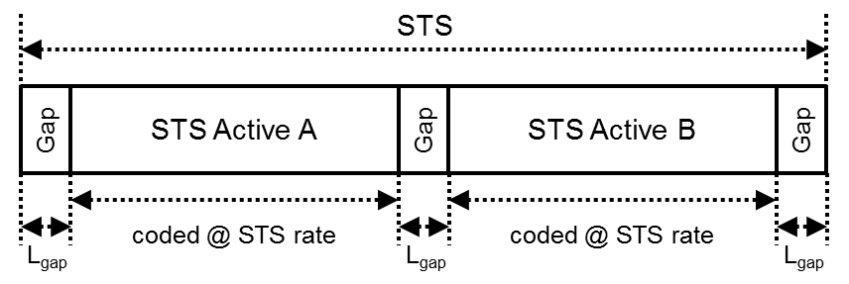
MIM: PRF64 Mode, STS (III)
A segment of active (non-zero) pulsing at the nominal mean PRF is encapsulated by guard intervals, or gaps, of length L_{gap} in counts of chips. L_{gap} shall be 512, a guard duration of, roughly, 1 µs. All chips during each gap shall carry no signal energies at each respective transmitter. (see §5.3.2)

Slide 11
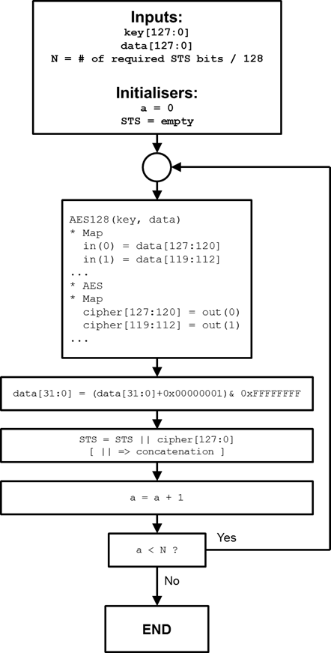
MIM: PRF64 Mode, STS (IV)
STS generated by Deterministic Random Bit Generator (DRBG) based on AES-128 (diagram as shown is revised compared to §5.3.1)
32-bit counter defined
Slide 9 defines use of 4096 bits from the DRBG for STS generation, implying N=32, which can be implemented using a 16-bit counter

Slide 12
Conclusion
Presented consensus:
Minimally Incremental Mode (MIM)
Retain a large number of elements from the existing 802.15.4 PHY
Allow re-use of legacy implementations with modest alterations
Legacy as basis for inter-operability

