Slide 1
Project: IEEE P802.15 Interest Group for Wireless Personal Area Networks (WPANs)
Submission Title: C-OOK for detecting Region-of-Interest (RoI) in V2V communication
Date Submitted: May 2018
Source: Minh Duc Thieu, Trang Nguyen and Yeong Min Jang [Kookmin University].
Contact: +82-2-910-5068 E-Mail: yjang@kookmin.ac.kr
Re:
Abstract: An introduction of new modulation scheme for RoI signaling in high speed OCC system for vehicles
Purpose: To introduce new modulation scheme which is feasible for detecting Region-of-Interest in V2V communication
Notice: This document has been prepared to assist the IEEE P802.15. It is offered as a basis for discussion and is not binding on the contributing individual(s) or organization(s). The material in this document is subject to change in form and content after further study. The contributor(s) reserve(s) the right to add, amend or withdraw material contained herein.
Release: The contributor acknowledges and accepts that this contribution becomes the property of IEEE and may be made publicly available by P802.15.

Slide 2
C-OOK for detecting Region-of-Interest (RoI) in V2V communication

Slide 3
Introduction
Detecting RoI can helps Rx camera identify the region of interest (RoI) to set up the communication link. When the RoI information is received by low-frame-rate Rx camera, high-rate data stream can be received by Rx high-frame-rate camera.
By deploying RoI-signaling technique, the computational cost of systems can also be decreased.
Some modulation schemes, which can used for detecting RoI, should support low frame-rate cameras, and flicker-free for human eyes.

Slide 4
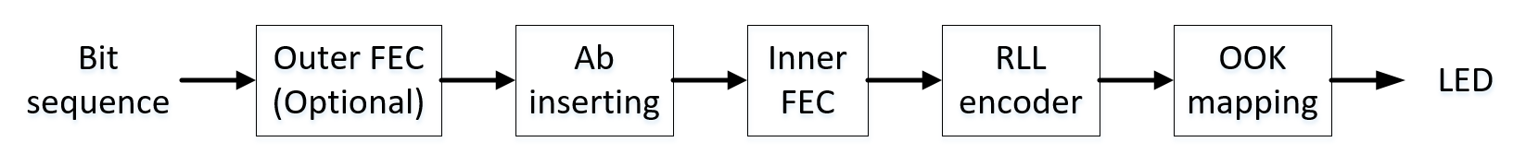
Camera-on-off-keying (C-OOK)
C-OOK is a modulation scheme which is based on On-Off Keying. It can support a large range of rolling shutter cameras which have a limit 8 kHz of shutter speed.
Reference architecture of C-OOK transmitter

Slide 5
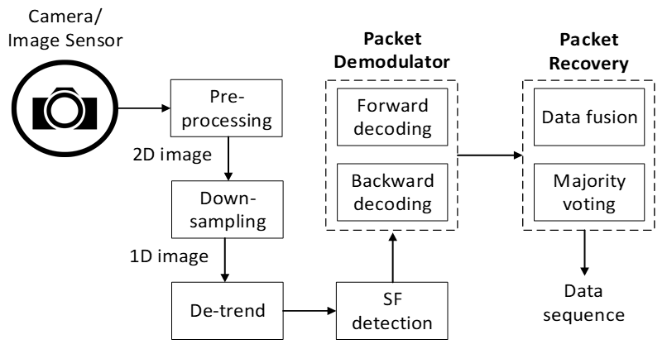
Camera-on-off-keying (C-OOK)
The decoding method procedure:
  Down-sampling of a received image.
  De-trended image to get the output data signal for SF detection.
  The packet demodulator process consists of two parallel processes, forward and backward decoding.
Reference architecture of C-OOK transmitter

Slide 6
Camera-on-off-keying (C-OOK)
A packet modulated by C-OOK consists of multiple repeated data sub-packet (DS) to avoid missing data in the gap time between two consecutive captured images.
The packet rate is defined as the number of different packets with different payloads, which is transmitted during a period of time.
DS format

Slide 7
Camera-on-off-keying (C-OOK)
RLL coding is proposed to use in DS for maintaining the brightness constant at 50%.
The data rate efficiency of RLL coding schemes is expressed by equation
Manchester code has the smallest data rate efficiency (50%), the 8B10B code has the most data rate efficiency (80%) among three RLL coding schemes.
Due to the limitation of shutter speed of rolling shutter camera, the selection of coding scheme needs to be suitable to use in the limited bandwidth without flickering for the human eye.

Slide 8
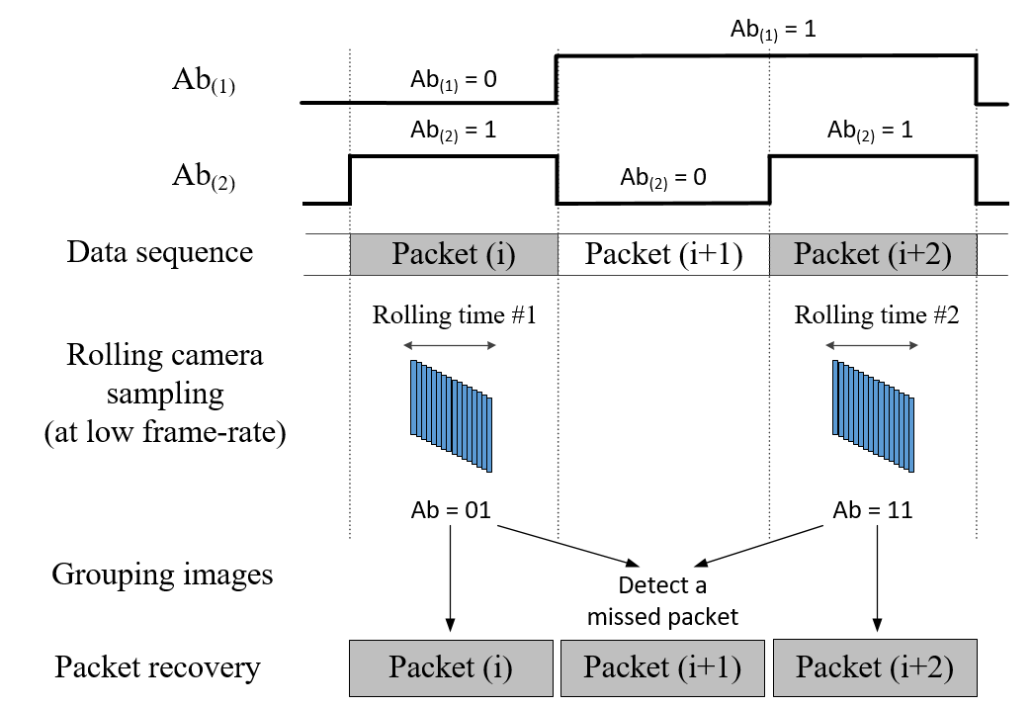
Camera-on-off-keying (C-OOK)
The combination of two Ab bits generates four different values: 00 01 10 and 11. Thus, they can detect a maximum of two missed packets continuously.
An example of the detection of a missed data packet by using two asynchronous bits Ab

Slide 9
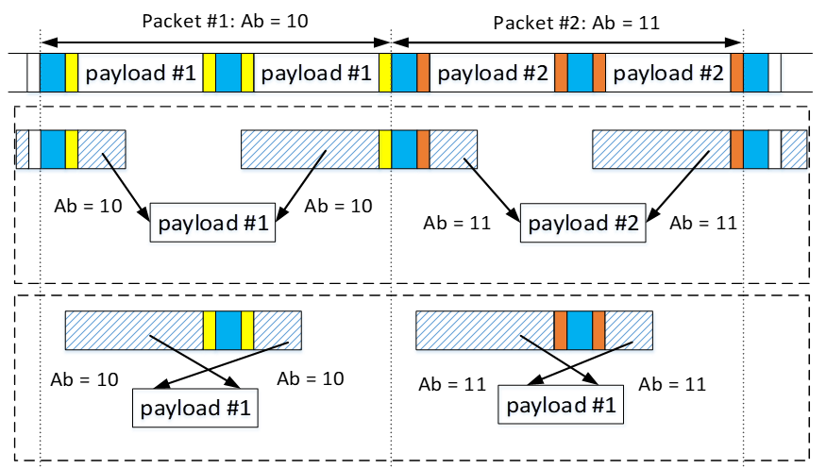
Camera-on-off-keying (C-OOK)
Two types of fusion algorithm is proposed to recover data symbols at different sampling times: inter-frame and intra-frame data fusion.
a)
b)
The illustration of data fusion algorithms.
(a) inter-frame data fusion. (b) intra-frame data fusion

