Slide 1
Project: IEEE P802.15 Working Group for Wireless Personal Area Networks (WPANs)
Submission Title: Transparent Display – CamCom Link for Onroad Location Specific Information Service
Date Submitted: July 2018
Source: Jaesang Cha (SNUST), Mariappan Vinayagam (SNUST), Changjun Ahn (Chiba Univ.), Hyoungkyu Song (Sejong Univ.), Sooyoung Chang (SYCA)
Address: Contact Information: +82-2-970-6431, FAX: +82-2-970-6123, E-Mail: chajs@seoultech.ac.kr
Re:
Abstract: This documents introduce the V2X CamCom Link design consideration for VAT. This proposed Transparent Display – CamCom link for onroad location specific information delivery. The proposed VAT solution can be used in the application services like ITS, ADAS, etc. on road condition, LED IT, Digital Signage with connected information services etc.
Purpose: To provided concept models of light communication based on transparent display CamCom link for Vehicular Assistant Technology (VAT) Interest Group
Notice: This document has been prepared to assist the IEEE P802.15. It is offered as a basis for discussion and is not binding on the contributing individual(s) or organization(s). The material in this document is subject to change in form and content after further study. The contributor(s) reserve(s) the right to add, amend or withdraw material contained herein.
Release: The contributor acknowledges and accepts that this contribution becomes the property of IEEE and may be made publicly available by P802.15.
Slide 1

Slide 2
Contents
Needs for Onroad Location Specific Information Service
Onroad Vehicles Transparent Display based CamCom Link
Conclusion
Slide 2

Slide 3
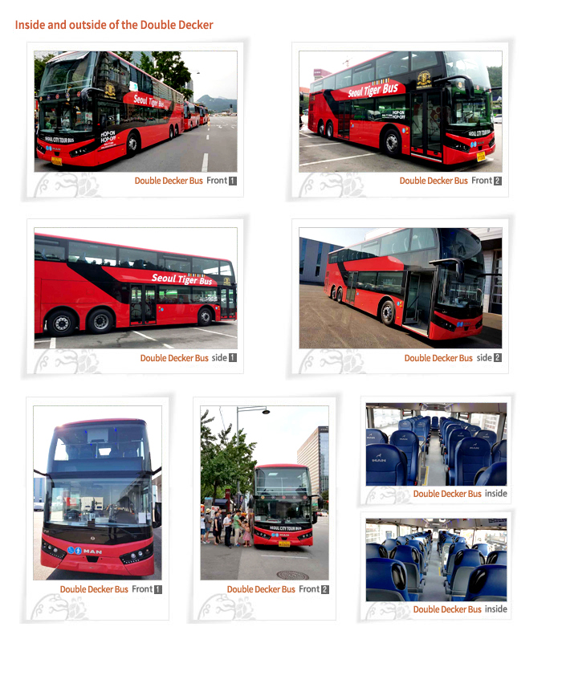
Needs for Onroad Location Specific Information Service
Needs
Onroad location specific information on drive
City tour bus is sightseeing tour bus for touristic cities
The buses pass by main tourist attractions and major landmarks, while a prerecorded audio commentary is provided through headphones in multiple languages giving important facts and information about what is being seen.
Basic Concept
Uses the vehicle transparent display and camera to provide location specific information to travelers
< Onroad Vehicle Transparent Display >
Slide 3

Slide 4
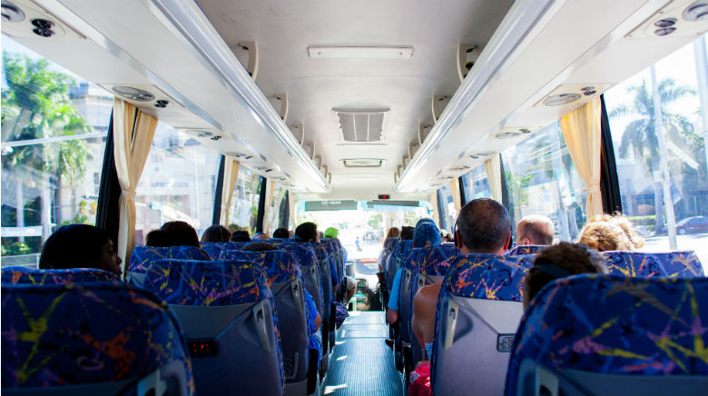
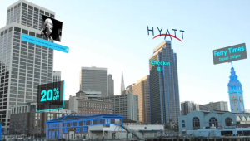
Onroad Vehicles Transparent Display based CamCom Link
Transparent Display based OCC Link
A tour bus is a bus with wide sections of glass windows, or other suitable transparent material with transparent display, allowing passengers to observe the environment from within the bus
The transparent display will allow tourist sightseeing through it and displays more information about observing objects.
Tx : Transparent Window, City Lighting , and Signage
Rx : CMOS Image Sensor
Modulations :
OOK, VPPM, Offset-VPWM, Multilevel PPM, Inverted PPM, Subcarrier PPM, DSSS SIK, etc.
Day-Night Communication Mode
Data Rate : 1K ~ 1Mb/s
Supported LoS(Line of Sight)
Available Distance : 2m ~ 50m
< Bus with Transparent Display >
Slide 4

Slide 5
Conclusion
Proposed the Transparent Display – CamCom Link for Onroad Location Specific Information Service
Uses the City Lighting & Signage and Transparent display for vehicle to provide location specific information
Makes trips more interactive and interesting
Slide 5

