Slide 1
Project: IEEE P802.15 Working Group for Wireless Personal Area Networks (WPANs)
Submission Title: Transparent Display – OCC Link for Location Specific Information Delivery using Buoy
Date Submitted: July 2018
Source: Jaesang Cha (SNUST), Mariappan Vinayagam (SNUST), Changjun Ahn (Chiba Univ.), Hyoungkyu Song (Sejong Univ.), Sooyoung Chang (SYCA)
Address: Contact Information: +82-2-970-6431, FAX: +82-2-970-6123, E-Mail: chajs@seoultech.ac.kr
Re:
Abstract: This documents introduce the V2X OCC Link design consideration for VAT. This proposed Transparent Display – OCC link delivers location specific information delivery on water environmental conditions. The proposed VAT solution can be used in the application services like ITS, ADAS, etc. on road condition, LED IT, Digital Signage with connected information services etc.
Purpose: To provided concept models of light communication based on transparent display applied OCC link for Vehicular Assistant Technology (VAT) Interest Group
Notice: This document has been prepared to assist the IEEE P802.15. It is offered as a basis for discussion and is not binding on the contributing individual(s) or organization(s). The material in this document is subject to change in form and content after further study. The contributor(s) reserve(s) the right to add, amend or withdraw material contained herein.
Release: The contributor acknowledges and accepts that this contribution becomes the property of IEEE and may be made publicly available by P802.15.
Slide 1

Slide 2
Contents
Needs for Transparent Display on Boat
Transparent Display based OCC Link with Buoy
Conclusion
Slide 2

Slide 3
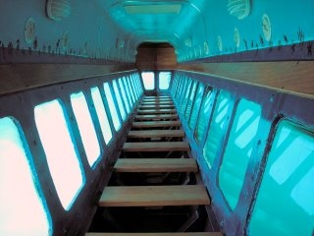
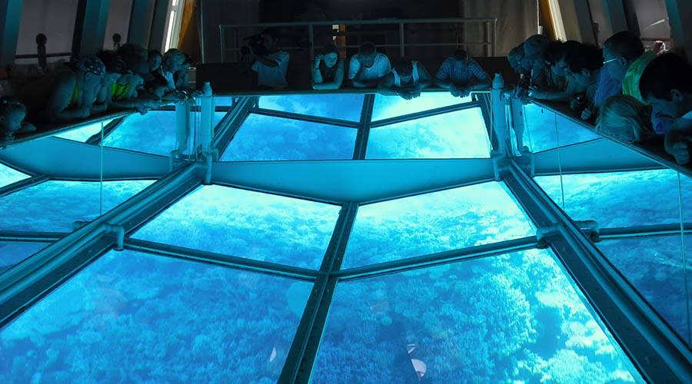
Needs for Transparent Display on Boat
Needs
Seashore location specific information on water travel
Glass bottom of boat explore the reef up close, watch vibrant marine life in their natural habitat and view colourful coral – all without getting wet
Stay dry while you explore the Great Barrier Reef on a fun, safe tour for non-swimmers of all ages
Guests board a boat fitted with either a thick, clear floor or transparent (display) walls that sit below the waterline.
Basic Concept
Uses the water vehicle transparent display and camera to provide location specific information to travelers
< Boat Transparent Display >
Slide 3

Slide 4
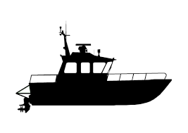
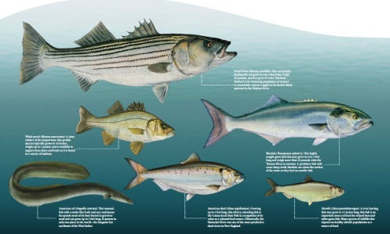
Transparent Display based OCC Link with Buoy
Transparent Display based OCC Link
A glass-bottom boat is a boat with one or more sections of glass, or other suitable transparent material with transparent display, below the waterline allowing passengers to observe the underwater environment from within the boat
The view through the transparent bottom is better than simply looking into the water from above, because one does not have to look through optically erratic surface disturbances
During the underwater sightseeing the OWC camera receives the data from smart buoy about the marine life of that area under the glass floor or walls and displays the content the transparent display.
Tx : Boat Transparent Window and Smart Buoy
Rx : CMOS Image Sensor in Boat
Modulations :
OOK, VPPM, Offset-VPWM, Multilevel PPM, Inverted PPM, Subcarrier PPM, DSSS SIK, etc.
Day-Night Communication Mode
Data Rate : 1K ~ 1Mb/s
Supported LoS(Line of Sight)
Available Distance : 2m ~ 50m
OCC Camera Link
Smart Buoy
< Boat with transparent floor or walls >
< Transparent display content based on Smart buoy >
Slide 4

Slide 5
Conclusion
Proposed the Transparent Display – OCC Link for Location Specific Information Delivery using Buoy
Uses the OCC Smart Buoy and Transparent display for boat to provide seashore specific information
Makes trips more interactive and interesting
Slide 5

