Slide 1
Project: IEEE P802.15 Working Group for Wireless Personal Area Networks (WPANs)
Submission Title: OWC Based Applied Service Using Helicopter Transparent Display
Date Submitted: July 2018
Source: Jaesang Cha (SNUST), Mariappan Vinayagam (SNUST), Changjun Ahn (Chiba Univ.), Hyoungkyu Song (Sejong Univ.), Sooyoung Chang (SYCA)
Address: Contact Information: +82-2-970-6431, FAX: +82-2-970-6123, E-Mail: chajs@seoultech.ac.kr
Re:
Abstract: This documents introduce the V2X OWC Link design consideration for VAT. This proposed OWC link technology using helicopter transparent display for applied service. The proposed VAT solution can be used in the application services like ITS, ADAS, etc. on road condition, LED IT, Digital Signage with connected information services etc.
Purpose: To provided concept models of light communication based on transparent display applied OWC link for Vehicular Assistant Technology (VAT) Interest Group
Notice: This document has been prepared to assist the IEEE P802.15. It is offered as a basis for discussion and is not binding on the contributing individual(s) or organization(s). The material in this document is subject to change in form and content after further study. The contributor(s) reserve(s) the right to add, amend or withdraw material contained herein.
Release: The contributor acknowledges and accepts that this contribution becomes the property of IEEE and may be made publicly available by P802.15.
Slide 1

Slide 2
Contents
Needs for Applied Service Using Helicopter Transparent Display
Transparent Display based OWC Link for Applied Service
Conclusion
Slide 2

Slide 3
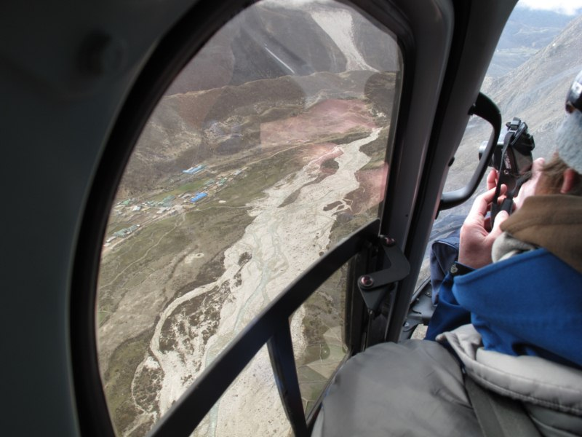
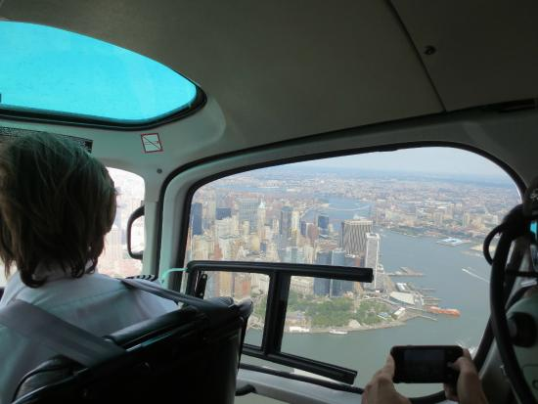
Needs for Applied Service Using Helicopter Transparent Display
Needs
Travelers can usually like to see beautiful scenery from the sky when user in the back seat or passenger seat of a helicopter.
The windows of these helicopters are made using transparent displays and combined with GPS.
Based on this, the transmission code for OWC link is loaded so that the user can receive additional information using the smart device.
Basic Concept
Uses the helicopter transparent display and camera to provide location specific information to travelers
< Helicopter with Transparent Display >
Slide 3

Slide 4
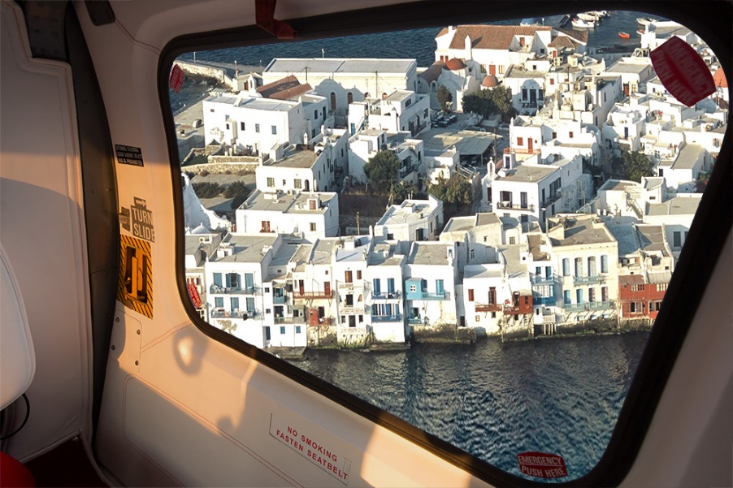
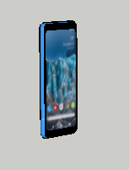
Transparent Display based OWC Link for Applied Service
Transparent Display based OWC Link
Additional information on the scenery as travel by helicopter
Information on remaining travel distance available
Can be applied not only to the landscape but also to the advertisement
Tx : Helicopter Transparent Window
Rx : CMOS Image Sensor in Smart Device Camera
Modulations :
OOK, VPPM, Offset-VPWM, Multilevel PPM, Inverted PPM, Subcarrier PPM, DSSS SIK, etc.
Day-Night Communication Mode
Data Rate : 1K ~ 1Mb/s
Supported LoS(Line of Sight)
Available Distance : 2m ~ 50m
Tx
Rx
< Helicopter Transparent Display – OWC Link >
Slide 4

Slide 5
Conclusion
Proposed the OWC Based Applied Service Using Helicopter Transparent Display
The proposed technology allows to get information about the surrounding area when travelers are on the helicopter and also provide information such as local specialty products, which can lead to purchase.
Proposed solution can also be applied to aircraft to give information on the flight path.
Slide 5

