Slide 1
Project: IEEE P802.15 Working Group for Wireless Personal Area Networks (WPANs)
Submission Title: LiFi / CamCom Technology with Computer Vision Techniques for Driving Assistance Solution on the Bridge
Date Submitted: July 2018
Source: Jaesang Cha, Minwoo Lee (SNUST), Vinayagam Mariappan (SNUST), Minsoo Kim (SR ENG Co., Ltd.), Sooyoung Chang (SYCA)
Address: Contact Information: +82-2-970-6431, FAX: +82-2-970-6123, E-Mail: chajs@seoultech.ac.kr
Re:
Abstract: This documents introduce the V2I LiFi / CamCom link design consideration for VAT. This proposed LiFi / CamCom link model with computer vision techniques for driving assistance solution on the bridge. This VAT solution can be used on the application services like ITS, ADAS, IoT/IoL, LED ID, digital signage with connected information services etc. on road condition.
Purpose: To provided concept models of light communication based LiFi/CamCom solution for Vehicular Assistant Technology (VAT) Interest Group
Notice: This document has been prepared to assist the IEEE P802.15. It is offered as a basis for discussion and is not binding on the contributing individual(s) or organization(s). The material in this document is subject to change in form and content after further study. The contributor(s) reserve(s) the right to add, amend or withdraw material contained herein.
Release: The contributor acknowledges and accepts that this contribution becomes the property of IEEE and may be made publicly available by P802.15.
Slide 1

Slide 2
Contents
Needs for LiFi / CamCom Technology with Computer Vision Techniques for Driving Assistance Solution on the Bridge
LiFi / CamCom Technology for Driving Assistance Solution on the Bridge
Conclusion
Slide 2

Slide 3
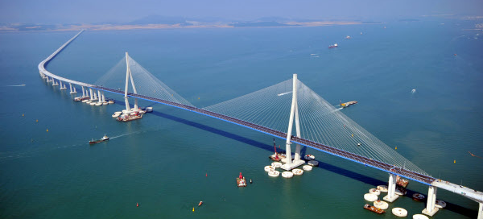
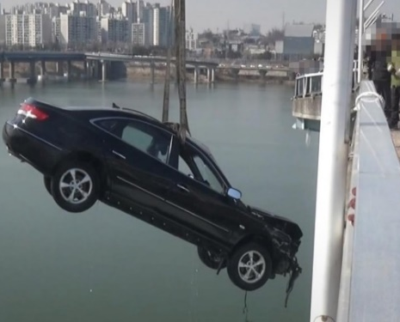
Needs for Driving Assistance Solution on the Bridge
Needs
As recent technology develops, massive bridges across the sea have been constructed and used by many people.
However, due to the weather effect, the sea has a considerable influence due to the wind.
Accordingly, a technique for securing safety by receiving accurate measurement data such as wind speed, wind speed, and wind direction is required.
Basic Concept
Uses the LiFi / CamCom solution for driving assistance solution on the bridge.
Used to receive information such as wind direction and wind speed, which are displayed in the light for view installed in the bridge, with the camera installed in the vehicle.
Provides a solution that enables safe operation by controlling the vehicle.
< Accidents in the Bridge >
GOOGLE
Slide 3

Slide 4
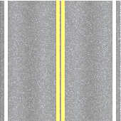
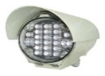
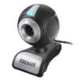
LiFi / CamCom Link for Driving Assistance on the Bridge
Light on the Bridge and Camera based LiFi/CamCom Link for Driving Assistance on the Bridge
Tx : Vehicle Hear/Rear Light
Rx : PD / Vehicle Hear/Rear camera
Modulations :
OOK, VPPM, Offset-VPWM, Multilevel PPM, Inverted PPM, Subcarrier PPM, DSSS SIK etc.
Day-Night Communication Mode
Data Rate : 10K ~ 2Mb/s
Supported LoS(Line of Sight)
Available Distance : 10m ~ 100m
Air Volume
Wind Speed
Wind Direction
…
010100101101110111010001010111100 …
< Driving Assistance on the Bridge >
※ A technology that receives information such as wind direction and wind speed by using visual light installed on the bridge and control the vehicle by receiving data from the camera installed in the vehicle.
Slide 4

Slide 5
Conclusion
Proposed the LiFi / CamCom Technology Based Military Vehicle Command Auxiliary System.
This technology utilizes the light installed on the bridge to acquire wind information and used the camera installed in the vehicle.
This solution proposed for safety issues that may be caused by winds in river or sea-only car road bridges.
Slide 5

