Slide 1
Project: IEEE P802.15 Working Group for Wireless Personal Area Networks (WPANs)
Submission Title: LiFi / CamCom Data Link for Aircraft Navigation Light Service on Air
Date Submitted: July 2018
Source: Jaesang Cha(SNUST), Ilkyoo Lee (Kongju National Univ.), Chanhyung Chung (RAPA), Incheol Jeong (Sungkonghoe Univ.), Vinayagam Mariappan(SNUST), Sooyoung Chang(SYCA)
Address: Contact Information: +82-2-970-6431, FAX: +82-2-970-6123, E-Mail: chajs@seoultech.ac.kr
Re:
Abstract: This documents introduce the V2V LiFi / CamCom Data Link design consideration for VAT. This LiFi / CamCom data link model proposed to introduce the possibility of using light communication for aircraft navigating light service on air. This VAT To provided concept models of Light Communication based LiFi / CamCom solution for preventing collisions on the land and aircraft moving, distance locating, support information accepting, emergency cases, etc.. This can be used on the application services like ITS, ADAS, IoT/IoL, LED ID, digital signage with connected information services etc. on road / on air / on water condition.
Purpose: To provided concept models of Light Communication based LiFi/CamCom solution for Vehicular Assistant Technology (VAT) Interest Group
Notice: This document has been prepared to assist the IEEE P802.15. It is offered as a basis for discussion and is not binding on the contributing individual(s) or organization(s). The material in this document is subject to change in form and content after further study. The contributor(s) reserve(s) the right to add, amend or withdraw material contained herein.
Release: The contributor acknowledges and accepts that this contribution becomes the property of IEEE and may be made publicly available by P802.15.
Slide 1

Slide 2
Contents
Needs for Aircraft Navigation Lighting
LiFi / CamCom Data Link for Aircraft Navigation
Conclusion
Slide 2

Slide 3
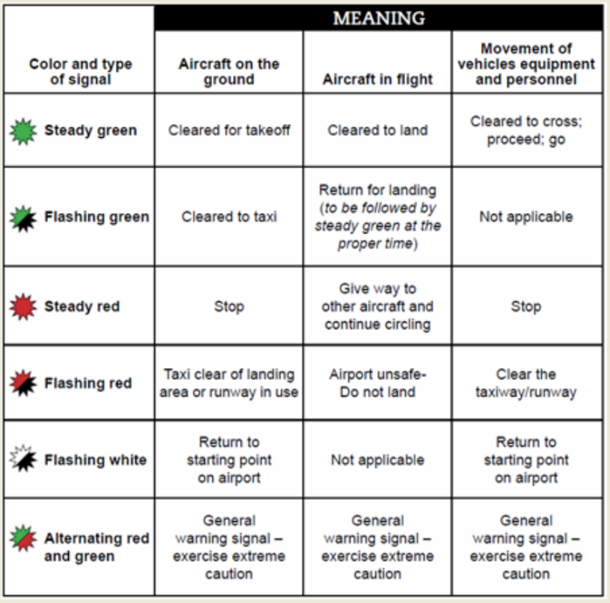
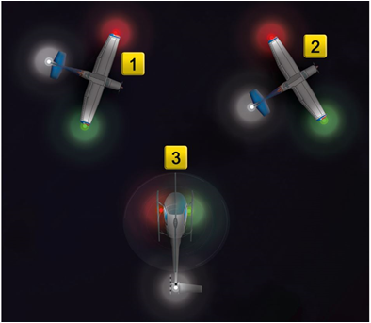
Needs for Aircraft Navigation Lighting
Needs
Navigation lights are not intended to provide illumination for the craft making the passage, only for other craft to be aware of it.
Navigation lights give information on a craft's position, heading, and status
By interpreting the position lights on other aircraft, the pilot in aircraft can determine whether the aircraft is flying in the opposite direction or is on a collision course
< Aircraft Navigation Lighting Signal Type >
Problems
Visual Illusions
Relative-Motion Illusion
Confusion With Ground Lights
Reversible Perspective Illusion
Flicker Vertigo
< Aircraft Navigation Lighting >
GOOGLE
Slide 3

Slide 4
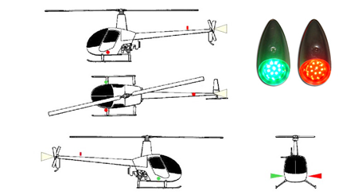
LiFi / CamCom Data Link for Aircraft Navigation
Aircraft LiFi / CamCom Data Link
Tx : Air Vehicles Outdoor Navigation Light
Rx : PD / CCTV Camera
Modulations :
OOK, VPPM, Offset-VPWM, Multilevel PPM, Inverted PPM, Subcarrier PPM, DSSS SIK etc.Day-Night Communication Mode
Data Rate : 1K ~ 1Mb/s
Supported LoS(Line of Sight)
Available Distance : more than 200m with lens
< Aircraft Lighting Based LiFi / CamCom Data Link>
Basic Concept
Use the existing aircraft outdoor lighting infrastructure and on vehicle cameras for LiFi / CamCom Link
Provides smart aircraft navigation solution using the LiFi / CamCom technology between aircraft and other flying vehicle for air collision preventions, distance locating, support information accepting, emergency cases, etc.
※ Helps to provide more information in aircraft actions in bad climatic conditions, emergency nearing, Visual Illusions, Relative-Motion Illusion, Confusion With Ground Lights, Reversible Perspective Illusion, Flicker Vertigo etc.
Slide 4

Slide 5
Conclusion
Proposed the Aircraft Navigation Light solution using LiFi / CamCom Technology
Uses the existing air vehicles outdoor navigation lighting infrastructure to built the system and does not required any additional infrastructure needs to be installed
Provides the concept models of light communication based LiFi/CamCom solution for preventing collisions on the land and aircraft moving, distance locating, support information accepting, emergency cases, etc.
Provides additional navigation information in aircraft actions in bad climatic conditions, emergency nearing, Visual Illusions, Relative-Motion Illusion, Confusion With Ground Lights, Reversible Perspective Illusion, Flicker Vertigo etc.
Slide 5

