Slide 1
Project: IEEE P802.15 Working Group for Wireless Personal Area Networks (WPANs)
Submission Title: Cloud Connected Inventory Management System Using OWC Technology
Date Submitted: July 2018
Source: Jaesang Cha, Minwoo Lee (SNUST), Vinayagam Mariappan (SNUST)
Address: Contact Information: +82-2-970-6431, FAX: +82-2-970-6123, E-Mail: chajs@seoultech.ac.kr
Re:
Abstract: This documents introduce the V2X OWC communication link design consideration for VAT. The proposed OWC data link model proposed to introduce the possibility of using light communication for cloud connected inventory management system. This proposed solution can be utilized as a part of a factory vehicle based inventory management system.
Purpose: To provided concept models of OWC link solution for Vehicular Assistant Technology (VAT) Interest Group
Notice: This document has been prepared to assist the IEEE P802.15. It is offered as a basis for discussion and is not binding on the contributing individual(s) or organization(s). The material in this document is subject to change in form and content after further study. The contributor(s) reserve(s) the right to add, amend or withdraw material contained herein.
Release: The contributor acknowledges and accepts that this contribution becomes the property of IEEE and may be made publicly available by P802.15.
Slide 1

Slide 2
Contents
Needs for Inventory Management System
Cloud Connected Inventory Management Using OWC Link
Conclusion
Slide 2

Slide 3
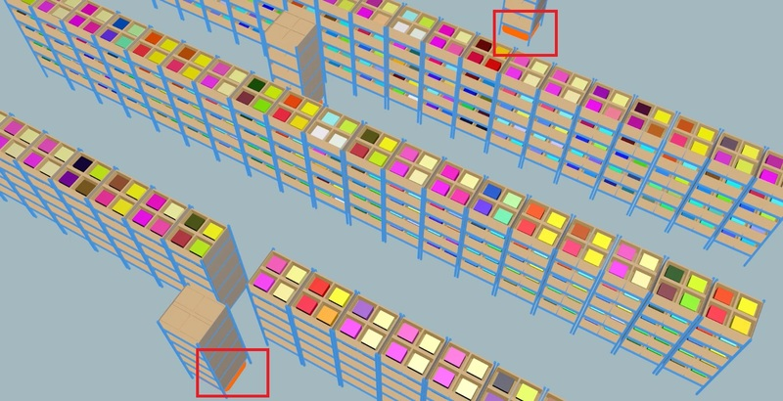
Needs for Inventory Management System
Needs
In distribution center, the work of delivering distribution is frequently done.
Inventory management can be problematic because the inventory of the goods changes from time to time.
Needs
When each tag is applied to each distribution, it is possible to manage inventory efficiently by monitoring program on-line.
Since the cloud network is used, the burden on data processing is minimized by utilizing only the residual information on the tag.
< Environment of Distribution Center >
Slide 3

Slide 4
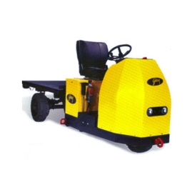
Cloud Connected Inventory Management Using OWC Link
Cloud Connected Inventory Management Using OWC Link
Real-time management system for managing the remaining amount of continuously fluctuating distribution in the factory using 2D Tag-based OWC Link and cloud network of distribution center.
Connected to a cloud-based management system and provides efficient management functions
Rx : Cloud Connected Camera in Vehicle
Tx : Distribution 2D-Tag
Modulations :
VTASC, SS2DC, QR-Code, Color Code, CSK, etc.
Day-Night Communication Mode
Data Rate : 1K ~ 1Mb/s
Supported LoS(Line of Sight)
Available Distance : 2m ~ 20m
C
Management System
B
A
B
C
A
Cloud
Amount of Shipments
A : -1
Product Shipments
< Cloud Connected Inventory Management System >
Slide 4

Slide 5
Conclusion
Proposed the Cloud Connected Inventory Management System Using OWC Technology
The existing technology has a structure to passively inspect the inventory in order to manage the continuously fluctuating inventory in the distribution factory
The propose approach provides efficient inventory management on-line through camera communication between Cloud Connected Camera attached to factory vehicle and 2D Code
Slide 5

