Slide 1
Project: IEEE P802.15 Working Group for Wireless Personal Area Networks (WPANs)
Submission Title: CSK Based OCC for Heavy Machinery Management On Construction Site
Date Submitted: July 2018
Source: Jaesang Cha, Minwoo Lee (SNUST), Vinayagam Mariappan (SNUST)
Address: Contact Information: +82-2-970-6431, FAX: +82-2-970-6123, E-Mail: chajs@seoultech.ac.kr
Re:
Abstract: This documents introduce the CSK based OCC V2X communication link design consideration for VAT. The proposed CSK based OCC data link model proposed to introduce the possibility of using light communication for heavy machinery management on construction site. This proposed solution can be utilized as a part of a complex of monitoring, logistics and scheduling.
Purpose: To provided concept models of CSK based OCC solution for Vehicular Assistant Technology (VAT) Interest Group
Notice: This document has been prepared to assist the IEEE P802.15. It is offered as a basis for discussion and is not binding on the contributing individual(s) or organization(s). The material in this document is subject to change in form and content after further study. The contributor(s) reserve(s) the right to add, amend or withdraw material contained herein.
Release: The contributor acknowledges and accepts that this contribution becomes the property of IEEE and may be made publicly available by P802.15.
Slide 1

Slide 2
Contents
Needs for Construction Areas Management
CSK Based OCC for Heavy Machinery Management
Conclusion
Slide 2

Slide 3
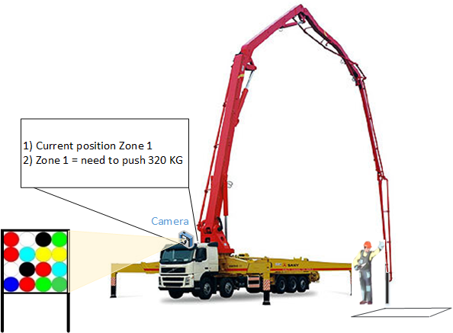
Needs for Needs for Construction Areas Management
Needs
To pay high-price of time management of heavy machinery during construction activities
Requires easy solution to provide optimal scheduling of moving, staying time and working scope
Needs
Operative information broadcasting to heavy machinery vehicles about current position
Information providing for time scheduling
Information providing for working scope (in current use case volume of concrete should be uploaded)
< Concrete Filling Truck Management in Construction Area >
Slide 3

Slide 4
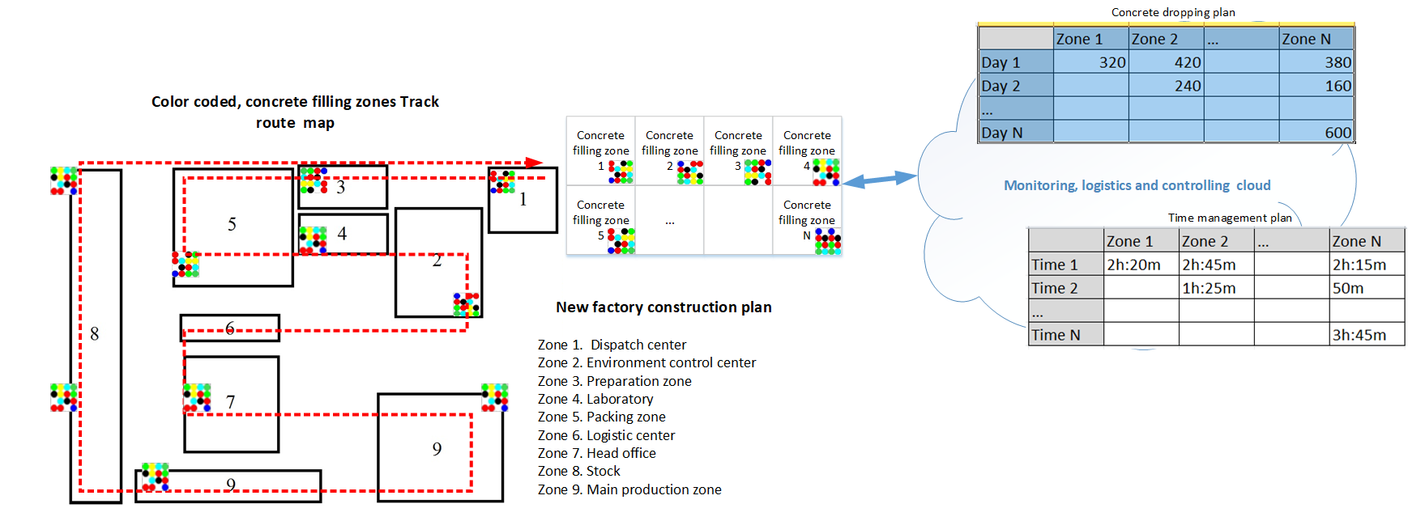
CSK Based OCC for Heavy Machinery Management
< CSK based OCC Data Link Solution Use-case for Construction Site Monitoring, Logistics and Work Scheduling>
CSK based OCC Data Link
Tx : CSK based LED Patch / Lamp
Rx : Camera Installed on Machinery
Modulations :
OOK, VPPM, Offset-VPWM, Multilevel PPM, Inverted PPM, Subcarrier PPM, DSSS SIK etc.
Day-Night Communication Mode
Data Rate : 1K ~ 1Mb/s
Supported LoS(Line of Sight)
Available Distance : more than 200m with lens
Slide 4

Slide 5
Conclusion
Proposed the CSK Based OCC for Heavy Machinery Management On Construction Site
Uses the existing CSK based LED Patch, LED Lamp, Signage used in the construction site and Construction site heavy machineries built-in cameras
Proposed solution can be utilized as a part of a complex of monitoring, logistics and work scheduling, etc.
Slide 5

