Slide 1
Project: IEEE P802.15 Working Group for Wireless Personal Area Networks (WPANs)
Submission Title: On Road Warning Light based Air Pollution Information Service Solution Using IoT/IoL Technology
Date Submitted: July 2018
Source: Jaesang Cha (SNUST), Minwoo Lee (SNUST), Mariappan Vinayagam (SNUST), Sooyoung Chang (SYCA)
Address: Contact Information: +82-2-970-6431, FAX: +82-2-970-6123, E-Mail: chajs@seoultech.ac.kr
Re:
Abstract: This documents introduce the V2X IoT/IoL Link design consideration for VAT. This proposed on road warning light based on IoT/IoL technology used for Air Pollution Information Service Solution. The proposed VAT solution can be used in the application services like ITS, ADAS, etc. on road condition, LED IT, Digital Signage with connected information services etc.
Purpose: To Provided Concept models of light communication based IoT/IoL solution for Vehicular Assistant Technology (VAT) Interest Group
Notice: This document has been prepared to assist the IEEE P802.15. It is offered as a basis for discussion and is not binding on the contributing individual(s) or organization(s). The material in this document is subject to change in form and content after further study. The contributor(s) reserve(s) the right to add, amend or withdraw material contained herein.
Release: The contributor acknowledges and accepts that this contribution becomes the property of IEEE and may be made publicly available by P802.15.
Slide 1

Slide 2
Contents
Needs for Air Pollution Information Service Solution
IoT/IoL Link for Air Pollution Information Service Solution
Conclusion
Slide 2

Slide 3
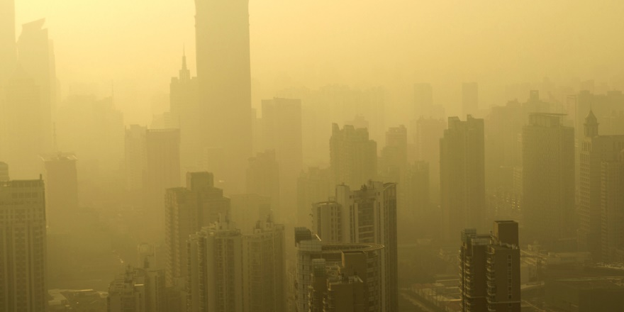
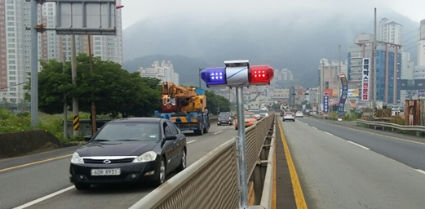
Needs for Air Pollution Information Service Solution
Needs
In recent years, as the problem of air pollution becomes serious, various related technologies are emerging.
Immediately response to air pollution in a driving situation is difficult
Use of infrastructure installed on the road is required to provide immediate information to the driver.
Basic Concept
Air pollution information service allows drivers in a vehicle to provide air pollution-related information to the driver on a roadside warning light for immediate recognition of air pollution.
In addition, possible to provide additional traffic information service as well as air pollution information at a warning light.
< Air Pollution Problem >
< Warning Light on the Road >
Slide 3

Slide 4
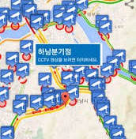
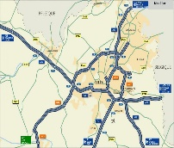
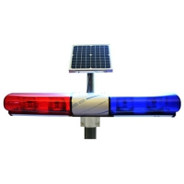
IoT/IoL Link for Air Pollution Information Service
IoT/IoL Connectivity Link for Air Pollution Information Service
Air Pollution Information Service Solution uses a warning light infrastructure installed on the road and in vehicle camera
Provides information to the driver of the vehicle about the air pollution in a warning light.
Rx : Vehicle Camera for Receiver
Tx : Warning Lights on the Road
Modulations :
OOK, VPPM, Offset-VPWM, Multilevel PPM, Inverted PPM, Subcarrier PPM, DSSS SIK, etc.
Day-Night Communication Mode
Data Rate : 1K ~ 1Mb/s
Supported LoS(Line of Sight)
Available Distance : 10m ~ 200m
Air Pollution Information
01010010110111011101000
< IoT/IoL Link for Air Pollution Information Service >
Slide 4

Slide 5
Conclusion
Proposed the On Road Warning Light based Air Pollution Information Service Solution Using IoT/IoL Technology.
Proposed technology that promptly informs the road driver about the air pollution situation by using the warning light installed on the road.
The application of this technology makes it possible to improve the utilization of the beacon, and provides a solution for the infant to immediately recognize and respond to the situation of air pollution.
Slide 5

