Slide 1
Project: IEEE P802.15 Working Group for Wireless Personal Area Networks (WPANs)
Submission Title: IoT/IoL Connectivity Link Through Highway Camera For Delivery Location Service
Date Submitted: July 2018
Source: Jaesang Cha (SNUST), Minwoo Lee (SNUST), Mariappan Vinayagam (SNUST), Sooyoung Chang (SYCA)
Address: Contact Information: +82-2-970-6431, FAX: +82-2-970-6123, E-Mail: chajs@seoultech.ac.kr
Re:
Abstract: This documents introduce the V2X IoT/IoL Link design consideration for VAT. This proposed smart parking solution based on IoT/IoL technology used as part of intelligent building management system for vehicle parking management. The proposed VAT solution can be used in the application services like ITS, ADAS, etc. on road condition, LED IT, Digital Signage with connected information services etc.
Purpose: To Provided Concept models of light communication based IoT/IoL solution for Vehicular Assistant Technology (VAT) Interest Group
Notice: This document has been prepared to assist the IEEE P802.15. It is offered as a basis for discussion and is not binding on the contributing individual(s) or organization(s). The material in this document is subject to change in form and content after further study. The contributor(s) reserve(s) the right to add, amend or withdraw material contained herein.
Release: The contributor acknowledges and accepts that this contribution becomes the property of IEEE and may be made publicly available by P802.15.
Slide 1

Slide 2
Contents
Needs for Delivery Location Service
IoT/IoL Connectivity Link for Delivery Location Service
Conclusion
Slide 2

Slide 3
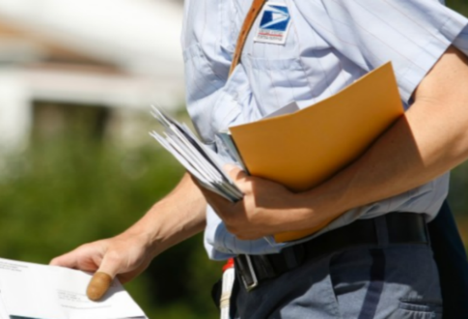
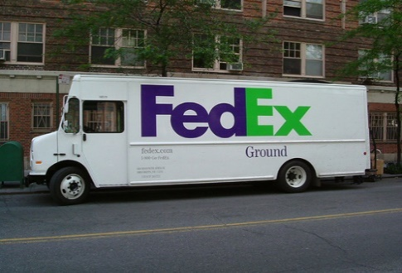
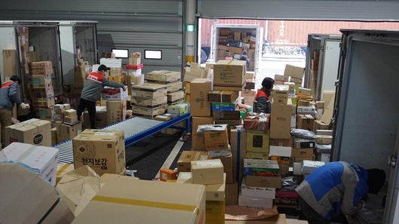
Needs for Delivery Location Service
Needs
To track the precise location of the item
When we receive our order online or offline, we can not get accurate location information about the location of the item.
Present approach allows user to determine the approximate location, but the procedure is complicated because user need to call a telephone or a delivery item separately to check the exact location of the delivery item
Basic Concept
In order to grasp the exact position of the delivered item in real time, the location information of the delivery is displayed online in real time by using the camera installed on the highway or the general road
Customers can view real-time update information on smartphone applications or online, enabling more accurate location of shipment
Uses the CCTV camera installed in roadways and Vehicle lighting system
< Delivery Service >
< Delivery Location Service >
Slide 3

Slide 4
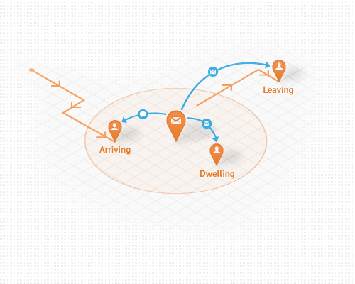
IoT/IoL Connectivity Link for Delivery Location Service
IoT/IoL Connectivity Link for Delivery Location Service
Delivery location service based on IoT/IoL connectivity link allows customers to instantly identify the location of the delivered item and receive accurate location information service compared to existing system
User can get status information and other additional information services as well as location service of courier service
Rx : Highway Camera for Receiver
Tx : Truck Front/Back Lights
Modulations :
OOK, VPPM, Offset-VPWM, Multilevel PPM, Inverted PPM, Subcarrier PPM, DSSS SIK, etc.
Day-Night Communication Mode
Data Rate : 1K ~ 1Mb/s
Supported LoS(Line of Sight)
Available Distance : 10m ~ 200m
Highway Camera
Location Service
Delivery Truck
< IoT/IoL Connectivity Link for Delivery Location Service >
Slide 4

Slide 5
Conclusion
Proposed the IoT/IoL Connectivity Link Through Highway Camera For Delivery Location Service Solution.
Uses the Highway Camera for Receiver and Truck Front/Back Lights for IoT/IoL connectivity link.
The conventional delivery location service can confirm the approximate position and there is a limit to grasp the more accurate position. However, the proposed solution can upload the real-time position information according to the position of the periodic camera, to provide status of delivery, additional traffic information, and etc.
Slide 5

