Slide 1
Project: IEEE P802.15 Working Group for Wireless Personal Area Networks (WPANs)
Submission Title: IoT/IoL Technology Based Smart Parking service solution
Date Submitted: July 2018
Source: Jaesang Cha (SNUST), Minwoo Lee (SNUST), Mariappan Vinayagam (SNUST), Sooyoung Chang (SYCA)
Address: Contact Information: +82-2-970-6431, FAX: +82-2-970-6123, E-Mail: chajs@seoultech.ac.kr
Re:
Abstract: This documents introduce the V2I IoT/IoL Link design consideration for VAT. This proposed smart parking solution based on IoT/IoL technology used as part of intelligent building management system for vehicle parking management. This proposed VAT solution can be used in the application services like ITS, ADAS, etc. on road condition, LED IT, Digital Signage with connected information services etc.
Purpose: To Provided Concept models of light communication based IoT/IoL solution for Vehicular Assistant Technology (VAT) Interest Group
Notice: This document has been prepared to assist the IEEE P802.15. It is offered as a basis for discussion and is not binding on the contributing individual(s) or organization(s). The material in this document is subject to change in form and content after further study. The contributor(s) reserve(s) the right to add, amend or withdraw material contained herein.
Release: The contributor acknowledges and accepts that this contribution becomes the property of IEEE and may be made publicly available by P802.15.
Slide 1

Slide 2
Contents
Needs for Smart Parking System
IoT/IoL Link for Smart Parking Service
Conclusion
Slide 2

Slide 3
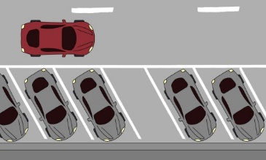
Needs for Smart Parking System
Needs
Too many vehicles are used in day to day activities from two wheelers, cars, bus, and heavy vehicles, etc.
When we use two wheelers or four wheelers for personal use required easy way to find the parking location and parking method
< Parking Area Management in Building >
Basic Concepts
When driver come inside unfamiliar building’s parking garage, especially where the parking garage is big and full of many cars, he is confusing and don’t know where to park
Using IoT/IoL technologies, we can provide better parking service for drivers
This solution is will be more convenient and save time for drivers
Slide 3

Slide 4
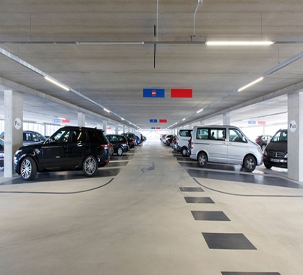
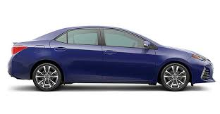
IoT/IoL Link for Smart Parking Service
Service on entrance
Parking garage
Service on exit
Gives the parking place
(2)
receiver
receiver
receiver
Pay for parking
(1)
(3)
Where can I park?
< IoT/IoL Link for Smart Parking Service >
IoT/IoL Link for Smart Parking System
Uses the Lighting System and the Camera connected on car to enable LiFi/CamCom technology for communication between parking garage and vehicle.
No need to spend time to find parking place and it allows automatic payment system
Tx : LED Lighting System in Building
Rx : Camera on Vehicles
Modulations :
OOK, VPPM, Offset-VPWM, Multilevel PPM, Inverted PPM, Subcarrier PPM, DSSS SIK, etc.
Day-Night Communication Mode
Data Rate : 1K ~ 1Mb/s
Supported LoS(Line of Sight)
Slide 4

Slide 5
Conclusion
Proposed the IoT/IoL Technology Based Smart Parking service solution
Using the building Lighting System and the Camera connected on car and parking garage to enable IoT/IoL technology for communication between parking garage and vehicle.
Optimize the time spend time to find parking place
Slide 5

