Slide 1
Project: IEEE P802.15 Working Group for Wireless Personal Area Networks (WPANs)
Submission Title: HMD-AR – CamCom Link for Drone Navigation Information and Control System
Date Submitted: July 2018
Source: Jaesang Cha, Vinayagam Mariappan (SNUST), Byungjun Min (Head IT Co., Ltd), Jungjin Ra (Head IT Co., Ltd), Juphil Cho (Kunsan National Univ.)
Address: Contact Information: +82-2-970-6431, FAX: +82-2-970-6123, E-Mail: chajs@seoultech.ac.kr
Re:
Abstract: This documents introduce the V2X HMD-AR – CamCom Link design consideration for VAT. This proposed HMD-AR – CamCom link solution for drone navigation information and control system. This can be used on the application services like IoT/IoL, LED ID, digital signage with connected information services etc. in factoring or shopping malls etc.
Purpose: To provided concept models of HMD-AR –CamCom Link for drone navigation information and control system for Vehicular Assistant Technology (VAT) Interest Group
Notice: This document has been prepared to assist the IEEE P802.15. It is offered as a basis for discussion and is not binding on the contributing individual(s) or organization(s). The material in this document is subject to change in form and content after further study. The contributor(s) reserve(s) the right to add, amend or withdraw material contained herein.
Release: The contributor acknowledges and accepts that this contribution becomes the property of IEEE and may be made publicly available by P802.15.
Slide 1

Slide 2
Contents
Needs for Drone Navigation Information
HMD-AR – CamCom Link for Drone Navigation Information
Conclusion
Slide 2

Slide 3
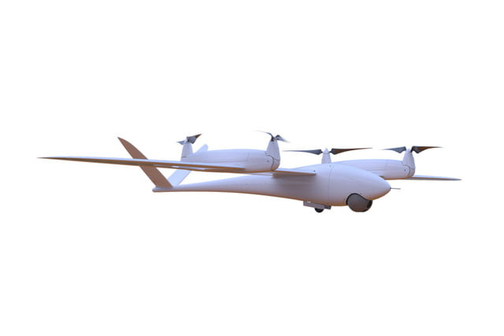
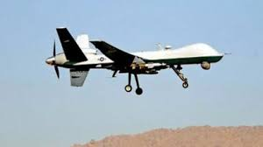
Needs for Drone Navigation Information
Needs
Required interactive path navigation guidance service on smart device for Relax and safety vehicle control
To provide long distance remote and nearby landing
Basic Idea
To provide navigating information for drone on the airport or airbase
Navigation service designed using LED-ID on road and pathway and HMD Camera
Provide nondestructive control support for drone operators
GOOGLE
< Drone System in Use>
Slide 3

Slide 4
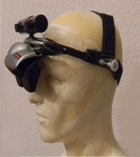
HMD-AR – CamCom Link for Drone Navigation Information
HMD-AR - CamCom Link For Drone Navigation Information and Control
HMD-AR – CamCom Link on drone control time, helps to design the smart navigation function to find the landing pathway , flight speed and height
Tx : Street / Pathway Shop Signage
Rx : CMOS Image Sensor in HMD
Modulations :
OOK, VPPM, Offset-VPWM, Multilevel PPM, Inverted PPM, Subcarrier PPM, DSSS SIK, VTASC etc.
Day-Night Communication Mode
Data Rate : 1K ~ 1Mb/s
Supported LoS(Line of Sight)
Available Distance : 2m ~ 20m
HMD
Drone Built-in With Camera
Camera
Drone device remote control by operator with HMD
< HMD-AR – CamCom Link for Drone Navigation >
Slide 4

Slide 5
Conclusion
Proposed the HMD-AR – CamCom Link for Drone Navigation Information and Control System
Uses the LED-ID technology on existing Landing strip / Pathway signage as HMD-AR – CamCom Link Transmitter to provide location specific informations
HMD-AR - CamCom Link on drone control time, helps to design the smart navigation function to find the landing pathway , flight speed and height.
Slide 5

