Slide 1
Project: IEEE P802.15 Working Group for Wireless Personal Area Networks (WPANs)
Submission Title: OWC Technology based Automatic Stockpile Sorting Subsystem Solution using Factory Vehicle
Date Submitted: July 2018
Source: Jaesang Cha (SNUST), Suhyung Cho (Hans ENS Co., Ltd.), Kirhyong Kim (Seil Technologies Co., Ltd.), Soonho Jung(Sunil Elecomm Co., Ltd.), Vinayagam Mariappan (SNUST)
Address: Contact Information: +82-2-970-6431, FAX: +82-2-970-6123, E-Mail: chajs@seoultech.ac.kr
Re:
Abstract: This documents introduce the V2X OWC Link design consideration for VAT. This proposed OWC solution helps to design a automatic stockpile sorting subsystem solution in factory. This can be used on the application services like IoT/IoL, LED ID, digital signage with connected information services etc. in factoring or shopping malls etc.
Purpose: To provided concept models of OWC based automatic stockpile sorting subsystem solution in factory for Vehicular Assistant Technology (VAT) Interest Group
Notice: This document has been prepared to assist the IEEE P802.15. It is offered as a basis for discussion and is not binding on the contributing individual(s) or organization(s). The material in this document is subject to change in form and content after further study. The contributor(s) reserve(s) the right to add, amend or withdraw material contained herein.
Release: The contributor acknowledges and accepts that this contribution becomes the property of IEEE and may be made publicly available by P802.15.
Slide 1

Slide 2
Contents
Needs for Automatic Stockpile Sorting Subsystem
OWC Link for Automatic Stockpile Sorting Subsystem
Conclusion
Slide 2

Slide 3
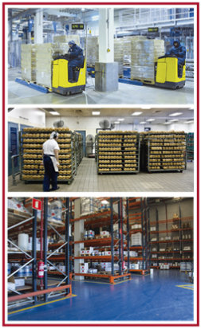
Needs for Automatic Stockpile Sorting Subsystem
Needs
The supply chain management is one of the key issues in smart factory which has to be managed is inventory
The smart factory inventory includes a vast spectrum of materials that is being transferred, stored, consumed, produced, packaged, or sold in one way or another during a firm`s normal curse of business.
The planning, storing, moving and accounting for inventory is the basis for all logistics
Basic Idea
Uses the existing factory lighting and installed CCTV infrastructure, Factory vehicles front light and camera installed in vehicles to implement stockpile sorting subsystem solution
Provides a simple interface to factory inventory system for stockpile sorting without additional interaction with factory support human resources.
GOOGLE
< Smart Factory Stockpile Management >
Slide 3

Slide 4
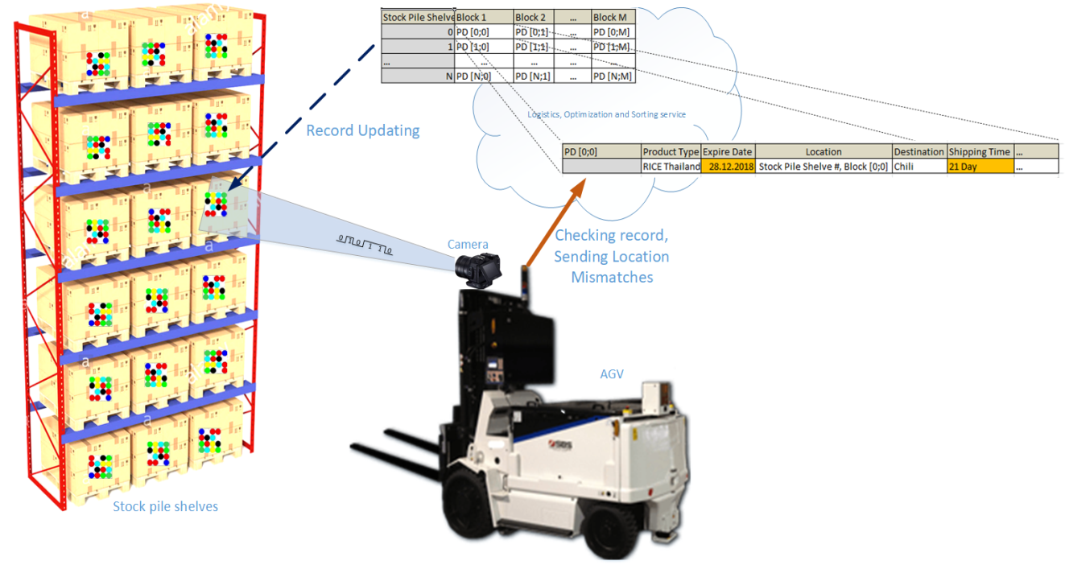
OWC Link for Automatic Stockpile Sorting Subsystem
OWC Data Link For Automatic Stockpile Sorting Subsystem
LED Patches on Shelve blocks dynamically receiving data from “Logistics and Sorting Services Management System”
Factory Vehicles checking information using OWC Solution
Comparing self current location and product location data
Optimize expire date similar product shipping
Tx : LED Patch / Light
Rx : PD / Camera on
Modulations :
OOK, VPPM, Offset-VPWM, Multilevel PPM, Inverted PPM, Subcarrier PPM, DSSS SIK, VTASC etc.
Day-Night Communication Mode
Data Rate : 1K ~ 1Mb/s
Supported LoS(Line of Sight)
Advantages
Needed for Stock Pile sorting and optimization
Mismatches finding
Shipping optimization
Dynamic data updating and sorting
< OWC Data Link For Automatic Stockpile Sorting Subsystem >
Slide 4

Slide 5
Conclusion
Proposed the automatic stockpile sorting subsystem solution using OWC technology
Uses the existing factory lighting infrastructures and factory vehicle lights, etc. as a OWC transmitter
Uses the factory installed CCTV camera and in vehicle installed camera as OWC Receiver
Used to optimize the stockpile location localization, sorting, controlling and mismatches finding using OWC technology
Slide 5

