Slide 1
Project: IEEE P802.15 Working Group for Wireless Personal Area Networks (WPANs)
Submission Title: [IG DEP Improved error controlling scheme for WBAN]
Date Submitted: [10 July, 2018]
Source: [Kento Takabayashi 1, Ryuji Kohno2,3,4] [1;Okayama Prefectural University, 2;Yokohama National University, 3;Centre for Wireless Communications(CWC), University of Oulu, 4;University of Oulu Research Institute Japan CWC-Nippon]
Address [1: 111-4-1 Kuboki, Soja-shi, Okayama, Japan 719-1197
2; 79-5 Tokiwadai, Hodogaya-ku, Yokohama, Japan 240-8501,
3; Linnanmaa, P.O. Box 4500, FIN-90570 Oulu, Finland FI-90014,
4; Yokohama Mitsui Bldg. 15F, 1-1-2 Takashima, Nishi-ku,Yokohama, Japan 220-0011]
Voice:[1; +81-82-830-1609, 2: +81-45-339-4115],
Email:[1: hitanaka@hiroshima-cu.ac.jp, 2:kohno@ynu.ac.jp, 3: ryuji.kohno@oulu.fi ] Re: []
Abstract: [ETSI Technical Committee on Smart BAN has been promoting research and development on dependable wireless systems for wide variety of applications of BAN such as radio controlling, automotive control etc by extending e-Health regarding medical BAN and so on. Thses slides may offer opportunity to discuss on use cases and applications of this standard.] Purpose: [The discussion on use cases and applications will lead definition and requirement of current ongoing research and development on dependable wireless networks.] Notice: This document has been prepared to assist the IEEE P802.15. It is offered as a basis for discussion and is not binding on the contributing individual(s) or organization(s). The material in this document is subject to change in form and content after further study. The contributor(s) reserve(s) the right to add, amend or withdraw material contained herein. Release: The contributor acknowledges and accepts that this contribution becomes the property of IEEE and may be made publicly available by P802.15.
Notes:
doc.: IEEE 802.15-09-0117-00-0007
<month year>

Slide 2
Improved error controlling scheme for WBAN
July 2018,
San Diego, CA, USA
Kento Takabayashi*¹, Ryuji Kohno*^{2,3}
*1 Okayama Prefectural University, Japan
*2 Yokohama National University, Japan
*3 University of Oulu Research Institute Japan – CWC-Nippon, Japan & Finland

Slide 3
Agenda
Error control in IEEE802.15.6
Proposed error control scheme for WBAN
Numerical results
Conclusion

Slide 4
1. Error control in IEEE802.15.6
IEEE802.15.6 shall use a (63, 51) BCH code as an error correcting code in narrowband, UWB and HBC PHY
Only user priority 6 data in UWB-PHY may use a hybrid ARQ with a (126, 63) shortened BCH code
WBAN may deal with 8 levels of user priority data
Those data have a wide range of quality of service (QoS)
The error controlling of the current IEEE Std. 802.15.6 cannot cope with it because of lack of flexibility

Slide 5
1. Motivation
The error control method of the current IEEE802.15.6 does not have sufficient high dependability
Vital sign data for medical use requires high dependability for correct diagnosis
It is also necessary to control medical equipment using wireless communications
The error correcting capability of the (63, 51) BCH code that is mandatory in the current standard is not sufficient for these data
The hybrid ARQ that may only be used for user priority 6 data in UWB-PHY does not correct bit errors at the first transmission
Hence, high SNR (in other words, high power consumption and very short range communication) and many retransmissions (in other words, large delay and high redundancy) are required to increase the dependability of the current error control method
Energy efficiency, that is a necessary requirement for WBAN, is also furher deteriorated due to the above characteristics

Slide 6
1. Purpose
We design a dependable and an energy efficient error controlling scheme that overcomes the problem of the current IEEE Std. 802.15.6 and satisfies the requirements of WBAN for medical use
The error controlling scheme also has flexibility to control a wide range of QoS
We proposes an error control scheme using a hybrid ARQ based on decomposable error correcting codes and Weldon’s ARQ protocol

Slide 7
2. Error controlling scheme for WBAN 1)
Proposed error control scheme using decomposable error correcting codes and Weldon’s ARQ protocol
It is based on punctured convolutional codes (constraint length $K$ = 3 and coding rates $r_{i}$ of 8/9 to 1/16)
The $r_{i}=8/9$ punctured code patterns (codeword 1 and codeword 1') are generated as shown in the next figure
At the first transmission, codeword 1 is sent
To increment the coding rate of the punctured code, elements of codeword 1' are sent after the first transmission
After sending all elements to reconstruct the original convolutional code, codewords 1 and 1' are transmitted alternately
A receiver reconstructs and decodes low-rate decomposable codes by changing the number of data copies in Weldon's ARQ protocol
1) K. Takabayashi, et al. “Cross-layer Design and Performance Analysis of Quality of Service Control Scheme for Wireless Body Area Networks,” IEEE Access, vol.5, pp.22462-22470, Nov. 2017.

Slide 8
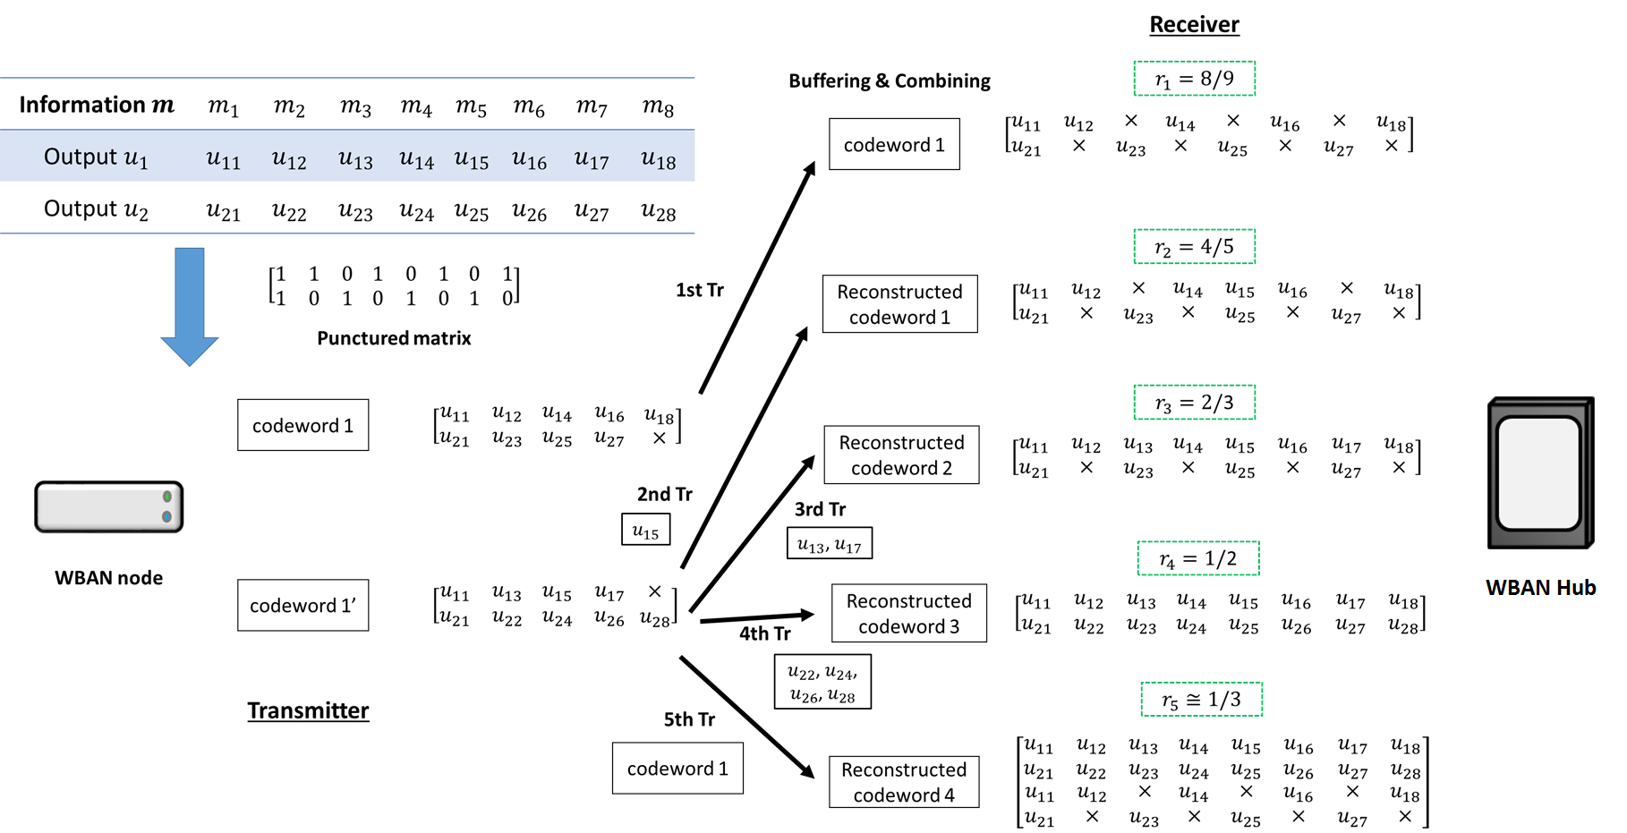
2. Proposed Error Control Scheme for WBAN
Fig. Overview of how to operate the proposed error controlling scheme

Slide 9
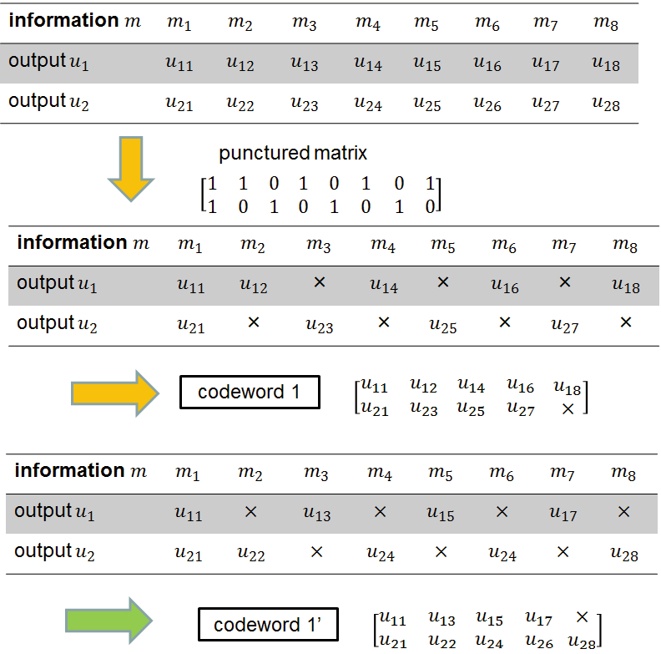
2. Decomposable error correcting codes
Information bits m are encoded by the half-rate convolutional code
Codeword 1 and codeword 1’ whose coding rate is 8/9 (for example) are generated by the punctured matrix
The punctured matrix placed alternately 1 and 0

Slide 10
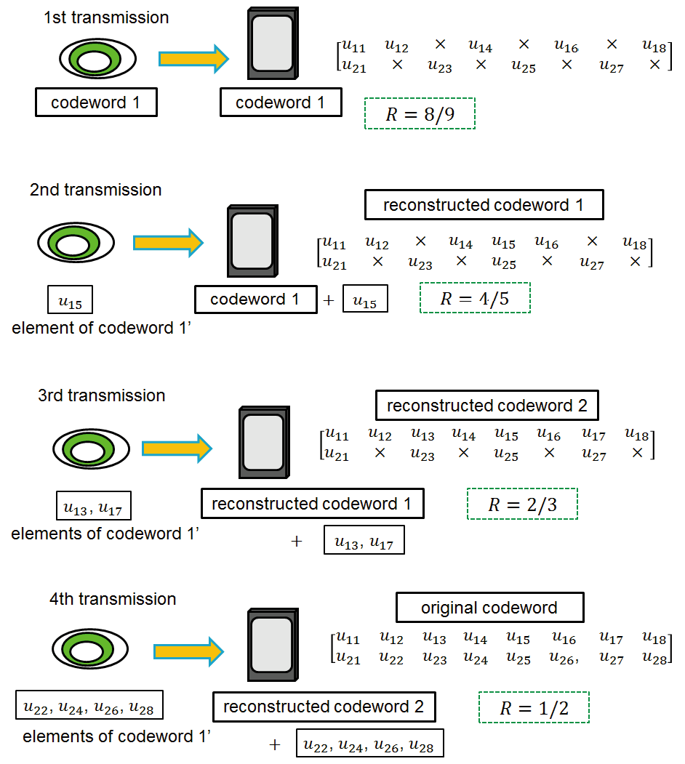
2. Decomposable error correcting codes
Elements of codeword1’ are transmitted and combined with buffered codeword to increase the error correcting capability at each retransmission
Advantage
Error correcting capability is variable depending on the combination of element codes
The number of retransmission can be reduced
The decoding is done only once and is the same process at all transmissions
Notes:
Then, a coding rate at the first transmission may be changed according to channel conditions

Slide 11
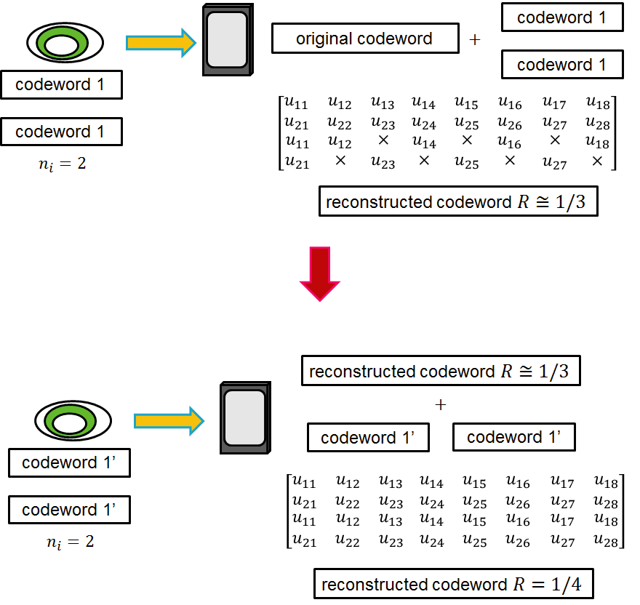
2. Decomposable error correcting codes
Cases in $R<1/2$
The coding rates are extended by using codeword 1 and codeword 1’ at each retransmission after combing the original codeword
A receiver reconstructs and decodes any low-rate decomposable error correcting codes by changing the number of data copies $n_{i}$ in Weldon’s ARQ protocol
Notes:
Then, a coding rate at the first transmission may be changed according to channel conditions

Slide 12
2. Weldon’s ARQ protocol
Weldon’s ARQ protocol cascades several $n_{i}$ copies of the original data at each retransmission when N-ACK is received
The data block is repeated $n_{q}$ times until even one block is successfully received (all bit errors in one data block are removed) or the maximum number of retransmission $q$ is reached
WBAN node
WBAN hub
$$n_{1}=1$$
data
transmission
When WBAN node receives N-ACK
WBAN hub
WBAN node
$$n_{2}=2$$
data
data
retransmission

Slide 13
2. Error controlling scheme for WBAN 1)
Advantages of the proposed error control scheme
The coding rate is very wide
Bit errors are sufficiently eliminated at the coding rate of $r_{c}$ = 8/9 under very good channel conditions
Very low coding rates remove bit errors under bad channel conditions
A coding rate at the first transmission may be changed according to channel conditions
In the case of the small number of retransmissions, it is sufficient to transmit the small number of redundant bits
This characteristic leads to improvement of energy efficiency and reduction of transmission delay at retransmission
1) K. Takabayashi, et al. “Cross-layer Design and Performance Analysis of Quality of Service Control Scheme for Wireless Body Area Networks,” IEEE Access, vol.5, pp.22462-22470, Nov. 2017.

Slide 14
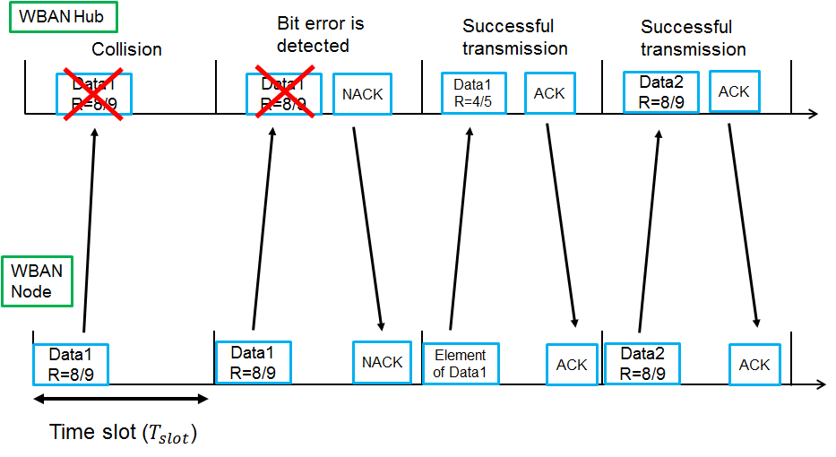
2. Proposed error control scheme for WBAN
Fig. Behavior of the proposed scheme with a random access protocol
Notes:
This figure shows a behavior of our proposed scheme in random access case.
When collision with other packets happens, WBANs node retransmits the same data.
In case that collision does not happen but bit errors are detected, NACK is returned and elements of codeword are transmitted in order to increase error correcting capability.
In case of no bit error and no collision, ACK is returned and then next data is transmitted.

Slide 15
3. Numerical results
Table. Parameters of analysis
Channel model | AWGN
Bandwidth | 499.2MHz
Modulation | DBPSK
FEC (Proposed scheme) | R=8/9 ~ 1/16, K=3, convolutional code
FEC (IEEE802.15.6) | (63.51) BCH code
ARQ protocol (proposal) | Weldon’s ARQ
ARQ protocol (others) | Stop-and-wait ARQ
The number of nodes, $N_{node}$ | 1~10
The maximum number of transmissions, $q$ | 10, 20
Information length, $L_{info}$ | 150, 255 octets
ACK length, $L_{ACK}$ | 7 octets
Uncoded data rate, $R$ | 7.8 Mbps
Slot length, $T_{slot}$ | 2.0 ms (Proposed scheme), 1.0 ms (IEEE802.15.6)

Slide 16
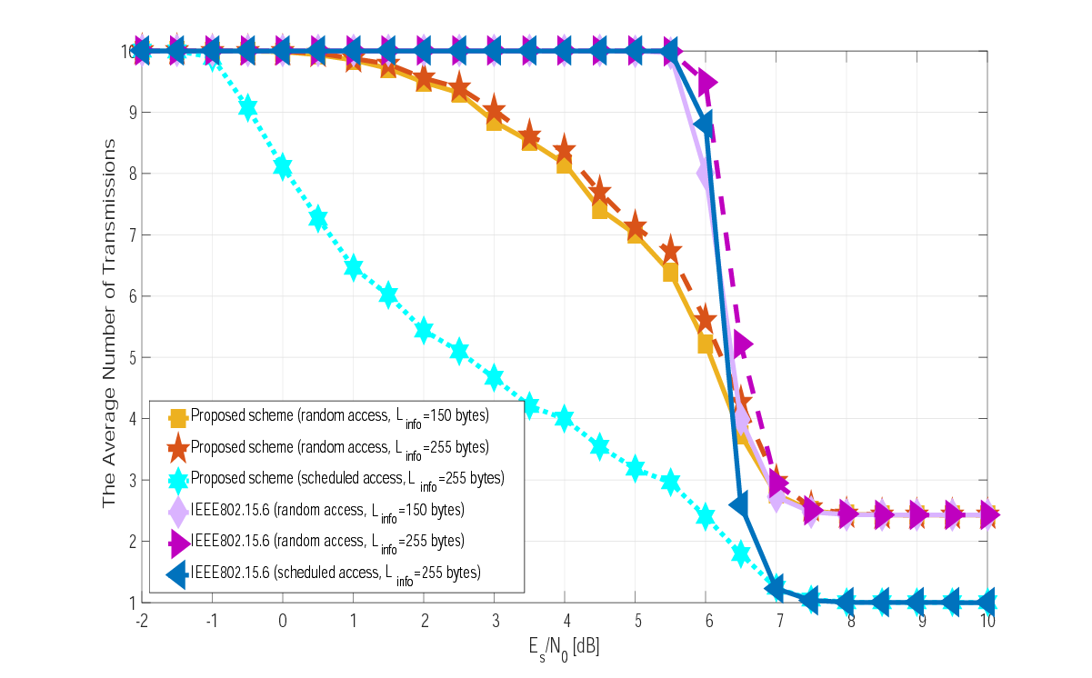
3. Numerical results
Proposed scheme is better
Scheduled access protocol is better
In random access, not converge at 1
The average number of transmission $N_{tx}$ as a function of $E_{s}/N_{0}$($N_{node}=5,q=10)$
Notes:
With a random access protocol, the performance with small $L_{info}$ is slightly better because the $P_{succ,i}^{PHY}$ is better and $P_{succ}^{MAC}$ is constant.
Then, in the same case, the average number of transmissions does not converge on $N_{tx}$= 1 under high SNR conditions because collision with other packets influences $N_{tx}$.
The proposed scheme demonstrates better performance than the standard scheme because its error correction capability is improved with every retransmission under no collision conditions.
As a result, $N_{tx}$ decreases gradually in a scheduled access protocol.

Slide 17
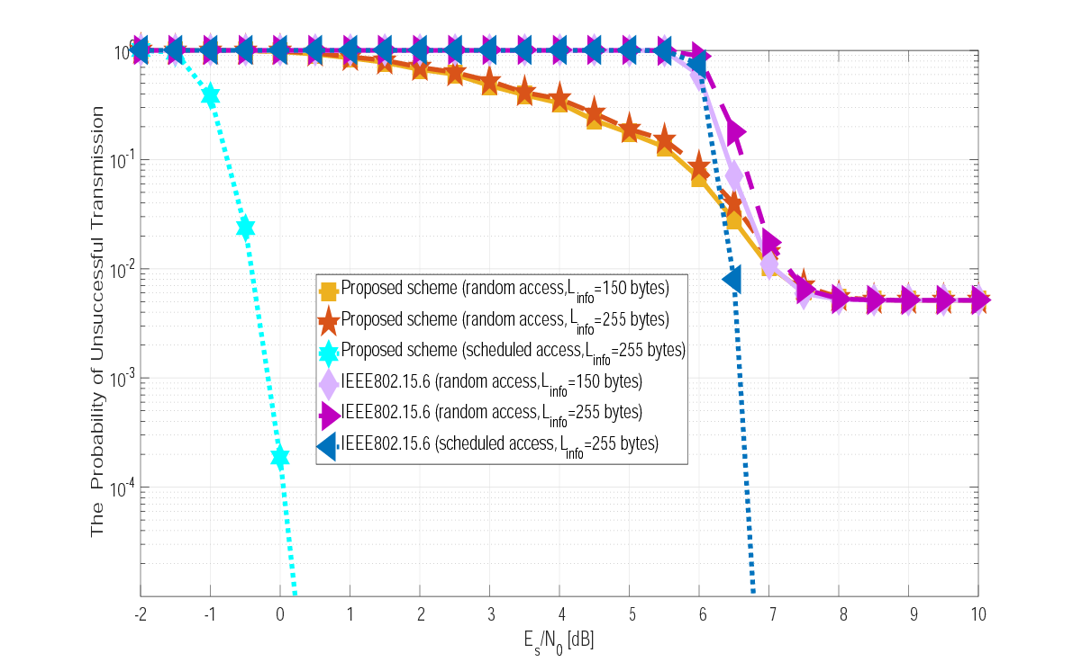
3. Numerical results
Scheduled access protocol is better
In random access, not converge at 1
Proposed scheme is better
The probability of unsuccessful transmission (1-$P_{succ}$) as a function of $E_{s}/N_{0}$ ($N_{node}=5,q=10)$
Notes:
The same things can be said as discussed relative to the average number of transmissions.
With a random access protocol, an error floor region appears, but with a scheduled access protocol, this does not occur because there are no collisions.
Then, the proposed system obtains a greater than 5 dB gain compared to the standard scheme with a scheduled access protocol.

Slide 18
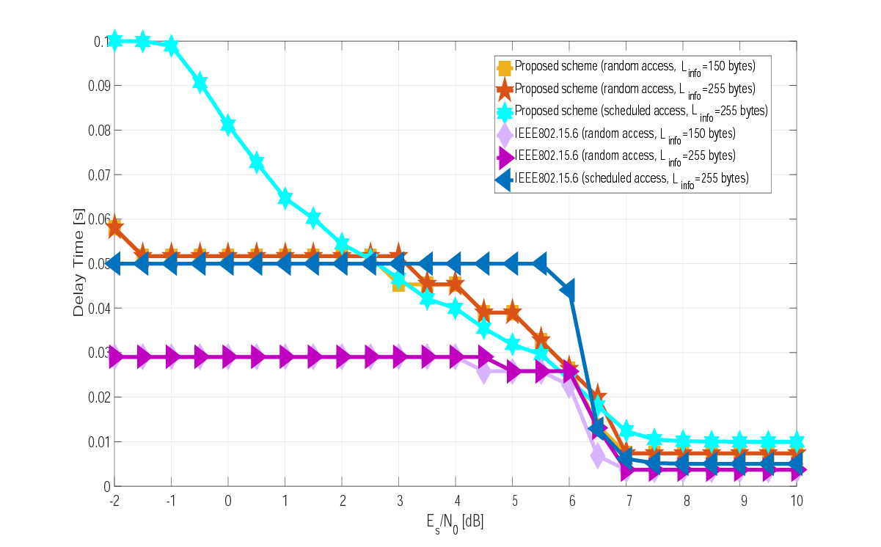
3. Numerical results
In middle SNR, scheduled access protocol is better
In high SNR, random access protocol is better
In low SNR, random access protocol is better
The average delay time as a function of $E_{s}/N_{0}$($N_{node}=5,q=10)$
Notes:
Under low and high SNR conditions, a random access case has better performance than scheduled access with the proposed scheme because, in a scheduled access case, when a certain node is transmitting data, other nodes do not transmit their own data.
However, under moderate SNR conditions, a scheduled access protocol is better because no collisions occur and error correcting is exploited in the error floor region.

Slide 19
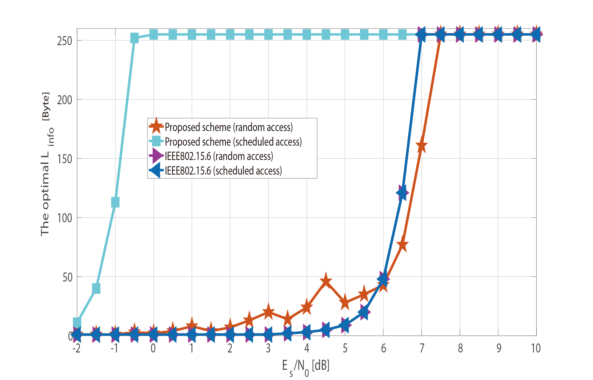
3. Numerical results
Optimal $L_{info}$ in case of maximum energy efficiency as a function of $E_{s}/N_{0}$($N_{node}=5,q=10$)
Notes:
$L_{info}$ is the length of information bits
In the proposed scheme in a scheduled access case, optimal $L_{info}$ is 255 bytes under in 0 dB conditions.
The same case shows the best energy efficiency
On the other hand, with random access, the standard scheme shows better optimal $L_{info}$ and maximum energy efficiency under a 6 dB $≤{E_{s}}/{N_{0}}≤$ 7.5 dB condition even though $N_{tx}$ and (1-$P_{succ}$) in the proposed scheme are less than those of the standard scheme; $ε_{enc}$ and $ε_{dec}$ in the proposed scheme affect performance significantly

Slide 20
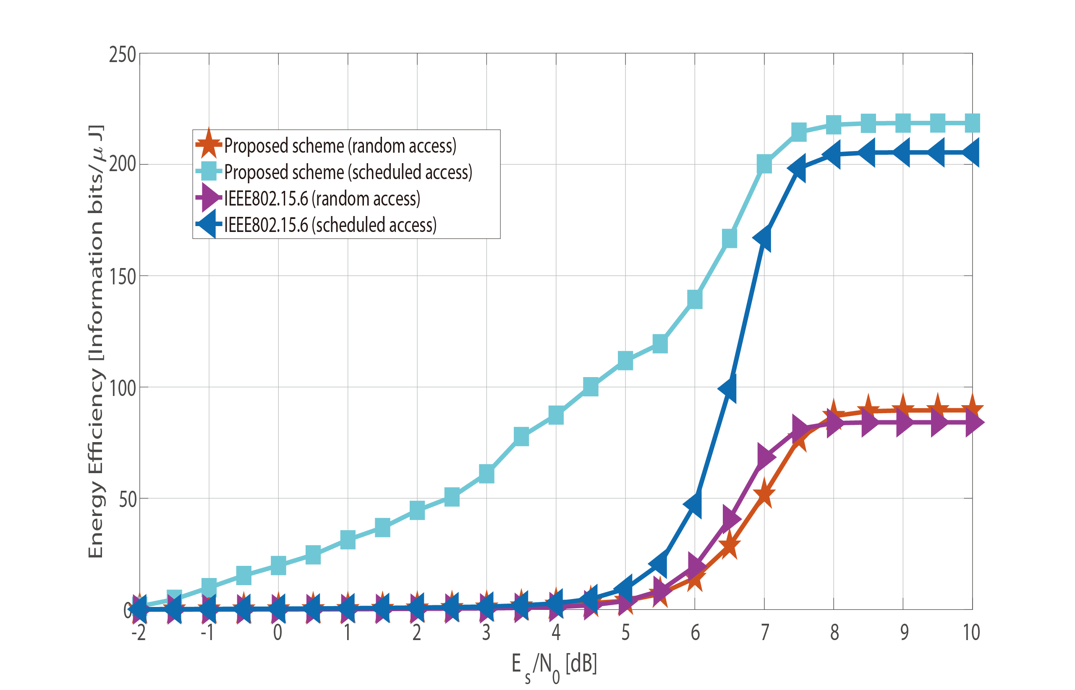
3. Numerical results
Maximum energy efficiency in optimal $L_{info}$ as a function of $E_{s}/N_{0}$($N_{node}=5,q=10)$
Notes:
In the proposed scheme in a scheduled access case, optimal $L_{info}$ is 255 bytes under in 0 dB conditions.
The same case shows the best energy efficiency
On the other hand, with random access, the standard scheme shows better optimal $L_{info}$ and maximum energy efficiency under a 6 dB $≤{E_{s}}/{N_{0}}≤$ 7.5 dB condition even though $N_{tx}$ and (1-$P_{succ}$) in the proposed scheme are less than those of the standard scheme; $ε_{enc}$ and $ε_{dec}$ in the proposed scheme affect performance significantly

Slide 21
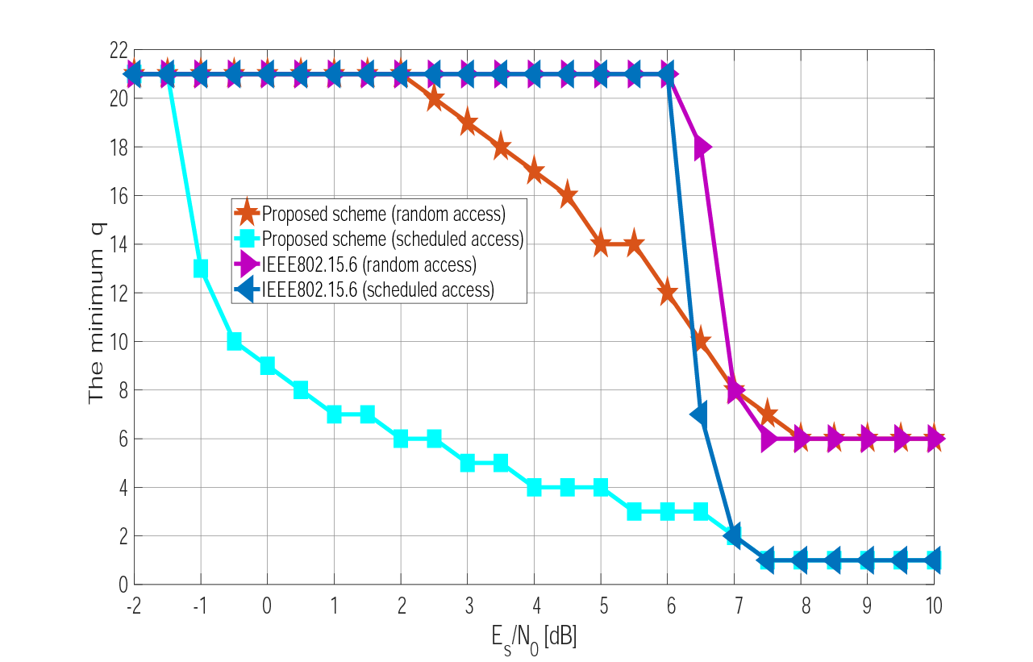
3. Numerical results
In random access, $q_{min}$ must be at least 6
In scheduled access protocol, $q_{min}$ is changed in a step
Minimum $q$ while satisfying $P_{succ}≥0.95$ as a function of $E_{s}/N_{0}$ ($q_{min}$) ($N_{node}$= 5, $L_{info}$= 255 bytes)
Notes:
$q$ is the maximum number of transmissions
If $P_{succ}<0.95$, we consider that $q_{min}$ is 21 for convenience.
Generally, the $q_{min}$ result is similar to that of $N_{tx}$.
Then, in a random access protocol case, it can be said that $q$ greater than 6 and $E_{s}/N_{0}$ greater than 2 dB in the proposed scheme and 6 dB in the standard scheme are required to satisfy this condition.

Slide 22
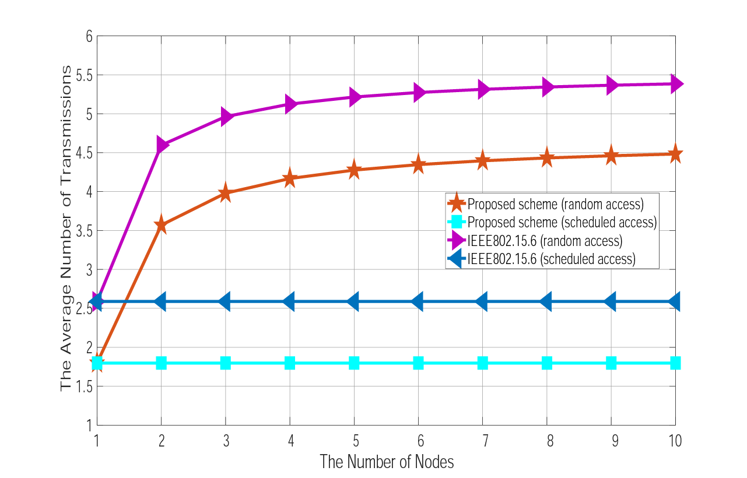
3. Numerical results
Random access increases $N_{tx}$
Average number of transmissions $N_{tx}$ as a function of $N_{node}$
(${E_{s}}/{N_{0}}=6.5 dB,q=10, L_{info}$= 255 bytes$)$
Notes:
The performance of $N_{tx}$ and $P_{succ}$ with a scheduled access protocol is constant and better than that of a random access protocol because no collisions occur.
Then, as $N_{node}$ increases, performance degrades with a random access protocol.

Slide 23
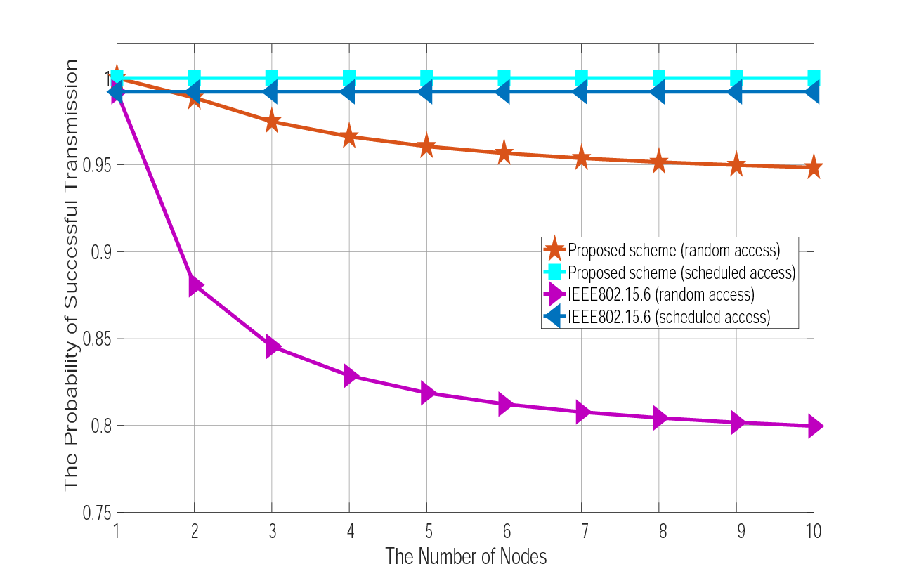
3. Numerical results
Random access decreases $P_{succ}$
Probability of successful transmission $P_{succ}$ as a function of $N_{node}$
(${E_{s}}/{N_{0}}=6.5 dB,q=10, L_{info}$= 255 bytes$)$
Notes:
The performance of $N_{tx}$ and $P_{succ}$ with a scheduled access protocol is constant and better than that of a random access protocol because no collisions occur.
Then, as $N_{node}$ increases, performance degrades with a random access protocol.

Slide 24
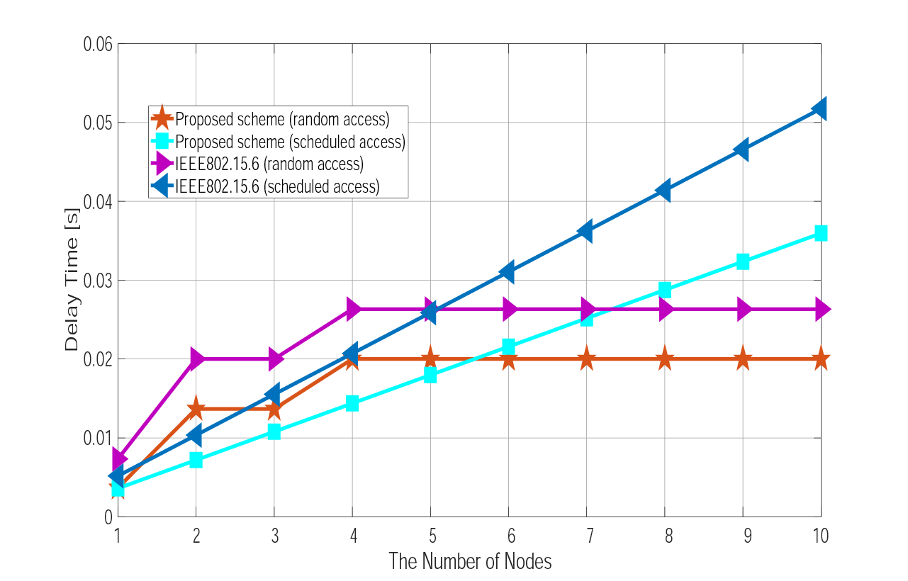
3. Numerical results
In small $N_{node}$, scheduled access protocol is better
In large $N_{node}$, random access protocol is better
Average delay time as a function of $N_{node}$
(${E_{s}}/{N_{0}}=6.5 dB,q=10, L_{info}$= 255 bytes$)$
Notes:
It can be said that, under small $N_{node}$ conditions, a scheduled access protocol has smaller delay time, whereas the delay time of a random access protocol is smaller under large $N_{node}$ conditions, as the number of time slots assigned to each node becomes small under large $N_{node}$ conditions.
Thus, each latency becomes longer under this condition.

Slide 25
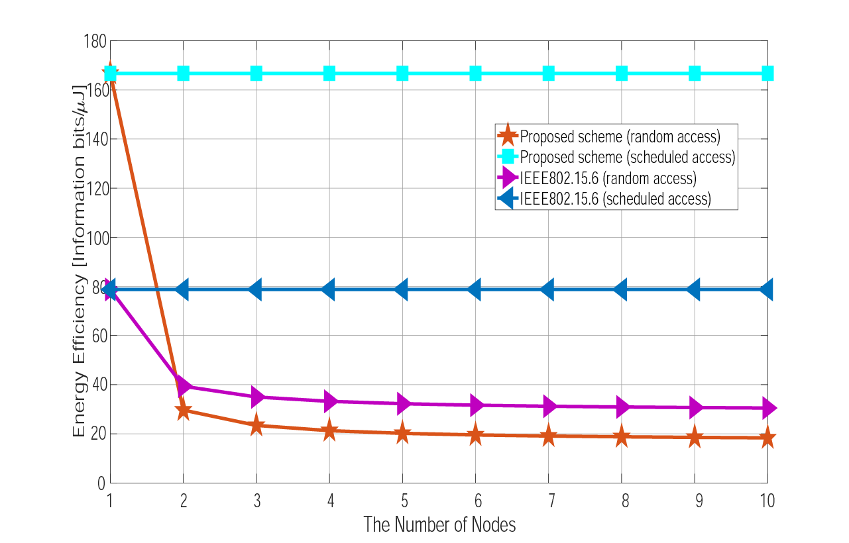
3. Numerical results
In random access protocol case, the standard scheme is better
Energy efficiency as a function of $N_{node}$
(${E_{s}}/{N_{0}}=6.5 dB,q=10, L_{info}$= 255 bytes$)$
Notes:
The same things can be said as for the case of $N_{tx}$ and $P_{succ}$.
However, with a random access protocol, the standard scheme outperforms the proposed scheme because $ε_{enc}$ and $ε_{dec}$ have significant influence in the proposed scheme.

Slide 26
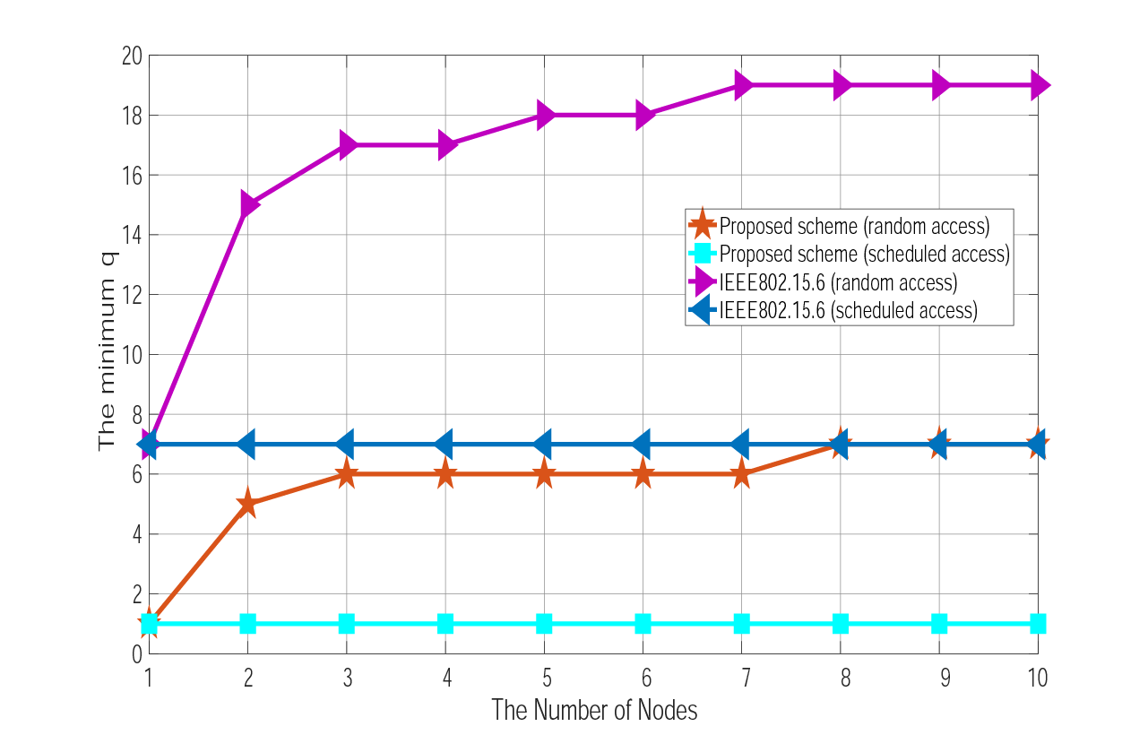
3. Numerical results
Minimum $q$ while satisfying $P_{succ}≥0.95$ as a function of $N_{node}$(${E_{s}}/{N_{0}}=6.5 dB,L_{info}= 255 bytes)$

Slide 27
4. Conclusions
The error control scheme of the current IEEE802.15.6 does not have sufficient high dependability and flexibility
Error control scheme using decomposable error correcting codes and hybrid ARQ is proposed
The scheme has very wide coding rates and smaller redundancy than IEEE802.15.6
Due to the flexible parameter setting, WBAN with various user priority data can control very wide quality of services (QoS)
Numerical results present effectiveness and advantages of the proposed method
The optimal length of information bits, energy efficiency and maximum number of transmissions were derived
Our proposed error control method is much more dependable and energy efficient than the current IEEE802.15.6 from results

