Slide 1
Project: IEEE P802.15 Working Group for Wireless Personal Area Networks (WPANs)
Submission Title: [IG DEP Space-time domain interference mitigation using based on OMF and TDL-AA for dependable UWB-BANs]
Date Submitted: [10 July 2018]
Source: [Takumi Kobayashi1, Ryuji Kohno1,2,3] [1;Yokohama National University, 2;Centre for Wireless Communications(CWC), University of Oulu, 3;University of Oulu Research Institute Japan CWC-Nippon]
Address [1; 79-5 Tokiwadai, Hodogaya-ku, Yokohama, Japan 240-8501
2; Linnanmaa, P.O. Box 4500, FIN-90570 Oulu, Finland FI-90014
3; Yokohama Mitsui Bldg. 15F, 1-1-2 Takashima, Nishi-ku,Yokohama, Japan 220-0011]
Voice:[1; +81-45-339-4115, 2:+358-8-553-2849], FAX: [+81-45-338-1157],
Email:[1: kohno@ynu.ac.jp, 2: Ryuji.Kohno@oulu.fi, 3: ryuji.kohno@cwc-nippon.co.jp] Re: []
Re: []
Abstract: [As a dependable PHY technology for wireless body area network(WBAN), schemes of Space-time domain interference mitigation using based on OMF and TDL-Array Antenna are introduced.]
Purpose: [information]
Notice: This document has been prepared to assist the IEEE P802.15. It is offered as a basis for discussion and is not binding on the contributing individual(s) or organization(s). The material in this document is subject to change in form and content after further study. The contributor(s) reserve(s) the right to add, amend or withdraw material contained herein.
Release: The contributor acknowledges and accepts that this contribution becomes the property of IEEE and may be made publicly available by P802.15.

Slide 2
Space-Time Domain Interference Mitigation Using Based on OMF and TDL-AA for Dependable UWB Wireless Body Area Networks (UWB-WBANs)
Takumi Kobayashi*, Ryuji Kohno*†
＊Yokohama National University
† University of Oulu Research Institute Japan – CWC-Nippon, Co. Ltd.

Slide 3
Issues on multiple BAN environment
  Inter-user interference
    IR-UWB uses the same pulse as all users signal in the same standard.
    Other users signal and/or the other network signal would be interference.
  Inter-system interference
    Interference from the other wreless system using overlapped frequency band. ⇒ Unknown
＊ 802.11a (wi-fi) （5GHz） overlaps
UWB-WBAN
IEEE 802.15.6
user B
Other UWB system.
e.g. IEEE 802.15.4a
user ？
user C
interference
user ？
interference
User A wants to connect to“B”.
user ？

Slide 4
Purpose and Suggestion
  Sparate and Recognize each interference from different source.
  ⇒ Apply suitable interference mitigation method according to source of interference.
  Using both of Spatial and Temporal signal processing.
Inter-user interference
Recognize and demodulate
known
“IUI” in this presentation
Interference from a system using
the same pulse
Pulse shape multiple access
Multi-user detection
Inter-system interference
unknown
“ISI” in this presentation
Remove
Interference from a system using
overlapped frequency
Interference canceller
Notes:
4

Slide 5
Chapter 2
Interference mitigation techniques and related researches
2.1 Orthogonal Matched filter
2.2 Tapped Delay Line Array Antenna
2.3 IR-UWB Communication using Modified Hermite Pulse
Notes:
5

Slide 6
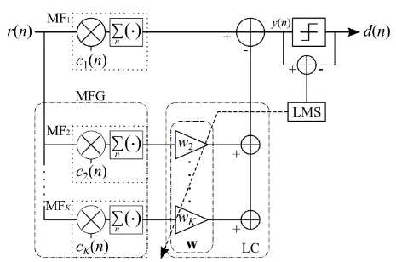
OMF； orthogonal matched filter
  consists a matched filter （MF₁） and MF Group（MFG）
  Tap coefficients of MF₁ are the same as sequence of desired signal.
  Coefficients of MF₁ and each MF_{k} that constituting MFG are orthogonal.
  Desired signal does not through MF_{2～K-1} because orthogonality.
  →only interference can through.
  MFG makes replica of interference signal by lenear combination with weight vector w of linear combiner; LC.
  Subtract interference replica from the output of MF₁ .
_{Principle of OMF}
  OMF can remove interference without any pre-knowledge of interference.
Notes:
6

Slide 7
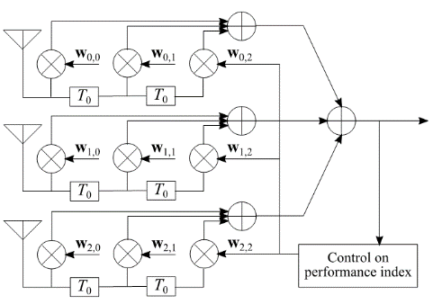

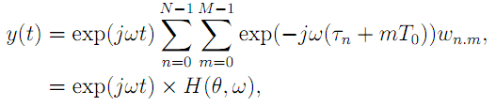

TDL-AA；Tapped delay line array antenna
  Array antenna by using multiple antenna elements and tapped delay line.
  Each antenna branch has coefficients.
  Transfer function of this antenna has parameters of signal incoming angle;θ and frequency; ω.
  ⇒has characteristics of both of spatial and time domain.
（Tapped delay line array antenna）
_{Principle of TDL-AA}
  TDL-AA can work as interference canceller on both of time and space domains
Notes:
7

Slide 8
Modified Hermite pulse; MHP applied to IR-UWB communication (Mohammad Ghavami et al,)
  Pulse function generated by modified Hermitian polynomials.
  Pulses are orthogonal each other in sync.（t=0）condition.
  Cross correlation =0.
  ⇒no interference
  In async.（t≠0） condition, not orthogonal.
Notes:
8

Slide 9
Orthogonality of MHP
  MHP: Modified Hermite Pulse
  Each user uses unique order MHP as its transmission signal.
  n-th order MHP is generated by n-th order modified Hermite polynomial.
  In sync.（t=0） and no distortion condition, MHPs are orthogonal.
  (cross correlation = 0)
  Channel propagation makes it distortion.
  ⇒NOT orthogonal.
Interference canceller
Notes:
9

Slide 10
overview
Proposal 1
Chapter 3
Pulse shape based OMF
Proposal 2
Chapter 4
Space-Temporal interference mitigation using TDL AA based on OMF using pulse orthogonality
OMF based on orthogonality of random sequence
（existing）
TDL Array antenna
（existing）
Notes:
10

Slide 11
Chapter 3
Time domain interference mitigation for inter-user and inter-system interference
Interference Cancellation for Intra and Inter UWB systems Using Modifed Hermite Polynomials Based Orthogonal Matched Filter
  3.1 Purpose
  3.2 System model and theoretical analysis
  3.3 Numerical Evaluation and results
Notes:
11

Slide 12
  UWB system takes several types of interference.
  Inter-user interference
    Typical UWB uses same pulse.
    The interference from the other user in same network.
  Inter-system interference
    The interference from the other system using same frequency band.
    Unknown interference.
UWB-WBAN
IEEE 802.15.6
user B
Other UWB system.
e.g. IEEE 802.15.4a
user ？
user C
interference
user ？
interference
User A wants to connect to“B”.
user ？
Notes:
12

Slide 13
Purpose and Suggestion
  Sparate and Recognize each interference from different source.
  ⇒ Apply suitable interference mitigation method according to source of interference.
  Using both of Spatial and Temporal signal processing.
Inter-user interference
Recognize and demodulate
known
“IUI” in this presentation
Interference from a system using
the same pulse
Pulse shape multiple access
Multi-user detection
Inter-system interference
unknown
“ISI” in this presentation
Remove
Interference from a system using
overlapped frequency
Interference canceller
Notes:
13

Slide 14
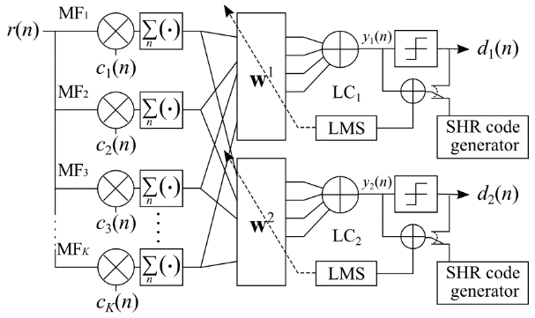
Proposed OMF with Multi-user detection
  As MF and MFG of OMF,
    Use discrete sampled MHP.
    Gramm-Schmidt orthonormalization is used for fill deficit in MFG.
  By utilizing the MHP as a MFG…
    Known user’s signal which uses same MHP as MFG can be retrieved.
    Unknown interference can be cancelled
MUD
Proposed system for 2 users detection.
    MUD and ISI mitigation
ISI mitigation
    Works at the same time
Notes:
14
therefore

Slide 15




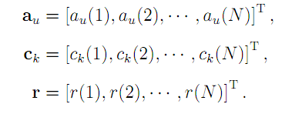
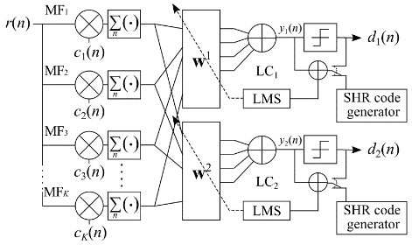



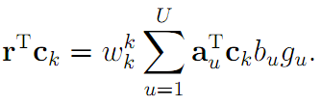

System model and theoretical analysis.
  Rx signal
In vector form
k-th orthogonal vector
is desired user’s pulse
output included in
Notes:
15
therefore

Slide 16



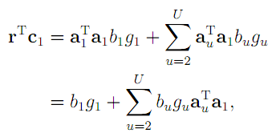



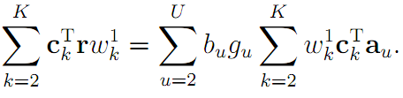
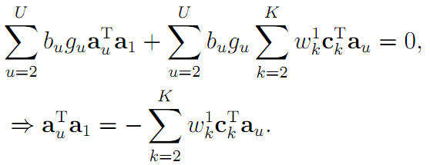
System model and theoretical analysis
Desired signal is assumed as a₁
k-th orthogonal vector
is desired user’s pulse
Desired signal
Interference
signal included in
Interference is cancelled in condition satisfies…
Notes:
16
therefore

Slide 17
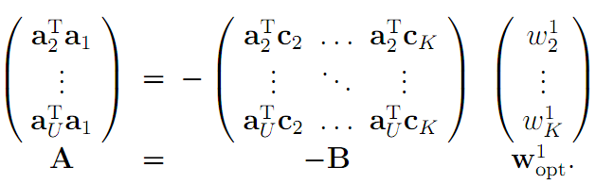

System model and theoretical analysis
Interference is cancelled in condition satisfies…
k-th orthogonal vector
is desired user’s pulse
In matrix
Optimum weight vector
*without noise
Notes:
17
therefore

Slide 18
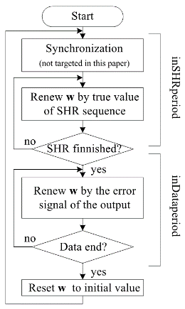
Numerical evaluation
    Assumed MHP-UWB which uses MHP as transmission pulse.
    Each user uses unique order MHP as a transmission pulse.
    MAC frame has generally known SHR preamble on its head.
    → Adaptive algorithm estimates an optimum solution by using this known preamble.
    IUI and ISI exist.
Notes:
18
therefore

Slide 19
  MUD and ISI canceller – Numerical evaluation.
Scenario 1
Scenario 2
user 5
user 1
user 2
user 2
DIR [dB] | -40 to +40
Known user | 2 (0th and 3rd MHP) | １ (0th MHP)
Unknown interference | Gold sequence DS-UWB, 29 users | Chirped pulse UWB, 1user
Channel (dist. / noise) | IEEE 802.15.6 CM3 path loss model + AWGN
Iteration for LMS / NLMS | 2,000 ~ 32,000 / 4,000 ~ 64,000 | 250 ~ 3,000 / 80 ~ 1280
Notes:
19

Slide 20
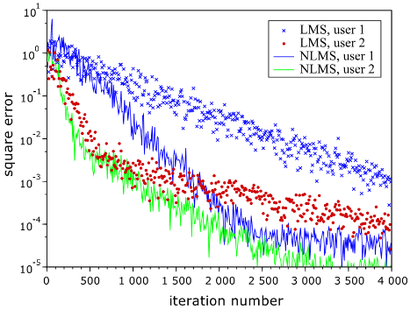
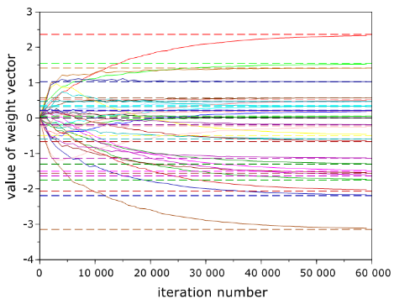
  Results of SC.1
Square error (SC.1).
E_{b}/N₀=+60dB, DIR=0dB
Weight coefficients (SC.1) E_{b}/N₀=+60dB, DIR=0dB.
LMS & NLMS algorithm towards to minimum square error.
Weight coefficients converge to optimum solution w_{opt}.
Multiple user’s signal retrieved with interference reduction.
Adaptive algorithm makes approx. solution.
Notes:
20

Slide 21
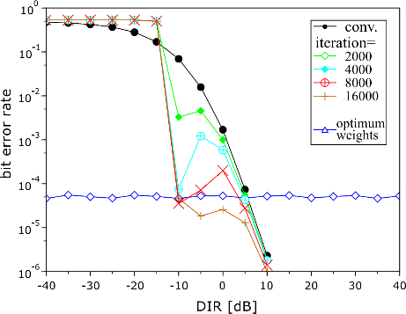
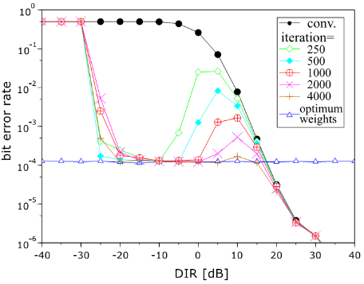
  Results (LMS algorithm)
DIR vs. BER (SC.1) E_{b}/N₀=+35dB.
DIR vs. BER (SC.2) E_{b}/N₀=+25dB.
More iteration number makes higer capacity of interference reduction
In low DIR situation, this system LMS algorithm cannot be used.
Notes:
21

Slide 22
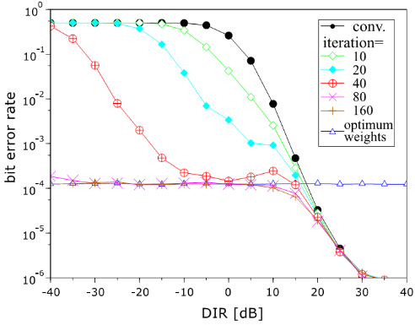
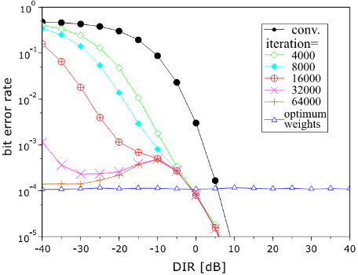
  Results (NLMS algorithm)
DIR vs. BER (SC.1) E_{b}/N₀=+35dB.
DIR vs. BER (SC.2) E_{b}/N₀=+25dB.
More iteration number makes higer capacity of interference reduction
Normalized LMS algorithm can be used even in extremely low DIR condition.
Notes:
22

Slide 23
  Results (Without noise)
DIR vs. BER (SC.1) E_{b}/N₀=+∞dB.
DIR vs. BER (SC.2) E_{b}/N₀=+∞dB.
More iteration number makes higer capacity of interference reduction
Notes:
23

Slide 24
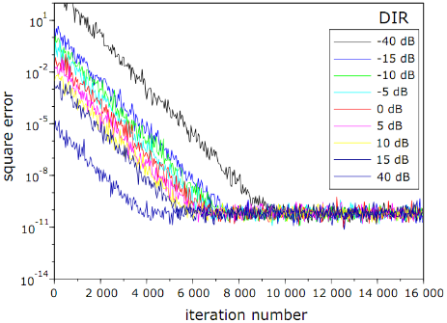
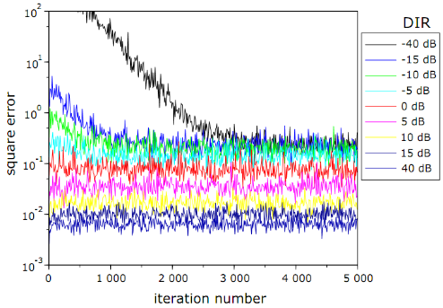
  Results of SC.1
Square error characteristics in various DIR(SC.1).
Square error characteristics in various DIR (SC.1).
E_{b}/N₀=+120dB, DIR=-40dB ~ +40dB
E_{b}/N₀=+25dB, DIR=-40dB ~ +40dB
Adaptive algorithm does not find an optimum weights in low DIR and low E_{b}/N₀. ⇒ ⇒ ⇒ Theoretical analysis with Noise
Notes:
24

Slide 25
Simulation results
  (noise free channel)
DIR vs. BER E_{b}/N₀=+∞dB.
More iteration number makes higer capacity of interference reduction

Slide 26
Simulation results
  (noise & interference channel)
Noise
enhancement
DIR vs. BER (SC.2) E_{b}/N₀=+25dB.
W_{opt} which is generated by theory does not satisfies minimum error In high DIR condition. ⇒ W_{opt} is not optimal solution in environment in which noise exists.
High DIR ➔ dominant cause of bit error is noise

Slide 27
  Theoretical analysis
Size reduction of weight vector by a coefficient Δ
Enhanced noise
Suppression of noise enhancement by Δ
noise
Residual interference
When W ≠ W_{opt} , interference remains.
Δ becomes smaller
⇒noise enhancement is suppressed
⇒residual interference is increased
Adaptive algorithm try to find MMSE “as smaller as possible ⇒ not optimum
Analyze a theoretical solution which satisfies MMSE criteria
Notes:
27

Slide 28
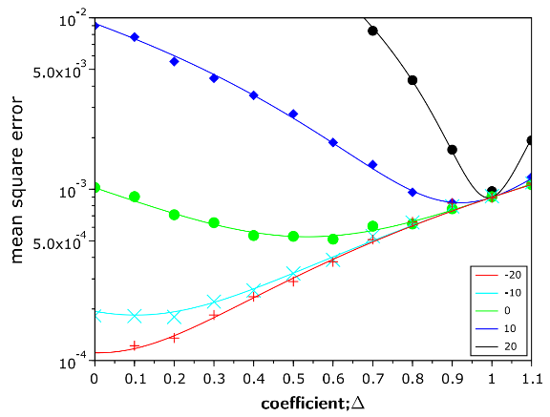



  Smaller Δ makes
⇒residual interference is increased
Wopt is shrinked by Δ ≦ 1.
⇒noise enhancement is suppressed
Δ_{opt} in 20dB
Δ_{opt} in 0dB
Δ_{opt} depends on power of interference and noise
Δ_{opt} in -10dB
Δ_{opt} in 10dB
Adaptive algoeithm cannot find Δopt but it can find approximate solution.
Δ_{opt} in -20dB
Δ which satisfies MMSE in various DIR (SC.2) E_{b}/N₀=+25dB.
Notes:
28

Slide 29
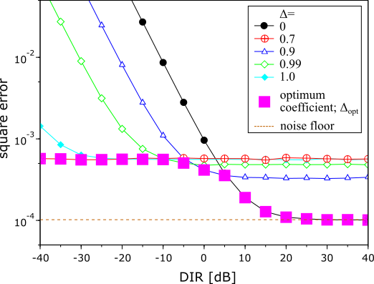
  Theoretical performance
Size reduction of weight vector by a coefficient Δ
  Smaller Δ
⇒residual interference is increased
⇒noise enhancement is suppressed
  Larger Δ
⇒residual interference is suppressed
⇒noise enhancement is increased
Optimum solution
Square error using various fixed Δ and Δ_{opt} in each DIR (SC.2) E_{b}/N₀=+25dB.
Notes:
29

Slide 30
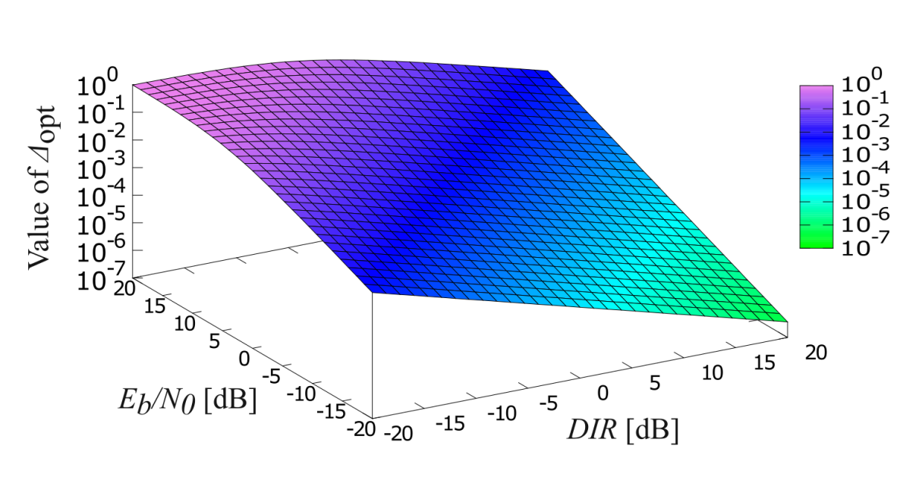
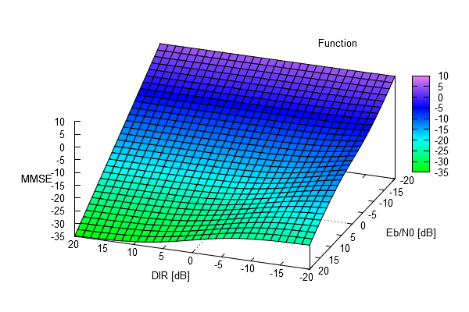
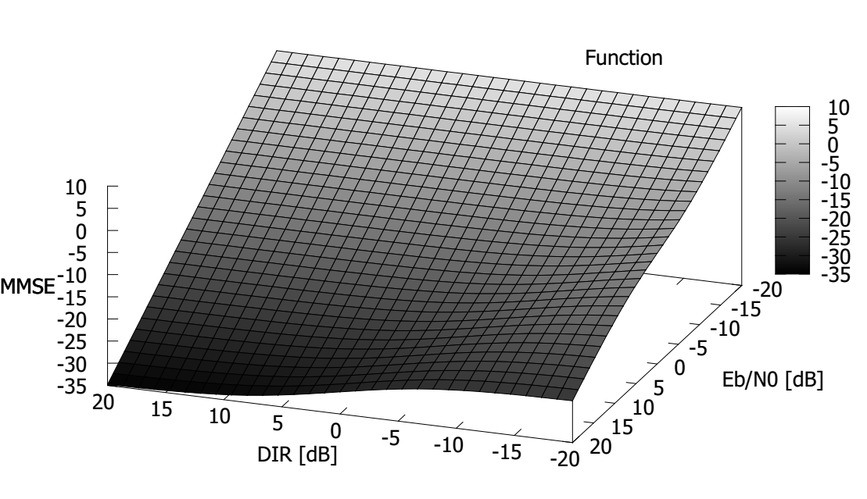
Theoretical analysis results
In High DIR and Low Eb/N0 channel, Δ_{opt} becomes close to 0 (zero).
In Low DIR and High Eb/N0 channel, Δ_{opt} becomes close to 1 (one).
Δ_{opt} value in each Eb/N0 and DIR conditions
Optimal solution Δ_{opt}w_{opt} provides a performance limit of our proposing system.
Although our system cannot remove noise, MSE can be reduced in low noise situation.
MSE in dB
MSE in optimum slution

Slide 31
Chapter 4
Space-time domain interference mitigation using TDL array antenna for MHP based IR-UWB
(2) Space Temporal Interference Cancellation Using TDL Array Antenna and Waveform Based OMF for IR-UWB Systems
  4.1 Proposed system model and theoretical analysis
  4.2 Numerical evaluation and results
Notes:
31

Slide 32
TDL-AA；Tapped delay line array antenna
  Array antenna by using multiple antenna elements and tapped delay line.
  Each antenna branch has coefficients.
  Transfer function of this antenna has parameters of signal incoming angle;θ and frequency; ω.
  ⇒has characteristics of both of spatial and time domain.
（Tapped delay line array antenna）
_{Principle of TDL-AA}
  TDL-AA can work as interference canceller on both of time and space domains
Notes:
32

Slide 33
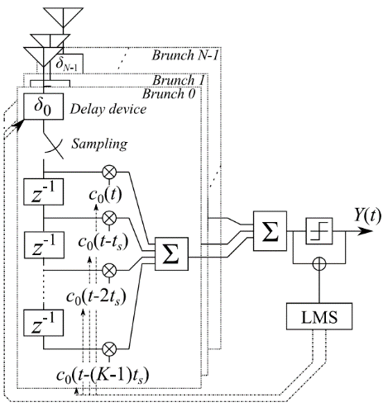
Apply pulse based OMF to spatial signal processing
  TDL array antenna
    Configured by multiple antennas and tapped delay line （TDL）
    TDL-AA can separate the signals which comes from the same direction by using time-domain signal processing.
  By applying OMF to TDL-AA
    Interference reduction is performed on the both of domains of time and space.
Space-temporal signal processing
Notes:
33
therefore

Slide 34
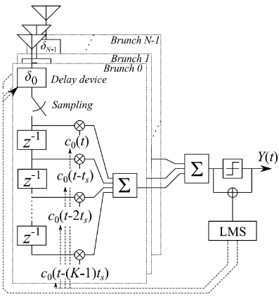
System model and optimum parameters.
  Beam forming,
    Delay time of each antenna brunch is adjusted to achieve Maximum Power of desired signal
    N ：number of antennas,
    ν： propagation speed
    d_{s} ：antenna distance
  Null-steering,
    MHP based OMF is used as a TDL.
    arrival time difference of u-th users signal in n-th antenna is
Notes:
34
therefore

Slide 35
System model
  Delay time for beam forming is
  OMF of n-th brunch has coefficients c_{n}(t) that satisfy bellow
where, w_{k} is determined as
Matrix form
is desired user’s pulse
is u-th user’s pulse (undesired)
k-th orthogonal vector
Notes:
35
therefore

Slide 36
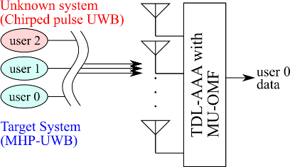
  Characteristics evaluation on each arrival angle
Scenario 6
Scenario 7
Number of antennas / placement | 5 / Linear array
Distance between antennas; d_{s} [m] | 0.45
Desired user’s pulse | 0th order MHP
Interference user’s pulse | 2nd order MHP (IUI) and chirped pulse UWB (ISI)
Arrival angle of desired signal [degree] | 10 | 0
Arrival angle of interference signal [degree] | 30 and -60 | 0 and 0
Notes:
36

Slide 37
Gain≠0
Gain≠0
No gain
TDL-AA without null-steering（ SC.6）
Space-temporal interference reduction (SC.7)
System has gain against an interference
→residual interference
Interference signal is reduced
Notes:
37

Slide 38
Gain≠0
No gain
MHP orthogonality
TDL-AA without null-steering （ SC.6）
Space-temporal interference reduction(SC.7)
System has gain against an interference
→residual interference
Interference signal is reduced
Notes:
38

Slide 39
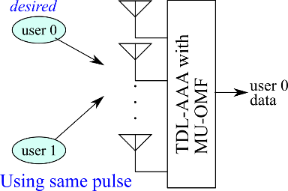
  Characteristics evaluation on each arrival angle
Scenario 8
    2 users use the same pulse
    Time-domain signal processing cannot reduce the interference
Number of antennas / placement | 5 / Linear array
Distance between antennas; d_{s} [m] | 0.45
Desired user’s pulse | 1st order MHP
Interference user’s pulse | 1st order MHP
Arrival angle of desired signal [degree] | -30
Arrival angle of interference signal [degree] | 30
Notes:
39

Slide 40
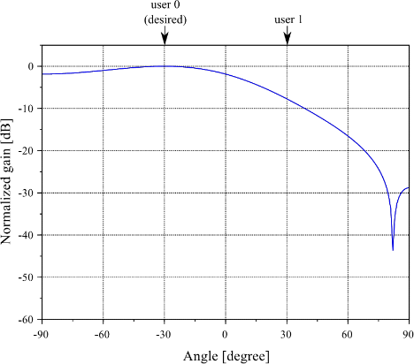
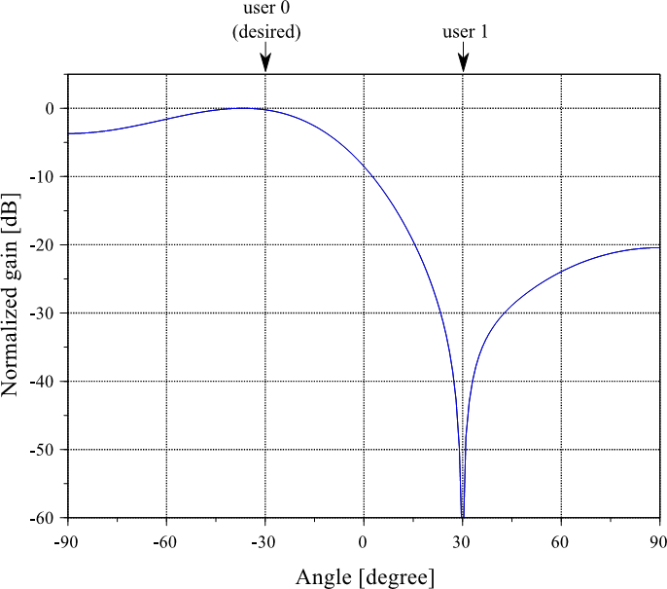
Max gain
Max gain
Gain≠0
reduction
TDL-AA without null-steering （ SC.8）
Space-temporal interference reduction(SC.8)
System has gain against an interference→residual interference
Interference can be eliminated if either one is different from the desired signal
Notes:
40

Slide 41
Conclusion
  OMF based on Modified Hermite pulse have been proposed.
  Interference mitigation (reduction) in Time-domain.
  By using layered structure, MHP based OMF combined with Code-based OMF.
    Reduce computation cost, and expand number of users (capacity)
  MHP based OMF is combined with TDL-AA.
    Interference mitigation on Time and space domains signal processing.
Notes:
41

Slide 42
References
Takumi Kobayashi Chika Sugimoto, Ryuji Kohno, “Theoretical analysis of interference canceler using modified hermite polynomials based orthogonal matched filter for IR-UWB systems in AWGN and interference channel,” Proc. 2017 20th International Symposium on Wireless Personal Multimedia Communications (WPMC) 2017, DOI: 10.1109/WPMC.2017.8301793
Takumi Kobayashi, Masato Suzuki, Chika Sugimoto, Ryuji Kohno, “Space temporal interference cancellation using TDL array antenna and waveform based OMF for IR-UWB systems,” ICT Express, Volume 1, Issue 2, pp.71-75, 2015. ISSN 2405-9595, https://doi.org/10.1016/j.icte.2015.09.006.
Takumi KOBAYASHI Chika SUGIMOTO Ryuji KOHNO, “Interference Cancellation for Intra and Inter UWB Systems Using Modified Hermite Polynomials Based Orthogonal Matched Filter,” IEICE TRANSACTIONS on Communications Vol.E99-B No.3 pp.569-577, 2016.

