Slide 1
Project: IEEE P802.15 Working Group for Wireless Personal Area Networks (WPANs)
Submission Title: [Simultaneous Ranging]
Date Submitted: [11th July 2018]
Source: [Jarek Niewczas, Michael McLaughlin, Billy Verso] Company [Decawave Ltd.]
Address [Peter Street, Dublin 8, Ireland]
Voice:[+353.87.233.7323], E-Mail:[billy.verso (at) decawave.com, jarek.niewczas (at) decawave.com]
Re: [Proposed enhancements to the HRP UWB PHY]
Abstract: [Describe a technique for simultaneous ranging with a view to including the necessary mechanisms in the HRP UWB PHY enhancement specification of amendment 802.15.4z]
Purpose: [This is a power saving technique]
Notice: This document has been prepared to assist the IEEE P802.15. It is offered as a basis for discussion and is not binding on the contributing individual(s) or organization(s). The material in this document is subject to change in form and content after further study. The contributor(s) reserve(s) the right to add, amend or withdraw material contained herein.
Release: The contributor acknowledges and accepts that this contribution becomes the property of IEEE and may be made publicly available by P802.15.

Slide 2
The aim of this presentation:
Present the concept of simulataneous ranging and describe the technique
Propose how to include it in the 802.15.4z amendment

Slide 3
Simultaneous ranging
  In certain applications, like automotive, it is required to measure the distance to the nearest of a number of devices
    e.g. with “anchor” points at corners of a car determine shortest distance from key-fob to car
  Simultaneous ranging is a method to reduce airtime and battery consumption by configuring multiple responding devices to respond at the same time (or almost at the same time) with overlapping frames
  Savings for the key fob can be quite significant. For example to perform single sided two-way ranging with N devices:
    It could require 2xN messages in case of N separate SS-TWR exchanges
    Or, N+1 messages if the all anchors respond serially to the same “poll” message
  With simultaneous ranging, only 2 messages are required from the key-fob’s point of view, the poll and the “simultaneous” response

Slide 4
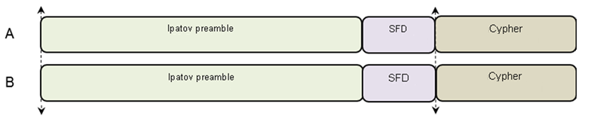
Simultaneous ranging – parallel variant
  There are multiple variations in how simultaneous ranging techniques can be deployed. The simplest one, here called “parallel variant” involves completely parallel transmission the packets
    To maintain security, all ciphers transmissions need to be aligned in time
  Depending on their relative distances the signals from each device can produce single or multiple peaks in the accumulator, however the 1st in time peak marks the distance of the closest responding device
  Multiple devices can respond at the same time, although more devices typically add more interference/multipath and sidelobes

Slide 5
Simultaneous ranging – parallel variant
  The scheme is suitable for situations where we only need to know the distance from the closest device (like in automotive secure bubble scenarios). Later paths from more distant devices may be buried in multipath of the closest device
  The clocks of all the responding devices need to be closely synchronized to be within +-1.5ppm, otherwise the receiver may synchronize carrier recovery to only one selected responder and the peaks from other will fail to accumulate due to their rotation at a different rate than the paths from the selected responder
  Another limitation is that preambles need to short, preferably <64µs, otherwise even low frequency offset will produce enough rotation during longer preambles that other paths will cancel out during accumulation. Short cipher length, means that usage of sidelobe minimization algorithms are necesarry
  Using longer preambles also carries the risk that carrier recovery will become unstable as various sub-paths from other responders will be interfering and changing their phases during the preamble

Slide 6
Simultaneous ranging – parallel variant
  For 64µs cipher and channel 5, the frequency offset should be within +/- 1.5ppm to keep amplitude loss below 5dB, as shown below
  For 128µs preamble, the frequency offset tolerance would be halved

Slide 7
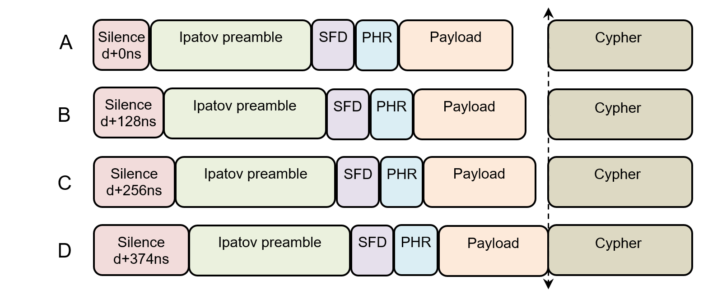
Simultaneous ranging – staggered variant
  The “parallel variant” carries some limitations
    Due to the risk of carrier recovery getting unstable, preambles need to be short and clocks very accurately synchronized
    There should be either no payload or all payload messages should be identical
  This second “staggered variant” solves those problems
  In this scheme, the start of the Ipatov preamble is shifted depending on device, but all cipher sequences are aligned to start at the same time

Slide 8
Simultaneous ranging – staggered variant
  The “staggered variant” introduces offsets between responding packets
    e.g. N*128ns
  This allows the receiver to place the “reception window” around just one responding device (e.g. by positioning it on the strongest paths) and synchronize it’s carrier recovery to it
    In this case the other devices will no longer interfere with carrier recovery operation
  This scheme allows each responder to send different payloads
    The receiver will decode the payload from the responder that is has locked to
  If other responders have frequency offset similar to one the receiver has locked to, their channels will also be seen in the accumulators
    In the Ipatov accumulator the peaks will be shifted by N*128ns for each responder
    And in the cipher accumulator they will be all on top of each other
  Analysis of the Ipator accumulator potentially allows for calculation of independent distances to each responder, while cipher accumulator provides (secured) distance to the nearest device

Slide 9
Simultaneous ranging – staggered variant
  The “staggered variant” requires that the initial N*128ns offsets be compensated by the gap before the cypher
  The receiver needs to know when cipher starts therefore the length of the gap needs to be signalled ahead
  We propose to use 2 PHR bits to signal gap length
  Since PHR is not encrypted and can be attacked, this information would also need to be repeated in secured payload and validated later

Slide 10
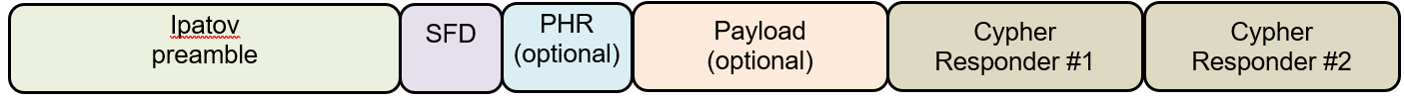
Simultaneous ranging – serial variant
  A “serial variant” is additionally proposed
  In this scheme, all (or selected) responders transmit Ipatov preamble and SFD which allows the receiver to synchronize
    PHR and Payload would be optional
  Rather than transmitting the same cipher at the same time the responders transmit individual cyphers only in their specific time slot
  The receiver can process multiple responses and calculate distances to each responder individually
  This scheme requires tight clock synchronization of all responders
  To avoid interference between cipher blocks, it is recommended to introduce gaps between them
  Cipher blocks can have different length but the shorest practical is 32µs, therefore it is recommended to support gaps every N*32µs

Slide 11
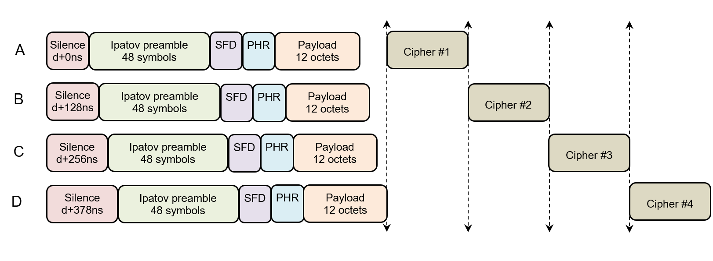
Simultaneous ranging – staggered serial variant
  The “serial variant” can be combined with “staggered” one
  This allows all responders to transmit Ipatov preamble and different payloads and also help with carrier recovery stability

Slide 12
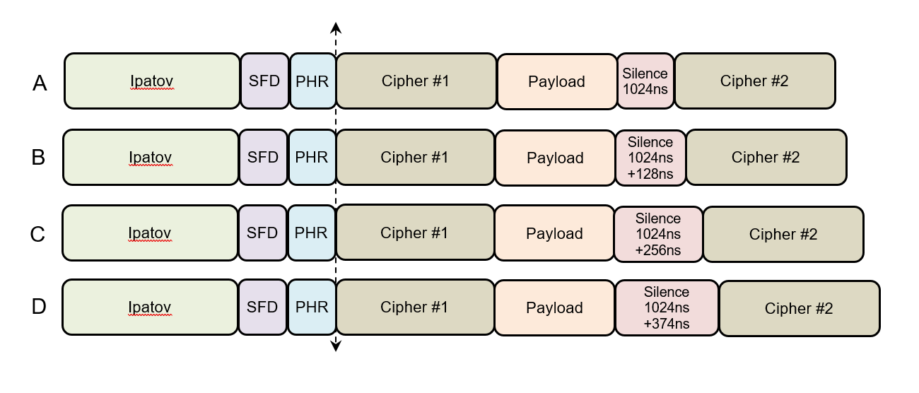
Simultaneous ranging – variant with two ciphers
  Additional, shorter variant is proposed, consisting of two ciphers
  Cipher #1 provides secure distance to the nearest device
  Cipher #2 provides multiple peaks in channel impulse response which could be used for localization/triangulation
  Payload can be placed after PHR, after cipher #1 or after cipher #2

Slide 13
PHR Changes
When sending the PHR at the data rate for 6.81 Mb/s and 27 Mb/s frames, pre-4z PHY won’t be able to receive it so we can re-specify some of the fields
Proposal:
GS bits specify the gap between data and the ciphered sequence in mode 2 for “Simultaneous Ranging”
  See 15-18-0108-04 for discussion of the other fields

Slide 14
Gap Specification (GS) bits
For simultaneous ranging, the GS bits let the receiving PHY know which of the four responders it has locked to and thereby determine the delay to the cipher sequence
To achieve this we need:
  A programmable response time
    This may be set differently in each responder
  A programmable gap in the transmitter between data and ciphered sequence
    This maybe set differently in each responder
  A programmable table in the receiver of 4 gaps, GsRxTab[4], one for each GS encoding.

Slide 15
Simultaneous ranging – summary
  Simultaneous ranging allows for 3 to 4 times shorter exchanges.
  In automotive scenarios, total exchange duration, with 2 to 6 devices, airtime can be reduced to 300µs (poll and response both around 100µs + response delay ). That compares favourably with non-simul-ranging schemes or with LRP, where multiple ranging exchanges would be necesarry (total duration possibly N*300µs)
  Total energy consumption for the whole multi-user simultaneous exchange can be as low as 10µJ
  Overall: lower energy consumption, shorter airtime, fewer collisions

Slide 16
THE END

