Slide 1
Project: IEEE P802.15 Working Group for Wireless Personal Area Networks (WPANs)
Submission Title: [digital sidelobe minimization]
Date Submitted: [10th July 2018]
Source: [Jarek Niewczas, Billy Verso] Company [Decawave Ltd.]
Address [Peter Street, Dublin 8, Ireland]
Voice:[+353.87.233.7323], E-Mail:[billy.verso (at) decawave.com, jarek.niewczas (at) decawave.com]
Re: [Proposed enhancements to the HRP UWB PHY]
Abstract: [Describe the performance benefits of digital side-lobe minimization]
Purpose: [contribute to the enhanced impulse radio group w.r.t. the HRP UWB PHY]
Notice: This document has been prepared to assist the IEEE P802.15. It is offered as a basis for discussion and is not binding on the contributing individual(s) or organization(s). The material in this document is subject to change in form and content after further study. The contributor(s) reserve(s) the right to add, amend or withdraw material contained herein.
Release: The contributor acknowledges and accepts that this contribution becomes the property of IEEE and may be made publicly available by P802.15.

Slide 2
The aim of this presentation:
Describe the issues associated with the reception of the cryptographically generated pseudo-random sequences proposed for enhancement of the HRP UWB PHY
These sequences exhibit poor auto-correlation properties
This submission discusses the issue and presents methods to address the problem

Slide 3
Cipher sequence structure:
With the cipher sequence generated cryptographically it will only be correctly received (correctly correlated in the receiver) when both TX and RX parties know the keys and cryptographic scheme
The receiver can validate the sequence by measuring the strength of the correlation across the whole sequence
Longer cipher sequences generally improve correlation strength, while channel path attenuation works the opposite way
Due to battery/power constraints it is highly desirable to use the shortest cipher sequences possible

Slide 4
Proposed cipher sequence structures:
Various cipher structures have been proposed at IEEE meeting in Warsaw. It is generally agreed that cypher PRF should be either 64MHz or 128MHz
Our PRF64 proposal uses binary pulses on the 8ns grid followed by 512ns guard interval, giving a virtual symbol time T_{csymb} that is ~1.0256 µs
Another HRP contribution proposed ternary PRF64 sequences on the fixed 8ns pulse grid (with 50% zeroes) and an optional hopping mode with 2ns hops
All PRF128 proposals are quite similar, utilizing full 8ns grid without zeroes. The only difference between proposals were gaps between cipher segments

Slide 5
512ns guard interval in the cipher sequence:
The 512ns guard interval between cipher symbols proposed in 15-18-0108 reduces inter-symbol interference and simplifies the implementation of the digital sidelobe minimization (DSM) algorithms.
These algorithms can reduce sidelobes by 25-35dB and typically involve calculations of auto-correlations, which in this case will be a binary 64x64.
The alternative PRF64 cypher structure with ternary symbols, reduces sidelobes by 3dB compared to binary PRF128 symbols when DSM is not used.
Comparison with the binary PRF64 cipher with guard intervals is more difficult because the sidelobes vary depending on their position.

Slide 6
512ns guard intervals in the cipher sequence:
The ternary cipher symbols also make DSM implementation more complex and intensive which will result in more power and more logic gates
For example, executing DSM with the ternary cipher proposal would involve 128x128 correlations per 1024ns symbol, rather than 64x64 as in case of our proposal
The DSM on ternary cipher could be alternatively implemented using smaller, 64-element symbols (512ns), where there would be similar 64x64 correlations, however twice as many in any given time
Due to lack of guard intervals, ternary cipher symbols are overlapping, and so the previous symbol also needs to be included in cross-correlation calculations
Sidelobe reduction by 3dB is generally not enough to provide good performance. Such system would require much longer cipher sequences

Slide 7
Sensitivity of the cipher sequences :
A number of applications, including passive entry, require high sensitivity to detect very weak, strongly attenuated 1st paths
A typical scenario could be a keyfob in the back pocket, which can attenuate the 1st path by 30dB or more
Each additional multipath component increases the pre-cursor sidelobes
In a typical parking garage environment, with rich multipath, sidelobes become a very significant problem
Digital sidelobe minimisation solves this problem by reducing sidelobes by 25 to 35dB and allows for cipher sequence length reduction by a factor of 4 to 16 depending on the conditions (channel, implementation etc)

Slide 8
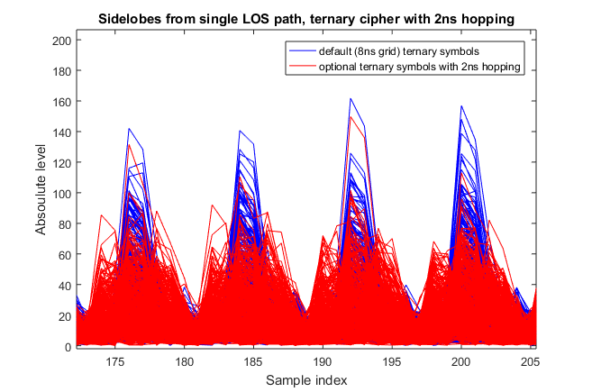
Cipher sequence with 2ns hopping:
This proposed optional scheme only theoretically decreases peak sidelobes by an additional 3dB by shifting some of the sidelobes in time by +/-2ns
In practice, the gain from this operation is much lower.
Additionally, digital sidelobe minimization would be highly complex to implement on such a sequence
Due to 3x number of sidelobe delays to optimize, the process is far less effective and also extremely intensive numerically
Due to these factors we caution against including this option in the standard

Slide 9
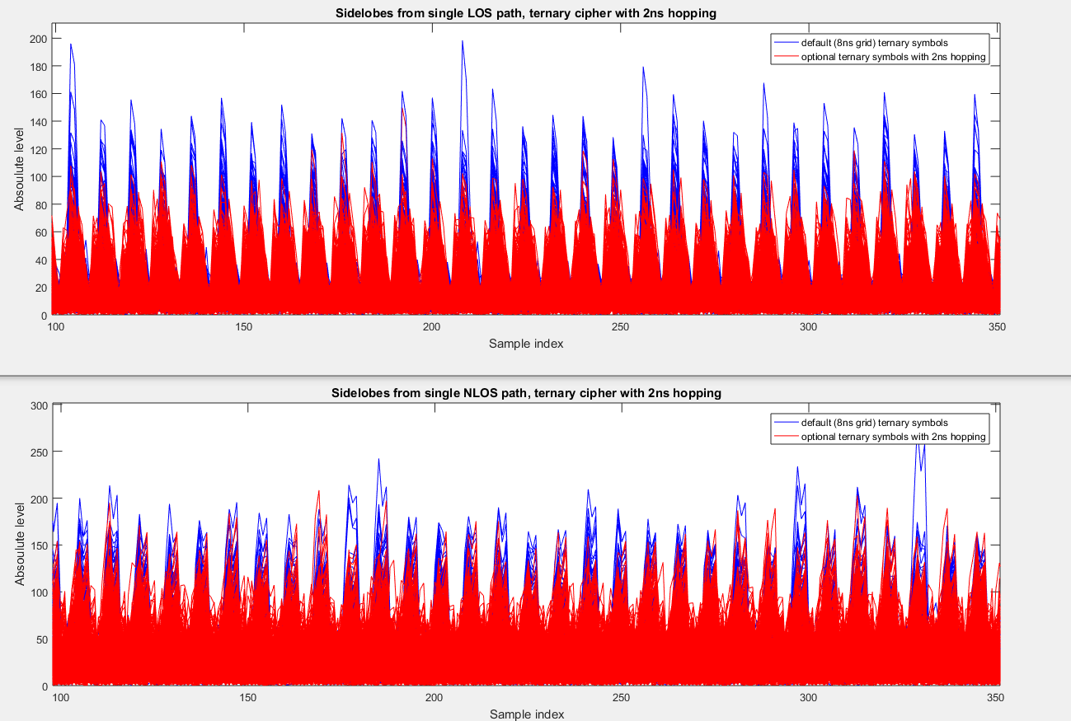

Slide 10
Cipher sequence with 2ns hopping:
The 3dB additional sidelobe reduction from this 2ns hopping scheme, would only be possible if the received pulses were very narrow (<2ns). This only happens with clean LOS paths. The NLOS signal reflected off the wall or travelling through-the-wall or through-human- body, is more spread out in time; the reflection occurs off a wider area and the signal travels along multiple sub-paths. Reflections are usually >4ns wide. That will cause the energy from shifted sidelobes, which are just 2ns apart, to overlap and add to each other, thus significantly reducing the 3dB sidelobe benefit
This is demonstrated on the previous slide: narrower LOS vs. wider NLOS paths are compared.

Slide 11
Digital sidelobe minimization – method 1
The 1st method to reduce sidelobes could be based on iterative subtraction/cancellation of sideobes in post-processing, using known channel input response and known auto-correlation function (sidelobes) of the cipher block
This method however has pretty poor performance, because sidelobes themselves interfere with channel input response measurement, distorting it
Processing–wise, subtracting sidelobes caused by ALL reflected paths in rich multipath channels would be extremely intensive and increasingly inaccurate with more reflected paths (richer multipath)

Slide 12
Digital sidelobe minimization – method 2
The 2nd method, the digital sidelobe minimization (DSM), can be implemented by modifying selected cipher bits, in such a way that correlation and accumulation (per-cipher-block) would result in reduced pre-cursor (or all) sidelobes
This method provides very good results and it’s numerical complexity can be made very low. One of the methods to reduce complexity involves reduction of the number of optimized sidelobes. To achieve this, it is better (in PRF64 mode) to use a guard interval. This reduces the number of “active” pulse positions per 1024ns from 127 to 63, and allows for implementation using shorter 64x64 correlation rather than 128x128
Similarly, it is much better to use fixed 8ns pulse grid, rather than the optional 2ns hopping, which would increase the number of the sidelobes to optimize 3 times

Slide 13
Digital sidelobe minimization - introduction
The initial sidelobes and the sidelobe “quality” metric can be computed based on the sum of the cross-correlations of the cipher block
The method involves iteratively changing the polarity of selected pulses in the cipher sequence and recalculating the sidelobe metric. If the sidelobe metric is reduced, the polarity change can be accepted and the next pulse can be tested. While the sign changes reduce peak cross-correlation somewhat, the sidelobe reduction is very dramatic
To achieve good sidelobe reduction, many hundreds of such tests have to be performed. Only a small proportion of them are accepted
For maintaining security, only the receiver correlator pulse polarity should be changed, otherwise the attacker may be able to predict certain future pulses with probability >50%
Other techniques can be used to reduce processing complexity

Slide 14
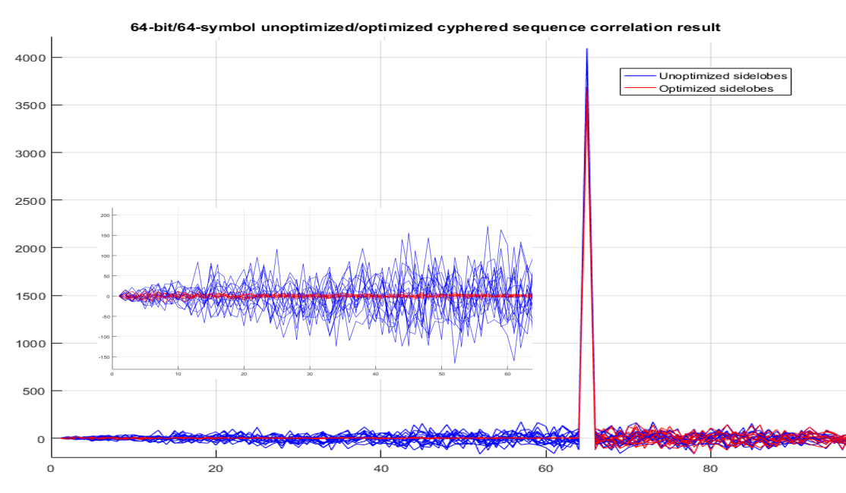
Digital sidelobe minimization - examples
An example of sidelobe reduction is shown below. Depending on scenario and parameters, (pre-cursor) sidelobes can be reduced by 25-35dBs in practical implementations

Slide 15
DSM OFF/ON - examples
The effects of the digital sidelobe minimization scheme (DSM) are tested in the following simulations. A channel consists of one weak path (-33dB) followed by 5 paths having random amplitudes (up to relative 0dB) placed at random delays (20-70ns behind the 1st path). RSL and noise levels are typical for a distance of approx 2.5 meters (UWB channel 5)
Such channels are typical in the garage environments (multiple reflections off the walls/ceiling/floor and other metal objects). The 1st weak path is because the device is kept in the back pocket
The purpose of the simulation is to establish optimal detection threshold levels to reliably detect the weak 1st path, while being safely above the noise/sidelobe peaks
Cipher lengths should be chosen to provide large margin between strongest noise/sidelobe peaks and the weakest 1st path peaks

Slide 16
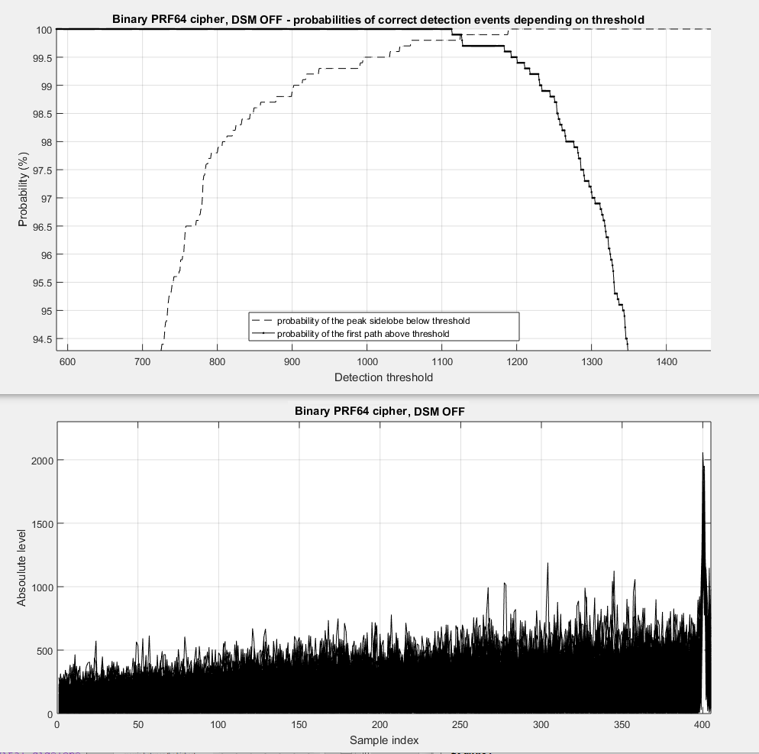
DSM OFF, PRF64 binary cipher
Our proposed binary PRF64 scheme with cipher length of 1024 symbols is shown (DSM OFF).
Threshold above 1200 would be required to avoid false detections.
However this will cause occassional misses of the 1st path (0.5% miss rate with thr=1200, 3% for thr=1300).
The weak 1st path is shown at delay index=400.

Slide 17
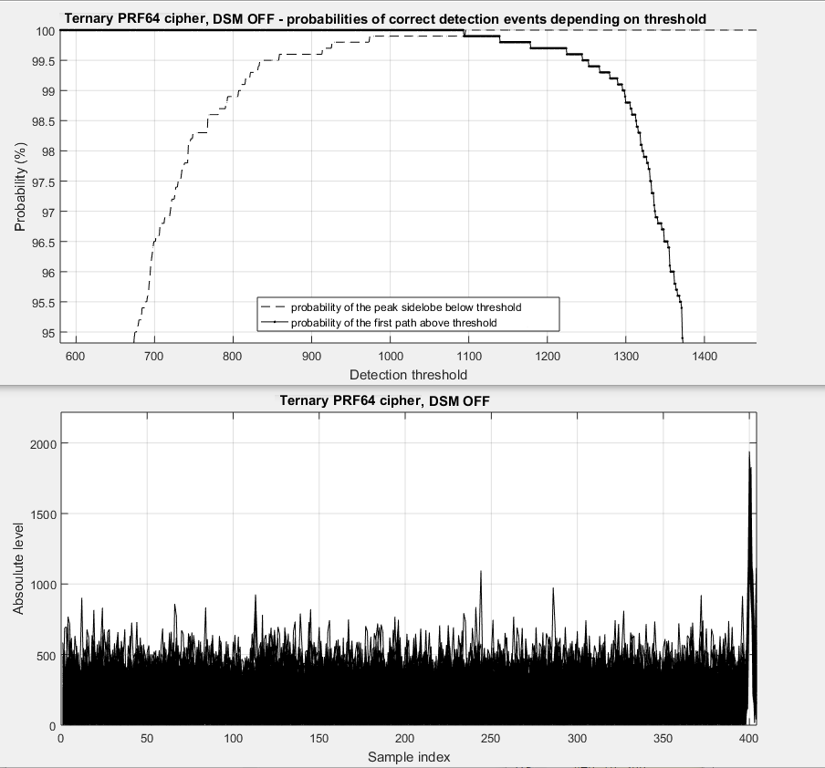
DSM OFF, ternary PRF64 cipher
The proposed ternary PRF64 scheme with cipher length of 1024 symbols is shown.
Threshold above 1100 would be required to avoid false detections. In practice larger safety margin would be required, increasing 1st path miss rate. Somewhat better performance compared to our binary scheme is due to ternary nature of the signal which reduces sidelobes by ~1-2 dBs in this case (it is not 3dB as in theoretical AWGN, due to delayed multipath and noise).

Slide 18
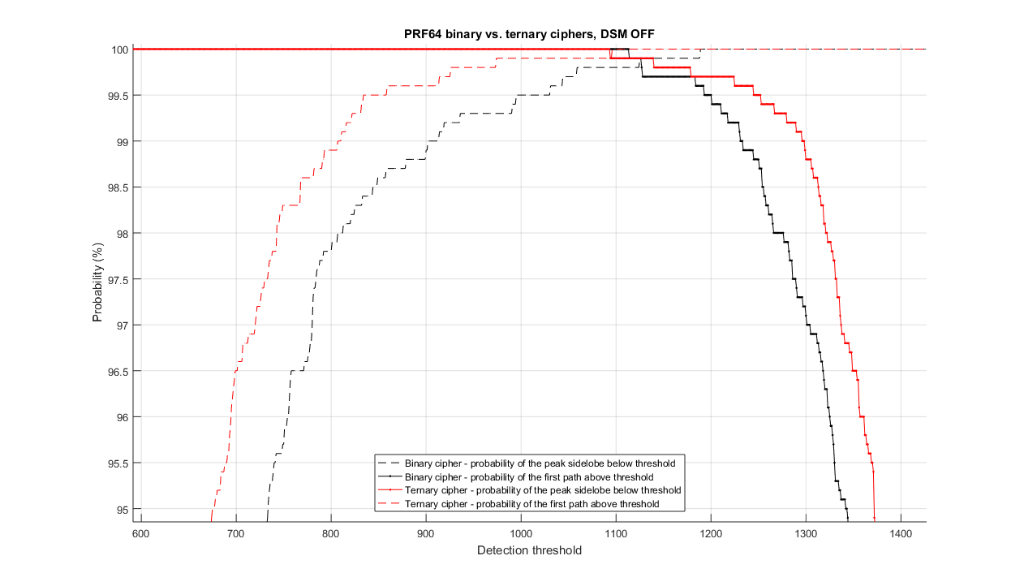
DSM OFF, PRF64 binary vs. ternary ciphers

Slide 19
DSM ON/OFF - summary
The two examples presented, demonstrate that on such challenging garage-like channels, with 1st path strongly attenuated (-33dB), even 1024 cipher symbols does not provide good enough performance. To avoid any risk of triggering on noise/sidelobe peaks, threshold calculation should be conservative, for example above 1400 in those cases, which would significantly increase the risk of missing the 1st weak path
The next slide presents results with DSM algorithm enabled. Drastic reduction of sidelobes allows for shortening of the cipher length to just 64 symbols, and despite that, margin between sidelobes and 1st path is considerably wider than in the previous simulations
In this scenario, DSM provides effectively more than 16x cipher length reduction, however, benefit from DSM will vary depending on channel multipath, RSL, receiver implementation and other factors

Slide 20
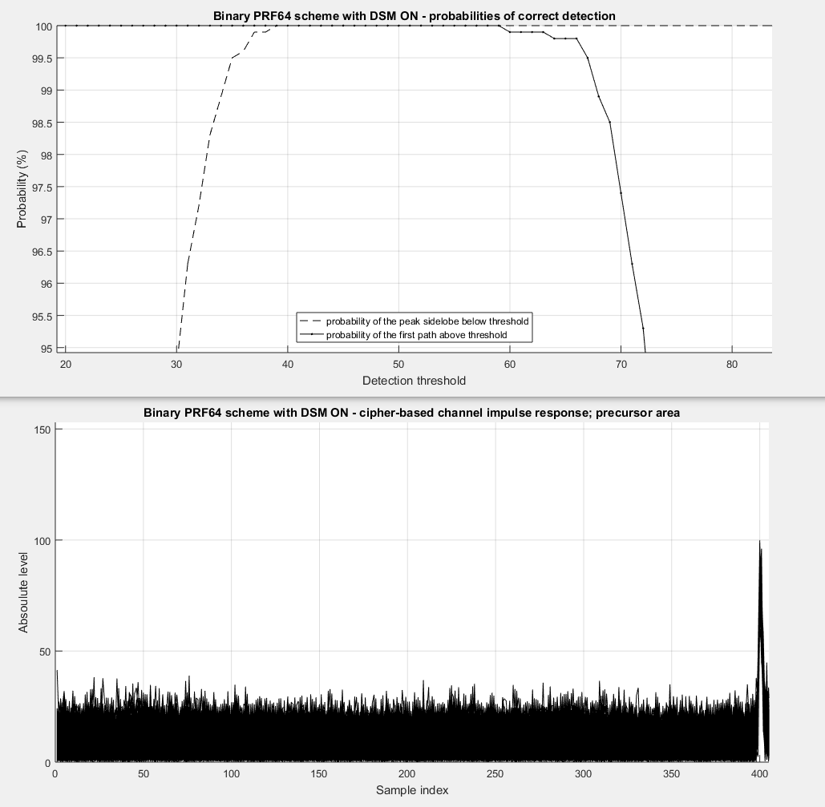
DSM on; PRF64 binary scheme
Our proposed PRF64 binary scheme with cipher length of just 64 symbols with DSM ON.
Due to lower symbol count, all amplitudes are lower.
The key finding here is large margin between the highest sidelobe (39) and the lowest 1st path amplitude (62) despite very short cipher length.
This demonstrates that with DSM ON, performance with 64 symbols is much better than with DSM OFF and 1024 symbols.

Slide 21
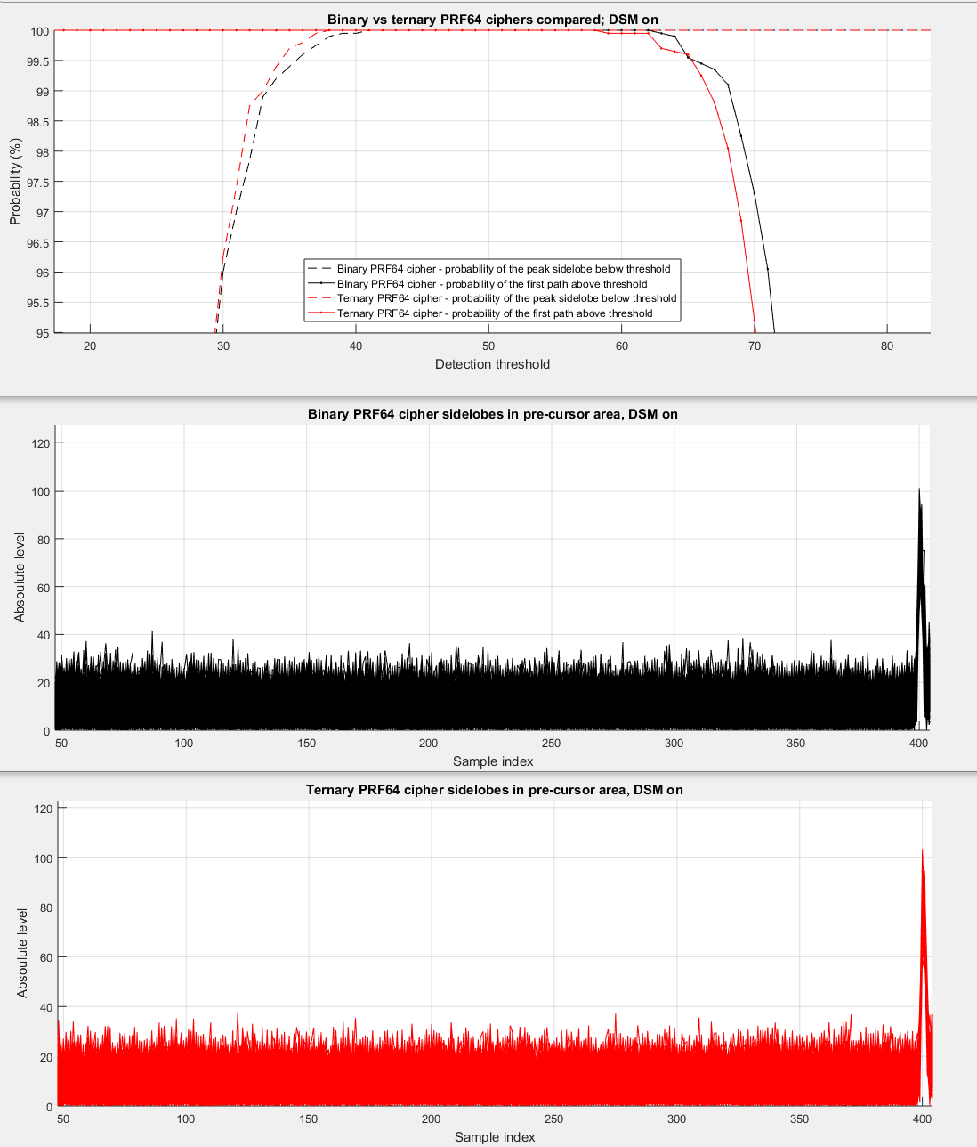
DSM on; PRF64 binary vs. ternary ciphers
The DSM algorithm could be applied to the ternary cipher scheme, similarly to our binary scheme. Assuming the same number of optimization iterations, sidelobes after DSM optimizations are practically the same (ternary scheme is 0-0.1dB lower), but our binary scheme has higher 1st path amplitude by ~0.15dB (due to lower number of accepted bit–changes in DSM).
Considering that the binary scheme is simpler to execute, hardware could support more iterations (for the same area/power used), thus increasing performance of the binary scheme compared to the ternary one.

Slide 22
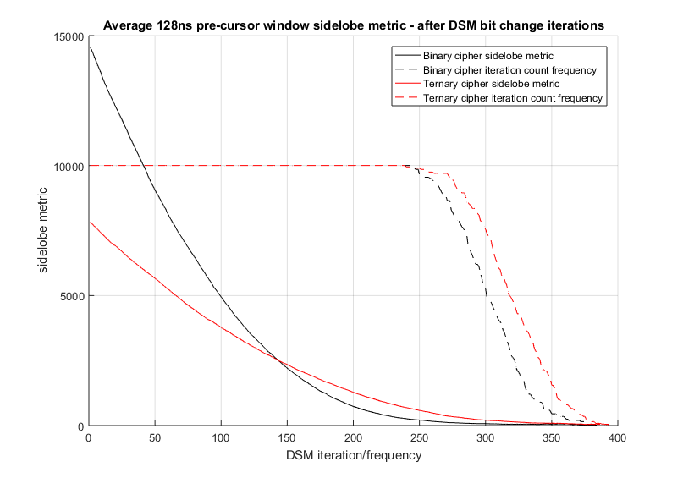
DSM on; PRF64 binary vs. ternary ciphers
DSM optimization process changes one bit per iteration, and if it reduces the sidelobe metric, it is accepted. Each changed bit however, lowers the peak correlation thus weakening the correlated signal. In the ternary cipher, due to 50% zeros, the sidelobe metric is reduced more slowly than in case of the binary cypher, therefore it requires more bit changes to achieve similar sidelobe reduction to the binary one (approximately 15% more accepted bit
changes). This results in
degraded peak correlation
for the ternary option.
This figure shows the
sidelobe metric changes vs
optimization iteration index.
It also shows that the binary
Cipher ends optimization
after fewer iterations.

Slide 23
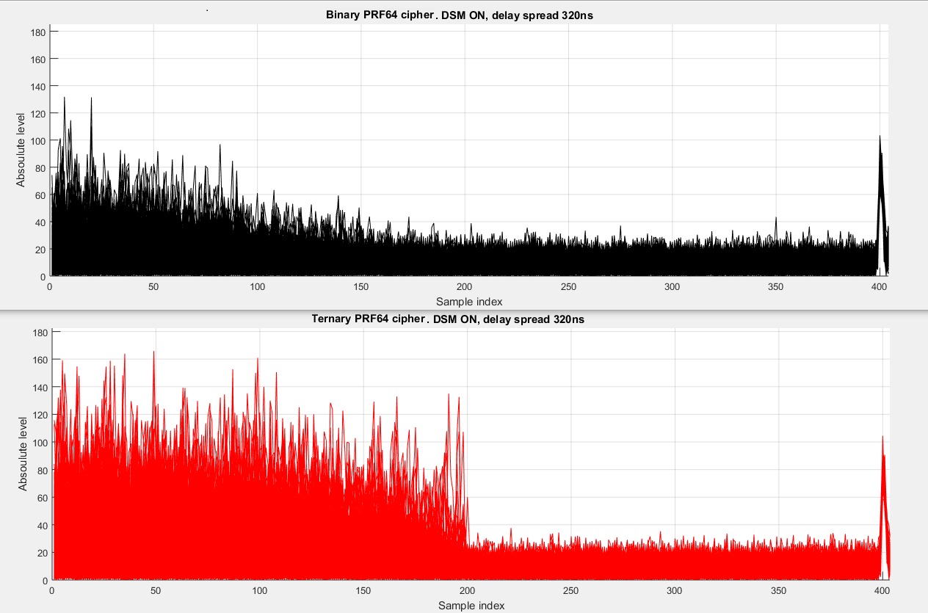
DSM on; PRF64 binary vs. ternary ciphers
Since DSM optimizes only a certain number of sidelobe delays before the 1st path (512ns in this example), a very late multipath can introduce early sidelobes. A channel with a delay spread of up to 320ns has been simulated. The results show that the binary scheme, due to it’s guard interval, handles the delayed multipath better than the ternary cipher scheme.

Slide 24
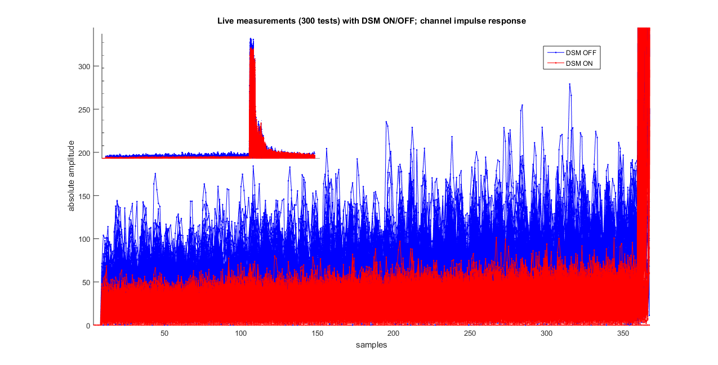
DSM on, PRF64 – practical measurement
Practical hardware measurement has been performed with DSM ON/OFF. Measurement was taken in a 20m2 room generating some multipath. Binary cipher length was 64 symbols.
Sidelobes without DSM are 9dB higher. To get the same performance as with DSM, the cipher sequence would need to be 8x longer.

Slide 25
DSM on PRF64 ciphers – summary
Sidelobes after DSM are practically the same with both cipher types
Binary cipher is easier to generate/transmit than ternary one
DSM implementation on the binary cipher is easier due to 64x64 vs one 128x128 or two 64x64 (per 1024ns) correlations
In DSM’s implementation, binary scheme’s +-1 samples can be represented by just 1 bit; in ternary cipher 2 bits are requried for representation (-1,0+1). That increases the digital complexity and area in this processing-intensive block. In case of the binary cipher, zeroes are also present, but only before the sequence and at fixed positions known to the digital designer.
Sum of auto-correlations of all symbols is always even in our proposed binary scheme, while it can be odd in the ternary scheme. That means extra bit-width is required in the DSM processing loop of the ternary cipher.
The binary scheme, due to the presence of the guard interval is less affected by late reflections (with large delay spread).
Bit changes in sidelobe optimization provide smaller sidelobe improvement gain in ternary cipher (due to 50% zeros), which means that more bit changes are required for similar sidelobe reduction as the binary scheme. That degrades peak correlation.
Higher number of accepted bit changes in DSM also means poorer per-symbol correlation. This could lead to problems with certain algorithms like carrier recovery.

Slide 26
DSM on PRF128 ciphers
The DSM algorithm can also be executed with PRF128 binary ciphers
Approximately 2x higher processing power is required compared to binary PRF64 binary cipher
Sidelobe performance after DSM optimization is only slightly worse than in case of PRF64 (meaning slighty higher sidelobes and lower peak correlation) but with half the sequence duration
Actual performance depends on implementation details (iteration counts/other parameters etc)

Slide 27
END

