Slide 1
Project: IEEE P802.15 Working Group for Wireless Personal Area Networks (WPANs)
Submission Title: [SRDEV PPDU for Enhanced Impulse Radio]
Date Submitted: [10 July, 2018]
Source: [Frank Leong (NXP Semiconductors), Wolfgang Küchler (NXP Semiconductors),
Thomas Baier (NXP Semiconductors), Brima Ibrahim (NXP Semiconductors),
Jochen Hammerschmidt (Apple), Ayman Naguib (Apple),
Thomas Reisinger (Continental), Daniel Knobloch (BMW)]
Re: [Input to the Task Group]
Abstract: [Presentation, SRDEV PPDU, Enhanced Impulse Radio]
Purpose: []
Notice: This document has been prepared to assist the IEEE P802.15. It is offered as a basis for discussion and is not binding on the contributing individual(s) or organization(s). The material in this document is subject to change in form and content after further study. The contributor(s) reserve(s) the right to add, amend or withdraw material contained herein.
Release: The contributor acknowledges and accepts that this contribution becomes the property of IEEE and may be made publicly available by P802.15.

Slide 2
SRDEV PPDU
Summary of 15-18-0286-01-004z-hrp-uwb-srdev-ppdu-text-contribution.docx

Slide 3
Overall Approach
General:
Nominal mean PRF ≥ 62.4 MHz
Require support for CH5 (6489.6 MHz) and CH9 (7987.2 MHz)
Distinguish between two enhancement stages:
Minimally Incremental Mode (“MIM”)
  Retain a large number of elements from the existing 802.15.4 PHY
  Allow re-use of legacy implementations with modest alterations
  Consider reduced implementation subset
Performance Optimized Mode (“POM”)
  Additional signaling and performance enhancements

Slide 4
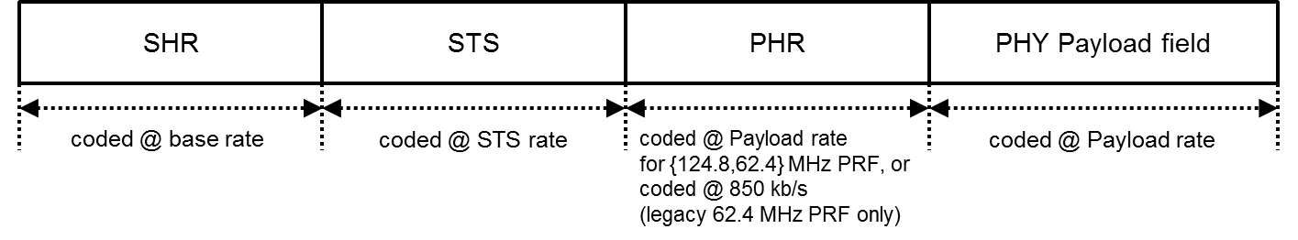
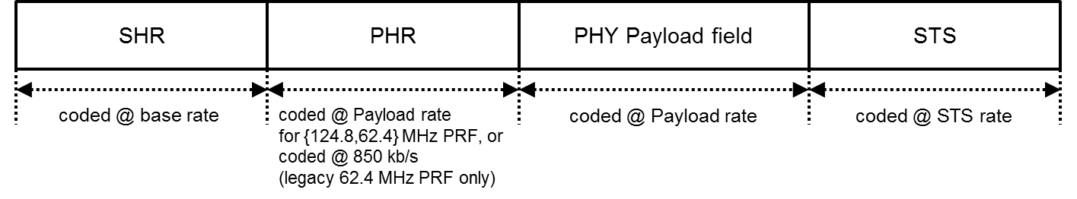
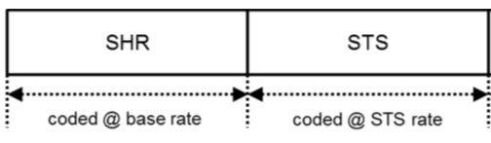
MIM: PRF64 Mode
Legacy SYNC, SFD, PHR, PSDU
Add Scrambled Timestamp Sequence (STS) field
  Three associated frame formats

Slide 5
MIM: PRF64 Mode, STS
STS generated by Deterministic Random Bit Generator (DRBG) based on AES-128
Provide for baseline performance that does not require Rx with Digital Side-Lobe Suppression (DSLS)
  Performance can be further enhanced when DSLS is applied

Slide 6
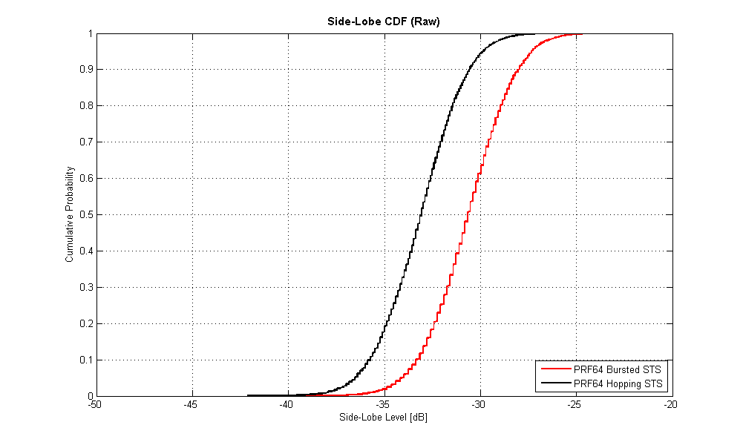

MIM: PRF64 STS w/o DSLS
Further ~3 dB improvement
with finer pulse grid, see §5.3.4
Simulation performed for $N_{STS,segment}= 32768$ (~65 µs),
across a {-128 ns, +128 ns} window around the main lobe

Slide 7
POM: PRF128 Mode
STS with highest possible natural BPSK entropy for δL=4
  Minimize frame length for given target entropy
Revised SYNC, SFD, PHR, PSDU
  Retain a large number of elements from the existing 802.15.4 PHY
  Same STS-based frame formats as for PRF64 mode (@CH{5,9})
  Re-use of δL=4 correlator hardware in Rx
  Active/Guard/Active/Guard PSDU symbol structure
  Constant PRF, maximizing degrees of freedom in AGC implementation
  Optimize PSDU coding scheme

Slide 8
POM: PRF128 SYNC (I)
Allow re-use of IEEE 802.15.4 HRP UWB δL=4 correlator
Maximum mean PRF (reduced PAPR)
Maximum processing gain (higher dynamic range)
Strongly impulse-like ACF
  Low, constant side-lobe level (~-42 dB for Length-127 sequence)
  Sidelobes may be further reduced by DSLS if desired
  Main purpose of SYNC is to facilitate acquisition, sidelobe performance of STS typically determines final accuracy of CIR estimate in SRDEV
Improved handling of DC content
  Corresponding receiver is less sensitive to DC offsets/spurs

Slide 9
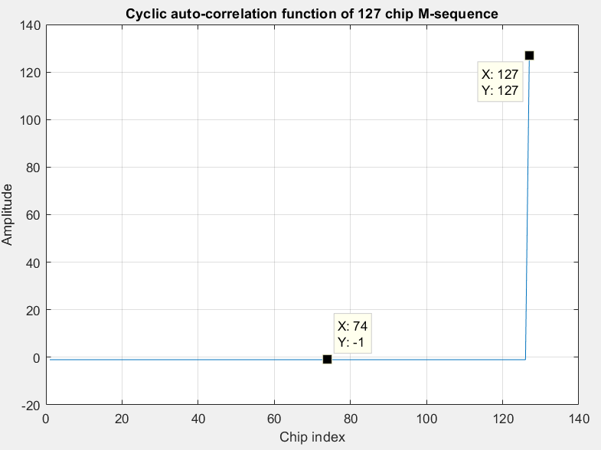
POM: PRF128 SYNC (II)

Slide 10
POM: PRF128 SFD
Binary codes to maximize ACF/length (minimize XCF/length)
ID | Pattern | N_{sym}
0 | --+- | 4
1 | ----++-+ | 8
2 | ---+-+--+--+++-+ | 16
3 | -----+---+++--+- -+-+-+--+--++--- | 32
4 | -----+---+--+--- -+-++---+-+-+--- ----++---++-+-++ --+-----++++--+- | 64

Slide 11
POM: PRF128 PHR
Simplify PHR w.r.t. legacy PHR
Allow extended PSDU lengths up to 1023 bytes
Same modulation, coding, and datarate as PSDU

Slide 12
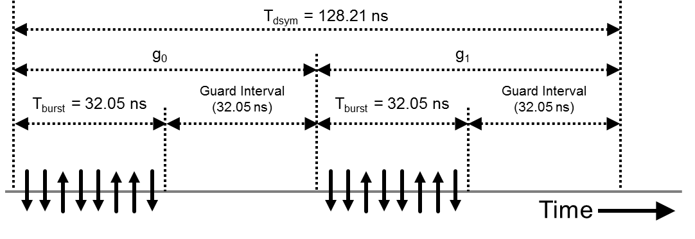
POM: PRF128 PSDU, Modulation (I)
Based on BPSK
Chip grid 499.2 MHz, local peak PRF 249.6 MHz

Slide 13
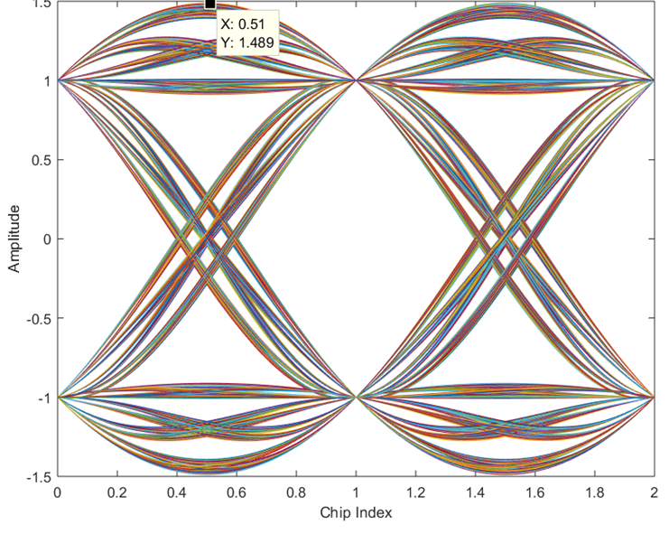
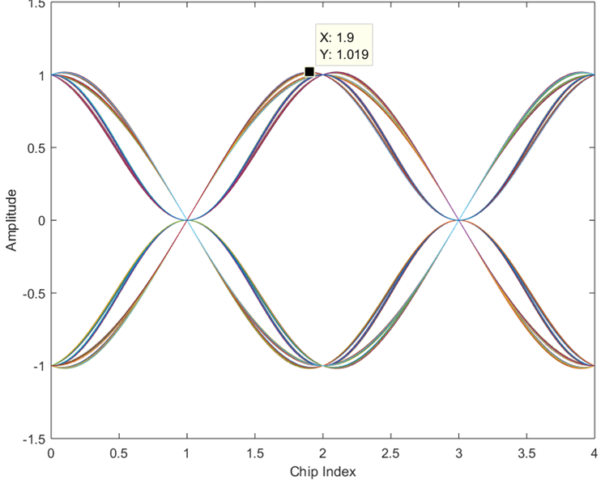
POM: PRF128 PSDU, Modulation (II)
Ex. using Raised Cosine (RC) pulse shape (Tp = 2 ns, alpha = 0.5)
Peak PRF 499.2 MHz: 3.46 dB headroom needed
Peak PRF 249.6 MHz (i.e., w/ guard chips): 0.16 dB headroom needed

Slide 14
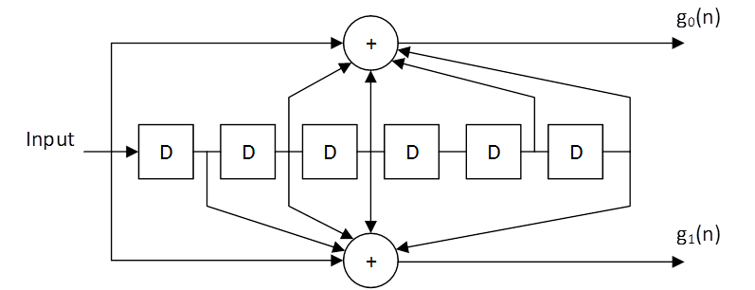
POM: PRF128 PSDU, Coding (I)
Constraint length 7 (as used for IEEE802.11a/g/n/p, DVB-T/S)
Using ubiquitous generator polynomials G=(133,171)
Data rate of 7.8 Mbit/s (no RS coding)
Efficient rate adaptation possible via puncturing

Slide 15
POM: PRF128 PSDU, Coding (II)
Simulation performed for 21-byte PSDU

Slide 16
Conclusion
Presented two enhancement stages:
Minimally Incremental Mode (MIM)
  Retain a large number of elements from the existing 802.15.4 PHY
  Allow re-use of legacy implementations with modest alterations
  Consider reduced implementation subset
Performance Optimized Mode (POM)
  Additional signaling and performance enhancements

