Slide 1
Project: IEEE P802.15 Working Group for Wireless Personal Area Networks (WPANs)
Submission Title: [FSK extension to lower data rates for Korea Sub-GHz Band]
Date Submitted: [9 July 2018]
Source: [Sangsung Choi] Company [Woosong University]
Address [171 Dongdaejeon-ro, Dong-gu, Daejeon, Korea]
Voice:[+82-42-630-9615], FAX: [+ 82-42-630-9119], E-Mail:[sschoi@wsu.ac.kr]
Re: []
[If this is a response to a Call for Contributions, cite the name and date of the Call for Contributions to which this document responds, as well as the relevant item number in the Call for Contributions.]
[Note: Contributions that are not responsive to this section of the template, and contributions which do
not address the topic under which they are submitted, may be refused or consigned to the “General Contributions” area.]
Abstract: [Proposed extending SUN FSK PHY specification to lower data rates in Korea sub-giga bands.]
Purpose: [Discussion.]
Notice: This document has been prepared to assist the IEEE P802.15. It is offered as a basis for discussion and is not binding on the contributing individual(s) or organization(s). The material in this document is subject to change in form and content after further study. The contributor(s) reserve(s) the right to add, amend or withdraw material contained herein.
Release: The contributor acknowledges and accepts that this contribution becomes the property of IEEE and may be made publicly available by P802.15.
NOTE: Update all red fields replacing with your information; they are required. This is a manual update in appropriate
fields. All Blue fields are informational and are to be deleted. Black stays. After updating delete this box/paragraph.

Slide 2
Overview of proposal
Proposed addition
Define lower data rates of FSK SUN PHY in Korea sub-giga bands(917~923.5MHz)
Add 2 frequency bands(264~268MHz & 940.1 ~ 946.3MHz) as FSK SUN PHY for Korea
Rationale
Many SUN deployments in Korea today use transceivers that support FSK.
Today lower data rates are very important in Korea because it provides many options to increase range in IoT services
Recently Korean government allocated additional unlicensed frequency bands for IoT services and needs to adopt the SUN FSK PHY in those frequency bands.
Slide 2
Notes:
July 18
Page 2

Slide 3
Sub-Giga Band Spectrum in Korea
Unlicensed Spectrum for IoT Service
Allocated only 917~923.5MHz for RFID/USN before 2015
Allocated 2MHz bandwidth in 260MHz band at 2015
Allocated 6.2MHz bandwidth in 940MHz band at 2016
2015
Allocated
2MHz Bandwidth
2016
Allocated
6.2MHz Bandwidth
Before 2015
6.5MHz Bandwidth
For RFID/USN
262~264MHz
917~923.5MHz
940.1~946.3MHz
Slide 3
Notes:
July 18
Page 3

Slide 4
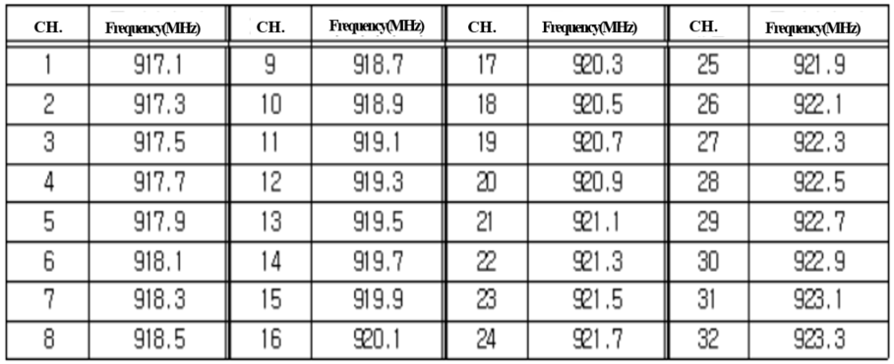
Current Korea Band for FSK SUN
917~923.5MHz Band(1)
32 Channels: Channel Bandwidth: 200KHz(fixed center frequency)
· CH.2, 5, 8, 11, 14, 17: Allocated DRM RFID Reader
· CH.1~CH18(917~920.6MHz): Prior to RFID
· CH.19~CH.32(920.6~923.5MHz): Prior to USN
Must use Duty Cycle or LBT or Frequency Hopping
Slide 4
Notes:
July 18
Page 4

Slide 5
Current Korea Band for FSK SUN
917~923.5MHz Band(2)
Different radiated power limits depend on service
· DRM RFID Reader: 4W EIRP
· RFID/USN
Ch.1, 3, 4, 6, 7, 9, 10, 12, 13, 15, 16, 18 : under 3mW
Ch. 2, 5, 8, 11, 14, 17, 19, 20～25 : under 10mW
Ch. 26 - 32 : under 25mW
under 200mW(outdoor fixed point-to-point)
Slide 5
Notes:
July 18
Page 5

Slide 6
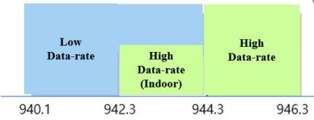
New Spectrum in Korea(1)
940.1 ~ 946.3MHz Band
Usage designation spectrum allocated in 2016
No Channel Bandwidth limits between 940.1~946.3MHz
· Narrow band system
Under 200mW of effective radiated Power
Must use duty cycle
Slide 6
Notes:
July 18
Page 6

Slide 7
New Spectrum in Korea(2)
262~264MHz Band
Flexible access common spectrum allocated in 2015
Channel Bandwidth: under 200KHz
Narrow band system
- Under 100mW of effective radiated Power
Must use duty cycle
Slide 7
Notes:
July 18
Page 7

Slide 8
Current Lower Data Rates in FSK SUN in Korea Band
Frequency Band(MHz) | Parameter | Operating Mode #1 | Operating Mode #2 | Operating Mode #3
917~923.5 (Korea) | Data Rate(Kb/s) | 50 | 150 | 200
 | Modulation | Filtered 2FSK | Filtered 2FSK | Filtered 2FSK
 | Modulation Index | 1.0 | 0.5 | 0.5
 | Channel Spacing (KHz) | 200 | 400 | 400
Slide 8
Notes:
July 18
Page 8

Slide 9
Extension proposal #1
For SUN FSK PHY – add two optional PHYs as defined in table below:
- It is convenient to change data rates without changing modulation schemes
Frequency Band(MHz) | Parameter | Operating Mode #1 | Operating Mode #2 | Operating Mode #3 | Operating Mode #4 | Operating Mode #5
917~923.5 (Korea) | Data Rate (Kb/s) | 50 | 150 | 200 | 12.5 | 25
 | Modulation | Filtered 2FSK | Filtered 2FSK | Filtered 2FSK | Filtered 2FSK | Filtered 2FSK
 | Modulation Index | 1.0 | 0.5 | 0.5 | 2 | 1
 | Channel Spacing (KHz) | 200 | 400 | 400 | 100 | 100
Slide 9
Notes:
July 18
Page 9

Slide 10
Extension proposal #2
For SUN FSK PHY – add 940.1~946.3 MHz for Korea as defined in table below:
- Only add frequency band for FSK PHY as 917~923.5MHz band
Frequency Band(MHz) | Parameter | Operating Mode #1 | Operating Mode #2 | Operating Mode #3 | Operating Mode #4 | Operating Mode #5
940.1~946.3 (Korea) | Data Rate (Kb/s) | 50 | 150 | 200 | 12.5 | 25
 | Modulation | Filtered 2FSK | Filtered 2FSK | Filtered 2FSK | Filtered 2FSK | Filtered 2FSK
 | Modulation Index | 1.0 | 0.5 | 0.5 | 2 | 1
 | Channel Spacing (KHz) | 200 | 400 | 400 | 100 | 100
Slide 10
Notes:
July 18
Page 10

Slide 11
Extension proposal #3
For SUN FSK PHY – add 264~268 MHz for Korea as defined in table below:
- 12.5, 25, 50Kbps as lower data-rates use narrow bandwidth
- Consider 2.4Kbps mode using narrowband optionally
(2.4Kbps @12.5KHz channel bandwidth)
Frequency Band(MHz) | Parameter | Operating Mode #1 | Operating Mode #2 | Operating Mode #3
262~264 (Korea) | Data Rate(Kb/s) | 50 | 12.5 | 25
 | Modulation | Filtered 2FSK | Filtered 2FSK | Filtered 2FSK
 | Modulation Index | 1.0 | 2 | 1
 | Channel Spacing (KHz) | 200 | 100 | 100
Slide 11
Notes:
July 18
Page 11

Slide 12
Conclusions
Propose to add 2 lower data rate modes of FSK SUN in Korea sub-giga bands(917~923.5MHz)
- It is convenient to add 12.5Kbps and 25Kbps data-rates without changing modulation schemes
- Our experience expect 4 ~ 6dB sensitivity improvement moving 50Kbps to 12.5Kbps-thus allowing longer range option
Propose to add 2 frequency bands for FSK SUN in Korea
- Add 264~268MHz band and 940.1~946.3MHz band
- Propose 12.5Kbps, 25Kbps, and 50Kbps in 264~268MHz bands
- Consider 2.4Kbps optional mode in 264~268MHz bands
Slide 12
Notes:
July 18
Page 12

