Slide 1
Project: IEEE P802.15 Working Group for Wireless Personal Area Networks (WPANs)
Submission Title: [HRP data mode options]
Date Submitted: [6th March 2018]
Source: [Prof Tony Fagan, Michael McLaughlin] Company [Decawave Ltd.]
Address [Peter Street, Dublin 8, Ireland]
Voice:[+353.87.233.7323], E-Mail:[billy.verso (at) decawave.com]
Re: [data modes for the HRP UWB PHY]
Abstract: [contribute to the enhanced impulse radio group w.r.t. the HRP UWB PHY ]
Purpose: []
Notice: This document has been prepared to assist the IEEE P802.15. It is offered as a basis for discussion and is not binding on the contributing individual(s) or organization(s). The material in this document is subject to change in form and content after further study. The contributor(s) reserve(s) the right to add, amend or withdraw material contained herein.
Release: The contributor acknowledges and accepts that this contribution becomes the property of IEEE and may be made publicly available by P802.15.

Slide 2
802.15.4a Data Modulation
In 802.15.4a the data modulation is BPM-BPSK where one burst of pulses is sent every symbol time and a data symbol looks like this:

Slide 3
802.15.4a 6.8Mbps at 64MHz (6.8A)
For 6.8Mbps data at the nominal PRF of 64MHz, the symbol rate is ~8MHz and the symbol time is approximately 128ns consisting of 64 2ns chips. Each burst consists of 8 pulses with 2ns spacing giving a 16ns long burst of pulses.
The UWB restrictions in the US, Europe and other places limit the mean power in 1ms to be -41.3dBm/MHz and they limit the peak power to be 0dBm in any 50MHz bandwidth.
This 50MHz limit effectively limits the amount of power in any 20ns period of signal to be 0dBm or 1mW.
All 8 pulses fit inside this 20ns,
  so each pulse is limited to 0.125mW.

Slide 4
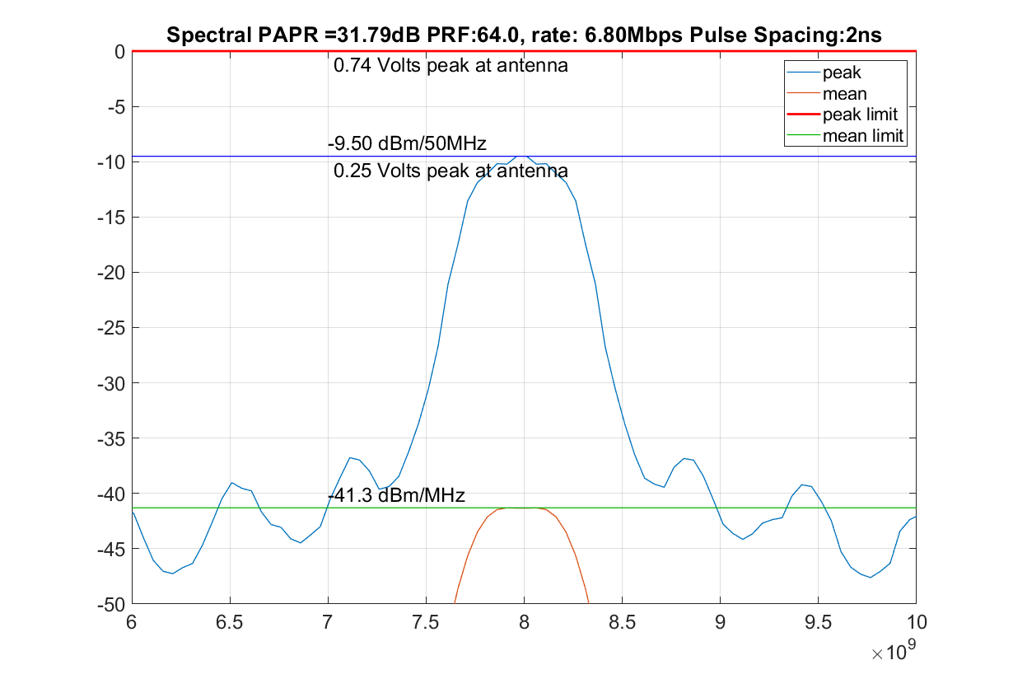
802.15.4a 6.8Mbps at 64MHz (6.8A)- Spectrum
Because some 20ns segments of signal have 8 pulses in them the spectral peak to average ratio (SPAR) is very high (32dB)
Peak Spectrum generated with a rectangular FFT window. Hamming window generates a similar spectrum.

Slide 5
6.8Mbps, 64MHz 8ns grid proposal (6.8B)
If the pulse spacing was increased from 2ns to 8ns this would provide a number of benefits
Any 20ns segment, i.e. 50MHz bandwidth, encompasses only 3 pulses, so each pulse can be at 0.33mW
  Each pulse can be increased in power by at least 4.3dB compared to current 6.8Mbps scheme and have the same 0dBm 50MHz peak power giving a 64% or more range advantage
Typically, length of pulses is at least 5ns so 4 pulse generators need to be used to implement current 802.15.4a scheme. This scheme only requires 1 pulse generator.

Slide 6
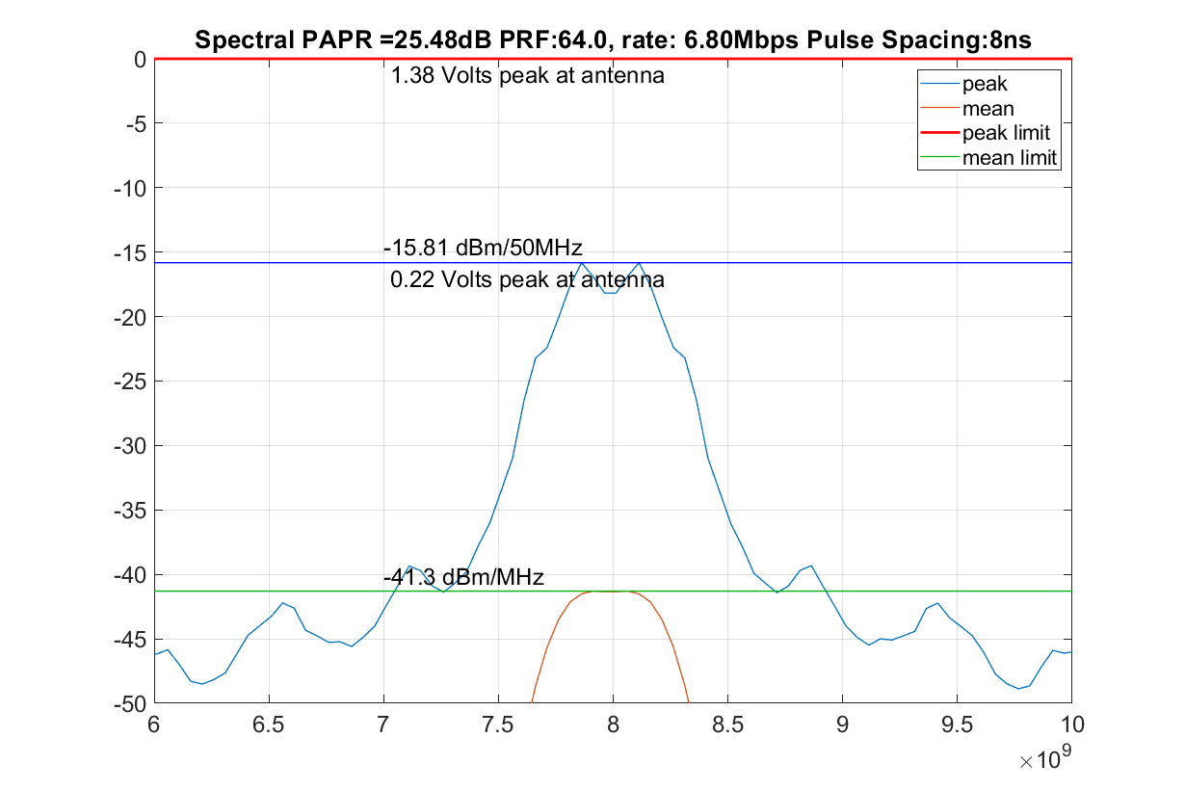
6.8Mbps, 8ns grid proposal (6.8B) - Spectrum
Because 20ns segments of signal can only have 3 pulses in them the spectral peak to average ratio (SPAR) is better (25.5dB)
Requires transmitter to be able to generate 1.38 Volts peak at the antenna which is very difficult with standard CMOS without an external amplifier.
Peak Spectrum generated with a rectangular FFT window. A Hamming window results in a lower peak spectrum.

Slide 7
6.8Mbps, 64MHz (6.8B) proposal cont.
Retains 4a BPM-BPSK modulation
  Allows reception by non-coherent receiver
This scheme has no hopping
  No need for spectrum whitening with the scrambler
  The extra spreading of the pulses helps against multipath
This scheme has no guard time, but wider spread of pulses improves multipath immunity.
Simulations over IEEE 802.15.4a channel model CM1 multipath channel show no receiver sensitivity loss sue to multipath.

Slide 8
Other Possible 6.8Mbps Schemes
Scheme (6.8C)
  Burst of 8 pulses with 8ns separation. 8 bits generated by rate 1/8 convolutional encoder and used to assign polarity of 8 pulses
    8 bits from rate 1/8 convolutional code and then scrambled
    Has same peak spectrum as BPM-BPSK scheme
    Uses different modulation than 802.15.4a
    Not compatible with non-coherent receiver
    Has a 70ns guard interval to protect against multipath

Slide 9
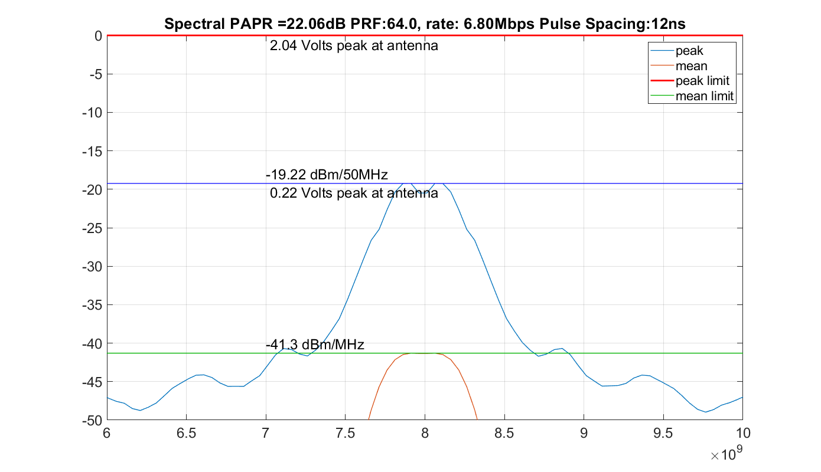
Other Possible 6.8Mbps Schemes
Scheme (6.8D)
  Burst of 8 pulses with 12ns separation. 8 bits generated by rate convolutional encoder and used to assign polarity of 8 pulses
    8 bits from rate 1/8 convolutional code and then scrambled
    Has better peak spectrum than 6.8B but no better than the preamble
    Uses different modulation than 802.15.4a
    Not compatible with non-coherent receiver
    Has a 42ns guard interval to protect against multipath

Slide 10
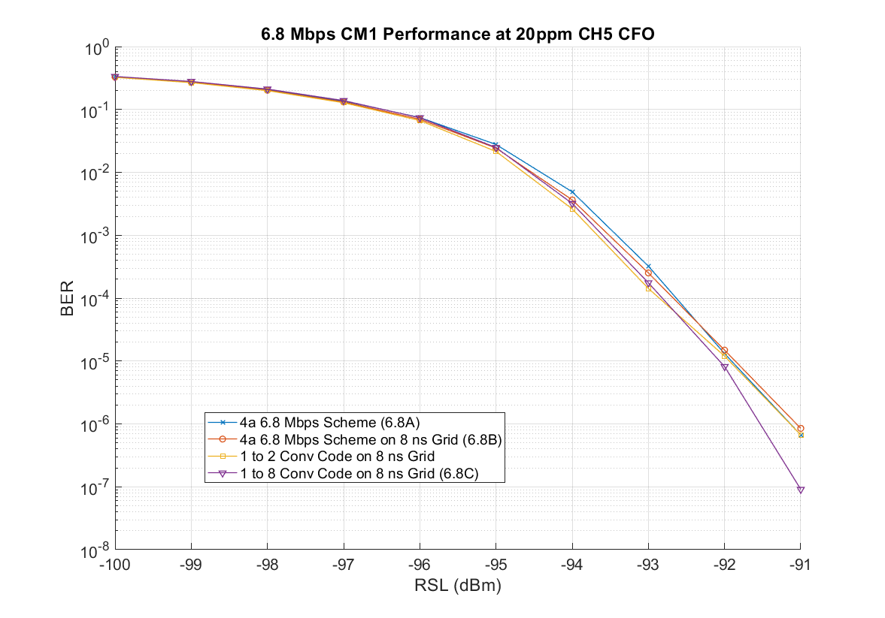
Performance over multipath channel CM1
Matlab simulations over IEEE 802.15.4a channel model CM1 multipath channel shows that scheme 6.8B has identical performance to 6.8A. Scheme 6.8C has very slightly better performance consistent with the higher hamming distance of the rate 1/8 code (21 vs 20 for 8 pulses)

Slide 11
6.8Mbps summary
Decawave proposes that 4z adopts scheme 6.8B as an option
  Potential of up to 6dB better performance
  Translates to twice range of current 6.8Mbps mode assuming the transmitter is peak voltage limited to ~0.7 Volts at the antenna
  Extra performance does require transmitter to be able to generate well in excess of 1.38Volts peak.
  The other possible options which we discussed are not compatible with BPM-BPSK modulation

Slide 12
802.15.4a 27Mbps at 64MHz (27A)
For 27Mbps data at the nominal PRF of 64MHz, the symbol rate is ~32MHz and the symbol time is approximately 32ns consisting of 16 2ns chips. Each burst consists of 2 pulses with a 2ns spacing between them
This 50MHz limit effectively limits the amount of power in any 20ns period of signal to be 0dBm or 1mW.
Possible for 4 pulses appear inside this 20ns

Slide 13
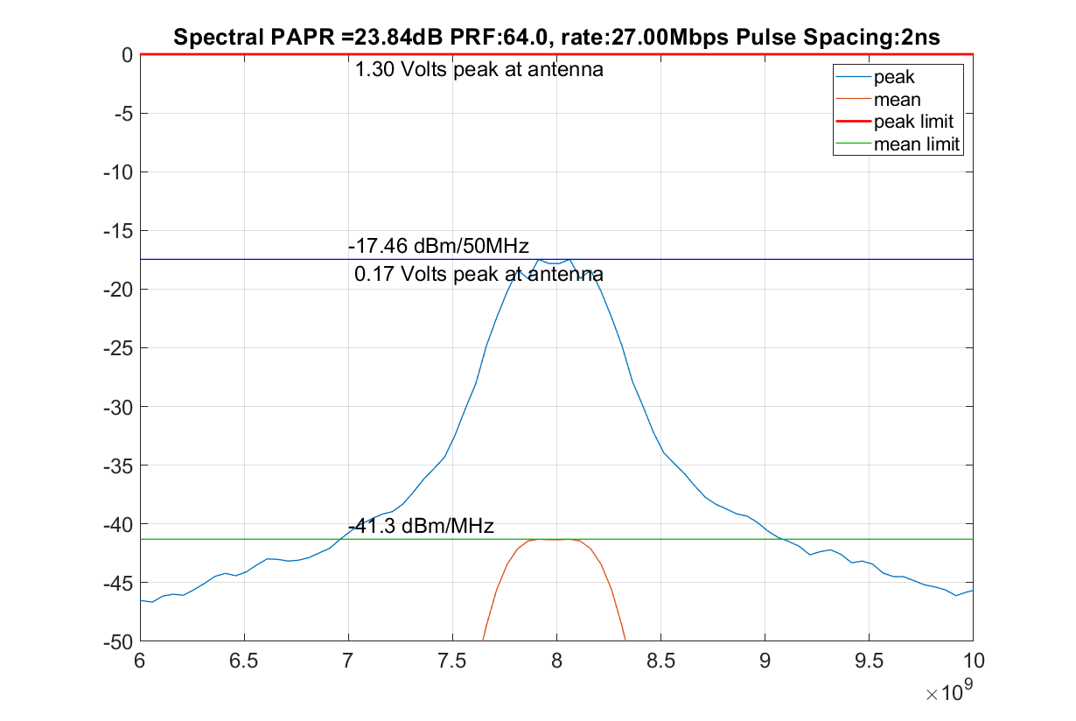
802.15.4a 27Mbps at 64MHz (27A)- Spectrum
Because some 20ns segments of signal have 4 pulses in them the spectral peak to average ratio (SPAR) is quite high (24dB)
Peak Spectrum generated with a rectangular FFT window.

Slide 14
27Mbps, 8 pulse proposal (27B)
If the number of pulses is increased from 2 to 8 this provides a number of benefits in a standard CMOS IC
Assuming the pulses are the same amplitude as in the preamble etc. each bit has 6dBs more energy
The standard 27Mbps mode (27A) could have pulses with twice the amplitude of the pulses used for 6.8Mbps, but this is not generally possible for two reasons:
(1) Receiver gain, AGC, thresholds have been trained with the preamble pulses
(2) Standard CMOS in a 40nm process can only generate about 0.75 V peak over PVT corners at the antenna because:
  There are losses of 6dB or more after the signal is generated before it reaches the antenna
    8GHz is a high frequency for standard CMOS
    Considerable loss in the balun
    Losses in the Tx/Rx switches
    Losses in the tracks
    Losses in the antenna feed and the antenna itself
    Losses higher at higher temperatures (must work to 105⁰C)

Slide 15
27Mbps, 8 pulse proposal (27B) cont.
Using existing convolutional encoder (16.3.3.2), use output g0 to select 1 of 2 pulse sequences, and g1 to invert or not.
    This standard rate 1/8 convolution code comes from Proakis
Then scramble v(n) using the existing scrambler (16.3.2), giving 8 chips per burst and 8 chips guard interval
Same spectrum as standard 6.8Mbps mode (6.8A)
Simulations show that this mode has the same performance at 6.8Mbps over an AWGN channel, as expected.
Simulations over the IEEE 802.15.4a CM1 channel model show just 1dB is lost due to multipath.

Slide 16
27Mbps summary
Decawave proposes that 4z adopts scheme 27B as an option for 27Mbps
  6dB better performance giving of current 27Mbps mode
  Translates to the same range of current 6.8Mbps mode assuming the transmitter is peak voltage limited to ~0.7 Volts at the antenna
  Power consumption for transmit and receive data portion of the frame is ¼ that of the current 6.8Mbps mode but has an equal range

