Slide 1
Project: IEEE P802.15 Working Group for Wireless Personal Area Networks (WPANs)
Submission Title: [802.15.4w proposal preview Fraunhofer IIS]
Date Submitted: [7 July, 2018]
Source: [Johannes Wechsler] Company [Fraunhofer Institute for Integrated Circuits IIS]
Address [Nordostpark 84, Nuremberg, 90411, Bavaria]
Voice:[ +49 911 58061-3334], FAX: [+49 911 58061-3299], E-Mail:[johannes.Wechsler@iis.fraunhofer.de]
Re: [IEEE P802.15.4w Low Power Wide Area Call for Proposals, IEEE 802.15-18-0147-01-004w]
Abstract: [Initial proposal preview from Fraunhofer IIS for 802.15.4w.]
Purpose: [Preview of the proposed PHY layer for a more interference robust transmission based on the existing LECIM PHY.]
Notice: This document has been prepared to assist the IEEE P802.15. It is offered as a basis for discussion and is not binding on the contributing individual(s) or organization(s). The material in this document is subject to change in form and content after further study. The contributor(s) reserve(s) the right to add, amend or withdraw material contained herein.
Release: The contributor acknowledges and accepts that this contribution becomes the property of IEEE and may be made publicly available by P802.15.

Slide 2
Proposal preview for 802.15.4w Fraunhofer IIS
Johannes Wechsler
Fraunhofer IIS

Slide 3
Motivation (1)
Trend: everything is smart and connected: houses, cities, meters, headphones …
→ more and more wirelessly connected devices
Most networks operate within a very limited range and don’t require very high sensitivity
→ Only very close networks interfere one another

Slide 4
Motivation (2)
Low Power Wide Area (LPWA) networks for smart metering, predictive maintenance etc., use very high sensitivity to achieve low-power and wide-area (10km+)
Many networks are potential interferers for the LPWA network

Slide 5
Motivation (3)
Radio systems originally designed for reliable long range communication have to deal with increased interference, especially in narrow, unlicensed bands [4]
22
interferer linear frequency sweep
frequency channel →
20
18
wide-band interferer
16
14
12
wide band spread-spectrum interferer
10
8
narrow-band interferer
6
4
2
0
0
0.5
1
1.5
2
2.5
3
3.5
time [sec] →

Slide 6
Goals for 802.15.4w
Extend 802.15.4 portfolio with option for LPWA at high interference [2]
802.15.4 for Low energy critical infrastructure monitoring (LECIM) FSK perfect candidate for extension to LPWA applications [4][1]
  Already uses fragmentation
  Designed for low data rates
  Already includes FEC and interleaving
Extend 802.15.4 LECIM FSK [3][4]
  Improve interference resilience with codeword fragmentation
  Extend to lower data rates to be even better suited for LPWA applications

Slide 7
Time Split Multiple Access (TSMA)
  Improve interference resilience with codeword fragmentation
    spread fragments (sub-packets) over time AND
    spread sub-packets over frequency (similar to FHSS)
    → capitalize on time and on frequency diversity
Many sub-packets (green) are not affected by interference
FEC can compensate losses
→ Low packet error rate (PER) despite interference
22
20
frequency channel →
18
16
14
12
10
8
6
4
2
0
0
0.5
1
1.5
2
2.5
3
3.5
time [sec] →

Slide 8
Detectability / Synchronization
Decodeability in interference channels given through FEC
Detectability in interference channels through inclusion of synchronization header (SHR) in every sub-packet
  Distributed SHR allow detection and synchronization even if multiple sub-packets are interfered

Slide 9
Synchronization header (SHR)
SHR design considerations for TSMA
  Non-TSMA overhead only one SHR ←→ TSMA multiple SHR
    Reduce size for single SHR to reduce overhead
  Allow reception with current off-the-shelf transceiver ICs
→ SHR as short prefix with start-of-frame delimiter SFD and short preamble
  SFD and preamble combined to form 16 bit header
    16 bit widely supported by current transceivers
  Additional preamble octets ‘01010101’ configurable
Configurable Preamble | Bits: 0–3 | 4-15
 | 0101 | SFD

Slide 10
Sub-packet splitting
Fragmentation of coded words and distribution over time
Time-Split Multiple Access
A single transmission comprises a fixed number of sub-packets here called a block
Number of sub-packets in a block depends on FEC
Sub-packet length depends on payload length

Slide 11
Blocks
PHY service data unit (PSDU)
A block can transmit up to 32 bytes PSDU
  PSDU size limited to 32byte for TSMA mode
    Memory requirements increase with the lengths of the PSDUs
    LPWAN applications predominantly use small payloads
      Optimized for these small payloads
  PSDUs exceeding 32 byte are fragmented in higher layers
    Possibly work in existing LECIM Fragmentation (?)

Slide 12
PHY Header (PHR)
No changes necessary to existing header [1]
Considerations for possible enhancements
  Frame Length length cannot exceed 32 (5bit would suffice for this proposal)
  Zero tailing for FEC is used
    6 bits of ‘0’ are always added, leaving two bits to a full byte
    Payloads are always multiple of byte
    Use 2 additional reserved bits to make MUX of PHR and PSDU a fully filled byte array without leftover bits
Bits: 0–1 | 2 | 3 | 4 | 5–15
Reserved | Parity | FCS Type | Data Whitening | Frame Length

Slide 13
TSMA Symbol rates and channel spacing
SDR receivers are capable to receive multiple transmissions simultaneously
Detection very computationally expensive when a plethora of options for modulation, data rate and channelization need to be considered
Efficient FFT based implementation possible, when:
  Channel spacing is an integer multiple of the symbol rate
    (G)MSK modulation ideal candidate width of 1bit/s/Hz
    allows channel widths of symbol rate in hz

Slide 14
Modulation
LECIM offers multiple choices for FSK [1]
  already includes a modulation index of 0.5 → MSK
Add Gaussian filtering with a BT of 1.0
  Further narrow down spectral mask
  Increase spectral efficiency to reduce impact on existing systems
Most common transceivers already support GFSK modulation

Slide 15
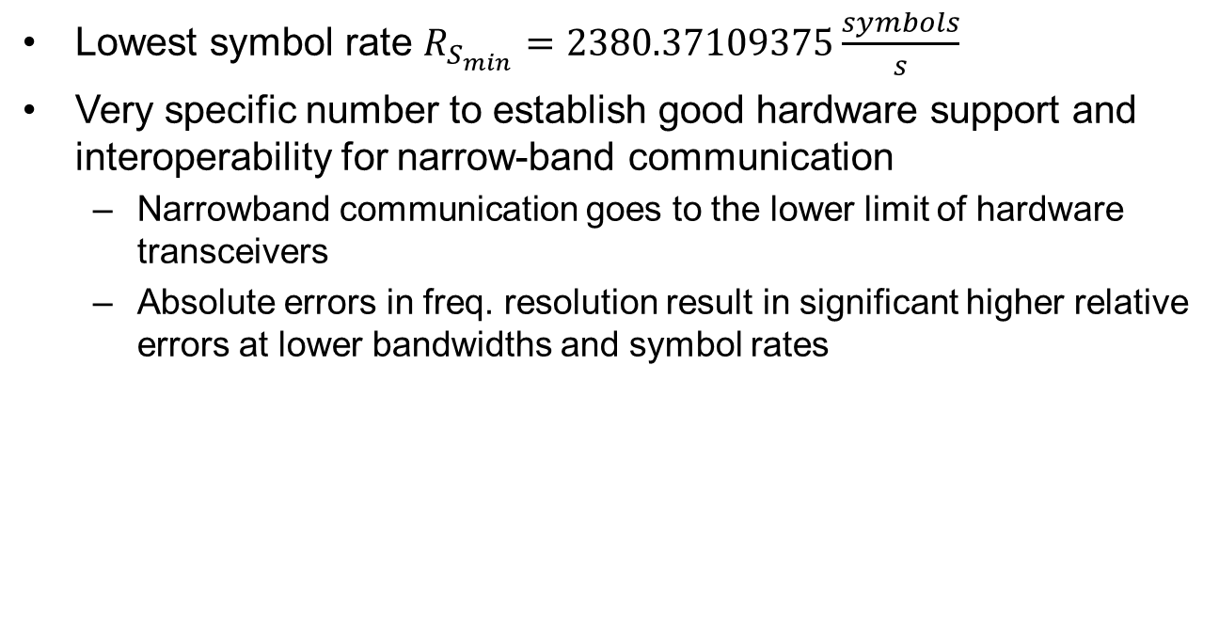
Symbol rate (1)
Lowest symbol rate $R_{S_{min}}=2380.37109375\frac{symbols}{s}$
Very specific number to establish good hardware support and interoperability for narrow-band communication
  Narrowband communication goes to the lower limit of hardware transceivers
  Absolute errors in freq. resolution result in significant higher relative errors at lower bandwidths and symbol rates

Slide 16
Symbol rate (2)
Common freq. resolution for transceivers ~100 Hz @900 MHz band
  Worst case channel error = 50 Hz
  Relative error at mismatch @ 2kHz channels: 2.5% error by design if step sizes mismatch
Deviation resolution and channel resolution commonly identical or separated by an integer multiple
  MSK through FSK modulator by deviation 1/4th of symbol rate
    → If deviation can’t be matched, modulation error by design

Slide 17
Symbol rate (3)
Goal: Good support for current off-the shelf crystals and oscillators
  Most transceivers use a power-2 decimator in the fractional PLL
  Freq. resolution = (Crystal Frequency) / 2^x
  with x commonly between 16 and 20 for channelization and between 16 and 22 for deviation
Transceivers often utilize crystals that are widely available
  26 MHz (GSM)
  32 MHz (Used in many transceivers)
  38.4 MHz (USB)

Slide 18

Symbol rate (4)
Symbol rate ideally is a multiple that can be obtained using one of these crystal frequencies divided by a power-of-2 and multiplied by an integer
For $R_{S_{min}}=2380.37109375\frac{symbols}{s}$
Crystal frequency | min. Power-of-2
 | for channelization | For deviation
26 MHz | 16 | 18
32 MHz | 19 | 21
38.4 MHz | 20 | 22
39 MHz | 14 | 16

Slide 19
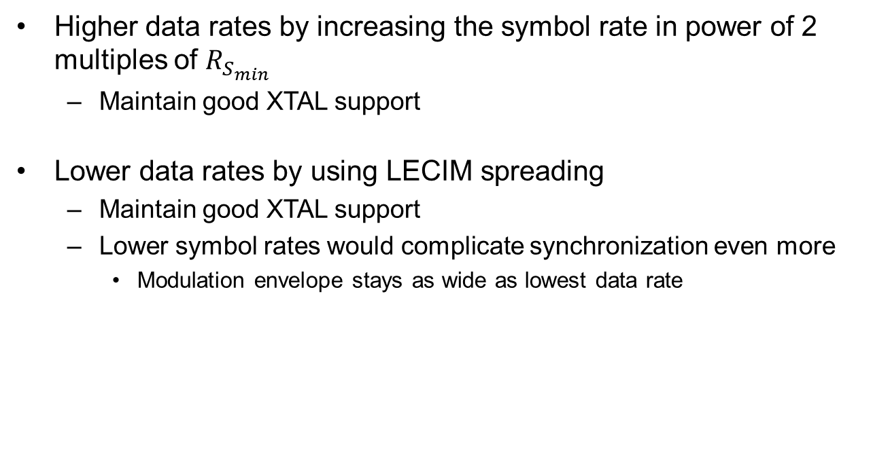
Symbol rate (5)
Higher data rates by increasing the symbol rate in power of 2 multiples of $R_{S_{min}}$
  Maintain good XTAL support
Lower data rates by using LECIM spreading
  Maintain good XTAL support
  Lower symbol rates would complicate synchronization even more
    Modulation envelope stays as wide as lowest data rate

Slide 20
Forward Error Correction (FEC)
Forward Error Correction
  Use existing
    Rate 1/2 convolutional code (LECIM)
      Polynomial: existing in LECIM
      Zero-Tailed
  Extend to rate 1/3 [2]
    Polynomial: tbd.
  Increase number of sub-packets per block according to coding
    For R = 1/2 use 12 sub-packets per block
    For R = 1/3 use 18 sub-packets per block

Slide 21
Interleaving
Block erasure or block interference are most common scenario in radio channels
  LECIM interleaver already deals with block errors
  TSMA adds time-frequency distribution → extend interleaver to sub-packets
Needs to handle loss or
distortion of:
  single sub-packet
  (most common)
  multiple successive
  sub-packets
  (seldom)
22
frequency channel →
20
18
16
14
12
10
8
6
4
2
0
0
0.5
1
1.5
2
2.5
3
3.5
time [sec] →

Slide 22
Interleaving by example (1)
No Interleaving
Loss of 1st
Loss of 1st and 2nd

Slide 23
Interleaving by example (2)
Spread consecutive symbols of codeword in different sub-packets
Loss of 1st
Loss of 1st and 2nd

Slide 24
Interleaving by example (3)
spread the sub-packets originally filled with consecutive symbols as far apart as possible
Loss of 1st
Loss of 1st and 2nd

Slide 25
Interleaving Method
Order the first input symbols linear to the S sub-packets
  First symbol → first sub-packet, first symbol
  Second symbol → second sub-packet, first symbol
  S-th symbol → S-th sub-packet, first symbol
  S+1 th symbol → first sub-packet, second symbol
  …
Repeat until all symbols are mapped to sub-packets
Reorder sub-packets to further improve distance for long-wide band interferers

Slide 26
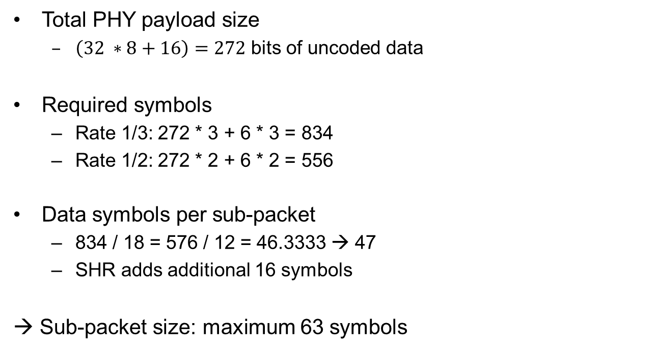
Symbols and data rate overview
Total PHY payload size
  $\left(32 ∗8+16\right)=272$ bits of uncoded data
Required symbols
  Rate 1/3: 272 * 3 + 6 * 3 = 834
  Rate 1/2: 272 * 2 + 6 * 2 = 556
Data symbols per sub-packet
  834 / 18 = 576 / 12 = 46.3333 → 47
  SHR adds additional 16 symbols
→ Sub-packet size: maximum 63 symbols

Slide 27
Time/Frequency Pattern (1)
Design goals
  Optimize to cope well with expected interference [4]
    Minimal time gap needs to be longer than longest interferer
    Minimal frequency step should exceed bandwidth of widest interferer
  Minimize impact on existing 802.11/15 networks
  Comply with regulatory requirements to be considered a FHSS system in EU (EN 300 220) and NA (FCC 15.247)
    At least 57 channels (EU)
    At least 25 kHz wide (NA)
    Use all channels with same duty cycle (NA)

Slide 28
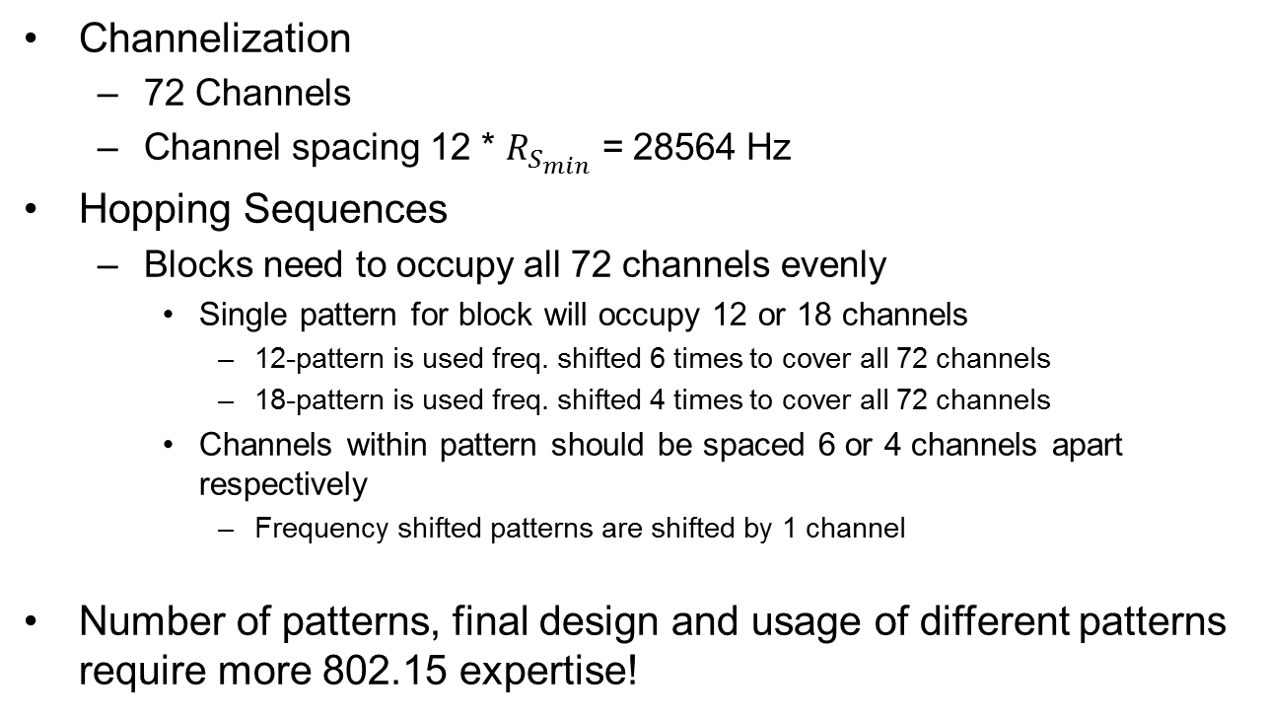
Time/Frequency Pattern (2)
Channelization
  72 Channels
  Channel spacing 12 * $R_{S_{min}}$ = 28564 Hz
Hopping Sequences
  Blocks need to occupy all 72 channels evenly
    Single pattern for block will occupy 12 or 18 channels
      12-pattern is used freq. shifted 6 times to cover all 72 channels
      18-pattern is used freq. shifted 4 times to cover all 72 channels
    Channels within pattern should be spaced 6 or 4 channels apart respectively
      Frequency shifted patterns are shifted by 1 channel
Number of patterns, final design and usage of different patterns require more 802.15 expertise!

Slide 29
Proposed
LECIM FSK Reference Modulator

Slide 30
Simulation models and settings
Setup environment from [3]
  Noise figure = 3 dB
  Channel models
    TU0: Typical Urban 0Hz Doppler [4]
    TU3: Typical Urban 3Hz Doppler [4]
  Interference models to test against [3]
    Outdoor urban, h_{BS}=140m [4]

Slide 31
Simulation Parameters
Additional settings
  10.000 packets per point to achieve smooth graphs
  Maximum PSDU size of 32 Bytes PSDU
    64 Symbols per sub-packet
    64 Symbols gap between sub-packets
  TSMA Time gap 64 symbols to cope with longest interferers of given model
  2.0 MHz bandwidth
  Receiver decodes with realistic channel estimation
  FEC = 1/3 rate convolutional code
    Effective data rates include FEC, PHR and SHR
Symbol rate (kS/s) | 2.38 + 2*Spread | 2.38 | 4.76 | 19.04
Eff. data rate (kbit/s) | 0.29 | 0.58 | 1.17 | 4.66

Slide 32
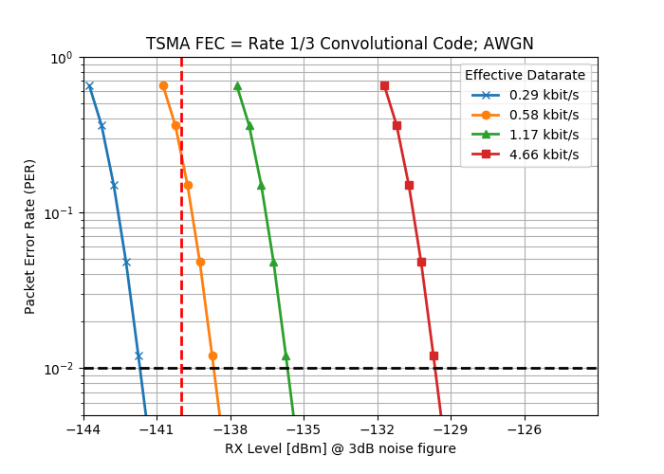
Minimum Required Sensitivity
Effective data rate of 0.29 kBit/s achieves required -140 dBm easily at 1% PER
Requires symbol spreading with factor of 2 and usage of R = 1/3 FEC

Slide 33
Impact of TSMA with FEC (1)
Comparison based on same on-air time to have same energy requirement for transmission
FEC 1/3 coded TSMA
  Effective data rate ~4.66 kbit/s
  Total on-air time 60ms
Uncoded
  35.25 Byte = 282 bits @ 4.76 kbit/s
  Total on-air time 59ms

Slide 34
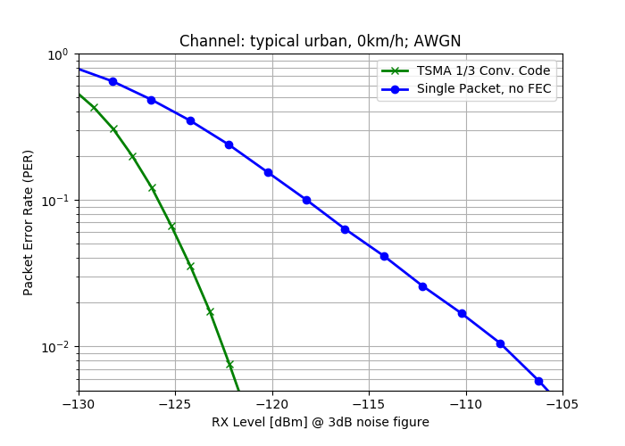
Impact of TSMA with FEC (2)
no interference
transmission at same transmission energy
15 dB gain of proposal compared to uncoded at 1% PER
15 dB

Slide 35
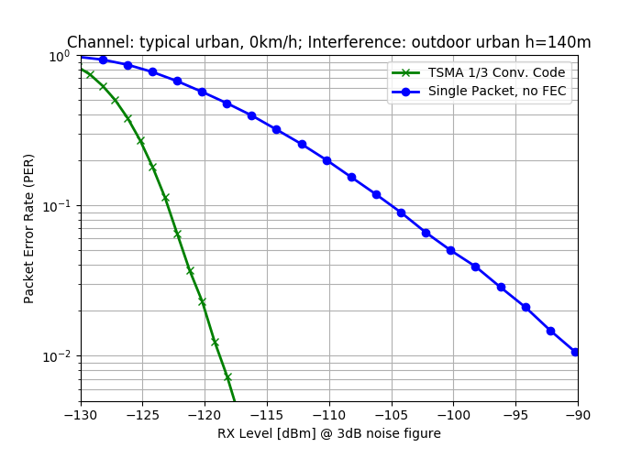
Impact of TSMA with FEC (3)
interference outdoor urban,
h = 140m [4]
transmission at same transmission energy
28 dB+ gain of proposal compared to uncoded at 1% PER
28.5 dB

Slide 36


Impact of TSMA with FEC (4)
Same on-air time for both transmissions for approximately similar power consumption
FEC coded can achieve same performance at ~ 1/500th of the required transmit energy
28 dB difference in required energy correspond to roughly to the comparison of a coin cell battery with a milk carton with same energy density
vs

Slide 37
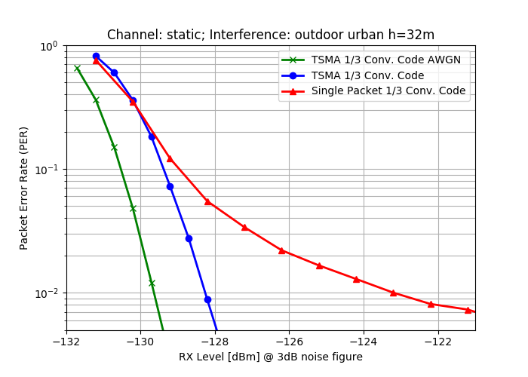
Interference Robustness (1)
Scenario less exposed receiver rural, h = 32m
5 dB gain over FEC coded transmission without TSMA at 1% PER
only 1.5 dB loss compared to non-interfered transmission at 1% PER
5 dB

Slide 38
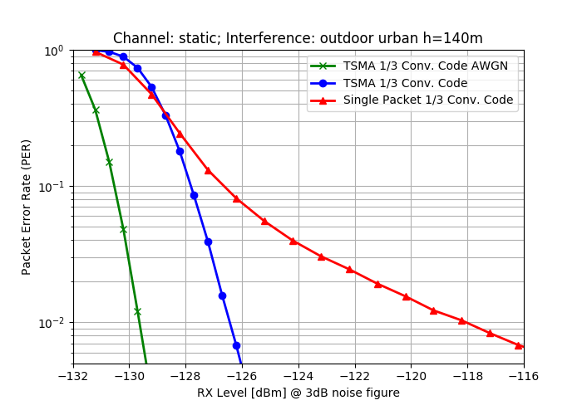
Interference Robustness (2)
Required Scenario urban, h = 140m [4]
8.5 dB gain over FEC coded transmission without TSMA at 1% PER
only 3 dB loss compared to non-interfered transmission at 1% PER
8.5 dB

Slide 39
Topics discussed in this preview
Data Rate
Symbol/Chip rates
Forward Error Correction
Modulation/Coding
Fragmentation
PHY Frame Structure
Transmit PSD
Operational Bands
Minimum Required Sensitivity
Interference Robustness

Slide 40
Open topics
Simulations to be done
  Coexistence Features
  Multipath Robustness
Discussion and feedback from the group required
  Time-/ Frequency Patterns
  Frequency, Synchronization and Timing (accuracies)
Discussion and feedback from the group on all topics presented here is very much appreciated

Slide 41
Thank you!
Any questions or suggestions?

Slide 42
References
[1] IEEE Std 802.15.4™-2015
[2] P802.15.4w PAR
[3] 802.15.4w Technical Guidance Document; 12 March, 2018; 15-18-0161-00-004w
[4] Draft IG LPWA Report; 3 November, 2017; 15-17-0528-01

