Slide 1
Project: IEEE P802.15 Working Group for Wireless Personal Area Networks (WPANs)
Submission Title: [ETSI TC Smart BAN Updates]
Date Submitted: [8 July, 2018]
Source: [Hirokazu Tanaka1
Address [1; 3-4-1, Ozuka-higashi, Asa-minimi, Hiroshima, Japan 731-3194,
2; 79-5 Tokiwadai, Hodogaya-ku, Yokohama, Japan 240-8501
3; Jaquet-Droz 1 Case, Neuchital, Switzerland CH-2002]
Voice:[1. +81-82-830-1609,-2; +81-45-339-4115], FAX: [2:+81-45-338-1157],
Email:[hi.tanaka@toshiba.co.jp] Re: []
Abstract: [ETSI Technical Committee on Smart BAN has been promoting research and development on dependable wireless systems for wide variety of applications of BAN such as radio controlling, automotive control etc by extending e-Health regarding medical BAN and so on. Thses slides may offer opportunity to discuss on use cases and applications of this standard.] Purpose: [The discussion on use cases and applications will lead definition and requirement of current ongoing research and development on dependable wireless networks.] Notice: This document has been prepared to assist the IEEE P802.15. It is offered as a basis for discussion and is not binding on the contributing individual(s) or organization(s). The material in this document is subject to change in form and content after further study. The contributor(s) reserve(s) the right to add, amend or withdraw material contained herein. Release: The contributor acknowledges and accepts that this contribution becomes the property of IEEE and may be made publicly available by P802.15.
Notes:
doc.: IEEE 802.15-09-0117-00-0007
<month year>

Slide 2
ETSI TC Smart BAN Updates
Hirokazu Tanaka*^{1,2}, John Farserotu*³
*1 Hiroshima City University, Japan
*2 Yokohama National University, Japan
*3 CSEM, Switzerland

Slide 3
Wearables in the IoT and smart environments
Wearables communicating and interacting in future IoT enabled smart environments:
Prevention Wellbeing
Smart home / living
Health / care Monitoring
Ageing well / Prevention
Home Automation, Appliances
Energy Efficiency
Safety & Security
Safety & Security
Home Automation
Other smart environments
Automotive, Aerospace…
Health/care Monitoring
Home Appliances
Energy Efficiency
Wearables are an important class of “things” in the IoT, WBAN for connecting wearables, sharing data, interaction and interoperability in the IoT.
Source: European Commission

Slide 4
ETSI TC SmartBAN
European Telecommunications Standards Institute (ETSI), > 800 members from 68 countries setting global standards for ICT.
ETSI Technical Committee (TC) Smart BAN
(SmartBAN) was approved March 2013.
It is responsible for the development of ETSI standards, specifications and reports etc. supporting SmartBAN technologies in
e.g. health, wellness, sport, smart living
and other application domains.
SmartBAN covers communication and associated physical layer, network layer, security, QoS and also provision of generic applications and services (e.g. web) for standardisation in the area of BAN technologies.
It takes a comprehensive view from PHY/MAC to higher layer system aspects (e.g. heterogeneity management, data transfer, coexistence, interaction).
http://www.etsi.org/

Slide 5
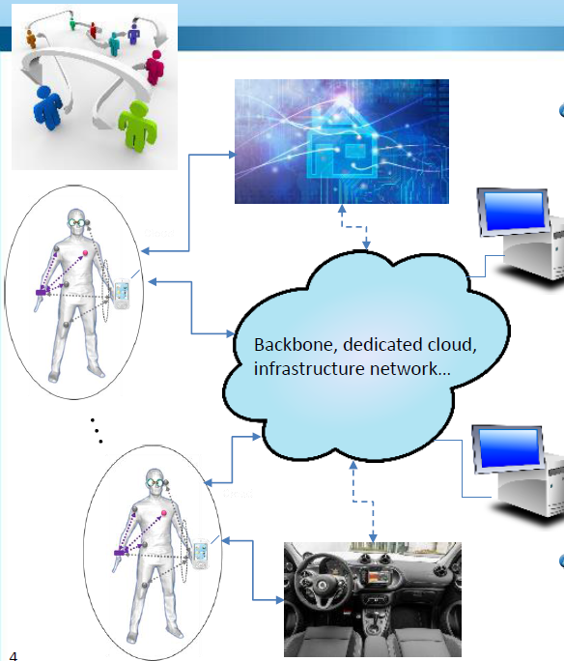
SmartBAN in the IoT – where are we today?
The work of TC SmartBAN is documented in the following ETSI Technical Specifications (TS) and Technical Reports (TR):
TS: SmartBAN Unified data representation formats, semantic and open data model
TS: SmartBAN Data representation and transfer, service and application; standardized interfaces, APIs and infrastructure for heterogeneity MGT
TR: SmartBAN Measurements and
Modelling of SmartBAN RF environment
TS: Low complexity MAC and routing for SmartBAN
TS: Enhanced, ultra-low power PHY for SmartBAN.
To be defined: smart control, network management, application to M-Band, security, SmartBAN implant comm

Slide 6
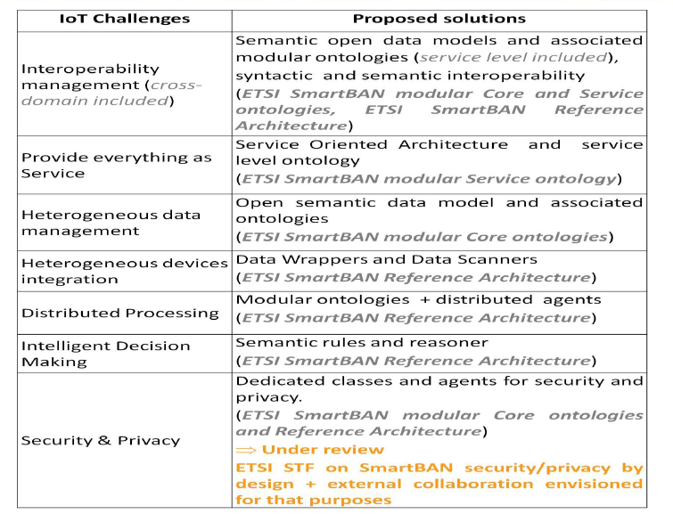
IoT challenges and SmartBAN proposed solutions

Slide 7
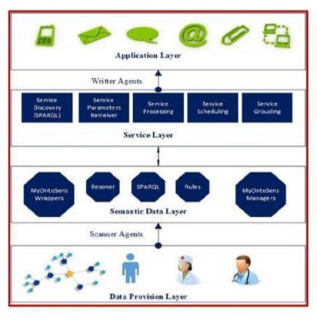
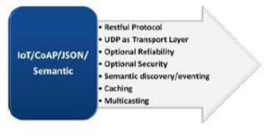
ETSI DTR/SmartBAN-004 reference architecture
Application Entities implementing a given SmartBAN application logic (e.g. data monitoring, patient evaluation result, patient notification...)
Generic entities related to service management functionalities
Entities mainly providing semantic and ontologies management functionalities + embedded intelligence related functionalities
Each entity of ETSI SmartBAN Service and Semantic Data layers can fully be considered as an IoT entity and thus all covered in the AIOTI IoT Layer

Slide 8
BANs Semantic Open Data Model & Ontology: Main objectives
BAN unified data representation formats (including sensor/actuator/relay/coordinator/Hub descriptions and sensed/measured data + management & control information), associated semantic open data model and corresponding ontology,
=> syntactic interoperability & data heterogeneity management, embedded intelligence, automated control, modularity, extensibility
BAN service layer representation model & associated ontology (as an extension of 1) ; IoT ontologies taken into account),
=> semantic interoperability, discovery & composition, information reusability, Sensor as a Service, BAN nodes & services discovery, full autonomous services, new applications development scaling

Slide 9
Standard IoT solutions – ACTIVAGE, IoT/IoE and SmartBAN
SmartBAN
IoT / IoE (AIOTI)
ACTIVAGE
Standards for interoperability
Standard Interoperable Secure / Private IoT solutions
Standard-secure-intraoperative
IoT ecosystems
Devices, connectivity, interaction
Standards for smart, interoperable IoT solutions for active and healthy aging (e.g. semantic interoperability, low power, robust, secure, private…)

Slide 10
Technical overview
The use of wearables and body sensor devices is rapidly growing in the Internet of Things (IoT).
Wireless Body Area Networks (BAN) offer a means of connectivity, facilitating the sharing of data, interaction and interoperability within smart environments, such as smart homes and living environments, as well as, emerging automotive and aerospace applications.
Design features
Star concept + multi hub relay
Efficient MAC and PHY, yielding very low latency emerging messaging, very low energy consumption, very fast initial set up time, channel reassignment
Real-time radio channel assignment (subject of further research)
Smartness: Semantic approach, semantic interoperablity, heterogeneity management, IoT compliance
Automatic node discovery (e.g. semantic discovery of nodes, composition (e.g. semantic discovery of nodes

Slide 11
Next steps for SmartBAN
Release of TR 103 394 - System Description SmartBAN NWI on implant communication liason with ERM TG 30 Possible STF’s in ETSI
Joint STF with SmartBAN and SmartM2M
STF envisioned for merging and/or aligning the SmartBAN ontology with SAREF + oneM2M ontologies
SmartBANs security and privacy
Semantic discovery/annotation/binding mechanisms for constrained nodes/Things
Collaboration with ACTIVAGE e.g. on wearables, WBAN and
semantic interoperability for Active & Healthy Ageing IoT
A SmartBAN workshop is planned at ETSI in the January-February timeframe 2018

Slide 12
TB Structure
Plenary level
Heterogeneity management, data representation and transfer (Telecom sud Paris)
Smart control, network management, interoperability & security
Multi-layer, co-existence and dependability for SmartBAN (Oulu, Florence)
Low complexity MAC and routing for SmartBAN (Toshiba,Oulu)
Enhanced, ultra-low power PHY for SmartBAN (Toshiba)
SmartBAN implant communication
SmartBAN System (Toshiba)

Slide 13
Major activities/deliverables (published)
TS 103 326 Ver. 1.1.1, Smart Body Area Network (SmartBAN), Enhanced Ultra-Low Power Physical Layer, 2015-04-28
TS 103 325 Ver. 1.1.1, Smart Body Area Network (SmartBAN), Low Complexity Medium Access Control (MAC) for SmartBAN, 2015-04-28
TS 103 378 Ver. 1.1.1, Smart Body Area Networks (SmartBAN), Unified data representation formats, semantic and open data mode, 2015-12-11
TR103 395 Ver. 1.1.1, Smart Body Area Network (SmartBAN); Measurements and modelling of SmartBAN Radio Frequency (RF) environment, 2016-12-20
TR103 394 Ver.1.1.1, Smart Body Area Networks (SmartBAN), System Description, 2018-1-15

Slide 14
Major activities/deliverables (in-progress)
DTS/SmartBAN-004 - TS 103 327, Smart Body Area Networks (SmartBAN); Service and application standardized enablers and interfaces, APIs and infrastructure for interoperability management, Q3 2018 (publication)
RTS/SmartBAN-005r1 – TS 103 325, Low complexity MAC and routing for SmartBAN, Draft started (TS 103 325), Q2 2018 (draft), Q1 2019 (approval)
RTS/SmartBAN-009r1 - TS 103 378, RTS/SmartBAN-009r1 - TS 103 378, Q1 2019 (publication)
DTR/SmartBAN-001 - Comparative analysis between SmartBAN and other short-range, Q4 2018 (draft), Q3 2019 (approval), shift by 6 months
Additionally, a NWI is proposed with TG30 in the domain of implant communications

Slide 15
STFs
DTR/SmartBAN-006 - Measurements and Modelling of SmartBAN RF environment
Scope: To develop the model, a three-stage approach is used where the first two stages use empirical test results to estimate parameters and to substantiate the analytical model.
Measurements: were evaluated based on variations in the operational environment, which takes into account the uncertainty in an installations location… evaluation points to potential trouble spots and helps in determining strategies for alleviating
Proposed STF’s
A STF merging SmartBAN with SAREF + oneM2M ontology is proposed
A STF on security, privacy and trust specific to SmartBAN is in discussion

Slide 16
DTR/SmartBAN-006 - Measurements and Modelling of SmartBAN RF environment
Scope: To develop the model, a three-stage approach is used where the first two stages use empirical test results to estimate parameters and to substantiate the analytical model.
Measurements: were evaluated based on variations in the operational environment, which takes into account the uncertainty in an installations location… evaluation points to potential trouble spots and helps in determining strategies for alleviating
Proposed STF’s
A STF merging SmartBAN with SAREF + oneM2M ontology is proposed
A STF on security, privacy and trust specific to SmartBAN is in discussion
Different to other TBs because ...

Slide 17
Next steps for SmartBAN
Release of TR 103 394 - System Description SmartBAN NWI on implant communication liason with ERM TG 30 Possible STF’s in ETSI
Joint STF with SmartBAN and SmartM2M
STF envisioned for merging and/or aligning the SmartBAN ontology with SAREF + oneM2M ontologies
SmartBANs security and privacy
Semantic discovery/annotation/binding mechanisms for constrained nodes/Things
Collaboration with ACTIVAGE e.g. on wearables, WBAN and
semantic interoperability for Active & Healthy Ageing IoT
A SmartBAN workshop is planned at ETSI in the January-February timeframe 2018

Slide 18
Thank you for your attention!
10

