Slide 1
Project: IEEE P802.15 Working Group for Wireless Personal Area Networks (WPANs)
Submission Title: [Overview of Japanese IEICE Technical Committee on Healthcare and Medical Information Communication Technology (MICT)]
Date Submitted: [7 July, 2018]
Source: [Shinsuke Hara1, Ryuji Kohno2,3,4] [1;Osaka City University, 2;Yokohama National University, 3;Centre for Wireless Communications(CWC), University of Oulu, 4;University of Oulu Research Institute Japan CWC-Nippon]
Address [1; 3-3-138 Sugimoto, Sumiyoshi-ku, Osaka, Japan 558-8585]
2; 79-5 Tokiwadai, Hodogaya-ku, Yokohama, Japan 240-8501,
3; Linnanmaa, P.O. Box 4500, FIN-90570 Oulu, Finland FI-90014,
4; Yokohama Mitsui Bldg. 15F, 1-1-2 Takashima, Nishi-ku,Yokohama, Japan 220-0011]
Voice:[1; +81- 6-6605-2795, 2: +81-45-339-4115, 3:+358-8-553-2849], FAX: [+81-45-338-1157],
Email:[1: hara@info.eng.Osaka-cu.ac.jp, 2:kohno@ynu.ac.jp, 3: ryuji.kohno@oulu.fi] Re: []
Abstract: [IEICE study group on Reliable Robust Radio Communication and Control has been promoting research and development on dependable wireless systems for wide variety of life critical applications such as medicine, disaster, dependable sensing and controlling cars, buildings, smart grids, and smart city by extending BAN from human body to bodies of cars, buildings, and so on. These slides may offer opportunity to discuss on available technologies to perform dependability in radio sensing and controlling systems.]
Purpose: [The discussion on use cases and applications will lead definition and requirement of current ongoing research and development on dependable wireless networks.]
Notice: This document has been prepared to assist the IEEE P802.15. It is offered as a basis for discussion and is not binding on the contributing individual(s) or organization(s). The material in this document is subject to change in form and content after further study. The contributor(s) reserve(s) the right to add, amend or withdraw material contained herein. Release: The contributor acknowledges and accepts that this contribution becomes the property of IEEE and may be made publicly available by P802.15.
Notes:
doc.: IEEE 802.15-09-0117-00-0007
<month year>

Slide 2
Overview of Japanese IEICE Technical Committee (TC) on Healthcare and Medical Information Communication Technology (MICT)
July 2018, San Diego
Shinsuke Hara^{*1},
Ryuji Kohno^{*2,3,4}
*1 Osaka City University, Japan
*2 Yokohama National University, Japan
*3 CWC, University of Oulu, Finland
*4 University of Oulu Research Institute Japan CWC-Nippon

Slide 3
Agenda
History of IEICE TC MICT
Scope of IECIE TC MICT
Covered Areas of IEICE TC MICT
Recent Activities of IEICE TC MICT

Slide 4
1.1 History of IEICE TC MICT (1/2) (Healthcare and Medical Information Communication Technology)
Fundamental
April 2014: IEICE Ad Hoc Technical Committee on Medical Information Communication Technology (MICT) was promoted to Technical Committee renaming it as “Healthcare and Medical Information Communication Technology (MICT)”
Chairs
6/2014-5/2016: Ryuji Kohno (Yokohama National University)
6/2016-5/2018: Masaru Sugimachi (National Cerebral and Cardiovascular Center)
6/2018- : Shinsuke Hara (Osaka City University)

Slide 5
1.2 History of IEICE TC MICT (2/2) (Healthcare and Medical Information Communication Technology)
TC members
44 members from academia, medicine, hospital, national institution, industries and so on

Slide 6
2. Scope of IEICE TC MICT (Healthcare and Medical Information Communication Technology)
Promotes not generalized but application-oriented researches related to healthcare, wellness and medicine
Pursues researches of dependable ICT on PHY, MAC and NWK for life-critical applications in medicine and healthcare
Gives different system design criteria of max-min (heightening the lowest throughput) and min-max (lowering the highest error rate) for guaranteeing dependability in healthcare and medical systems
Applies the developed algorithms, techniques and methods to real practices in healthcare, wellness and medicine

Slide 7
3. Covered Areas of IEICE TC MICT (Healthcare and Medical Information Communication Technology)
Any topics related to interdisciplinary researches between engineering and healthcare/medicine. The engineering includes circuit theory and design, information theory, control theory, signal processing, radio propagation, communications and so on, which enhance dependability in healthcare/medicine
Body Area Network (BAN) and Ultra Wide Band (UWB) techniques harmless to human bodies
Regulatory sciences

Slide 8
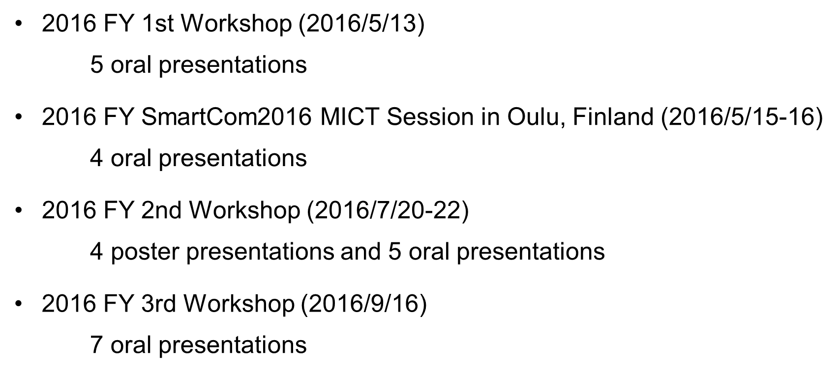
4. Recent Activities of IEICE TC MICT(1/4) (Healthcare and Medical Information Communication Technology)

Slide 9
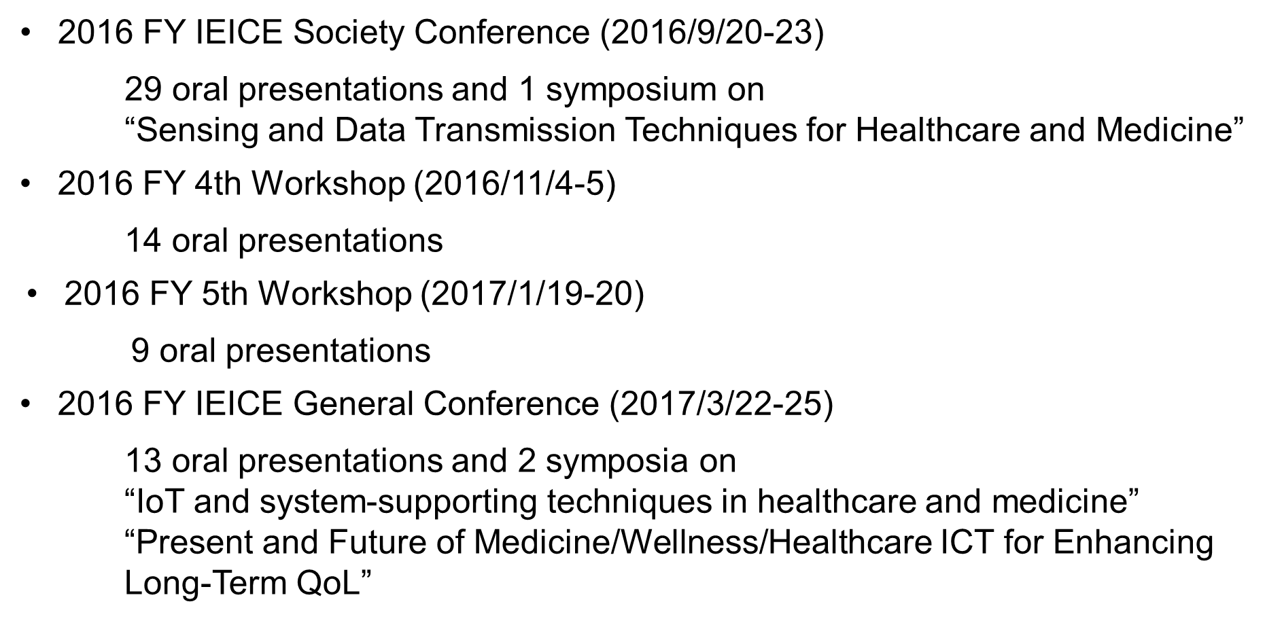
4. Recent Activities of IEICE TC MICT(2/4) (Healthcare and Medical Information Communication Technology)

Slide 10
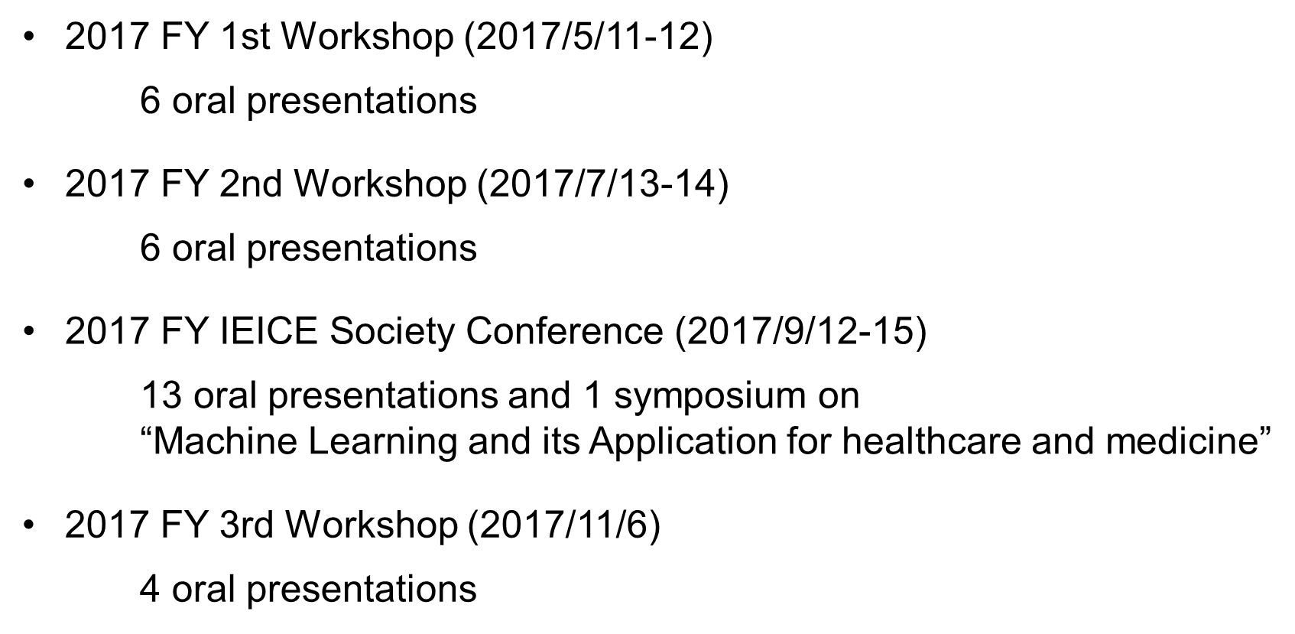
4. Recent Activities of IEICE TC MICT(3/4) (Healthcare and Medical Information Communication Technology)

Slide 11
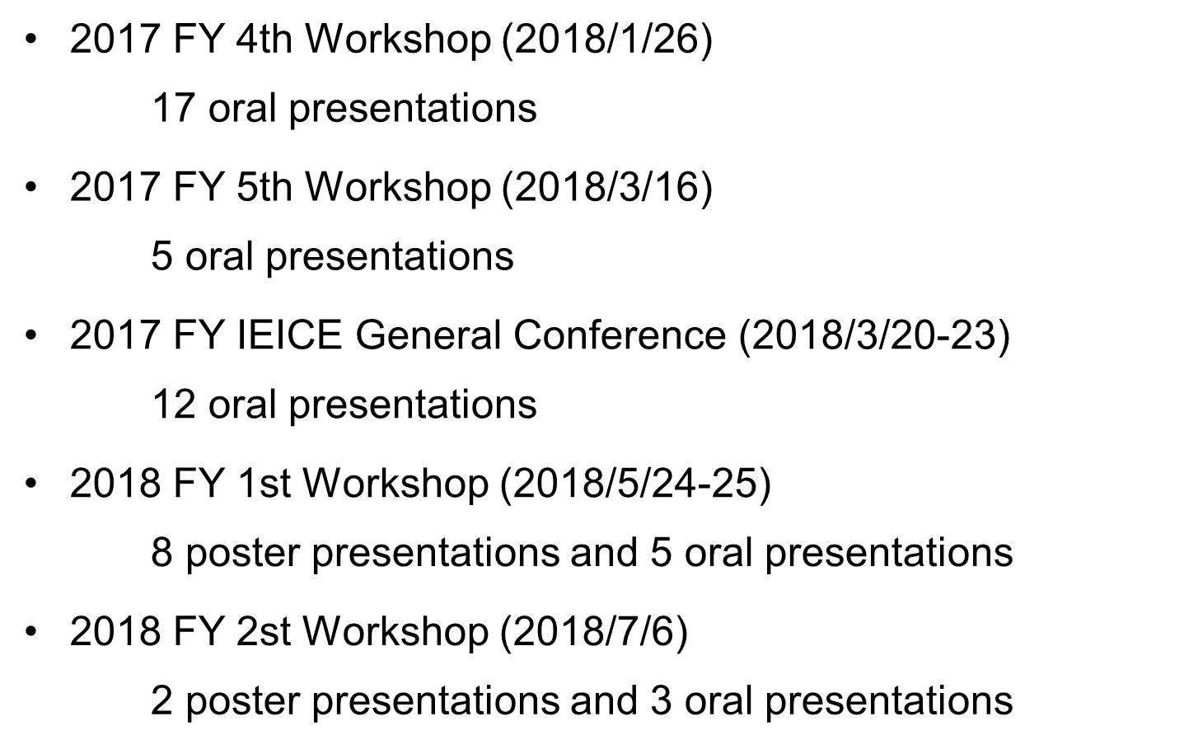
4. Recent Activities of IEICE TC MICT(4/4) (Healthcare and Medical Information Communication Technology)

Slide 12
5. IEICE Transactions on Communications
“Special Section on Healthcare, Medical Information and Communication Technology for Safe and Secure Society”
Submission due 2/July/2018 Issue, June 2019
The IEICE Transactions on Communications announces that it will publish a special section entitled "Healthcare, Medical Information and Communication Technology for Safe and Secure Society" in June 2019.
The cyber-physical systems bring new societies with a rapid development of the Information and Communication Technology (ICT), and there are several efforts to fit such societies in the world. The trials are projected as the Industry 4.0 in Germany, the Industrial Internet in the US, and the Made in China 2025. Japan has a project named the Society 5.0 which aims to construct a safe and secure society. One of the big issues in the Society 5.0 is an extension of healthy-life expectancy. Then, healthcare / medical innovation applying ICT is highly desired. Furthermore, healthcare / medical ICT provides a new paradigm to research and development areas due to innovative integration between medicine and engineering. Healthcare / medical ICT has been widely recognized as an emerging area in a biomedical engineering research field. For achieving safe and secure society through dependable healthcare / medical services, it is necessary to rapidly develop fundamental core technologies of the healthcare / medical ICT from various aspects such as sensors, devices, big data, communication networks, robotics and regulatory science.
To bring the safe and secure society with healthcare / medical ICT research field, the special section is planned to publish papers on the related fields.

Slide 13
6. Web Site of IEICE TC MICT (Healthcare and Medical Information Communication Technology)
http://www.ieice.org/~mict/

