Slide 1
Project: IEEE P802.15 Working Group for Wireless Personal Area Networks (WPANs)
Submission Title: Scalable multiple access frame structure for energy-efficient low data rate radio communication in shared bands
Date Submitted: 8 July, 2018
Source: Eunhye Park, Youngnam Han, KAIST
IT Conv. Centre (N1) 717, Daejeon, 34141, Korea
Voice: +82 10 3025 4503,
E-Mail: eunhyepark@kaist.ac.kr
Abstract: Scalable multiple access frame structure is a simple MAC level scheme that allows energy efficient initial access for low data rate communication.
Purpose: Present a novel idea to decrease energy consumption for LPWA networks with little implementation effort on existing systems.
Notice: This document has been prepared to assist the IEEE P802.15. It is offered as a basis for discussion and is not binding on the contributing individual(s) or organization(s). The material in this document is subject to change in form and content after further study. The contributor(s) reserve(s) the right to add, amend or withdraw material contained herein.
Release: The contributor acknowledges and accepts that this contribution becomes the property of IEEE and may be made publicly available by P802.15.

Slide 2
Scalable Multiple Access Frame Structure
Energy efficient low data rate radio communication in shared bands

Slide 3
Low Power Wide Area Networks
Recap
Requirements [1]
  PHY shall be based on low energy, critical infrastructure monitoring (LECIM) FSK PHY.
  Support lower data rates compared to the LECIM FSK PHY.
  Support very limited energy end point devices
    Such as: 10 ~ 20 year battery life with no maintenance, i.e., original battery supplies all energy for the life of the device.

Slide 4
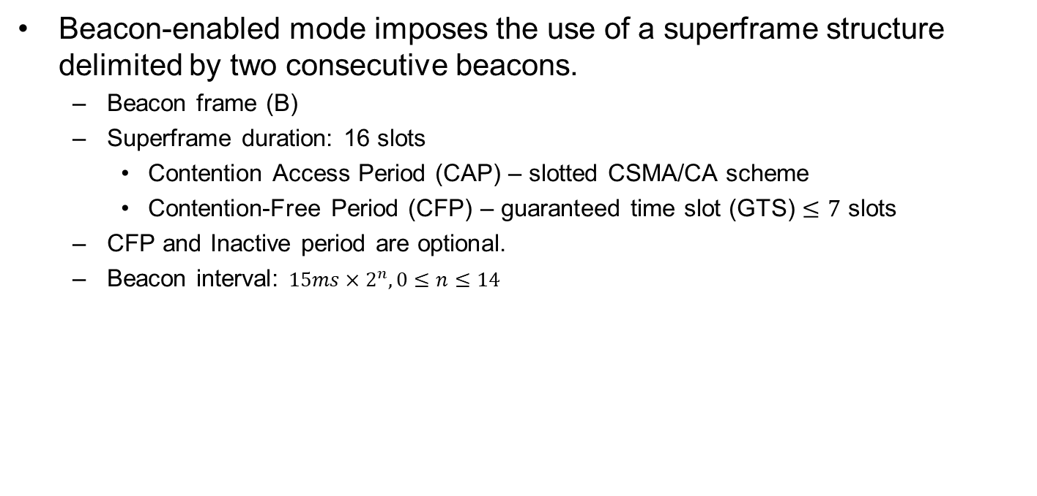
Superframe structure in IEEE.802.15.4k [2]
Beacon-enabled mode imposes the use of a superframe structure delimited by two consecutive beacons.
  Beacon frame (B)
  Superframe duration: 16 slots
    Contention Access Period (CAP) – slotted CSMA/CA scheme
    Contention-Free Period (CFP) – guaranteed time slot (GTS) $≤7$ slots
  CFP and Inactive period are optional.
  Beacon interval: $15ms×2^{n}, 0≤n≤14$
Examples of IEEE 802.15.4 superframe structures

Slide 5
Superframe structure in IEEE.802.15.4k
The size of CFP may vary depending on demand by associated network devices.
The beginning of CFP and the duration of superframe are informed to the attached network devices by the PAN coordinator in its beacon.
Disadvantages:
  During CAP, throughput is around 37% under the slotted ALOHA.
  Energy waste caused by collisions.

Slide 6
Scalable Multiple Access Frame Structure
Proposal to lower energy consumption:
Short request (REQ) message (without data payload)
Reservation-based transmission for successfully contended nodes in RP.
Flexible length of a frame depending on the number of successful REQ messages specified in CAP
NP: Notification period
RP: Reservation period

Slide 7
Scalable Multiple Access Frame Structure
The general MAC frame format – REQ message
  PHY packet fields: Preamble (32 bits), Start of packet delimiter (8 bits), PHY header (8 bits) → 6 bytes
  REQ message does not contain payload.

Slide 8
Scalable Multiple Access Frame Structure
NP MAC frame format
  Similar to the beacon frame format.
  A duration between NP to next beacon depends on the number of devices succeeded in CAP (Scalable)

Slide 9
Scalable Multiple Access Frame Structure
During beacon period B, PAN coordinator announces the new start of a frame, and length of CAP, etc. Contending parameters are included here.
During CAP, nodes transmit a request signal (REQ) to PAN coordinator in slotted ALOHA manner (or CSMA/CA with shorter backoff parameters).
During NP, PAN coordinator announces the start of RP and broadcasts the transmission time allocation.
During RP, devices turn ON their radio modules and transmit the data packet during their own transmission time slots, turn OFF, otherwise.

Slide 10
Scalable Multiple Access Frame Structure
Pros:
  Less energy is wasted due to collisions.
  System scalable with flexible frame length.
Cons:
  Lower data rate due to overhead.
  For short data payload, benefit may be little.

Slide 11
Example case
Simulation parameters
Data rate | 40kbits/s (5000 bytes/s)
# of devices | 20
Access scheme | CSMA/CA
REQ_length | 20 bytes
MSG_length | 20 + 60 bytes
ACK_length | 12 bytes
# and duration of CAP slot | 1200, 0.2ms (for BI=4)
Duration of a RP slot | 1 – 3 ms
Beacon | 32 bytes
NP | 32 + N_succ*1
10 successes, 24 collisions (on avg.)
Additional overhead for devices: (20*10) =226 bytes
Additional overhead for PAN coordinator: 32+1*10+12*10 = 162 bytes
Reduced colliding packets = 23*60*2 + 1*60*4 = 3,000 bytes
➔ Saving 2,500+ bytes for devices
Total duration = 240 (CAP, fixed) + 2 (NP) + 18*10 (RP, flexible)= 432 ms
BI: beacon interval

Slide 12
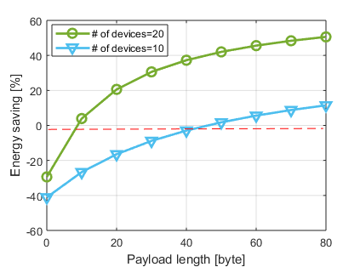
Example case
Simulation parameters
Data rate | 40kbits/s (5000 bytes/s)
# of devices | 10, 20
Access scheme | CSMA/CA
REQ_length | 20 bytes
MSG_length | 20 + [0 to 80]
ACK_length | 12 bytes
# and duration of CAP slot | 1200, 0.2ms (for BI=4)
Duration of a RP slot | 1 – 3 ms
Beacon | 32 bytes
NP | 32 + N_succ*1
Saves energy consumption significantly as the length of data (payload) increases and/or as the number of contending devices increases.

Slide 13
Summary
Scalable multiple access frame structure is independent of higher level protocol
Scalable multiple access frame structure requires no change
Scalable multiple access frame structure saves energy consumption significantly as the length of data (payload) increases and/or as the number of contending devices increases.
Scalable multiple access frame structure can improve channel utility by flexibly change the frame length.

Slide 14
References
[1] J. Robert, “ Draft IG LPWA Report,” 15-17/528r0, 2017
[2] IEEE Std 802.15.4: Low-Rate Wireless Personal Area Networks (LR-WPANs)

