Slide 1
Project: IEEE P802.15 Working Group for Wireless Personal Area Networks (WPANs)
Submission Title: [Proposal to 15.4z for enhancing UWB PHYs]
Date Submitted: [July 6, 2018]
Source: [Huan-Bang Li, Kenichi Takizawa, and Fumihide Kojima] Company [NICT, Japan]
[Hisashi Nishikawa] Company[Global Interface Technologies Japan Inc.]
Address [3-4 Hikarino-oka, Yokosuka, Kanagawa, Japan]
[590 Nojiri, Rittoh-shi, Siga, Japan]
Voice:[-], E-Mail:[lee (at) nict.go.jp]
Re: [Proposed changes to IEEE802.15.4-2015 for enhancing UWB PHYs]
Abstract: [Contribute a proposal to the enhanced impulse radio group 15.4z]
Purpose: [Propose the modifications of the HRP as well as LRP UWB PHYs]
Notice: This document has been prepared to assist the IEEE P802.15. It is offered as a basis for discussion and is not binding on the contributing individual(s) or organization(s). The material in this document is subject to change in form and content after further study. The contributor(s) reserve(s) the right to add, amend or withdraw material contained herein.
Release: The contributor acknowledges and accepts that this contribution becomes the property of IEEE and may be made publicly available by P802.15.

Slide 2
Proposal to 15.4z for enhancing UWB PHYs

Slide 3
ToC
Background/Motivation
Modulation Proposal for HRP UWB PHY
Band plan proposal for LRP UWB PHY

Slide 4
Background
IEEE Std 802.15.4™-2015 includes two IR-UWB based PHY specifications with supporting MAC features.
HRP UWB PHY (IEEE Std 802.15.4a – 2007)
LRP UWB PHY (IEEE Std 802.15.4f – 2012)
Both were developed for low-rate WPAN with consideration/emphasis on ranging capbility.
Operating frequency bands
HRP UWB PHY: low band and high band
LPR UWB PHY: high band only

Slide 5
Motivations
IR-UWB Ranging has different requirement/emphasis on PHY compared to communication.
Enhancing ranging capbility by modifying or expanding existing features of IR-UWB PHY in IEEE Std 802.15.4™-2015 .
Proposals are presented respectively for HRP UWB as well as for LRP UWB.
Harmonization with other proposals.

Slide 6
Modulation Features of HRP UWB
BPM+BPSK
Non-coherent
00 | 0 -
01 | 0 -
10 | 1 -
11 | 1 -
coherent
T/2
Guard interval
T/2
シンボル間ガード区間
S
0
1
15
16
31
32
33
47
48
63
-S
0
1
15
16
31
32
33
47
48
63
S
0
1
15
16
31
32
33
47
48
63
Scramble interval
-S
0
1
15
16
31
32
33
47
48
63
Coherent (BPM+BPSK) for better performance.
Non-coherent (BPM) for simple structure.

Slide 7
HRP UWB Improvement Proposal
OOK
1T
Guard interval
2T
S
0
1
15
16
31
32
0
1
15
16
31
32
S
0
1
15
16
31
32
-S
0
1
15
16
31
32
63
BPSK
OOK for simple structure.
BPSK for better performance

Slide 8
HRP UWB Improvement Proposal (Cnt’d)
Figure 16-3—HRP UWB PHY symbol structure
Add OOK – BPSK mode to Figure. 16-3
OOK or BPSK pulses
OOK or BPSK pulses

Slide 9
HRP UWB Improvement Proposal (Cnt’d)
Add a new ranging mode by replacing BPM+BPSK with an OOK and a BPSK, where OOK and BPSK are two seperated modulation options.
Choose OOK for simlicity (reduce cost and power consumption)
Choose BPSK for better performance
Cut the symbol duration by half to reduce the ToF
Shortening TOA ranging time to save power
Increase system capacity

Slide 10
Large Bandwidth Features of LRP UWB
LRP UWB only uses high band with large bandwidth.
Favorable for compansating distance loss compared to low band
Ranging-favorited because of inherent high precision of time resolution
Adopted high bands are not comprehensive
Only focus on 6 – 9 GHz
Beyond 9 GHz is not included

Slide 11
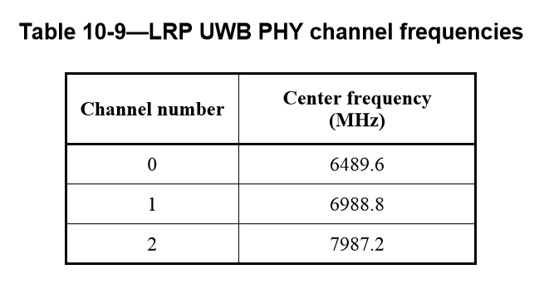
LRP UWB Improvement Proposal
Add channel number 3 to Table 10-9 to effectively use beyond 9GHz
3 | 8486.4
Notes:
19.7.3 LPR UWB PHY PSD mask
IEEE802.15.4-2015

Slide 12
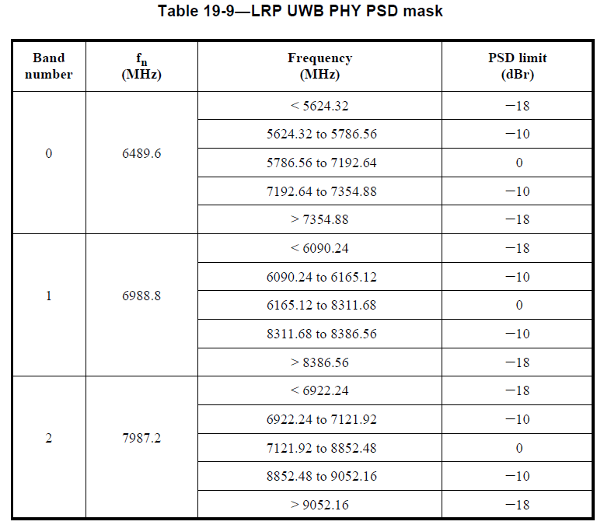
LRP UWB Improvement Proposal (Cnt’d)
Add PSD mask for channel number 3 to Table 19-9
3 | 8486.4 | <7587.84 | -18
 |  | 7587.84 to 7662.72 | -10
 |  | 7662.72 to 9809.28 | 0
 |  | 9809.28 to 9884.16 | -10
 |  | > 9884.16 | -18
Notes:
19.7.3 LPR UWB PHY PSD mask
IEEE802.15.4-2015

Slide 13
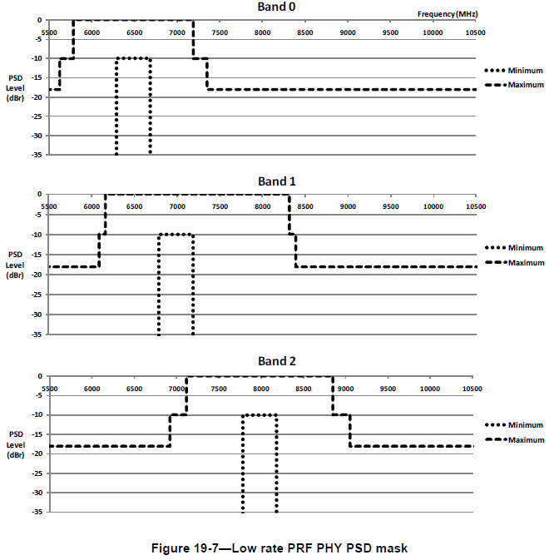
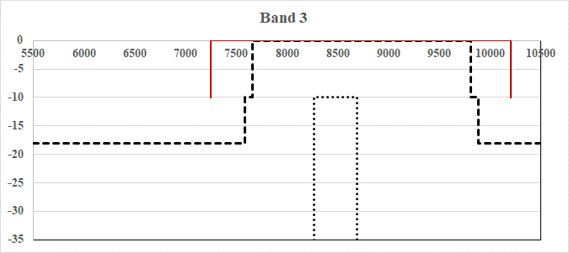
LRP UWB Improvement Proposal (Cnt’d)
Add PSD mask illustration for channel number 3 to Figure 19-7
PSD mask satisfies Japan and Korea

Slide 14
Harmonization With HRP Band Plan
LRP UWB Improvement Proposal (Cnt’d)
LRP Band number | HRP Band plan
0 | Ch.7
1 | Ch. 5, 6, 8, 9
2 | Ch.11
3 | Ch. 9, 10, 12, 13

Slide 15
Reference Slides

Slide 16
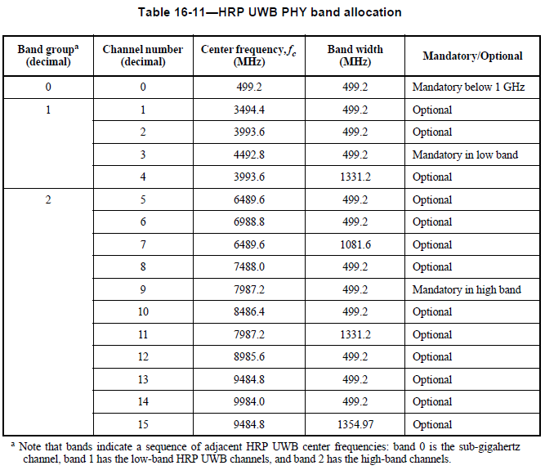
HRP Band Plan

Slide 17
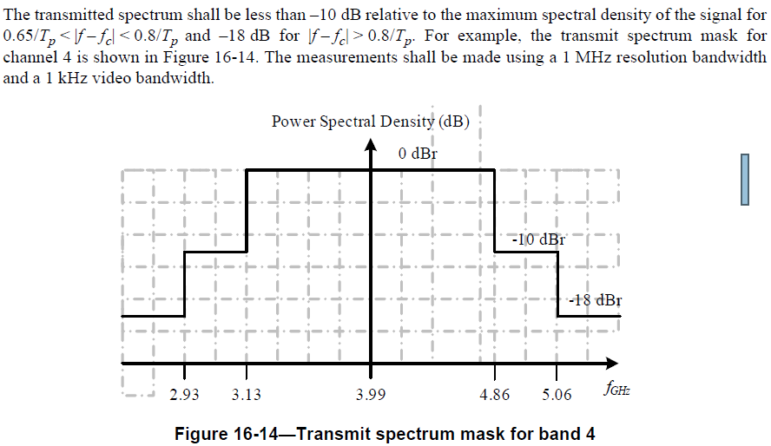
Calculation of PSD Mask
16.4.6 Transmit PSD mask

